Slide 1

Insurance Loss

Slide 2

Business Case
Predict the size of insurance loss, likely from automobile accidents
Insurance companies always improving their models
Better predictive models mean that they have a competitive advantage is pricing-can offer good risks better prices and not take on bad risks
Property/personal insurance much harder to predict than life insurance

Slide 3

Data
Isn’t asking to predict if a loss occurred, only the severity
Data scrubbed of all identifying information- purely machine learning exercise
14 continuous variables pre-scaled between 1 and 0 and more than 100 categorical variables, 72 of which are binary
Insurance loss highly right skewed, even the log is still right skewed

Slide 4

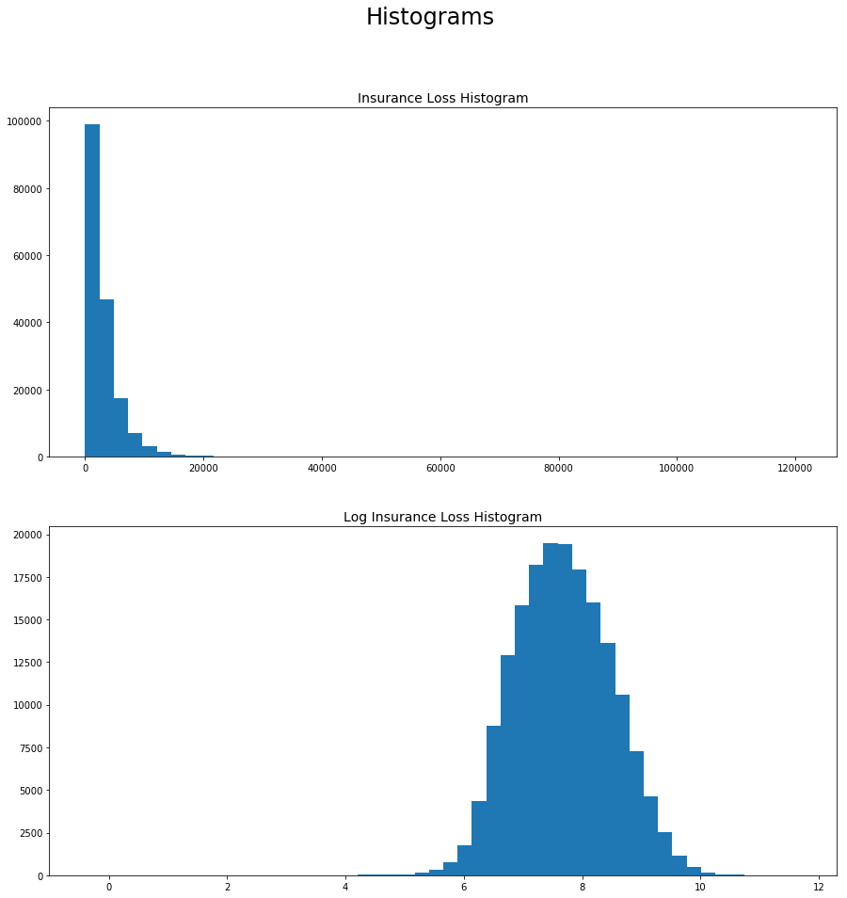
Data, continued

Slide 5

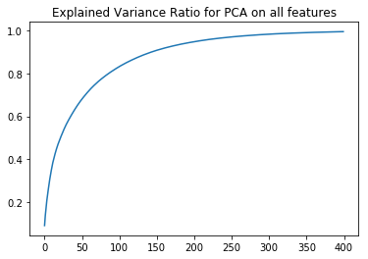
Data Prep
Exploded every categorical feature into dummy variables. Since some had upwards of a 100 categories, ended up with more than 100 features
My assumption was that I could always reduce variables at the end-not necessarily the best assumption

Slide 6

Modelling
My plan was to split the model into classification followed by linear regression
In the first iteration, I would predict whether insurance loss would be above or below an arbitrary threshold- I set it to the 75th percentile since it was a round number and only slightly above the mean
In order for this to work, I’d need to be able to classify the data well, and once classified, the results of the individual regressions would need to be better than the regression on the whole data set
Neither turned out to be true
Whatever method, knn, naïve bayes, logistic regression, random forest classifier, I couldn’t get the accuracy above 87%, which was not too impresssive given that random guess should have gotten 75% right.
I also performed linear regressions on the split data, knowing their classificiations, and still got a worse r² than regression on the whole set

Slide 7
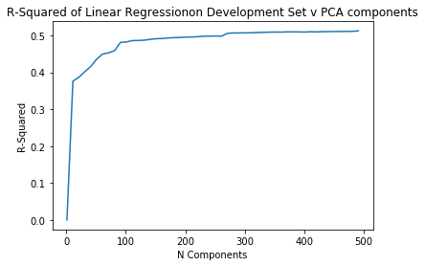
Evaluation
I tried other models: SVR, Polynomial Linear Regression, but either the full data set crashed the kernel, or the model wasn’t great on truncated data
Linear regression on the principle components of the full feature list worked best. Random Forest Regressor got similar results, but was much slower

Slide 8
Evaluation Cont’d
I got an r-squared of just above .5 and a score, in mean absolute error of 1230, a major improvement in magnitude from my original score of 1928, but only enough to put me at about 2300 out of 3000 in the leaderboard

Slide 9
What I could have done better
Creating so many dummy variables in preprocesing made my linear regression better, but seems to have put a cap on my score since anything more sophisticated was essentially ruled out for lack of processing power
The winner of the competition posted a summary of his solution. Among the models he used were XGBoost, Regularized Greedy Forest, and others that I didn’t recognize. He used a TF-IDF on the categorical features, which I should have thought of

