Slide 1
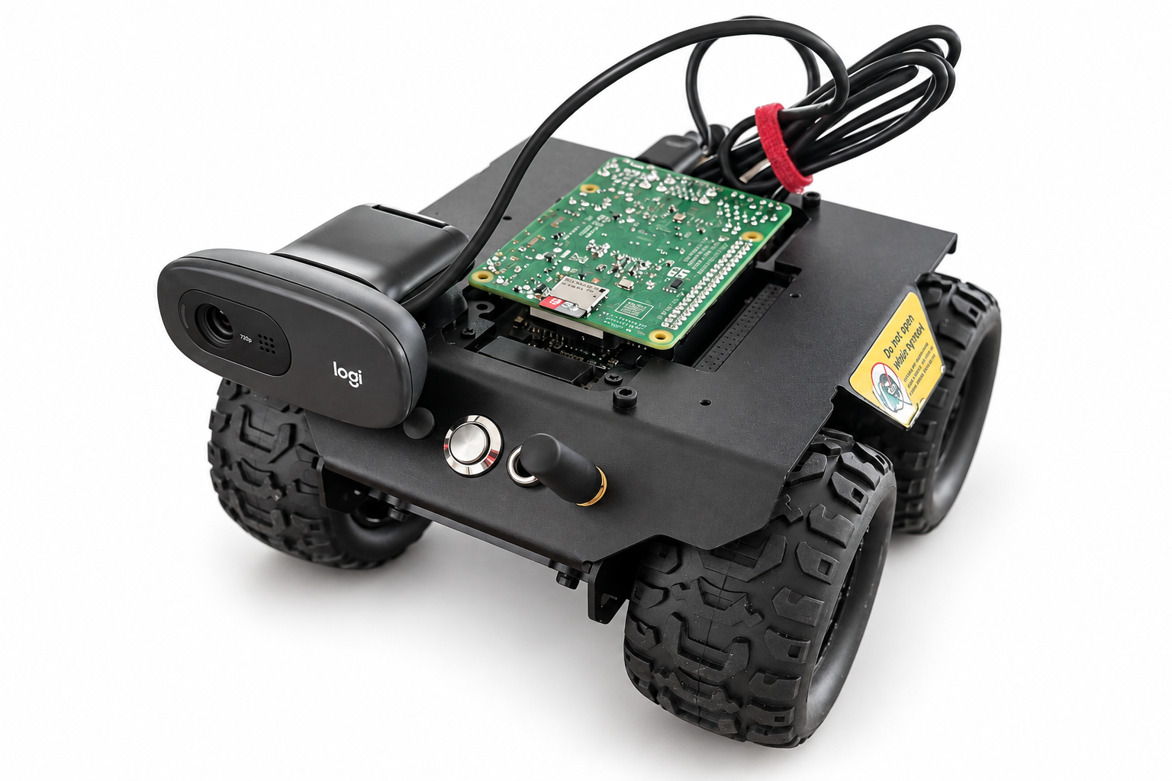
ROVER
A robot platform
for remote vision
Prototype pitch
September 2026
01
Notes:
Opening pitch: Rover is a Raspberry Pi camera prototype mounted on a wheeled chassis, with StampNote as the web viewing layer. Present remote driving as a product direction until the motor-control integration is demonstrated.
Source: user-provided prototype photos IMG_8361–IMG_8364, 21 September 2026, and the documented rover setup and diagnostic sessions on 19–20 September 2026. Product name Rover is a working name. Photos use AI-assisted background replacement and exposure cleanup. Original hardware photographs remain the authoritative engineering record.

Slide 2
Remote checks need
a useful viewpoint
A live feed helps only when it shows the thing you need to check.
Fixed viewpoints
Someone has to go and look
A room camera can leave the relevant
object or corner outside its view.
A closer inspection can still depend on
a person being available on site.
Product opportunity: a camera platform that can change its viewpoint.
02
Notes:
Problem hypothesis for discovery interviews. The deck does not claim measured demand or quantified time savings. Ask potential users which remote checks they cannot complete with existing equipment.
Source: user-provided prototype photos IMG_8361–IMG_8364, 21 September 2026, and the documented rover setup and diagnostic sessions on 19–20 September 2026. Product name Rover is a working name. Photos use AI-assisted background replacement and exposure cleanup. Original hardware photographs remain the authoritative engineering record.

Slide 3
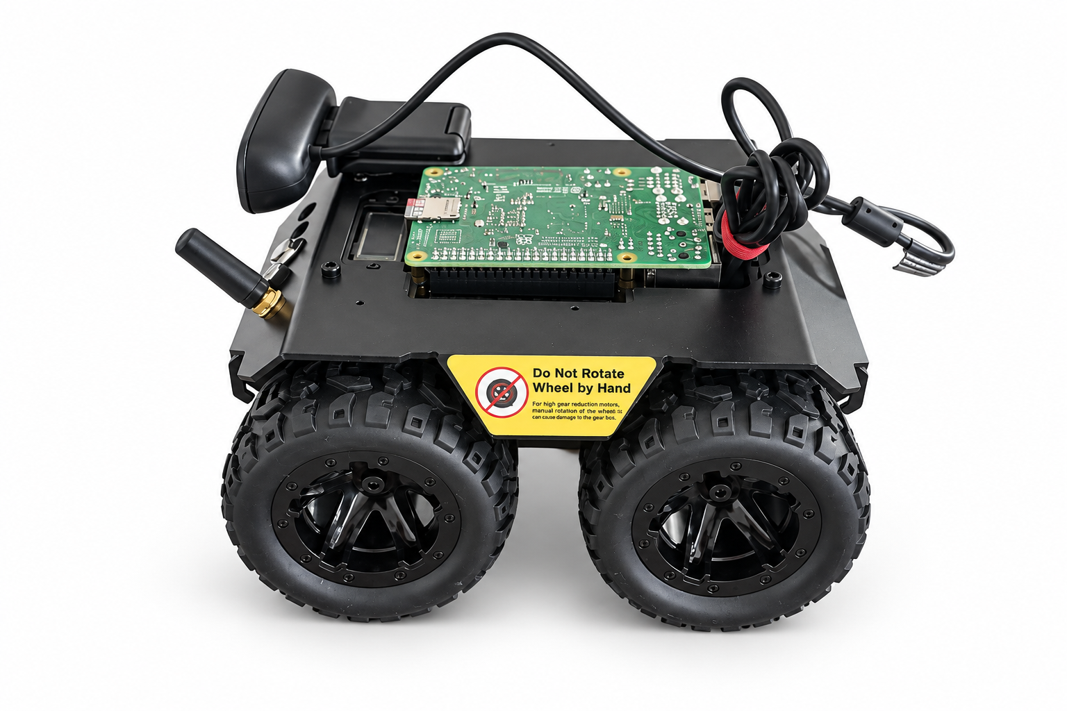
The Rover prototype
USB webcam
A live view from the robot’s position.
Raspberry Pi 4
Runs the operating system and
StampNote in Chromium.
Wheeled chassis
A physical base for the next stage
of remote movement development.
03
Notes:
The photos show a black wheeled chassis, USB webcam, Raspberry Pi board and exposed connections. Raspberry Pi 4 identification comes from the setup history. No speed, battery life, range, payload, weather resistance or motor-control performance has been measured in the supplied material.
Source: user-provided prototype photos IMG_8361–IMG_8364, 21 September 2026, and the documented rover setup and diagnostic sessions on 19–20 September 2026. Product name Rover is a working name. Photos use AI-assisted background replacement and exposure cleanup. Original hardware photographs remain the authoritative engineering record.

Slide 4
A working camera foundation
720p
Automatic browser startup
The Pi opens robotic-control after boot.
Live capture demonstrated
Signed-in camera sharing
1280 × 720 video in Chromium
with the earlier C270 webcam.
StampNote links the camera session
to its Live tunnel viewing flow.
Next validation: replacement webcam detection and automatic capture after boot.
04
Notes:
720p capture was verified in Chromium with the C270 during earlier setup sessions: videoWidth 1280, videoHeight 720, paused false and a live camera track. The boot service and direct /robotic-control launch passed a reboot test. The Google sign-in and live camera page status were verified. The later replacement webcam was not detected by Linux at the last check, so this is historical prototype evidence rather than a claim that the new camera is already validated. Automatic startStream() is now present in deployed page code, but capture depends on a detected compatible camera.
Source: user-provided prototype photos IMG_8361–IMG_8364, 21 September 2026, and the documented rover setup and diagnostic sessions on 19–20 September 2026. Product name Rover is a working name. Photos use AI-assisted background replacement and exposure cleanup. Original hardware photographs remain the authoritative engineering record.

Slide 5
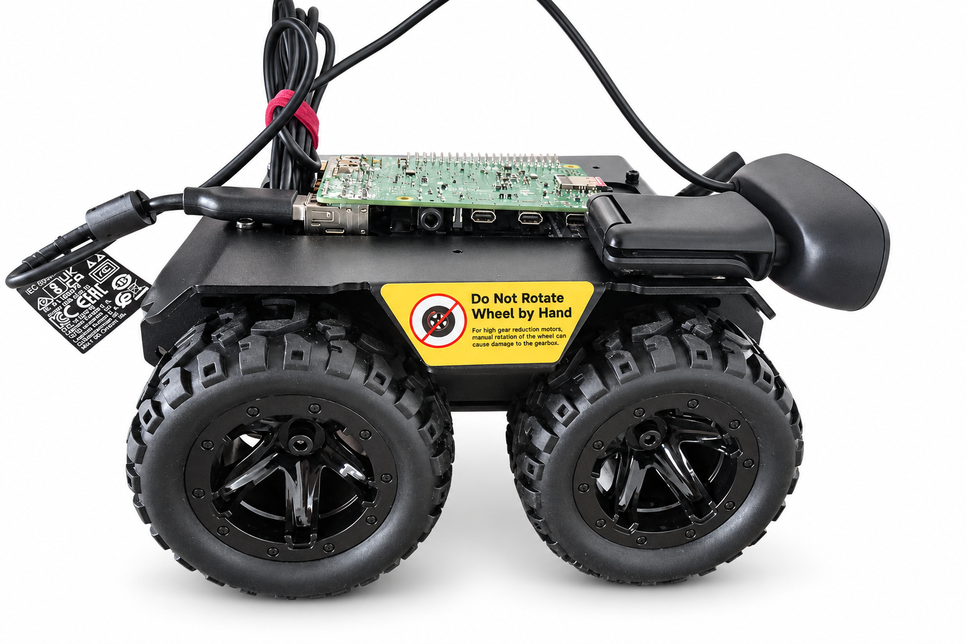
StampNote is the viewing layer
The robot hosts the camera.
StampNote provides the browser session.
01
Power on
The Pi starts Chromium.
02
Open robotic-control
The dedicated camera page loads.
03
Start the camera
The site requests the USB webcam.
04
Share the live view
A signed-in session enables Live tunnel.
05
Notes:
Operational flow based on the implemented Linux boot launcher, site camera code and Firebase sign-in. The page is https://stampnote-omega.vercel.app/robotic-control. Boot opening is verified. Page-level automatic camera activation is implemented in the deployed JavaScript as of 20 September 2026 and still needs end-to-end validation with the replacement webcam. The Live tunnel transport and access behaviour should be validated in the pilot; no recording retention or compliance capability is claimed.
Source: user-provided prototype photos IMG_8361–IMG_8364, 21 September 2026, and the documented rover setup and diagnostic sessions on 19–20 September 2026. Product name Rover is a working name. Photos use AI-assisted background replacement and exposure cleanup. Original hardware photographs remain the authoritative engineering record.

Slide 6
First pilot: indoor visual checks
Suggested starting point: small workshops and private workspaces.
Check a workspace remotely
Investigate a changed view
See a bench, doorway or storage area
without arranging a video call.
Test whether a new camera angle
helps answer a specific question.
Pilot boundaries
Known indoor space. Consenting users. Supervised movement once validated.
06
Notes:
Proposed target market and use-case hypotheses, not current customers. The suggested first pilot is a small indoor workspace with the owner’s permission, a known Wi-Fi network and a defined visual inspection task. Home/pet viewing is an adjacent concept. Avoid care, safety-critical monitoring, outdoor autonomy or security guarantees until separately validated.
Source: user-provided prototype photos IMG_8361–IMG_8364, 21 September 2026, and the documented rover setup and diagnostic sessions on 19–20 September 2026. Product name Rover is a working name. Photos use AI-assisted background replacement and exposure cleanup. Original hardware photographs remain the authoritative engineering record.

Slide 7
Where Rover could fit
A potential middle ground between an installed camera and an on-site person.
Workflow | Fixed camera | Phone video call | Rover concept
Viewpoint | Installed location | Person positions it | Wheeled platform
On-site help | Setup and adjustment | Needed during the call | Goal: less routine help
User access | Camera app or browser | Calling app | StampNote browser
Best initial role | Continuous fixed view | Guided human inspection | Remote visual checks
Remote driving remains a development milestone.
07
Notes:
Conceptual comparison of workflows, not a competitor feature audit. A fixed camera can pan or tilt but remains at its installed location. A phone video call relies on a person to position it. Rover’s mobility benefit is a proposed outcome contingent on safe motor-control integration. No claim of better price, latency, image quality, reliability or autonomy is made.
Source: user-provided prototype photos IMG_8361–IMG_8364, 21 September 2026, and the documented rover setup and diagnostic sessions on 19–20 September 2026. Product name Rover is a working name. Photos use AI-assisted background replacement and exposure cleanup. Original hardware photographs remain the authoritative engineering record.

Slide 8
A route to first revenue
Proposed model
Pilot engagement
Hardware and setup
Work with a small number of owners
to define and test a useful visual check.
Offer a configured robot once reliability
and support needs are understood.
Optional recurring service
Support and fleet management, if pilots demonstrate a continuing need.
08
Notes:
Business-model hypotheses for an early product pitch. No revenue, customers, funding, unit economics, price or market-size data were supplied. The recommended sequence is discovery and pilot evidence before selecting a commercial offer. Define pricing only after a bill of materials, assembly time, setup effort and ongoing support cost are known.
Source: user-provided prototype photos IMG_8361–IMG_8364, 21 September 2026, and the documented rover setup and diagnostic sessions on 19–20 September 2026. Product name Rover is a working name. Photos use AI-assisted background replacement and exposure cleanup. Original hardware photographs remain the authoritative engineering record.

Slide 9
The next build priorities
01
Reliable capture
Validate the new webcam, boot capture and recovery after Wi-Fi loss.
02
Safe remote movement
Integrate motor control, a stop action and supervised driving tests.
03
A repeatable pilot
Measure setup effort, useful checks completed and support needs.
Success means a repeatable viewing task, not simply a working demo.
09
Notes:
Proposed sequence with no promised dates. First close the hardware and recovery gaps observed in this conversation. Then demonstrate safe motor control with an emergency stop and a defined operator workflow before a supervised pilot. Autonomous navigation, obstacle avoidance, battery endurance and outdoor use are not demonstrated capabilities.
Source: user-provided prototype photos IMG_8361–IMG_8364, 21 September 2026, and the documented rover setup and diagnostic sessions on 19–20 September 2026. Product name Rover is a working name. Photos use AI-assisted background replacement and exposure cleanup. Original hardware photographs remain the authoritative engineering record.

Slide 10
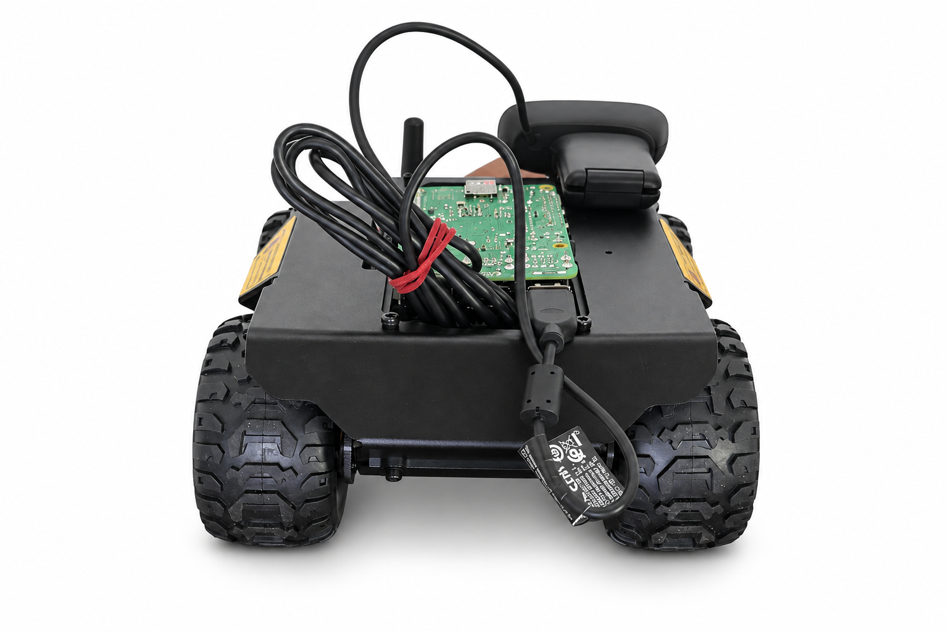
Pilot partners for the next build
A real prototype.
A clear next experiment.
We are looking for a small indoor site
and an owner willing to test a
useful remote viewing task.
Next milestone
A reliable session from power-on
to a usable live view.
10
Notes:
Proposed call to action for partner or investor discussions, not an assertion that a pilot programme already has participants. Seek access to a small indoor test site and feedback on a concrete viewing task. Investment terms and a funding amount remain unspecified because the user has not supplied a budget or fundraising plan.
Source: user-provided prototype photos IMG_8361–IMG_8364, 21 September 2026, and the documented rover setup and diagnostic sessions on 19–20 September 2026. Product name Rover is a working name. Photos use AI-assisted background replacement and exposure cleanup. Original hardware photographs remain the authoritative engineering record.

