Slide 1
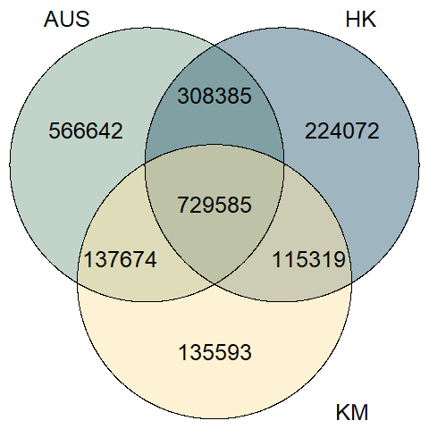
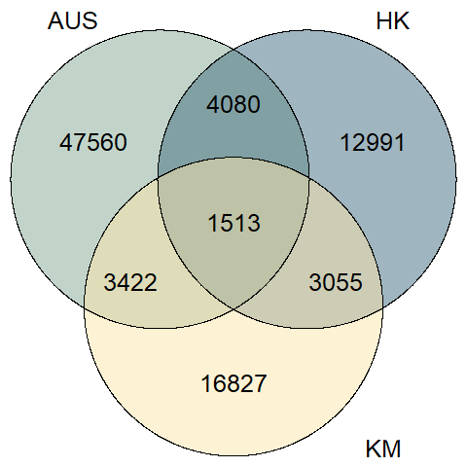
Venn Diagram for Microbial Genes
Deseq
Unfiltered
Filtered (p<=0.05)
Notes:
left side: based on raw gene count; right side: based on DESeq2 output

Slide 2
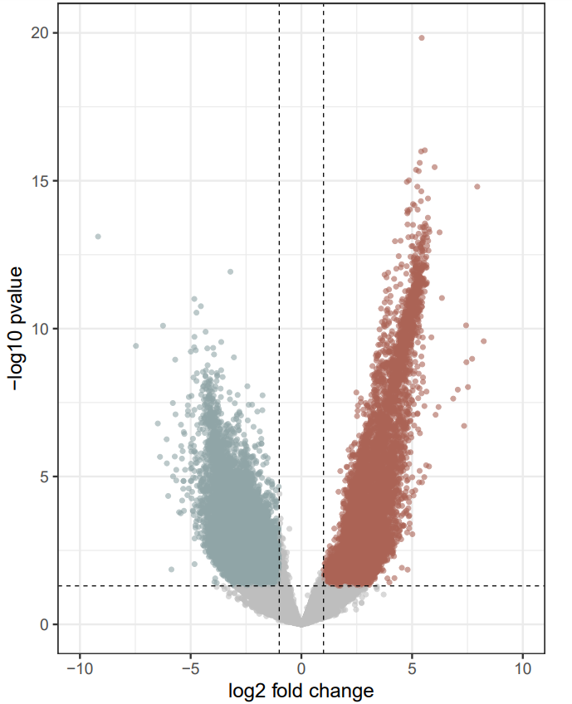
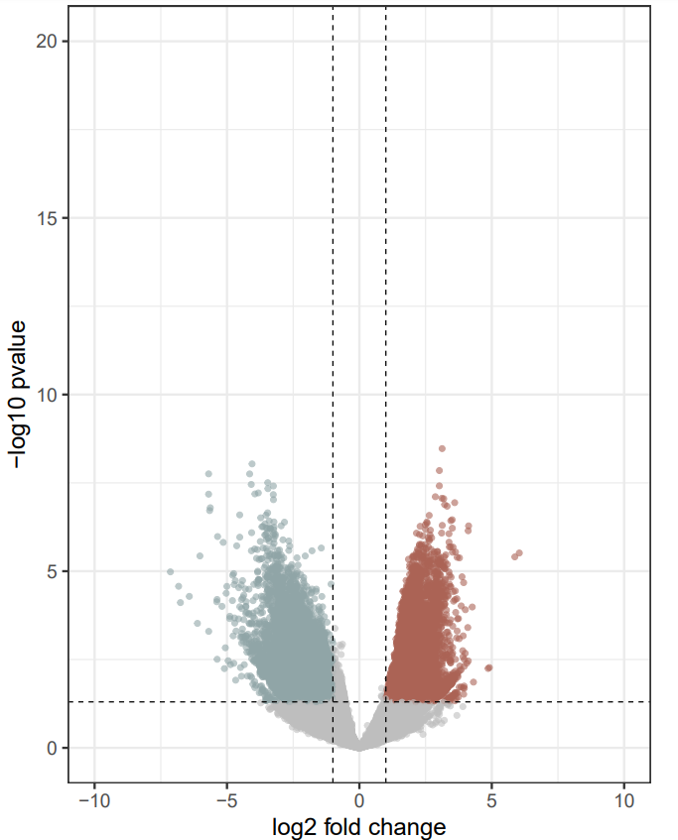
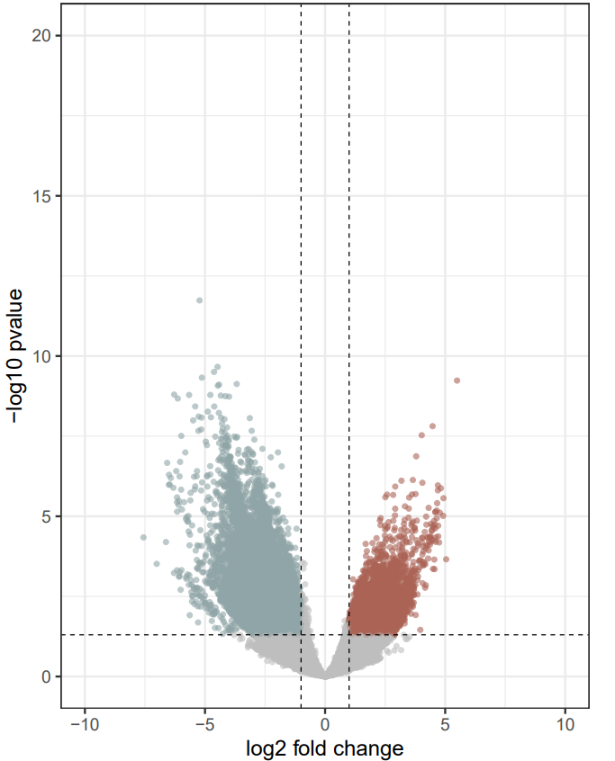
CD-enriched and CD-depleted Microbial Genes in AUS, HK, and KM
CD-depleted
CD-enriched
CD-depleted
CD-enriched
CD-depleted
CD-enriched
AUS
HK
KM
44223
10979
13834
7168
20565
3705
Cutoff for log2 FC is 1
Cutoff for p-value is 0.05
Cutoff for log2 FC is 1
Cutoff for p-value is 0.05
Cutoff for log2 FC is 1
Cutoff for p-value is 0.05

Slide 3
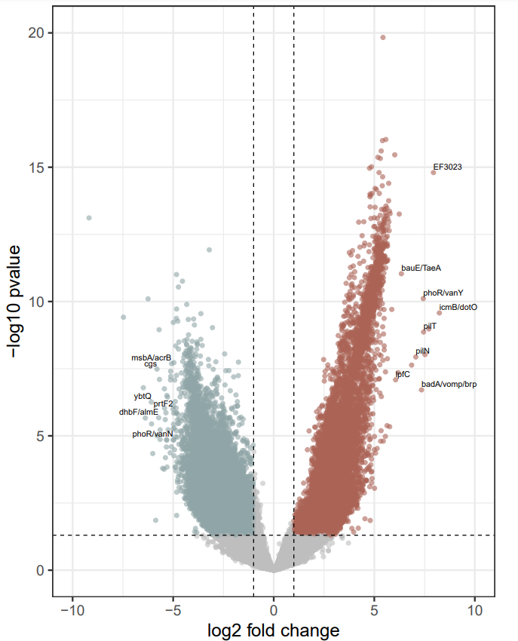
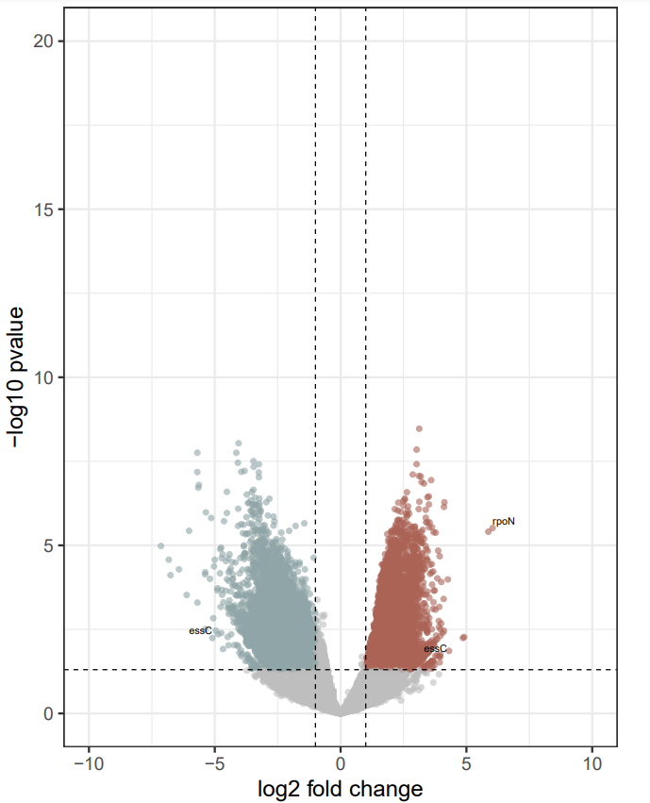
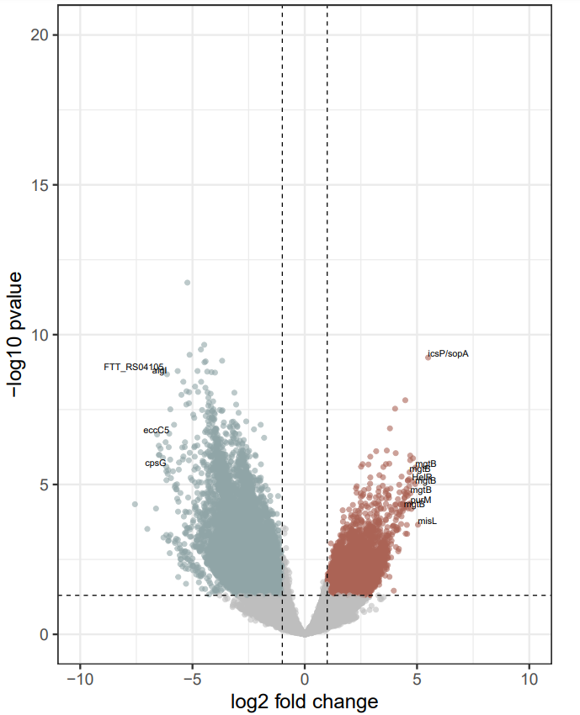
CD-enriched and CD-depleted Microbial Genes in AUS, HK, and KM
CD-depleted
CD-enriched
CD-depleted
CD-enriched
CD-depleted
CD-enriched
AUS
HK
KM
44223
10979
13834
7168
20565
3705
Cutoff for log2 FC is 1
Cutoff for p-value is 0.05
Cutoff for log2 FC is 1
Cutoff for p-value is 0.05
Cutoff for log2 FC is 1
Cutoff for p-value is 0.05
Notes:
Label those outliers

Slide 4
Microbial Gene Annotation Workflow
173
Virulence Factor Genes (VFGs)
1469
1134
Microbial genes consistently up- and down-regulated in CD patients cross AUS, HK, and KM
|log2 FC| > 1
68
Antibiotic Resistance Genes (ARGs)
p<=0.05
Notes:
Venn Diagram: Based on DESeq output

