Slide 1
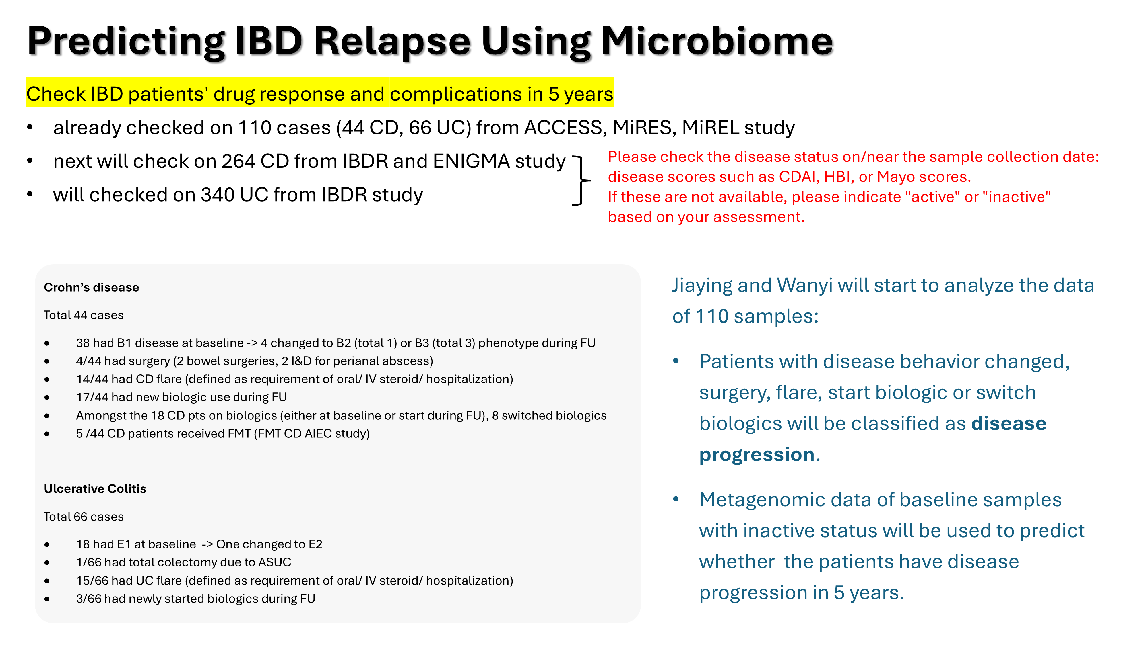

Slide 2







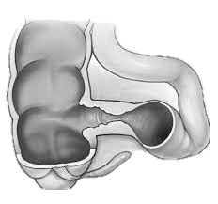





Study design
Baseline
5-year follow up
Stool samples
Clinical information
No Progression (noProg)
n = 62
n =
Crohn's disease
Definition of disease progression
Crohn' s disease
B1 at baseline and changed to B2 or B3 phenotype during FU
had surgery (bowel surgeries, I&D for perianal abscess)
had CD flare (defined as requirement of oral/ IV steroid/ hospitalization)
newly started biologics
switched biologics
Ulcerative Colitis
E1 at baseline, and changed to E2
had total colectomy due to ASUC
had UC flare (defined as requirement of oral/ IV steroid/ hospitalization)
newly started biologics during FU
Progression (Prog)
n = 43
Exclude 5 subjects who passed away or defaulted on follow-up

Slide 3
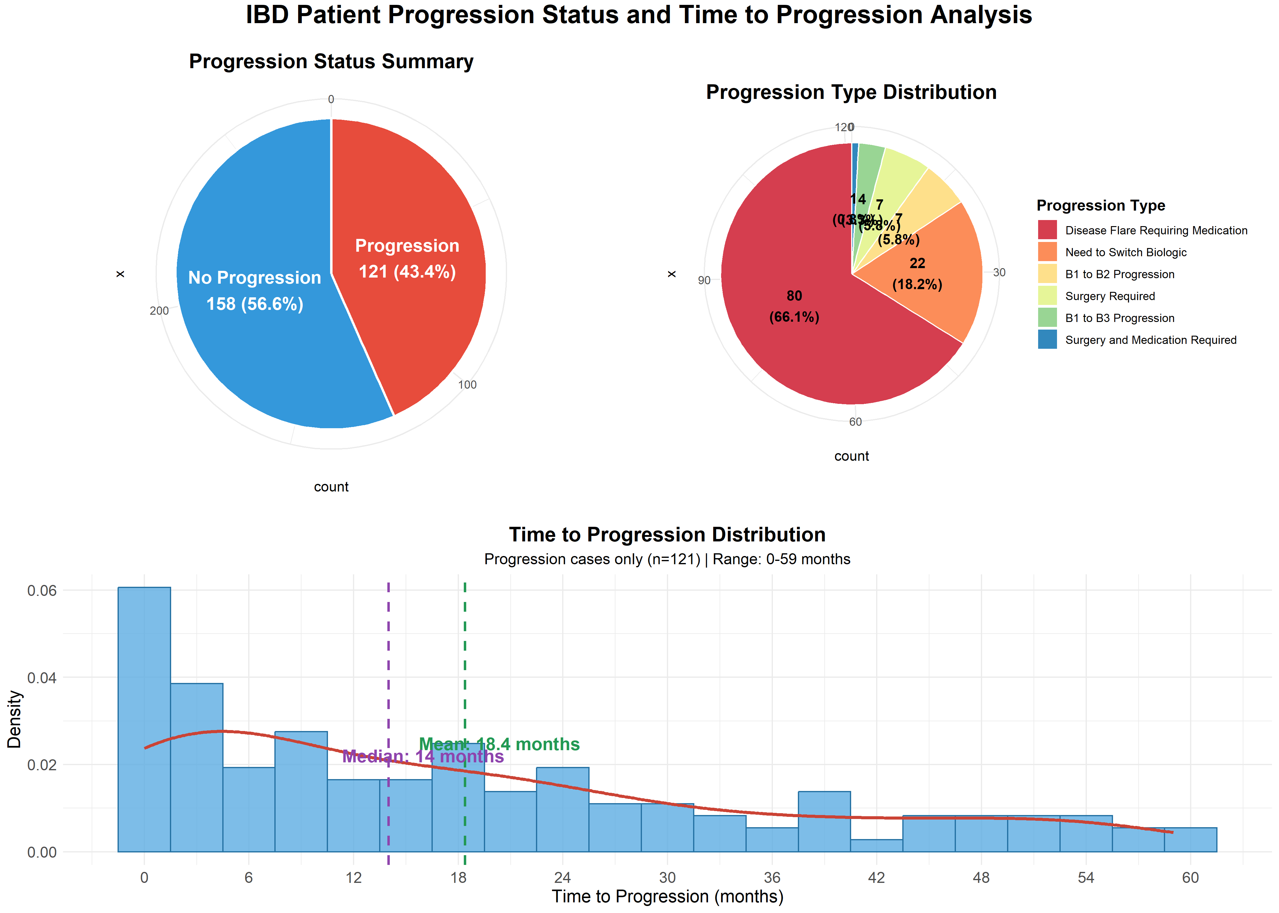
ENIGMA | IBDR | Longitude
75 | 173 | 31

Slide 4
Found 31 files, saved to metaphalan_data/longitude_sample_files.txt
Sample ID CD117 not found
Sample ID CD148 not found
Sample ID CD149 not found
Sample ID CD150 not found
Sample ID CD160 not found
Sample ID CD177 not found
Sample ID CD178 not found
Sample ID CD179 not found
Found 165 files, saved to metaphalan_data/IBDR_sample_files.txt
Found 74 files, saved to metaphalan_data/ENIGMA_sample_files.txt

Slide 5
Question list
1. Only the first recorded flare event date is used for analysis.
2. Patients who showed no progression and were lost to follow-up during the 5-year period have been excluded: CD058, CD077, CD111, HK1007, HK1021, HK1031, HK1084, ACC0107, ACC0085, ACC0118, ACC0072
3. When calculating flare times in months, for entries missing the exact day (only month and year available), I used the first day of the month as the default.
4. For patient HK1054, both medication and surgery times were recorded as May 2022. These dates have been standardized to May 1, 2022 (Reference #3).
5. A entry marked "n/a (*E admitted at st. T, only known Abx was given)" in "Flare_requiring_oral_IV_Steroids_Hospitalisation (1: Yes; 0: No)", there is a relevant date but no clear classification. We are currently treating it as 1.
6. In the "New drug use" column, some entries contain drug names (should be 0/1). Should these be converted to 1?
7. Should the dates be matched with the Flare column or the Steroid column? Dates align completely with Steroid entries and mostly with Flare entries. Currently, we use Flare column to classify the samples.
8. Some samples show zero intervals in medication progressions. (So strange…)
Flare_requiring_oral_IV_Steroids_Hospitalisation (1: Yes; 0: No) | 5ASA | Thiopurines | MTX | Steroid (Oral/ IV) | Date

