Slide 1
Decision Tree Random Forest AdaBoost(adaptive Boosting) Gaussian Naive Bayes KNN(K Nearest Neighbour) MLP(Multi-Layer Perceptron) QDA(Quadratic Discriminant Analysis)
Notes:
Today I will introduce the following seven common and most basic machine learning algorithms.

Slide 2
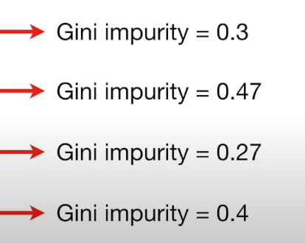
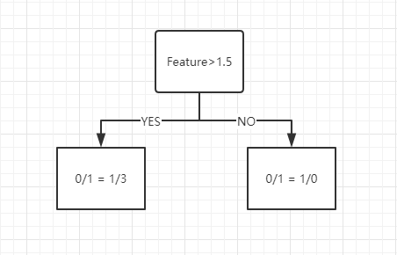
Decision Tree
Feature 1 | Label
1 | 0
2 | 1
3 | 0
4 | 1
5 | 1
Steps:
1. Arrange the value of feature from small to large;
2. Calculate the average value of each two values of the feature;
3. Calculate the Gini impurity score for each mean. Gini coefficient reflects the probability that two samples are randomly selected from the sample set with different categories. Therefore, the gini impurity is used as the indicator of Gini coefficient.
( Gini impurity = 1 - (the probability of “0”) - (the probability of “1”) );
4. The minimum value of Gini impurity score of mean is taken as the value of this feature.
(1+2)/2=1.5
(2+3)/2=2.5
(3+4)/2=3.5
(4+5)/2=4.5
Total Gini(Feature1) = 4/(4+1) * 0.336 + 1/(1+4) * 0 = 0.3
...
Gini = 0.336
Gini = 0
Notes:
The first is the decision tree. A decision tree is a data structure that can be used for classification and regression. The core components of the decision tree are root node, internal node and leaf node. They use the GINI coefficient as the basis for the division.
Here's how the decision tree works:
The first thing we need to do is determine the root node of the decision tree, because it is the starting point of the decision tree, and all internal nodes are initiated and extended from the root node.
In general, there are four steps to determine the root node:
The first step is to calculate the features in the training set one by one. Here, taking the list extracted from the left as an example, we need to arrange the value of Feature1 from small to large. In the second step, we need to calculate the average value of every two adjacent features.The third step is to calculate the Gini impurity score for each mean. Gini coefficient reflects the probability that two samples are randomly selected from the sample set with different categories.The larger the Gini coefficient is, the greater the probability that two samples are drawn randomly from the sample set with different categories, i.e. the smaller the sample purity is.Therefore, the gini impurity is used as the indicator of Gini coefficient. The higher the gini impurity is, the greater the category error of the two samples will be. Therefore, here, we need to adopt the principle of reducing the purity of the Gini operation. Look at the figure in the lower left, when the Feature is greater than 1.5 and is NO, the determination results are all attacks. At this time, the set categories are consistent, and the Gini purity is 0, that is, the error is 0. Finally, The minimum value of Gini impurity score of mean is taken as the value of this feature.

Slide 3
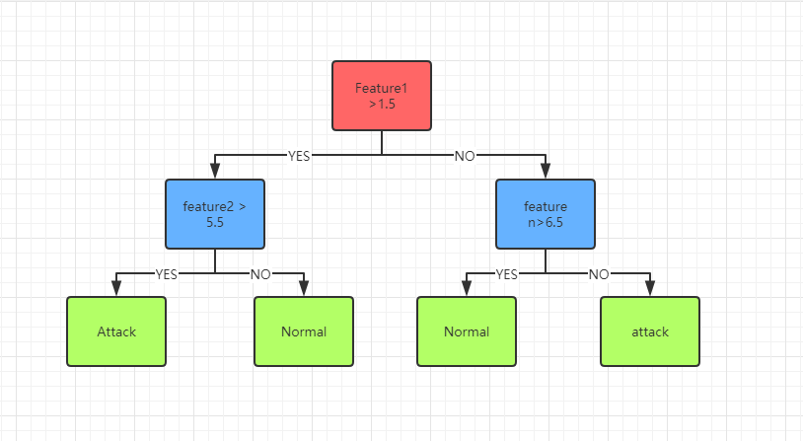
Decision Tree
eg. If Gini(feature 1) = 3.5 < Gini(feature 2) = 5.5 < Gini(feature n) = 6.5, feature 1 will be the Root Node. feature2 will be the second node. And we can use the terms of the value of feather1 on the same row as the value of feather2 to decide whether we're going to split to the left or the right. Finally, Leaves will be the end. point.
Feature1 | ... | Feature n | Label
1 | ... | 6 | 0
2 | ... | 7 | 1
3 | ... | 8 | 0
4 | ... | 9 | 1
5 | ... | 5 | 1
Notes:
Ok, we have calculated the Gini impurity of all features, so we can select the root node and the subsequent internal node by using the principle of selecting the lowest purity. Here is an example, If Gini(feature 1) < Gini(feature 2)< Gini(feature n), feature 1 will be the Root Node. feature2 will be the second node. And we can use the terms of the value of feather1 on the same row as the value of feather2 to decide whether we're going to split to the left or the right. Each path, starting at the root node, after two nodes have been screened, results in a classification with the highest purity, and this node is the leaf node.Therefore, the process in which the decision tree opens branches and scatters leaves is the process in which the purity of classification is gradually improved.

Slide 4
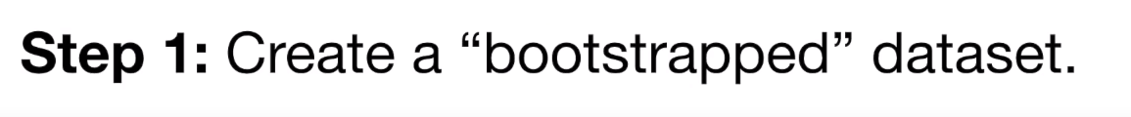
Random Forest
Feature1 | ... | Feature n | Label
1 | ... | 6 | 0
2 | ... | 7 | 1
3 | ... | 8 | 0
4 | ... | 9 | 1
5 | ... | 5 | 1
Feature1 | ... | Feature n | Label
2 | ... | 7 | 1
2 | ... | 7 | 1
3 | ... | 8 | 0
1 | ... | 6 | 0
5 | ... | 5 | 1
Notes:
After introducing the decision tree, I will introduce the random forest, because it is based on the decision tree, the construction of multiple decision trees to generate a classification algorithm. Firstly, there are two random sampling processes. Random Forest shall sample the input data and columns. For row sampling, the method of put back is adopted, that is, there may be duplicate samples in the sample set obtained by sampling. The new sample must ensure that the number of rows and columns and the table header are the same as the original table.

Slide 5
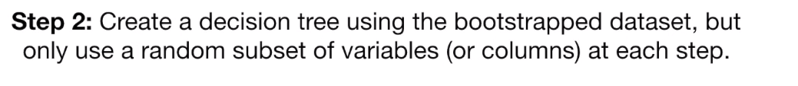
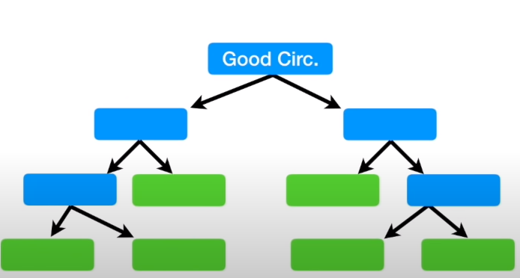
Random Forest
Feature1 | ... | Feature n | Label
2 | ... | 7 | 1
2 | ... | 7 | 1
3 | ... | 8 | 0
1 | ... | 6 | 0
5 | ... | 5 | 1
Feature n
Notes:
With the newly created a random list, we need to use to generate these lists, create a decision tree for each feature, the use of data set is created by the random list before, so each used feature list is different, the process of creating in my decision tree algorithm is explained in detail, here is not much to do here.

Slide 6
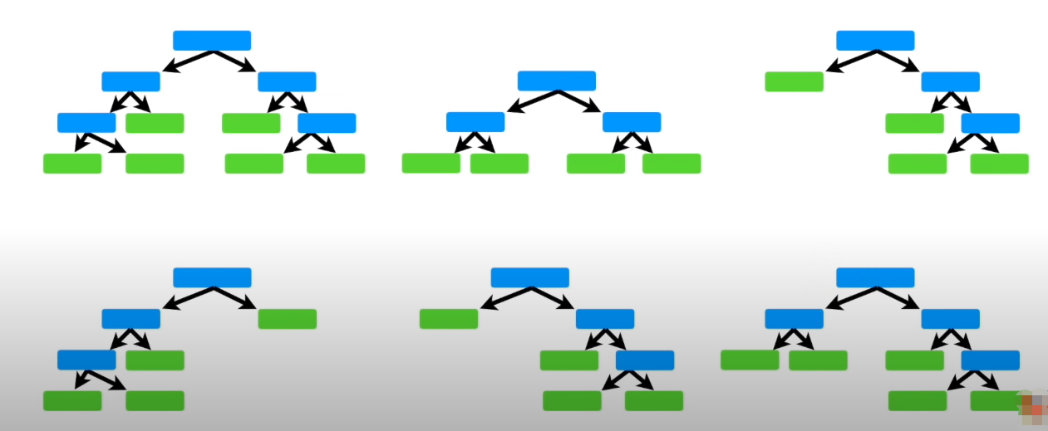
Random Forest
Step3 Use the random forest
Feature 3
Feature 1
Feature 2
Feature 4
Feature 5
...
Feature n
Notes:
The decision tree for each feature is trained from the root node. If the termination condition is reached on the current node, the current node is set as a leaf node. If it is a classification problem, the predicted output of the leaf node is the type with the largest number in the current node sample set.If it is a regression problem, the predicted output is the average value of each sample value in the current node sample set.If the current node does not meet the termination condition, the random feature is selected from the feature without being put back and the training continues. The termination conditions mentioned here are the number of n_estimators of the decision tree, the depth of the decision tree, max_depth, etc., which can be set during modeling.

Slide 7
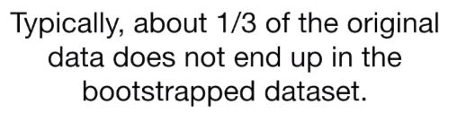
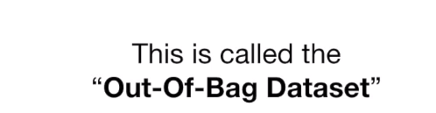
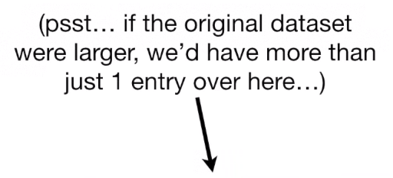
Random Forest
Step 4: They will beecome the test dataset to estimate the forest.
Feature1 | ... | Feature n | Label
Notes:
In the process of fitting the random forest model, because the training list is repeatable, 1/3 Of the original training data will not be used. This kind Of data is called the out-of-bag Dataset, which can be used as a test set.

Slide 8
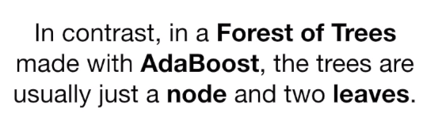
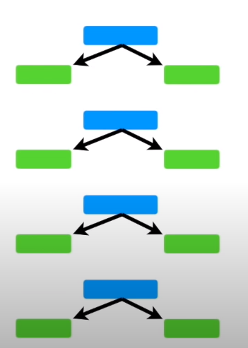
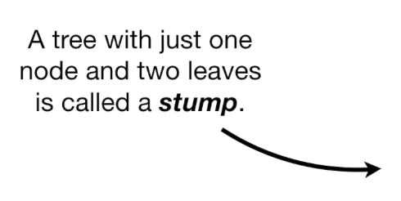
AdaBoost
Notes:
The full name of AdaBoost is adaptive boost, which means it is a kind of algorithm that can adapt itself and improve the classification effect. Its self-adaptation lies in that the weight of the misclassified samples of the previous basic classifier will increase, while the weight of the correctly classified samples will decrease, which will be used to train the next basic classifier again.At the same time, a new weak classifier is added in each iteration, and the final strong classifier is not determined until a predetermined small enough error rate or a predetermined maximum number of iterations is reached. The error rate and maximum number of iterations can be set at modeling time.

Slide 9
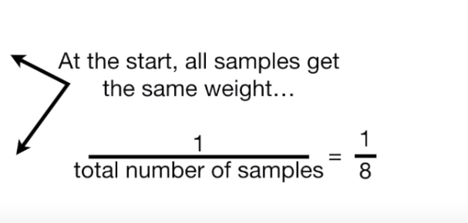
AdaBoost
Feature1 | ... | Feature n | Label | WEIGHT
1 | ... | 6 | 0 | 1/5
2 | ... | 7 | 1 | 1/5
3 | ... | 8 | 0 | 1/5
4 | ... | 9 | 1 | 1/5
5 | ... | 5 | 1 | 1/5
1/5
Notes:
First, we need to initialize the WEIGHT distribution WEIGHT of the training data. If there are N training sample data, each training sample is initially assigned the same WEIGHT: WEIGHT=1/N.

Slide 10
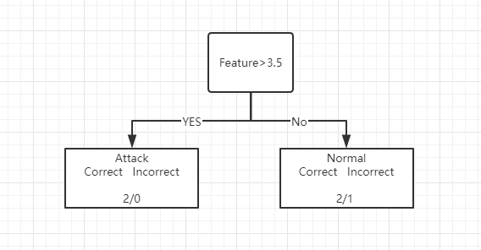
AdaBoost
Feature1 | ... | Feature n | Label | WEIGHT(TOTAL ERROR)
1 | ... | 6 | 0 | 1/5
2 | ... | 7 | 1 | 1/5
3 | ... | 8 | 0 | 1/5
4 | ... | 9 | 1 | 1/5
5 | ... | 5 | 1 | 1/5
Gini = 0
Gini = 0.444
Gini impurity = 1 - (the probability of correct) - (the probability of incorrect)
Total Gini(Feature1) = 2/(4+1) * 0 + 3/(1+4) * 0.444 = 0.333
...
Notes:
Through the calculation and selection method of gini impurity in the decision tree, the weak classifier with the lowest error rate is selected as the first stump, where gini impurity is the error rate.

Slide 11
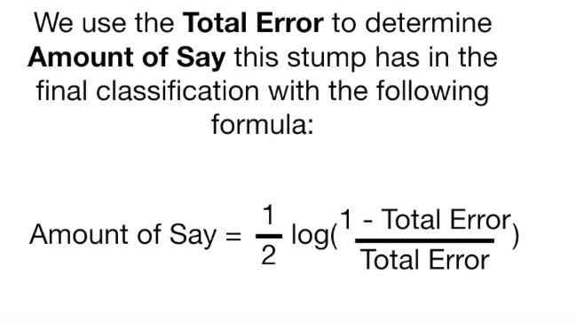
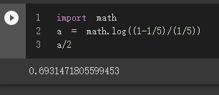
AdaBoost
Amount of Say(Feature1) = 1/2 * log[(1-1/5)/(1/5)] = 0.693
...
Amount of Say(Feature n) = 1/2 * log[(1-Total Error/Total Error]
Notes:
Then we need to train the weak classifier.The specific training process is as follows: if a training sample point is accurately classified by a weak classifier, then the corresponding weight of the next training should be reduced. Conversely, if a training sample point is misclassified, its weight should increase.The weighted updated sample set is used to train the next classifier, and the whole training process goes on iteratively.Here the parameter that determines whether the WEIGHT value is lowered or increased in the next iteration is Amount of Say.Its calculation is shown here and calculated using Feature1 as an example.

Slide 12
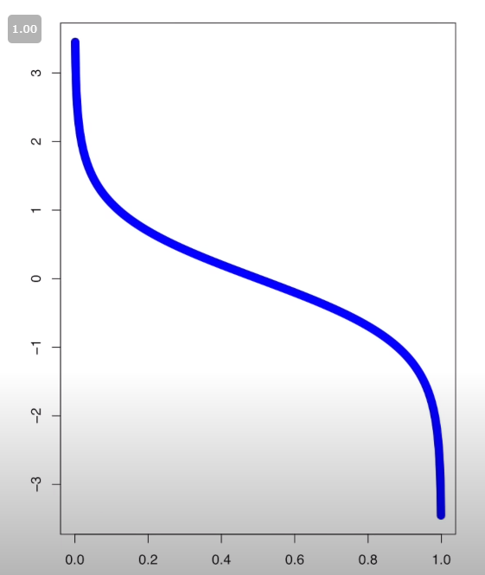
AdaBoost
Amount of Say
The Blue Line tells the Amount of Say for Total Error values between 0 and 1.
(Weight) total Error
Notes:
The relationship between the error and Amount of Say is given here.It can be seen from the figure that error =0.5 is a cut-off point.When the error value is less than 0.5 and close to 0, the value of Amount of Say will be higher; when the error value is more than 0.5, the value of Amount of Say will be negative, in other words, this kind of indicator has no right of discourse.

Slide 13
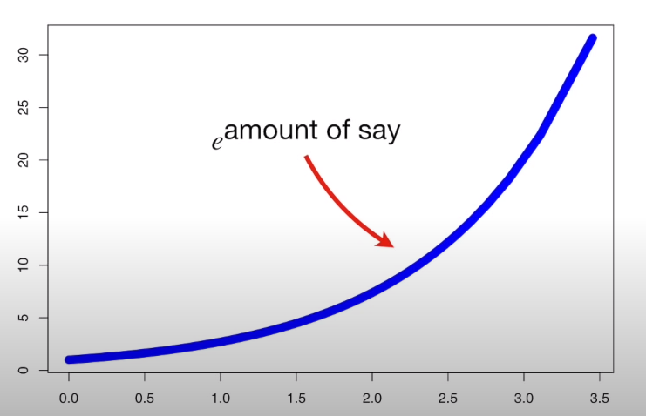
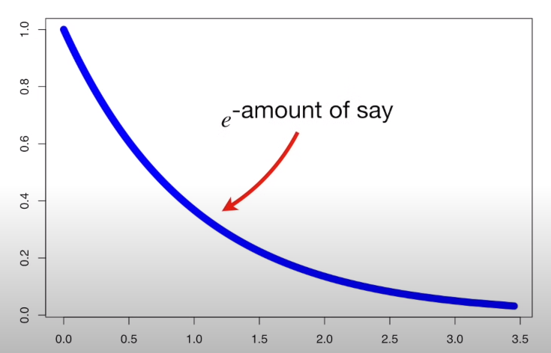
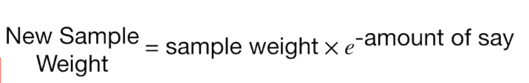
AdaBoost
Increasing the weight of bad sample:
New Sample Weight = old sample weight *
Decreasing the weight of good sample:
Notes:
Here I'll show you how to increase and decrease the error weights. The X axis represents the original error weight, and the Y axis represents the added or reduced error weight. The blue curve is e to the amount of say and e to the one over the amount of say.

Slide 14
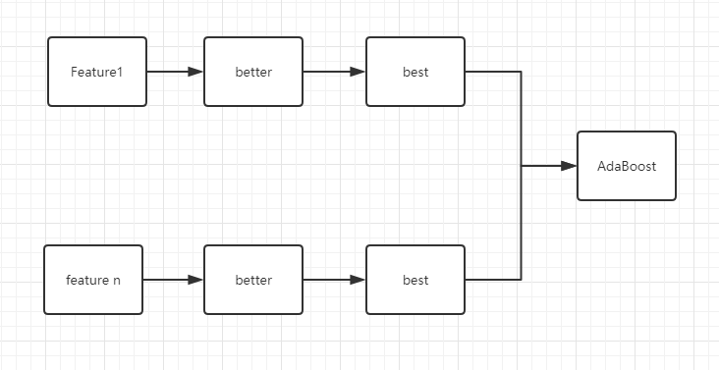
AdaBoost
.
.
.
......
Notes:
Here, I used only two features are displayed in the examples to demonstrate the iterative evolution process of each tree stump. The weak classifier of each feature completed by evolution will eventually form a strong classifier. The value of anount of say of each weak classifier determines their weight in the final classifier.

Slide 15
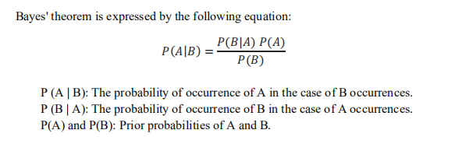
Gaussian Naive Bayes
1.The algorithm is used to adjust the value of feature, and its numerical distribution is fitted to the normal distribution.(The normal distribution curve is determined by the mean value and standard deviation of feature);
2.In the test set, reference tag values make independent assumptions.The probability of independent events is calculated according to the following formula. The large probability value is the output.
For the easy understanding, we no longer use event A and event B, but use the X and y commonly used in machine learning:
P(y|X)=[P(X|y)P(y)]/P(X)
Notes:
The gaussian Naive Bayes algorithm adjusts the eigenvalues so that their numerical distribution conforms to the normal distribution.If x is multidimensional data, then we can assume P(X1, |y),P(X2, |y)...The events corresponding to P(Xn|y) are independent of each other, and these values are multiplied together to obtain P(X|y), which is the classification result.

Slide 16
Gaussian Naive Bayes
Feature 1 | ... | Feature n | Label
1 | ... | 6 | 0
3 | ... | 8 | 0
Feature1 | ... | Feature n | Label
1 | ... | 6 | 0
2 | ... | 7 | 1
3 | ... | 8 | 0
4 | ... | 9 | 1
5 | ... | 5 | 1
→
Feature 1 | ... | Feature n | Label
2 | ... | 7 | 1
4 | ... | 9 | 1
5 | ... | 5 | 1
Notes:
Here, I still use the example I used before to explain the implementation of the whole algorithm.First, for the training set, the algorithm USES the value of Label to classify, here are 0 and 1, namely attack and normal.The training data is divided into two sub-tables according to the indexes of these two items.

Slide 17
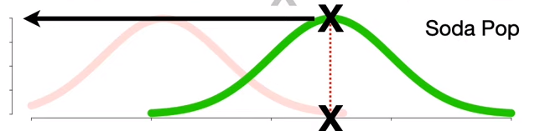
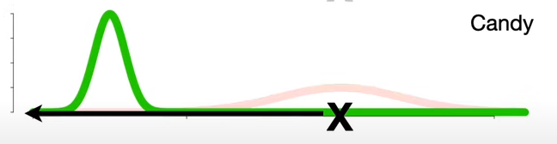
Gaussian Naive Bayes
Feature 1
Feature n
Attack/Label = 1
P(attack)*P(F1|attack)*...*P(Fn|attack)
......
Feature n
Not Attack/Label = 0
Feature 1
P( not attack)*P(F1|not attack)*...*P(Fn|not attack)
Notes:
For the two subtables, P (X|y) of each feature is calculated, and the numerical distribution follows the gaussian distribution.Here, I only show the distribution of Feature1 and Feature N. In this graph, X is the eigenvalue, and Y is the conditional probability of the eigenvalue P (X| Y). At this point, the algorithm is a training complete. When there is training data input, calculate the training data as attack and normal conditional probability respectively. The formula has been given here.Compare the values of the two conditional probabilities and select the larger one as the output result.

Slide 18
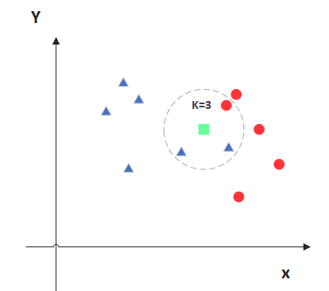
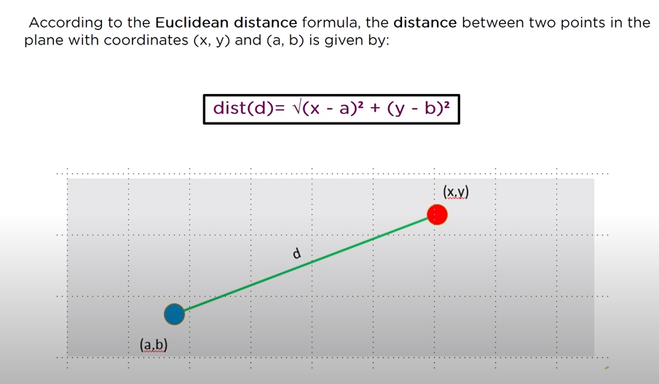
K Nearest Neighbour
Feature1 | Feature 2 | Feature 3 | Label
1 | 3 | 6 | 0
2 | 2 | 7 | 1
3 | 6 | 8 | 0
4 | 4 | 9 | 1
5 | 8 | 5 | 1
Notes:
KNN is arguably one of the simplest classification algorithms, and I'll stick with the previous example here.Assuming that there are three features participating in the fitting, the numerical values of these three features will present such a situation in the two-dimensional diagram.The calculation formula of Euclidean distance between two points is given in the lower part of the figure.The green points in the figure represent the points in the unknown test set, and K value is set as 3, that is, choose the nearest three points around the green point, where there are two blue points and a red point, then the green point's property is blue.

Slide 19
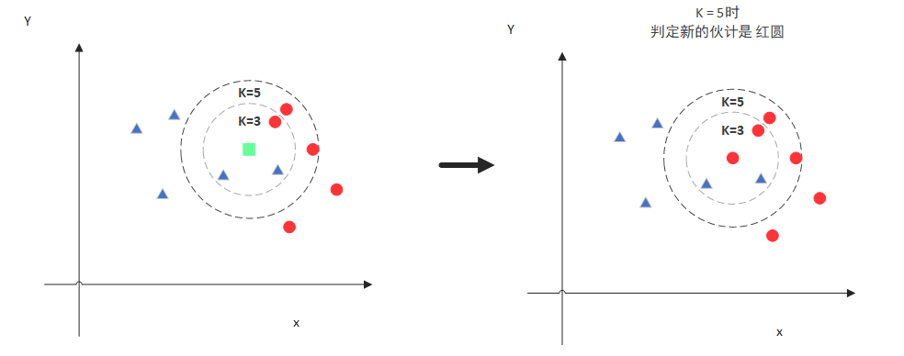
K Nearest Neighbour
If K=5, the new blue point is belong to red because the number of red points are more than blues' in K =5
Notes:
I'm going to continue this example here, where when K chooses 5, the new blue point is belong to red because the number of red points are more than blues' in K =5.

Slide 20
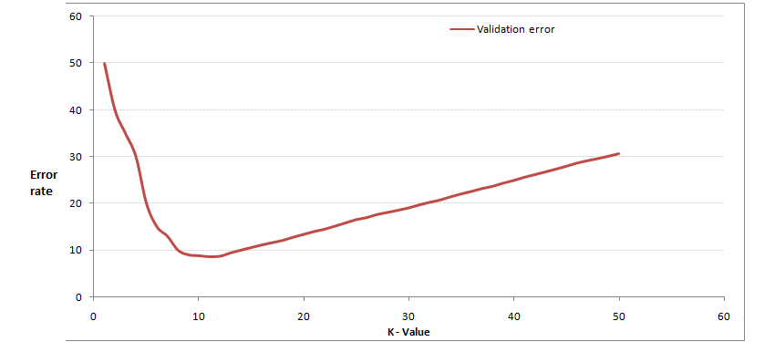
K Nearest Neighbour
Notes:
We know from the graph above that K is important, so how do we know what K is?The answer is through cross validation (sample data according to certain proportion will split out the training data and verify the use of data, such as 6:4 split out part of the training data and test data), starting from the select a smaller values of K, increasing the value of K, and then calculating the variances of the validation set, finally found a more suitable K value calculated by cross validation of variance after you will get the following figure. This figure actually is easy to understand, when you increase k, general error rate will be reduced, because there are around, more samples can be for reference will get better classification effect but note that, unlike k - means, when the k value is bigger, error rate will be higher and it is easy to understand, for example, you are a total of 35 sample when you k increased to 30, KNN is meaningless so basically when choosing k point can choose a larger critical point k, when it continues to increase/decrease error rate will rise, such as k = 10 in this picture.

Slide 21
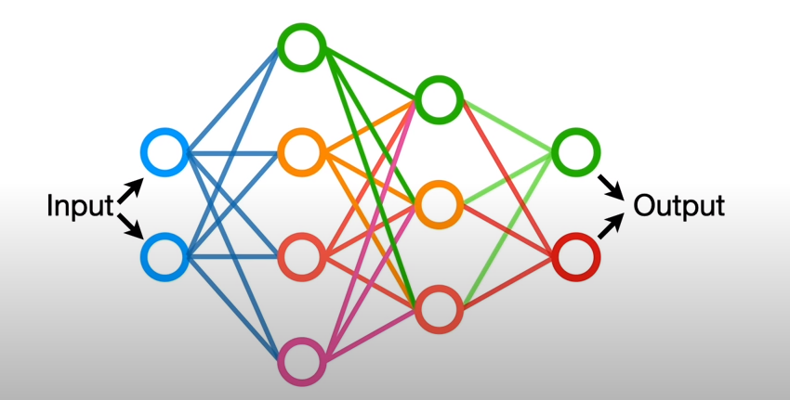
MLP
MLP is a type of artificial neural network.
Artificial neural networks (ANN) are a method of machine learning inspired by the way the human brain works.
The purpose of this method is to mimic the characteristics of the human brain, such as learning, decision-making and acquiring new information.
Notes:
MLP is also called ANN (Artificial Neural Network). In addition to the input and output layers, it can have multiple hidden layers in the middle. The simplest MLP contains only one hidden layer, namely a three-layer structure.The diagram shown here has two hidden layers, The first hidden layer has four nodes/units, the second one has three.

Slide 22
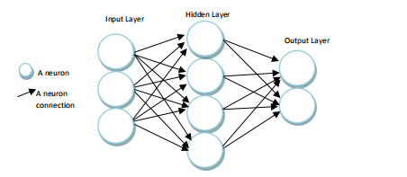
MLP
The input layer is the stage where the MLP is responsible for receiving data.No information processing is performed at this level.Only the information received is transmitted to the next layer, the hidden layer.
In the hidden layer, the data sent from the input layer is processed and transmitted to the next layer, the output layer.
In the output layer, which is the last layer, each cell is tied to all the cells in the hidden layer, and the results of the processed data in the hidden layer are served at this stage.
Notes:
The input layer is the stage where the MLP is responsible for receiving data.No information processing is performed at this level.Only the information received is transmitted to the next layer, the hidden layer.
In the hidden layer, the data sent from the input layer is processed and transmitted to the next layer, the output layer.
In the output layer, which is the last layer, each cell is tied to all the cells in the hidden layer, and the results of the processed data in the hidden layer are served at this stage.

Slide 23
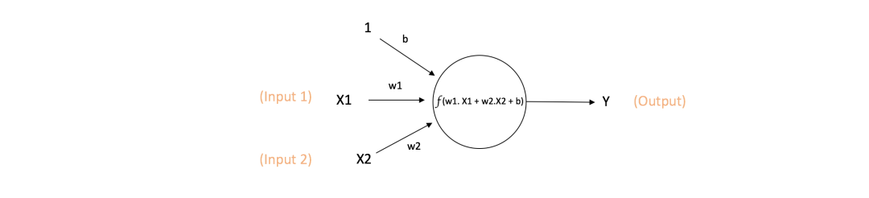
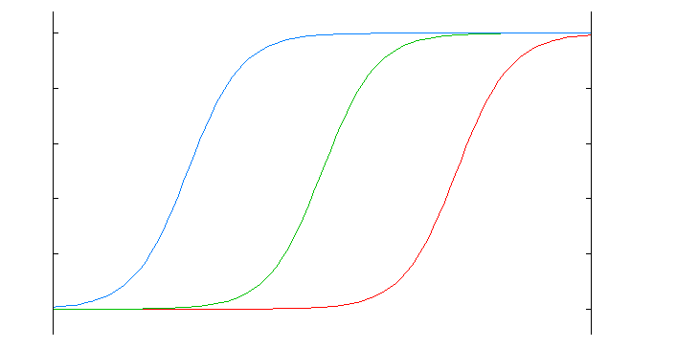
MLP
Y = f(w1*x1+w2*x2+b)
The green curve below is an unbiased activation function, blue is a negative bias, and red is a positive bias.
Notes:
As the basic unit of artificial neural network, neuron is generally referred to as Node or Unit.A single neuron receives input from other neurons, or from an external source, and calculates the output.Each input is accompanied by a weight, namely W, which depends on the relative importance of the other inputs. The figure below is a simple illustration of a single neuron.The network accepts and inputs with weights of W1 and W2.There is also input 1 with a weight of b (known as bias). The main function of bias is to provide each neuron with a trainable constant value, which is mainly reflected by moving the activation function to the left or right in the quadrant. Frankly speaking, it is how easy it is for neurons to output 1. The green curve below is the unbiased activation function, the blue is negative bias, and the red is positive bias. The mathematical expression of the output function of this neuron is in here: Y = f(w1*x1+w2*x2+b). f(x) is an activation functions. It's important to note here that activation functions are not intended to activate anything by name. In the neuron output mentioned earlier, the activation function f (x) is a nonlinear function, because most of the data on earth is not linear. Mathematically, when the activation function is linear, a two-layer neural network approximates almost all functions.However, if f(x)=x when the activation function is the identical activation function, it does not satisfy this property, and then the whole network is essentially a single layer neural network.
Here, I'll introduce the most commonly used activation function: Sigmoid.

Slide 24
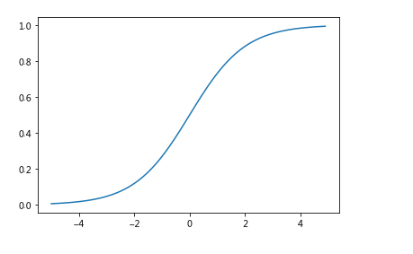
MLP
Sigmoid:
It can transform the output between 0 and 1, which means that if it's a very large negative number it will output 0, and if it's a very large positive number it will output 1. The graphical representation of Sigmoid is shown here.

Slide 25
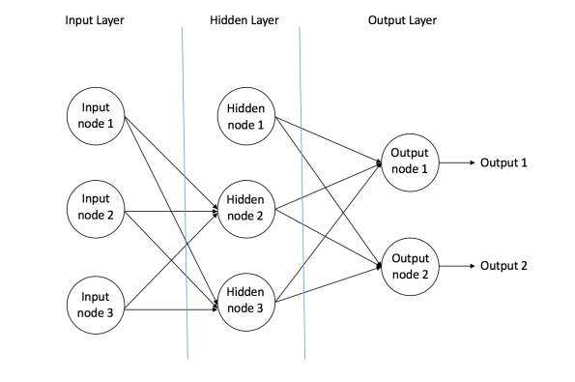
MLP
.
.
.
.
.
.
.
.
.
Forward structure
Notes:
The forward structure, also known as the feed-forward structure, is the first neural network to be invented and the simplest. It consists of multiple nodes (neurons) arranged in multiple layers. Nodes in adjacent layers have connections or edges. All connections are weighted.
We can see that the network is divided into three areas: the leftmost input layer, the middle hidden layer, and the rightmost output layer.In a nutshell, the Input layer is responsible for getting the external information. It should be noted that there is no calculation here, and only information is passed to the hidden layer.The hidden layer is responsible for most of the calculation, but in fact, there can be multiple or no hidden layers in a feedforward network.The output layer is responsible for a part of the calculation and transmits information to the outside world.
We say that the feed-forward neural network is the simplest network because: the information is only one-way movement, from the input layer to move forward, and then through the hidden layer to the output layer, there is no loop or loop in the network.

Slide 26
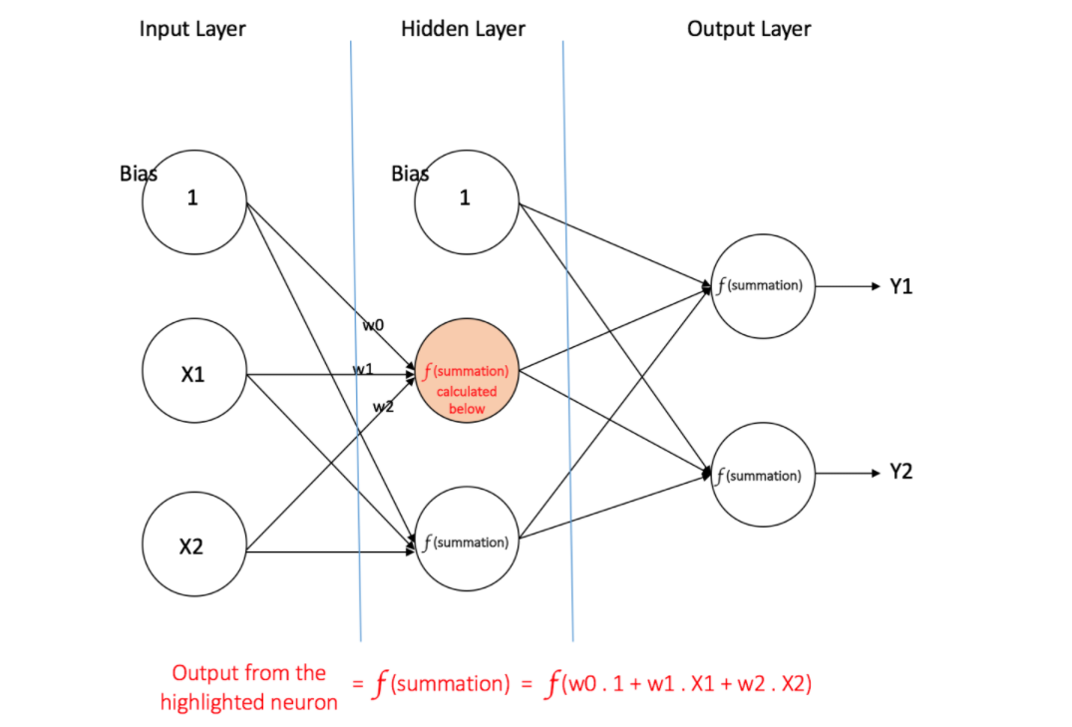
MLP
Multilayer Perceptron(MLP)
Notes:
MLP contains at least one hidden layer, and you can learn nonlinear functions.Let's bring back the schematic of the activation function to make it look more like a three-tier structure of a neural network.A series of feature X and target Y are given here. A multilayer perceptron can learn the relationship between feature and target for the purpose of classification or regression.

Slide 27
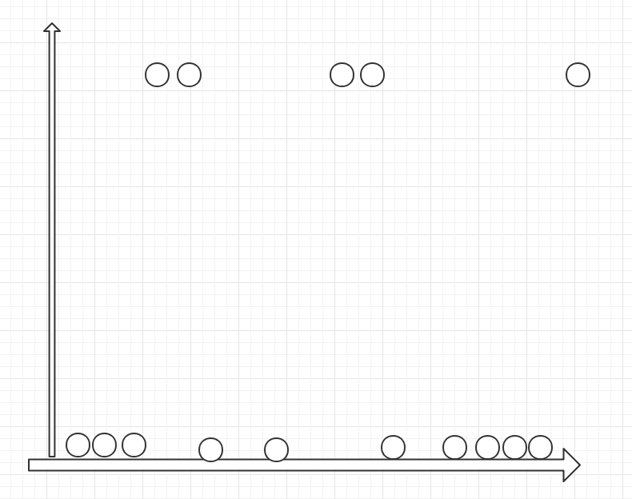
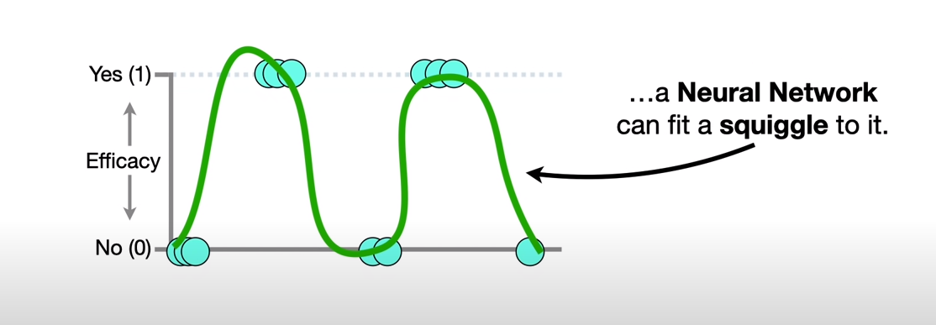
MLP
1
1
0
Feature 1 to Feature n
Feature
Notes:
After introducing the mathematical principles learned in MLP, I think I need to explain them more vividly. Please look at these two pictures. The above is the scatter expression of the training set, y is the label values 0 and 1 in the training set, and X is the feature variable.Correspond to attack and normal.The figure below shows the curve graph after the neural network finally learns and fits. We can see that the curve graph fitted well connects all feature variables. So each neuron in the hidden layer, what are they looking at?

Slide 28

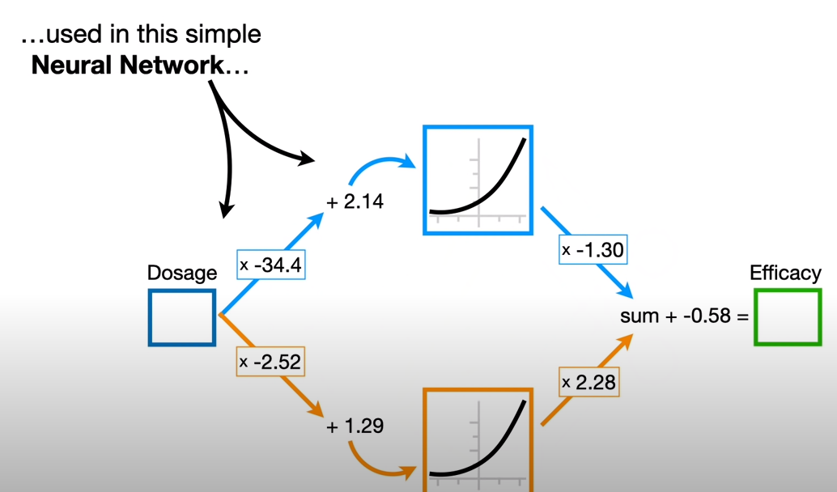
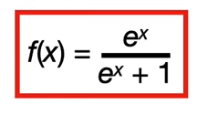
MLP
单击此处添加正文
Feature1 to n
Come from fitting
Notes:
It vividly expresses that each neuron in the hidden layer is assigned a small part in the last continuous curve. With the help of activation function, the linear fitting of data is completed, and the final output is summarized into the perfect curve we just saw.

Slide 29
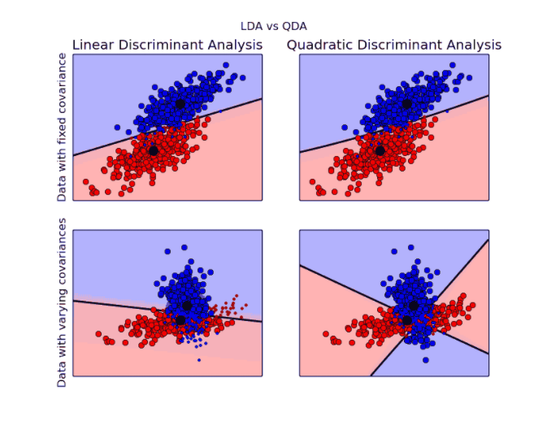
QDA
no difference in LDA and QDA classification results
Under different covariance matrices, the classification boundaries of LDA and QDA are obviously different, and LDA can no longer accurately classify data
Notes:
Similar to linear discriminant analysis, quadratic discriminant analysis is another linear discriminant analysis algorithm. They have similar algorithm characteristics. The only difference is that linear discriminant analysis is used when the covariance matrix of different categories of samples is the same.When the covariance matrices of samples of different classifications are different, the quadratic criterion should be used.
In order to clearly understand the difference between LDA and QDA, the following figure shows the difference of LDA and QDA performance under fixed covariance matrix and different covariance matrix:
It can be seen from the figure that under the fixed covariance matrix, there is no difference in LDA and QDA classification results (the two figures above). However, under different covariance matrices, the classification boundaries of LDA and QDA are obviously different, and LDA has been unable to accurately classify data (the following two figures).
So, what is the covariance matrix?

Slide 30
QDA
Covariance is defined as the covariance of any two random variables X and Y, denoted as Cov(X,Y), and mathematically defined as:
Cov(X,Y)=E{[ X–E(X)][Y-E(Y) ]}
As X gets larger and larger,Y gets larger and larger, and then Cov(X,Y) > 0;
As X goes down,Y goes down, so does Cov(X,Y) > 0;
As the value of X increases, the value of Y decreases, and then Cov(X,Y) < 0;
As X goes down,Y goes up, and Cov(X,Y) < 0.
Notes:
In statistics, there are several basic indicators to describe sample distribution, such as mean value, variance, standard deviation, kurtosis, skewness, maximum, minimum, extreme, etc., all of which describe a dimension.If there are multiple dimensions in a sample, how can the relationship between different dimensions be described besides the distribution rule of each dimension separately?
Covariance is an indicator used to describe the relationship between dimensions.It is defined as: the covariance of any two random variables X and Y, denoted as Cov(X,Y), and defined as:
Cov (X, Y) = {E [X - E (X)] [Y - E (Y)]}, Where E(X) E(Y) reflects the mean values of the components X and Y and it reflects the relationship between any two random variables (or any two dimensions).
Summarize the laws between the X and Y is that when two random variables tend to be along the same trend of covariance, the opposite is negative covariance but we know that the different dimensions may be due to the scale of value itself exists differences between the deviation of the results caused, such as the unit of the order amount is probably ten thousand yuan range, while the user level may be less than 10 in order to eliminate the difference of the distribution of digital need to standardization of covariance, and the index of standardized the correlation coefficient (usually expressed in P), its matrix is called a correlation matrix.
The basic meaning of relevant system P is as follows:
When P > 0, X and Y are positively correlated
When P < 0, X and Y are negatively correlated
So what happens when P is equal to 0?Does that mean irrelevant?-- When P is equal to 0, it means that there is no linear correlation between X and Y, but there may be other correlations.

