Slide 1
Decision Tree Random Forest AdaBoost(adaptive Boosting) Gaussian Naive Bayes KNN(K Nearest Neighbour) MLP(Multi-Layer Perceptron) QDA(Quadratic Discriminant Analysis)

Slide 2
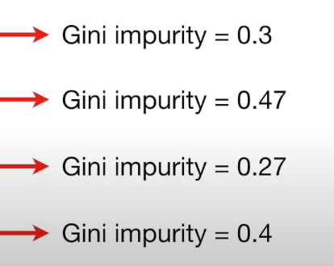
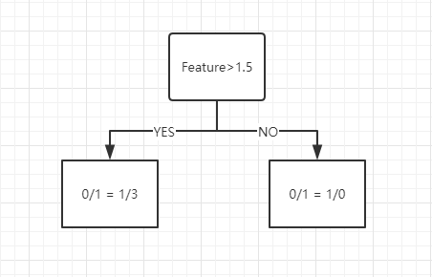
Decision Tree
Feature 1 | Label
1 | 0
2 | 1
3 | 0
4 | 1
5 | 1
Steps:
1. Arrange the value of feature from small to large;
2. Calculate the average value of each two values of the feature;
3. Calculate the Gini impurity score for each mean
(Gini impurity = 1 - (the probability of “0”) - (the probability of “1”) );
4. The minimum value of Gini impurity score of mean is taken as the value of this feature.
(1+2)/2=1.5
(2+3)/2=2.5
(3+4)/2=3.5
(4+5)/2=4.5
Total Gini(Feature1) = 4/(4+1) * 0.336 + 1/(1+4) * 0 = 0.3
...
Gini = 0.336
Gini = 0

Slide 3
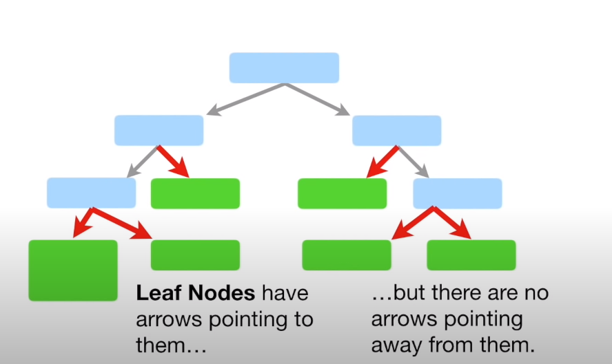
Decision Tree
If Gini(feature 1) < Gini(feature n), feature 1 will be the Root Node. Other features use the same way to become defferent Internal Nodes with different layers.
Finally, Leaves will be the end point.
Feature1 | ... | Feature n | Label
1 | ... | 6 | 0
2 | ... | 7 | 1
3 | ... | 8 | 0
4 | ... | 9 | 1
5 | ... | 5 | 1
Root Node
Internal Nodes

Slide 4

Random Forest
Feature1 | ... | Feature n | Label
1 | ... | 6 | 0
2 | ... | 7 | 1
3 | ... | 8 | 0
4 | ... | 9 | 1
5 | ... | 5 | 1
Feature1 | ... | Feature n | Label
2 | ... | 7 | 1
2 | ... | 7 | 1
3 | ... | 8 | 0
1 | ... | 6 | 0
5 | ... | 5 | 1

Slide 5
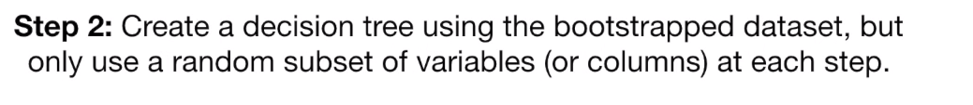
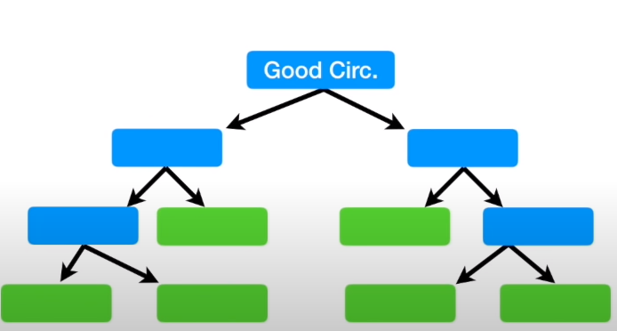
Random Forest
Feature1 | ... | Feature n | Label
2 | ... | 7 | 1
2 | ... | 7 | 1
3 | ... | 8 | 0
1 | ... | 6 | 0
5 | ... | 5 | 1
Feature n

Slide 6
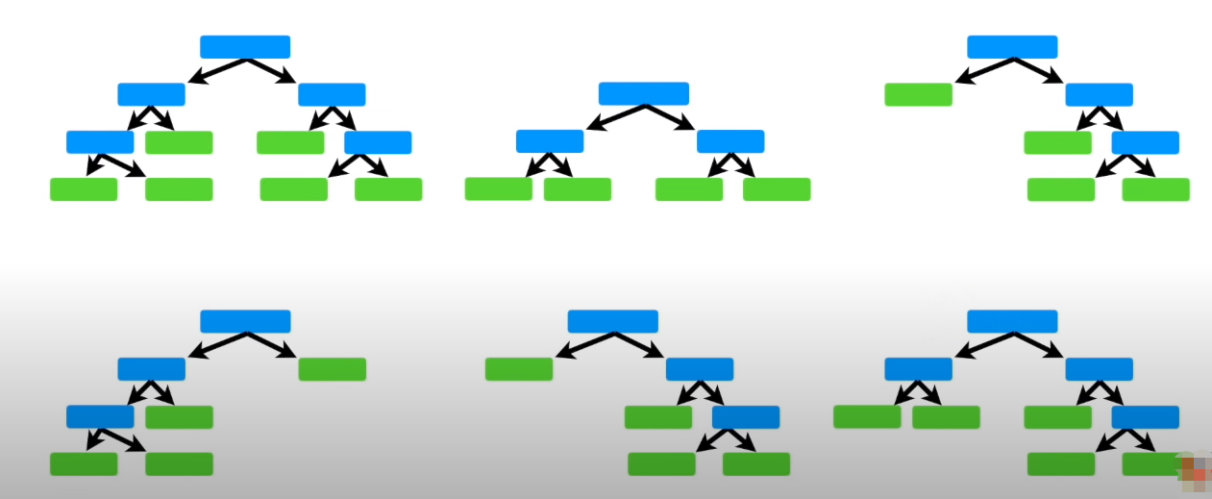
Random Forest
Step3 Use the random forest
Feature 3
Feature 1
Feature 2
Feature 4
Feature 5
...
Feature n

Slide 7
Random Forest
Normal or Attack(0/1)
N | M
If N < M, it is a attack;
If N > M, it is normal.

Slide 8
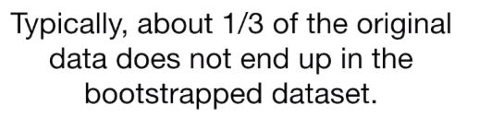
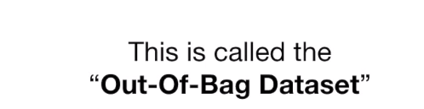
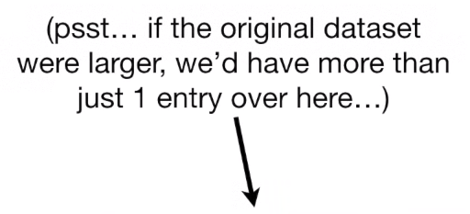
Random Forest
Step 4: They will beecome the test dataset to estimate the forest.
Feature1 | ... | Feature n | Label

Slide 9
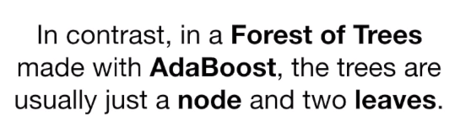
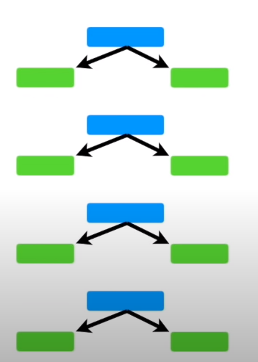
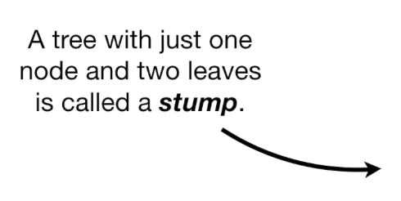
AdaBoost

Slide 10
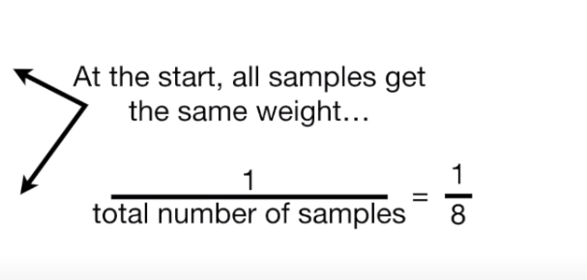
AdaBoost
Feature1 | ... | Feature n | Label | WEIGHT
1 | ... | 6 | 0 | 1/5
2 | ... | 7 | 1 | 1/5
3 | ... | 8 | 0 | 1/5
4 | ... | 9 | 1 | 1/5
5 | ... | 5 | 1 | 1/5
1/5

Slide 11
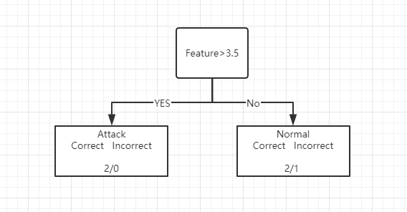
AdaBoost
Feature1 | ... | Feature n | Label | WEIGHT(TOTAL ERROR)
1 | ... | 6 | 0 | 1/5
2 | ... | 7 | 1 | 1/5
3 | ... | 8 | 0 | 1/5
4 | ... | 9 | 1 | 1/5
5 | ... | 5 | 1 | 1/5
Gini = 0
Gini = 0.444
Gini impurity = 1 - (the probability of correct) - (the probability of incorrect)
Total Gini(Feature1) = 2/(4+1) * 0 + 3/(1+4) * 0.444 = 0.333
...

Slide 12
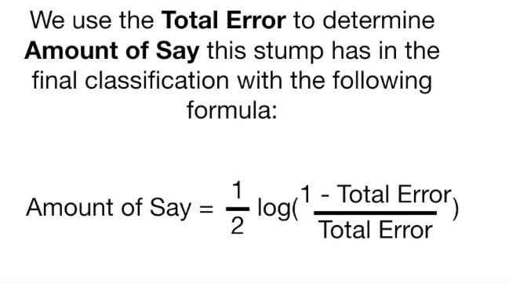
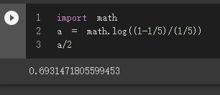
AdaBoost
Amount of Say(Feature1) = 1/2 * log[(1-1/5)/(1/5)] = 0.693
...
Amount of Say(Feature n) = 1/2 * log[(1-Total Error/Total Error]

Slide 13
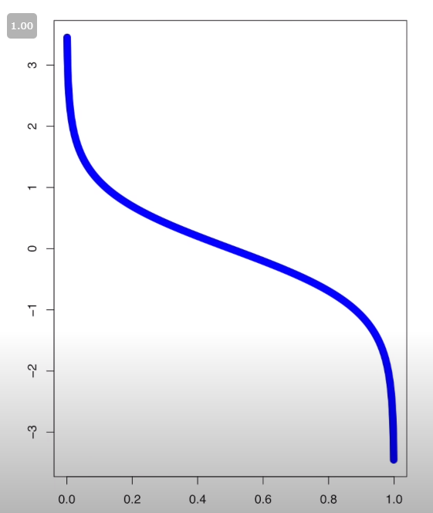
AdaBoost
Amount of Say
The Blue Line tells the Amount of Say for Total Error values between 0 and 1.
(Weight) total Error

Slide 14
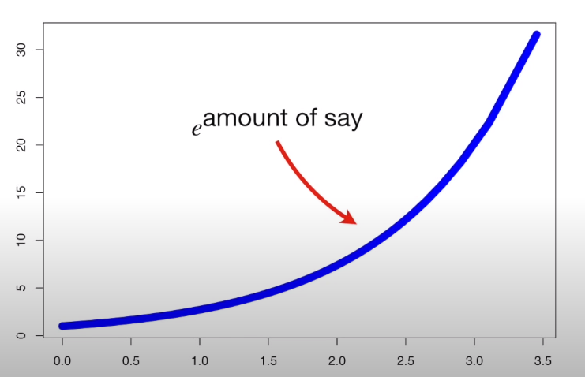
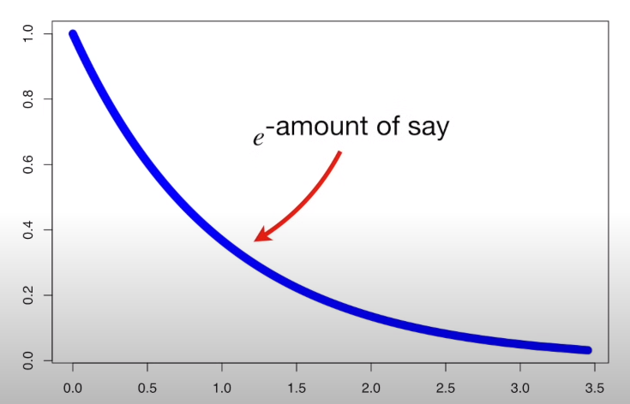

AdaBoost
Increasing the weight of bad sample:
New Sample Weight = old sample weight *
Decreasing the weight of good sample:

Slide 15
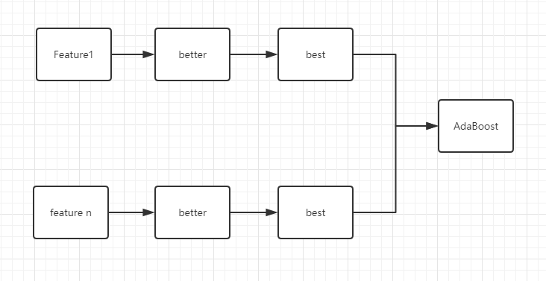
AdaBoost
.
.
.
......

Slide 16
Gaussian Naive Bayes
1.The algorithm is used to adjust the value of feature, and its numerical distribution is fitted to the normal distribution.(The normal distribution curve is determined by the mean value and standard deviation of feature);
2.In the test set, reference tag values make independent assumptions.The probability of independent events is calculated according to the following formula. The large probability value is the output.

Slide 17
Gaussian Naive Bayes
Feature 1 | ... | Feature n | Label
1 | ... | 6 | 0
3 | ... | 8 | 0
Feature1 | ... | Feature n | Label
1 | ... | 6 | 0
2 | ... | 7 | 1
3 | ... | 8 | 0
4 | ... | 9 | 1
5 | ... | 5 | 1
→
Feature 1 | ... | Feature n | Label
2 | ... | 7 | 1
4 | ... | 9 | 1
5 | ... | 5 | 1

Slide 18
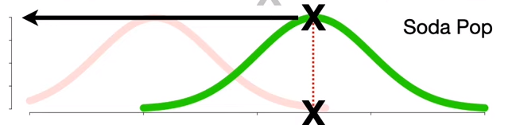
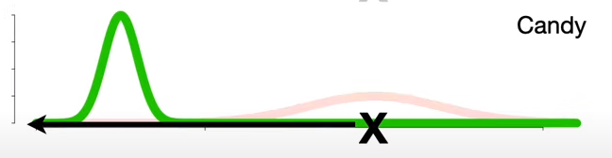
Gaussian Naive Bayes
Feature 1
Feature n
Attack/Label = 1
P(attack)*P(F1|attack)*...*P(Fn|attack)
......
Feature n
Not Attack/Label = 0
Feature 1
P( not attack)*P(F1|not attack)*...*P(Fn|not attack)

Slide 19
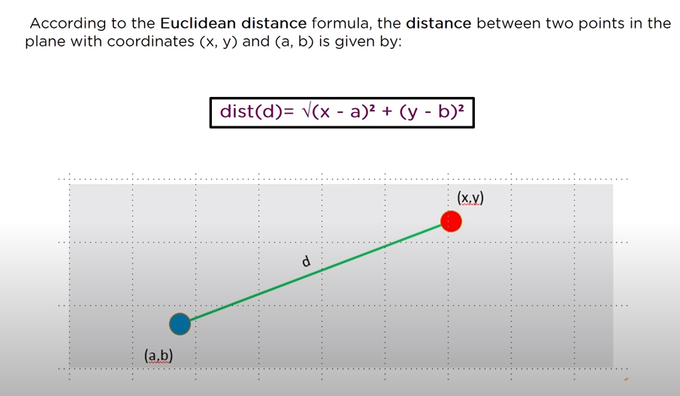
K Nearest Neighbour
Feature1 | ... | Feature n | Label
1 | ... | 6 | 0
2 | ... | 7 | 1
3 | ... | 8 | 0
4 | ... | 9 | 1
5 | ... | 5 | 1

Slide 20
K Nearest Neighbour
eg. There is uncatagory class:
(Feature 1, Feature n) (4,3);
dist1 =
= 18
dist 2 = 20
dist 3 = 26
dist 4 = 36
dist 5 = 5

Slide 21
K Nearest Neighbour
K means how many nearest neighbor.
If K = 3 in here, Look at the table: There are three samples with labs selected:(0,1,1). By voting, the label of this group of unknown samples is 1.
Feature1 | ... | Feature n | Label | Edclidean Distance
1 | ... | 6 | 0 | 18
2 | ... | 7 | 1 | 20
3 | ... | 8 | 0 | 26
4 | ... | 9 | 1 | 36
5 | ... | 5 | 1 | 5
Label : (0,1,1)

Slide 22
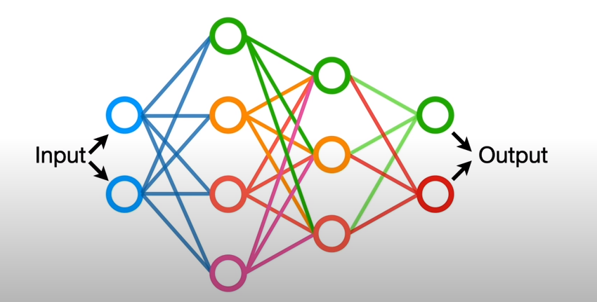
MLP
MLP is a type of artificial neural network.
Artificial neural networks (ANN) are a method of machine learning inspired by the way the human brain works.
The purpose of this method is to mimic the characteristics of the human brain, such as learning, decision-making and acquiring new information.

Slide 23
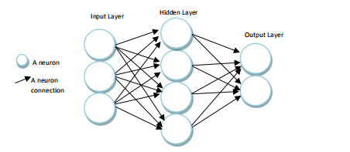
MLP
The input layer is the stage where the MLP is responsible for receiving data.No information processing is performed at this level.Only the information received is transmitted to the next layer, the hidden layer.
In the hidden layer, the data sent from the input layer is processed and transmitted to the next layer, the output layer.
In the output layer, which is the last layer, each cell is tied to all the cells in the hidden layer, and the results of the processed data in the hidden layer are served at this stage.

Slide 24
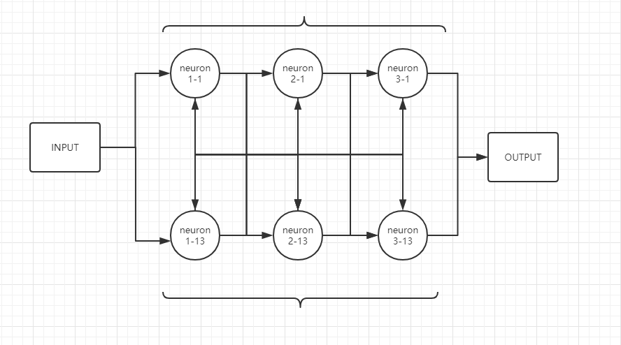
MLP
.
.
.
.
.
.
.
.
.

Slide 25
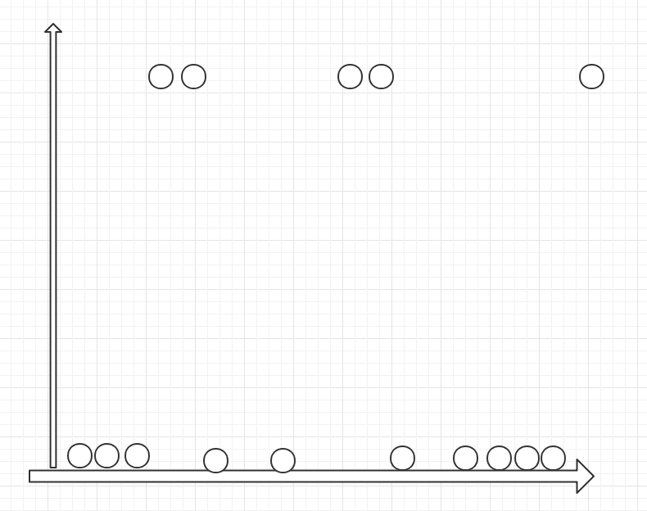
MLP
1
0
Feature

Slide 26

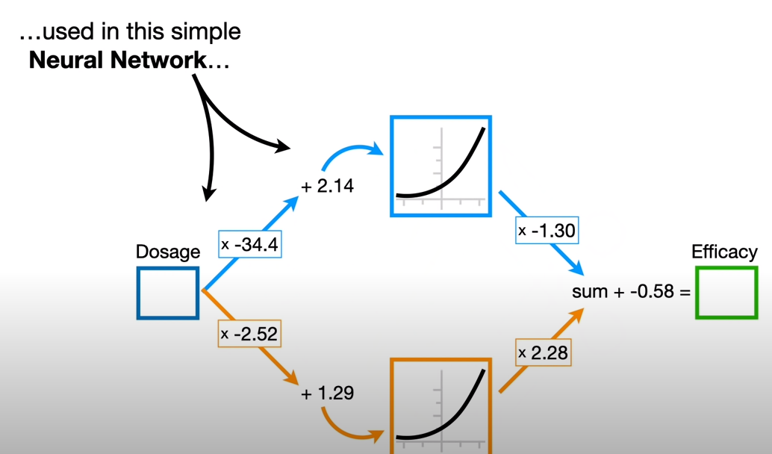
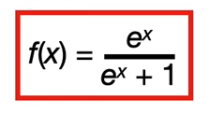
MLP
单击此处添加正文
Feature1 to n
Come from fitting

Slide 27
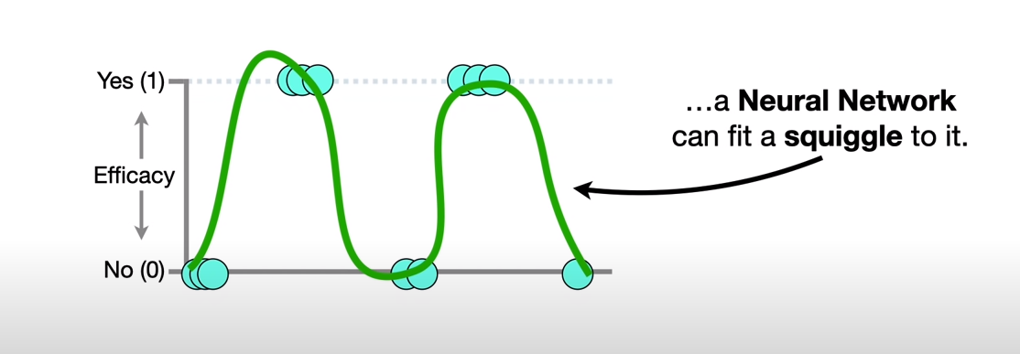
MLP
Feature 1 to Feature n

Slide 28
QDA
Quadratic discriminant analysis (QDA) is a discriminant analysis method.
Discriminant analysis is a statistical technique for assigning one measure to a group of many species.
When this assignment is made, the observed data must be assigned to the group to which it belongs.If it is assigned to a group that does not belong to it, an error occurs.This error is called the "error rate."
The purpose of discriminant analysis is to minimize the error rate of the distribution process.
This analysis is called a linear discriminant analysis, assuming that the data sets are normally distributed and have equal variances.
If the assumption that the group variances are equal is incorrect, a quadratic discriminant analysis is obtained.In order to apply the quadratic discriminant analysis, the number of observed samples must be greater than the number of groups.

Slide 29
LDA
Feature n
Feature 1

Slide 30
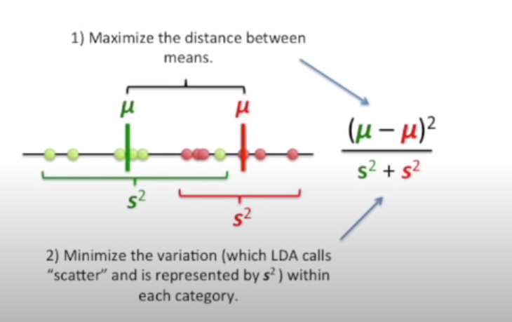
LDA
单击此处添加正文

Slide 31
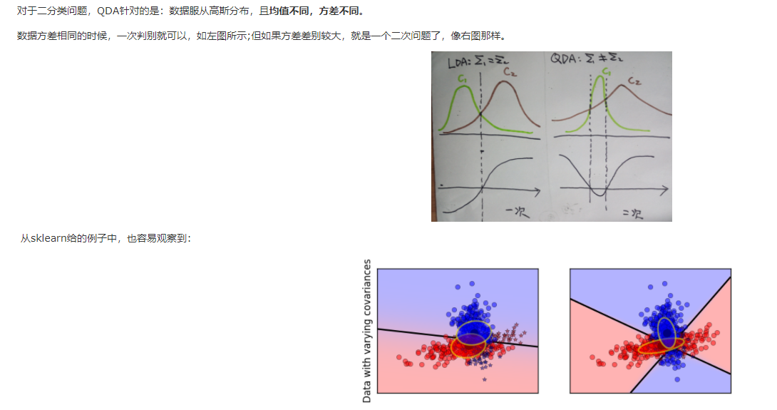
QDA

Slide 32
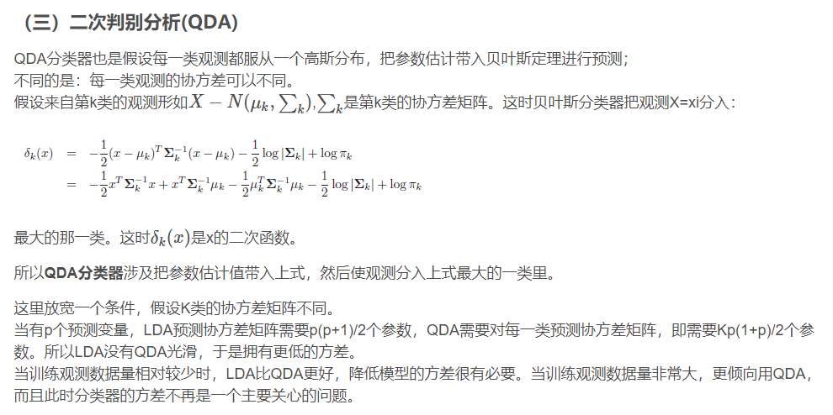
QDA

