Slide 1
Dspace two zone vav system tuning
2021-11-30

Slide 2
Issues
dSpace cannot output desired voltage when connected with ALC controllers
Method
Rewired all the connections and redo tests

Slide 3
Test 1: Constant Source from Simulink
Open loop: dSpace disconnect with ALC
Constant Source
Slot | Board | Channel | ALC | Model | dSpace (V) | Model | dSpace (V)
16 | DS6241 | 4 | N | 4 | 4 | 7 | 7
 |  | 5 | N | 4 | 4 | 7 | 7
 |  | 6 | N | 4 | 4 | 7 | 7
 |  | 7 | N | 4 | 4 | 7 | 7
 |  | 8 | N | 4 | 4 | 7 | 7
 |  | 9 | N | 4 | 4 | 7 | 7
 |  | 16 | N | 4 | 4 | 7 | 7
 |  | 17 | N | 4 | 4 | 7 | 7
Work correctly !

Slide 4
Test 1: Constant Source from Simulink
Closed loop: dSpace connect with ALC
Constant Source
Slot | Board | Channel | ALC | Model | dSpace (V) | Model | dSpace (V) | Model | dSpace (V) | Model | dSpace (V) | Model | dSpace (V) | Model | dSpace (V)
16 | DS6241 | 4 | Y | 4 | 2.537 | 7 | 2.538 | 2 | 1.998 | 2.5 | 2.497
 |  | 5 | Y | 4 | 2.628 | 7 | 2.627 | 2 | 1.998 | 2.5 | 2.498
 |  | 6 | Y | 4 | 2.625 | 7 | 2.622 | 2 | 1.997 | 2.5 | 2.498
 |  | 7 | Y | 4 | 2.538 | 7 | 2.539 | 2 | 1.996 | 2.5 | 2.498
 |  | 8 | Y | 4 | 2.621 | 7 | 2.622 | 2 | 1.998 | 2.5 | 2.498
 |  | 9 | Y | 4 | 2.624 | 7 | 2.624 | 2 | 1.997 | 2.5 | 2.498
 |  | 16 | Y | 4 | 3.997 | 7 | 6.99 | 2 | 1.998 | 8.5 | 8.5 | 9 | 8.78 | 10 | 8.78
 |  | 17 | Y | 4 | 3.997 | 7 | 6.99 | 2 | 1.997 | 8.5 | 8.49 | 9 | 8.78 | 10 | 8.78
1. Each channel has a maximum voltage that is less than the specified maximum voltage in ALC Controller:
(1). For channel 4-9, which are connected to a 0-5V AI input in the zone controller, the maximum voltage dSpace can output is around 2.5 V instead of 5 V
(2). For channel 16-17, which are connected to a 0-10V AI input in the chiller controller, the maximum voltage dSpace can output is around 8.5 V instead of 10 V
2. The maximum voltage obtained for each channel in today’s test (2.5V/8.5V) is different from that in yesterday’s test (1.8V).

Slide 5
Test 2: Weather Data
The tested hour has a Tout and Rhout, less than 8.5V. Therefore, it should be correctly outputted by dSpace and received by ALC controller.
Weather File
Slot | Board | Channel | ALC | Model | dSpace (V)
16 | DS6241 | 16 | Y | 6.42 | 6.42
 |  | 17 | Y | 6.58 | 6.58
Work correctly!

Slide 6
Test 3: Remap the voltage based on the obtained maximum voltage for each channel
Remap model outputs and voltage relationship to perform linear interpretation:
0-5V AI input of zone controller ←→ 0-2.5V outputs from Modelica/dSpace
0-10V AI input of chiller controller ←→ 0-5V outputs from Modelica/dSpace

Slide 7
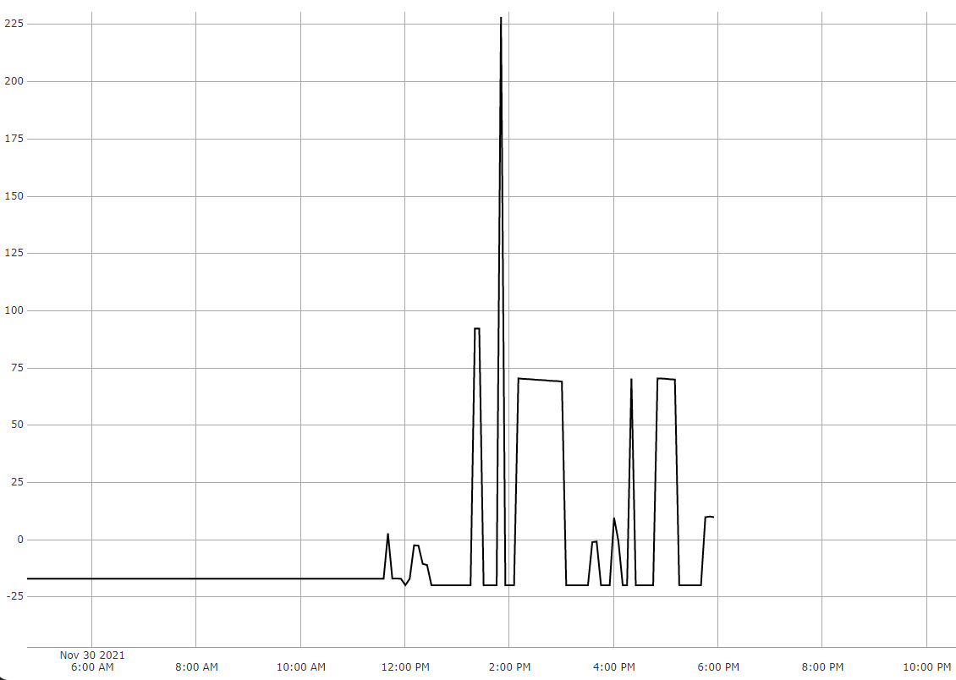
Test 3: Trending Results – 2021-11-30
Weather Only: test only weather file in Modelica – correct
Weather + one zone: test one vav zone with weather file – correct
Weather + two zone: test two vav zones with weather file – not working !!!
The voltage for Tout should be around 3.3 V, but I can only get 1.06V
The model complexity has influence on hardware?? - unreasonable
Weather+ one zone
TOut
Weather only
Weather+ two zone

Slide 8
Some thoughts and todos
ALC controller (Different AI type) has an influence on the dSpace maximum voltage output
Summarizing and reaching out to Chirag
Wiring has influence on the maximum voltage as well?
Different maximum voltage from today and yesterday
How to confirm?

