Slide 1
Introduction to an Equation-based Object-oriented Modeling Language: Modelica
Yangyang Fu, PhD
Texas A&M University
8/30/2021

Slide 2
Agenda
A Simple Differential Algebraic Equation (DAE)
Modelica/Dymola
Introduction to Modelica by Examples
Your First Modelica Model
Revisit Some Modelica Basics

Slide 3



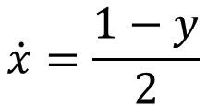
A Simple DAE
Arrange to
ODE
Take the arranged format
$$2\dot{x}=1−y$$
$$y=\sqrt{x^{2}−1}$$
% call matlab ode solver to solve
tspan = [0, 10];
x0 = 1;
[t,x] = ode45(@SimpleDAE, tspan, x0);
% define DAE system in terms of ODE format
function dx=SimpleDAE(t, x)
y = sqrt(x^2-1);
dx = (1- y)/2;
end
$$x^{2}−y^{2}=1$$
$$\dot{x}=\frac{1−y}{2}$$
model SimpleDAE
Real x(start=1);
Real y;
equation
2*der(x) = 1 - y;
x^2 - y^2 = 1;
annotation (experiment(
StartTime=0,
StopTime=10,
__Dymola_Algorithm="Dassl”
));
end SimpleDAE;
Take the format AS IT IS
Modelica Implementation
Matlab Implementation

Slide 4
Modelica
What is Modelica?
How to Build a Modelica Model

Slide 5
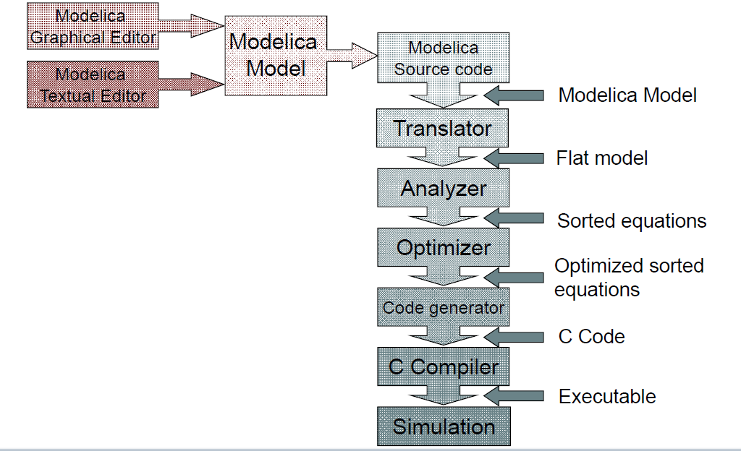
Modelica Modeling and Simulation Procedure
Modeling
Compilation
Simulation

Slide 6
Dymola
Dymola is a commercial tools for performing Modelica modeling and simulation
Some others:
OpenModelica – opensource
jModelica – opensource/commercial
Simulation X
MapleSim
…

Slide 7
Dymola Interfaces
Run a “helloworld” example
Tour Dymola

Slide 8
Introduction to Modelica by Examples
Modeling with Modelica
An Electrical System Example
A Mechanical System Example
A Thermal System Example

Slide 9
Modeling with Modelica
Flat and hierarchical models
data types, attributes, components, interface-variables, package concept, inheritance
Special model classes
constraints on variables and parameters
input, output, final, protected
equation vs algorithm
class types in Modelica
type, connector, model, block, function, package
Matrices, arrays and arrays of components
definition, index sets, for-in-loop, array functions
Physical fields
global variables
Hybrid modeling
events, if-then-else, when-statement

Slide 10
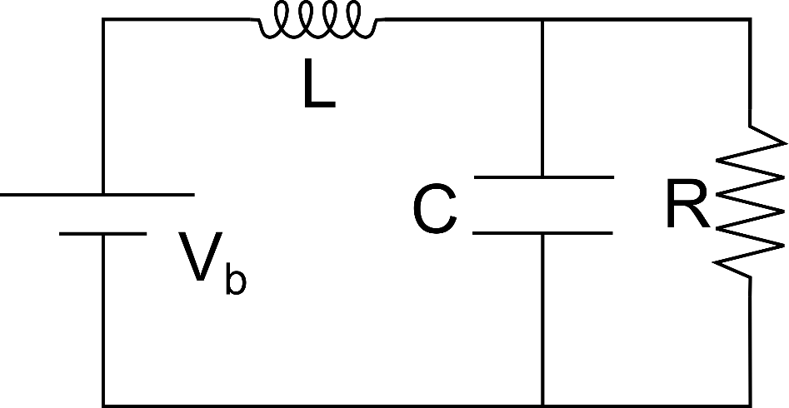




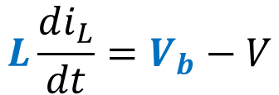
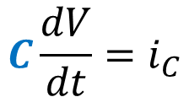
An Electrical Example
$$V=i_{R}R$$
Knowns:
Mathematical Representation
$$C\frac{dV}{dt}=i_{C}$$
$$R, C, L, V_{b}$$
V?
Unknowns:
$$L\frac{di_{L}}{dt}=V_{b}−V$$
$$V, i_{R}, i_{C}, i_{L}$$
$$i_{L}=i_{R}+i_{C}$$
Low-Pass RLC Filter
4 unknowns with 4 equations

Slide 11
A Straight-forward Way – Flat Model
model RLC1 "A low-pass RLC filter example using text editor"
type Voltage=Real(unit="V");
type Current=Real(unit="A");
type Resistance=Real(unit="Ohm");
type Capacitance=Real(unit="F");
type Inductance=Real(unit="H");
parameter Voltage Vb=24 "Battery voltage";
parameter Inductance L = 1;
parameter Resistance R = 100;
parameter Capacitance C = 1e-3;
Voltage V;
Current i_L;
Current i_R;
Current i_C;
equation
V = i_R*R;
C*der(V) = i_C;
L*der(i_L) = (Vb-V);
i_L=i_R+i_C;
annotation (experiment(StartTime=0,
StopTime=2,
__Dymola_Algorithm="Dassl"));
end RLC1;
Define a model RLC1 and provide descriptive documentation

Slide 12
A Straight-forward Way – Flat Model
model RLC1 "A low-pass RLC filter example using text editor"
type Voltage=Real(unit="V");
type Current=Real(unit="A");
type Resistance=Real(unit="Ohm");
type Capacitance=Real(unit="F");
type Inductance=Real(unit="H");
parameter Voltage Vb=24 "Battery voltage";
parameter Inductance L = 1;
parameter Resistance R = 100;
parameter Capacitance C = 1e-3;
Voltage V;
Current i_L;
Current i_R;
Current i_C;
equation
V = i_R*R;
C*der(V) = i_C;
L*der(i_L) = (Vb-V);
i_L=i_R+i_C;
annotation (experiment(StartTime=0,
StopTime=2,
__Dymola_Algorithm="Dassl"));
end RLC1;
Define different unit classes by using type

Slide 13
A Straight-forward Way – Flat Model
model RLC1 "A low-pass RLC filter example using text editor"
type Voltage=Real(unit="V");
type Current=Real(unit="A");
type Resistance=Real(unit="Ohm");
type Capacitance=Real(unit="F");
type Inductance=Real(unit="H");
parameter Voltage Vb=24 "Battery voltage";
parameter Inductance L = 1;
parameter Resistance R = 100;
parameter Capacitance C = 1e-3;
Voltage V;
Current i_L;
Current i_R;
Current i_C;
equation
V = i_R*R;
C*der(V) = i_C;
L*der(i_L) = (Vb-V);
i_L=i_R+i_C;
annotation (experiment(StartTime=0,
StopTime=2,
__Dymola_Algorithm="Dassl"));
end RLC1;
Define model parameters (usually represent physical sizes etc)
Parameter is changeable before simulation, but is not changeable during simulation
Modelica Declaration
parameter Voltage Vb=24 "Battery voltage";
prefix
class
instance
descriptive doc (optional)

Slide 14
A Straight-forward Way – Flat Model
model RLC1 "A low-pass RLC filter example using text editor"
type Voltage=Real(unit="V");
type Current=Real(unit="A");
type Resistance=Real(unit="Ohm");
type Capacitance=Real(unit="F");
type Inductance=Real(unit="H");
parameter Voltage Vb=24 "Battery voltage";
parameter Inductance L = 1;
parameter Resistance R = 100;
parameter Capacitance C = 1e-3;
Voltage V;
Current i_L;
Current i_R;
Current i_C;
equation
V = i_R*R;
C*der(V) = i_C;
L*der(i_L) = (Vb-V);
i_L=i_R+i_C;
annotation (experiment(StartTime=0,
StopTime=2,
__Dymola_Algorithm="Dassl"));
end RLC1;
Define model variables representing unknowns.
Variable is changeable during simulation, and dependent on other variables or parameters.

Slide 15
A Straight-forward Way – Flat Model
model RLC1 "A low-pass RLC filter example using text editor"
type Voltage=Real(unit="V");
type Current=Real(unit="A");
type Resistance=Real(unit="Ohm");
type Capacitance=Real(unit="F");
type Inductance=Real(unit="H");
parameter Voltage Vb=24 "Battery voltage";
parameter Inductance L = 1;
parameter Resistance R = 100;
parameter Capacitance C = 1e-3;
Voltage V;
Current i_L;
Current i_R;
Current i_C;
equation
V = i_R*R;
C*der(V) = i_C;
L*der(i_L) = (Vb-V);
i_L=i_R+i_C;
annotation (experiment(StartTime=0,
StopTime=2,
__Dymola_Algorithm="Dassl"));
end RLC1;
Resistor
Capacitor
Define model equations based on physical laws.
Inductor
Current Law

Slide 16
A Straight-forward Way – Flat Model
model RLC1 "A low-pass RLC filter example using text editor"
type Voltage=Real(unit="V");
type Current=Real(unit="A");
type Resistance=Real(unit="Ohm");
type Capacitance=Real(unit="F");
type Inductance=Real(unit="H");
parameter Voltage Vb=24 "Battery voltage";
parameter Inductance L = 1;
parameter Resistance R = 100;
parameter Capacitance C = 1e-3;
Voltage V;
Current i_L;
Current i_R;
Current i_C;
equation
V = i_R*R;
C*der(V) = i_C;
L*der(i_L) = (Vb-V);
i_L=i_R+i_C;
annotation (experiment(StartTime=0,
StopTime=2,
__Dymola_Algorithm="Dassl"));
end RLC1;
Define others, e.g., experiment setup

Slide 17
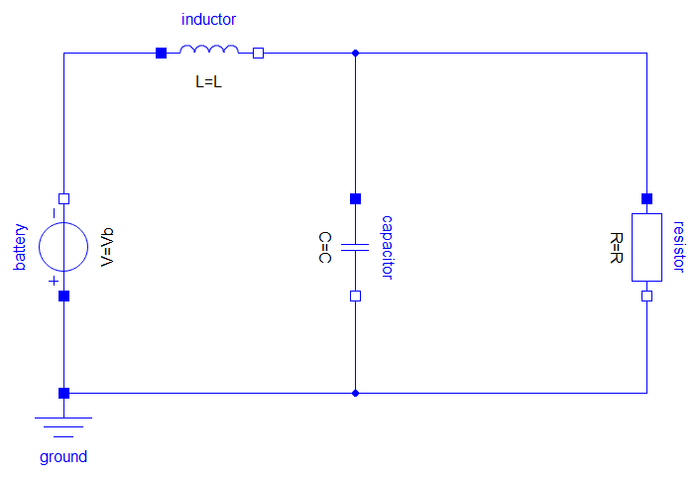
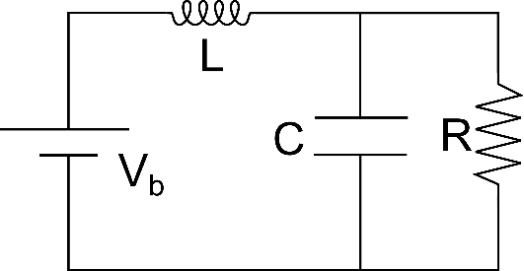
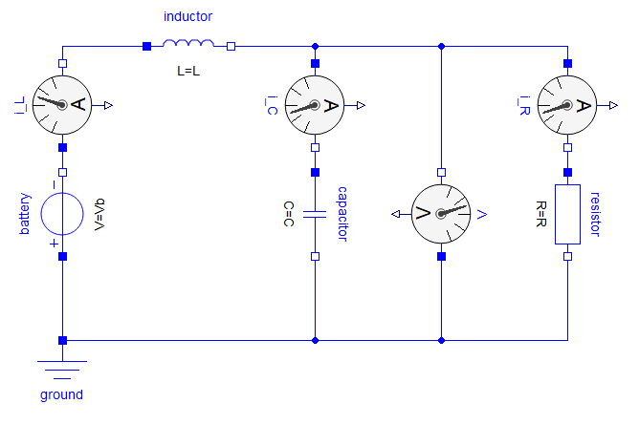
A “Modelica” Way – Hierarchical Model
model RLC2 "A low pass RLC filter using graphical editor"
parameter Modelica.SIunits.Inductance L=1;
parameter Modelica.SIunits.Resistance R=100;
parameter Modelica.SIunits.Voltage Vb=24 “Battery voltage";
parameter Modelica.SIunits.Capacitance C=1e-03
Modelica.Electrical.Analog.Basic.Inductor inductor(L=L);
Modelica.Electrical.Analog.Basic.Resistor resistor(R=R);
Modelica.Electrical.Analog.Basic.Capacitor capacitor(C=C);
Modelica.Electrical.Analog.Sources.ConstantVoltage battery(V=Vb);
Modelica.Electrical.Analog.Basic.Ground ground;
equation
connect(resistor.n, battery.p);
connect(capacitor.n, battery.p);
connect(battery.p, ground.p);
connect(battery.n, inductor.p);
connect(capacitor.p, inductor.n);
connect(inductor.n, resistor.p);
annotation (experiment(StartTime=0,
StopTime=2,
__Dymola_Algorithm="Dassl"));
end RLC2;
Direct Representation
Source Code
RLC2
Direct Representation with Virtual Sensors
RLC2WithSensors

Slide 18
Source Code Comparison
model RLC1
type Voltage=Real(unit="V");
type Current=Real(unit="A");
type Resistance=Real(unit="Ohm");
type Capacitance=Real(unit="F");
type Inductance=Real(unit="H");
parameter Voltage Vb=24 "Battery voltage";
parameter Inductance L=1;
parameter Resistance R=100;
parameter Capacitance C=1e-3;
Voltage V;
Current i_L;
Current i_R;
Current i_C;
equation
L*der(i_L) = (Vb-V);
V = i_R*R;
C*der(V) = i_C;
i_L=i_R+i_C;
annotation (experiment(StartTime=0,
StopTime=2,
__Dymola_Algorithm="Dassl"));
end RLC1;
model RLC2
parameter Modelica.SIunits.Voltage Vb=24 “Battery voltage";
parameter Modelica.SIunits.Inductance L=1;
parameter Modelica.SIunits.Resistance R=100;
parameter Modelica.SIunits.Capacitance C=1e-03
Modelica.Electrical.Analog.Basic.Inductor inductor(L=L);
Modelica.Electrical.Analog.Basic.Resistor resistor(R=R);
Modelica.Electrical.Analog.Basic.Capacitor capacitor(C=C);
Modelica.Electrical.Analog.Sources.ConstantVoltage battery(V=Vb);
Modelica.Electrical.Analog.Basic.Ground ground;
equation
connect(resistor.n, battery.p);
connect(capacitor.n, battery.p);
connect(battery.p, ground.p);
connect(battery.n, inductor.p);
connect(capacitor.p, inductor.n);
connect(inductor.n, resistor.p);
annotation (experiment(StartTime=0,
StopTime=2,
__Dymola_Algorithm="Dassl"));
end RLC2;

Slide 19
Questions
Plot and compare V from RLC1 and RLC2?
Plot V from RLC1 after simulation
Plot V.v from RLC2WithSensors after simulation
Difference between flat modeling and hierarchical modeling?
Flat modeling requires mathematical representation – difficult for complex system
Hierarchical modeling requires physical representation – easy for complex system
How does the keyword “connect” formulate the equations?
Acausal connections – connector
Causal connections – signal

Slide 20
Component Model
acausal connector
acausal connection
Component 1
Component 2
causal connector
causal connection
A component class should be defined independently of the environment, very essential for reusability
A component may internally consist of other components, i.e. hierarchical modeling
Complex systems usually consist of large numbers of connected components

Slide 21











Acausal Connection – Acausal Connector
Electrical
Two kinds of variables in acausal connectors
R3
Potential variable: Connected variables are identical;
Flow variable: connected variables fulfil the zero-sum equation
$$v_{3}$$
$$p$$
$$i_{3}$$
$$v_{1}$$
$$v_{2}$$
connector class
$$p$$
$$p$$
R2
instance name of connector class
R1
potential variable class name
$$i_{1}$$
$$i_{2}$$
connector Pin
SI.ElectricPotential v;
flow SI.Current i;
end Pin;
Pin pin;
v
+
pin
$$v_{1}=v_{2}=v_{3}$$
i
flow variable class name
$$i_{1}+i_{2}+i_{3}=0$$
an instance pin of class Pin

Slide 22






Acausal Connection – Acausal Connector
Electrical
connector Pin
SI.ElectricPotential v;
flow SI.Current i;
end Pin;
R3
$$v_{3}$$
$$p$$
$$i_{3}$$
$$v_{1}$$
$$v_{2}$$
$$p$$
$$p$$
R2
connect(R1.p,R2.p);
connect(R1.p,R3.p);
connect(R2.p,R3.p);
R1
$$i_{1}$$
$$i_{2}$$
$$R1.p.v=R2.p.v$$
$$v_{1}=v_{2}=v_{3}$$
$$R1.p.v=R3.p.v$$
$$i_{1}+i_{2}+i_{3}=0$$
$$R2.p.v=R3.p.v$$
$$R1.p.i+R2.p.v+R3.p.i=0$$

Slide 23
Other Acausal Connectors
Other physical acausal connector classes in Modelica Standard Library
Domain Type | Potential | Flow | Modelica Library
Electrical | Voltage | Current | Electrical.Analog
Translational | Position | Force | Mechanics.Translational
Rotational | Angle | Torque | Mechanics.Rotational
Magnetic | Magnetic potential | Magnetic flux | Magnetic.FluxTubes
Hydraulic | Pressure | Volume/mass flow | Fluid
Thermal | Temperature | Heat flow | Thermal.HeatTransfer
connector XXX
Potential variable_name;
flow Flow variable_name;
end XXX;

Slide 24
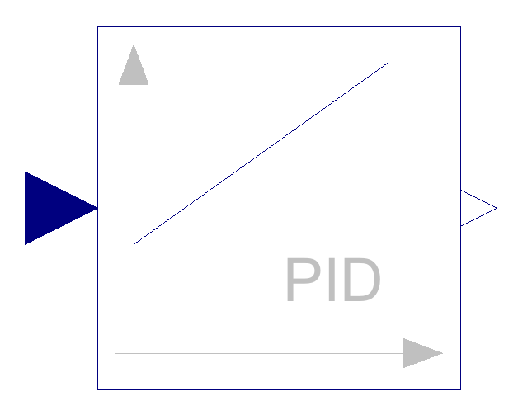
Causal Connection – Causal Connector
input signal: instance of InPort
connector InPort
input Real signal_name;
end InPort;
connector OutPort
output Real signal_name;
end OutPort;
fixed causality
output signal: instance of OutPort
PID Controller Class

Slide 25
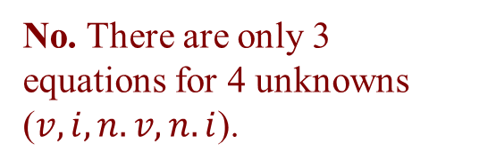

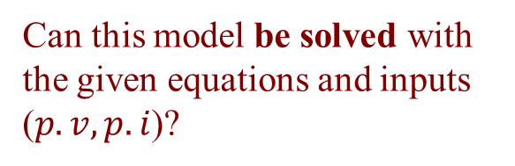




Common Component Structure
The base class TwoPin has two connectors p and n for positive and negative pins.
$$p.v$$
TwoPin
$$n.v$$
p
n
$$n.i$$
$$p.i$$
+
-
partial class (cannot be instantiated)
$$i, v$$
partial model TwoPin
SI.Voltage v ;
SI.Current i ;
Pin p ;
Pin n ;
equation
v = p.v - n.v;
0 = p.i + n.i;
i = p.i;
end TwoPin;
// TwoPin is the same as OnePort in
// Modelica.Electrical.Analog.Interfaces
connector Pin
SI.ElectricPotential v;
flow SI.Current i;
end Pin;
positive pin
negative pin
Can this model be solved with the given equations and inputs ($p.v, p.i$)?
No. There are only 3 equations for 4 unknowns ($v, i, n.v, n.i$).

Slide 26















Electrical Components
model Resistor “Ideal electrical resistor”
extends TwoPin;
parameter Real R “Resistance”;
equation
R*i = v;
end Resistor;
$$p.v$$
$$n.v$$
p
n
$$n.i$$
$$p.i$$
+
-
$$i,v$$
model Inductor “Ideal electrical inductor”
extends TwoPin;
parameter Real L “Inductance”;
equation
L*der(i) = v;
end Inductor;
$$p.v$$
$$n.v$$
p
n
$$n.i$$
$$p.i$$
+
-
$$i,v$$
model Capacitor “Ideal electrical capacitor”
extends TwoPin;
parameter Real C “Capacitance”;
equation
i = C*der(v);
end Capacitor;
$$p.v$$
$$n.v$$
p
n
$$n.i$$
$$p.i$$
+
-
$$i,v$$

Slide 27
Revisit RLC2
model RLC2 "A low pass RLC filter using graphical editor"
parameter Modelica.SIunits.Inductance L=1;
parameter Modelica.SIunits.Resistance R=100;
parameter Modelica.SIunits.Voltage Vb=24 “Battery voltage";
parameter Modelica.SIunits.Capacitance C=1e-03
Modelica.Electrical.Analog.Basic.Inductor inductor(L=L);
Modelica.Electrical.Analog.Basic.Resistor resistor(R=R);
Modelica.Electrical.Analog.Basic.Capacitor capacitor(C=C);
Modelica.Electrical.Analog.Sources.ConstantVoltage battery(V=Vb);
Modelica.Electrical.Analog.Basic.Ground ground;
equation
connect(resistor.n, battery.p);
connect(capacitor.n, battery.p);
connect(battery.p, ground.p);
connect(battery.n, inductor.p);
connect(capacitor.p, inductor.n);
connect(inductor.n, resistor.p);
annotation (experiment(StartTime=0,
StopTime=2,
__Dymola_Algorithm="Dassl"));
end RLC2;

Slide 28
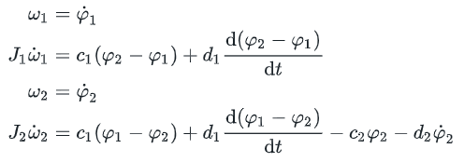

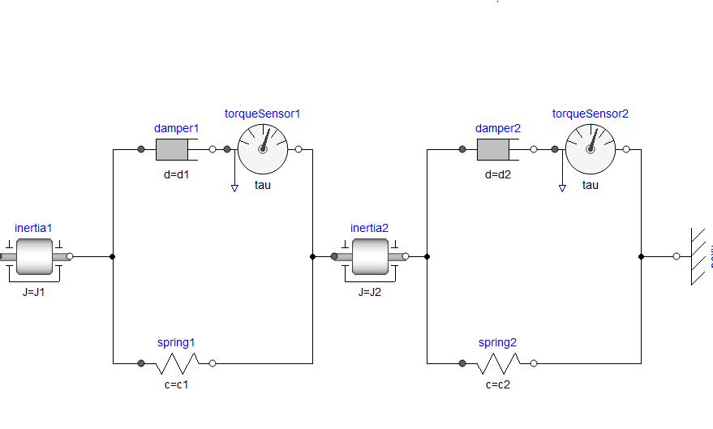
A Mechanical Example
model Example1
type Angle=Real(unit="rad");
type AngularVelocity=Real(unit="rad/s");
type Inertia=Real(unit="kg.m2");
type Stiffness=Real(unit="N.m/rad");
type Damping=Real(unit="N.m.s/rad");
parameter Inertia J1=0.4 "Moment of inertia for inertia 1";
parameter Inertia J2=1.0 "Moment of inertia for inertia 2";
parameter Stiffness c1=11 "Spring constant for spring 1";
parameter Stiffness c2=5 "Spring constant for spring 2";
parameter Damping d1=0.2 "Damping for damper 1";
parameter Damping d2=1.0 "Damping for damper 2";
Angle phi1 "Angle for inertia 1";
Angle phi2 "Angle for inertia 2";
AngularVelocity omega1 "Velocity of inertia 1";
AngularVelocity omega2 "Velocity of inertia 2";
initial equation
phi1 = 0;
phi2 = 1;
omega1 = 0;
omega2 = 0;
equation
// Equations for inertia 1
omega1 = der(phi1);
J1*der(omega1) = c1*(phi2-phi1)+d1*der(phi2-phi1);
// Equations for inertia 2
omega2 = der(phi2);
J2*der(omega2) = c1*(phi1-phi2)+d1*der(phi1-phi2)-c2*phi2-d2*der(phi2);
annotation (experiment(StopTime=5, __Dymola_Algorithm="Dassl"));
end Example1;
Initial Conditions:

Slide 29
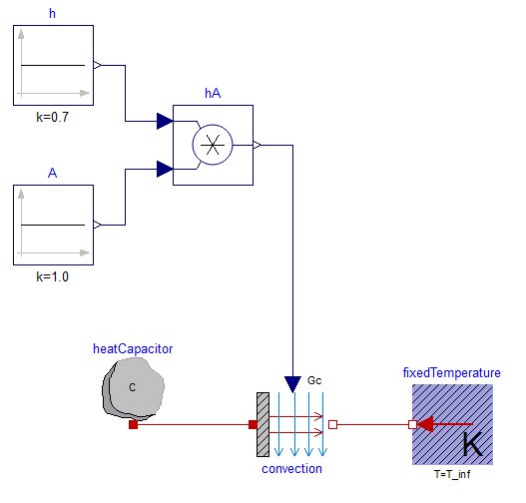

A Thermal Example
Newton Cooling:
$$mc_{p}\dot{T}=hA(T_{∝}−T)$$
Flat Math Model:
Hierarchical Physical Model:
model Example1
parameter Real T_inf=25 "Ambient temperature";
parameter Real T0=90 "Initial temperature";
parameter Real h=0.7 "Convective cooling coefficient";
parameter Real A=1.0 "Surface area";
parameter Real m=0.1 "Mass of thermal capacitance";
parameter Real c_p=1.2 "Specific heat";
Real T "Temperature";
initial equation
T = T0 "Specify initial value for T";
equation
m*c_p*der(T) = h*A*(T_inf-T)"Newton's law of cooling";
end Example1;

Slide 30
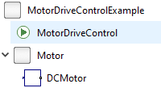
Your First Modelica Model
We want to control the rotational speed of an outgoing shaft at a given speed reference.
The studied system diagram is shown in the figure.
Proposed Steps
Step 0: Configure model/package structure
Step 1: Build a DC-motor model
Step 2: Build a DC-motor with mechanical rotational devices
Step 3: Build a closed-loop control for the motor-driven rotational system by regulating motor voltage
voltage
reference
Controller
Motor
Gearbox
Load
rotation speed

Slide 31
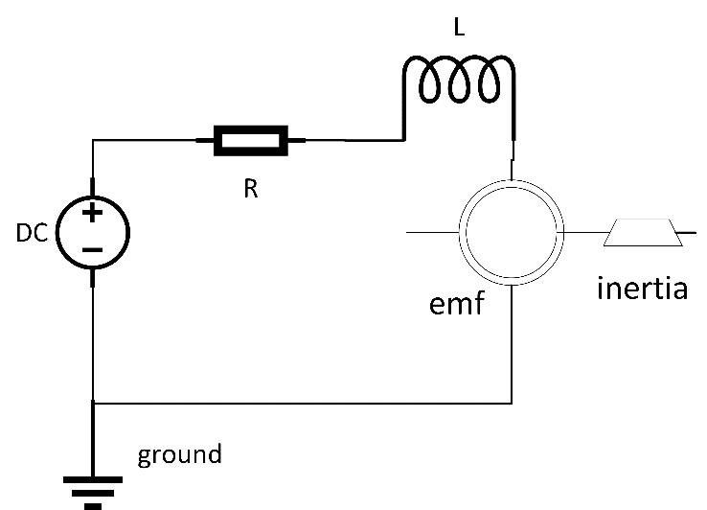
Step 1: DC-Motor Model
A Ideal DC-Motor Model
Understand the dc motor model assumptions
Build a dc-motor model
Inside Motor package, create a new model and name it as DCMotor
In the graphic editor of DCMotor, drag&drop the following components:
Causal interface Vb: Modelica.Blocks.Interfaces.RealInput
Acausal interface flange: Modelica.Mechanics.Rotational.Interfaces.Flange_b
Resistor Ra: Modelica.Electrical.Analog.Basic.Resistor
Inductor La: Modelica.Electrical.Analog.Basic.Inductor
EMF emf: Modelica.Electrical.Analog.Basic.EMF
Inertia inertia: Modelica.Mechanics.Rotational.Components.Inertia
DC source with voltage input Vs: Modelica.Electrical.Analog.Sources.SignalVoltage
Ground G: Modelica.Electrical.Analog.Basic.Ground
Connect each component in the graphic editor – be careful about the positive/negative pins
Vb

Slide 32
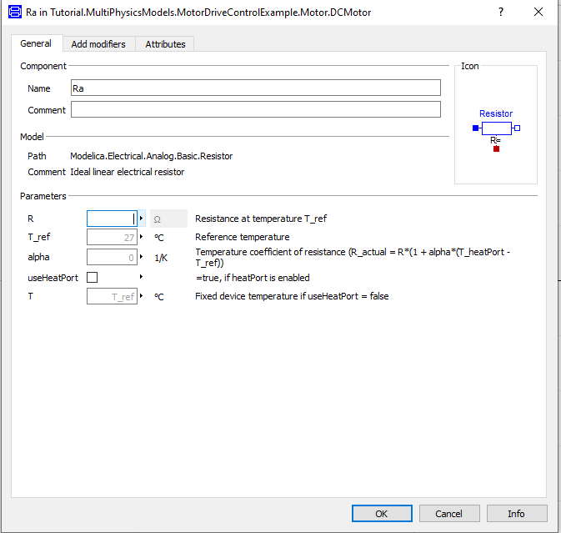
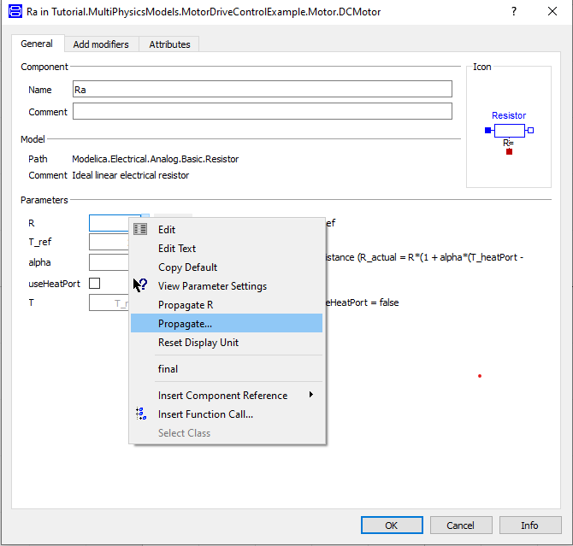
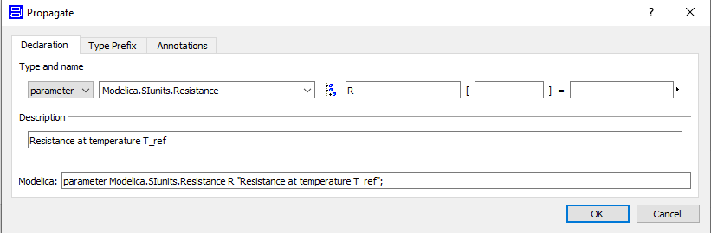
Step 1: DC-Motor Model
A Ideal DC-Motor Model
Build a dc-motor model
Inside Motor package, create a new model and name it as DCMotor
In the graphic editor of DCMotor, drag&drop the following components:
Connect each component in the graphic editor
Propagate component parameters to the top level
Define R in Ra
i) Left click Ra twice, which opens a tab showing different parameters used by Ra, and locate the parameter R that to be propagated
ii) Left click the small trangle symbol at the right of the input box, which pops a new window
iii) In the tab window, select Propogate, choose “OK” for all popped tabs and exit.
The source code changes after propagation:
parameter Modelica.SIunits.Resistance R "Resistance at temperature T_ref";
Modelica.Electrical.Analog.Basic.Resistor Ra(R=R)

Slide 33
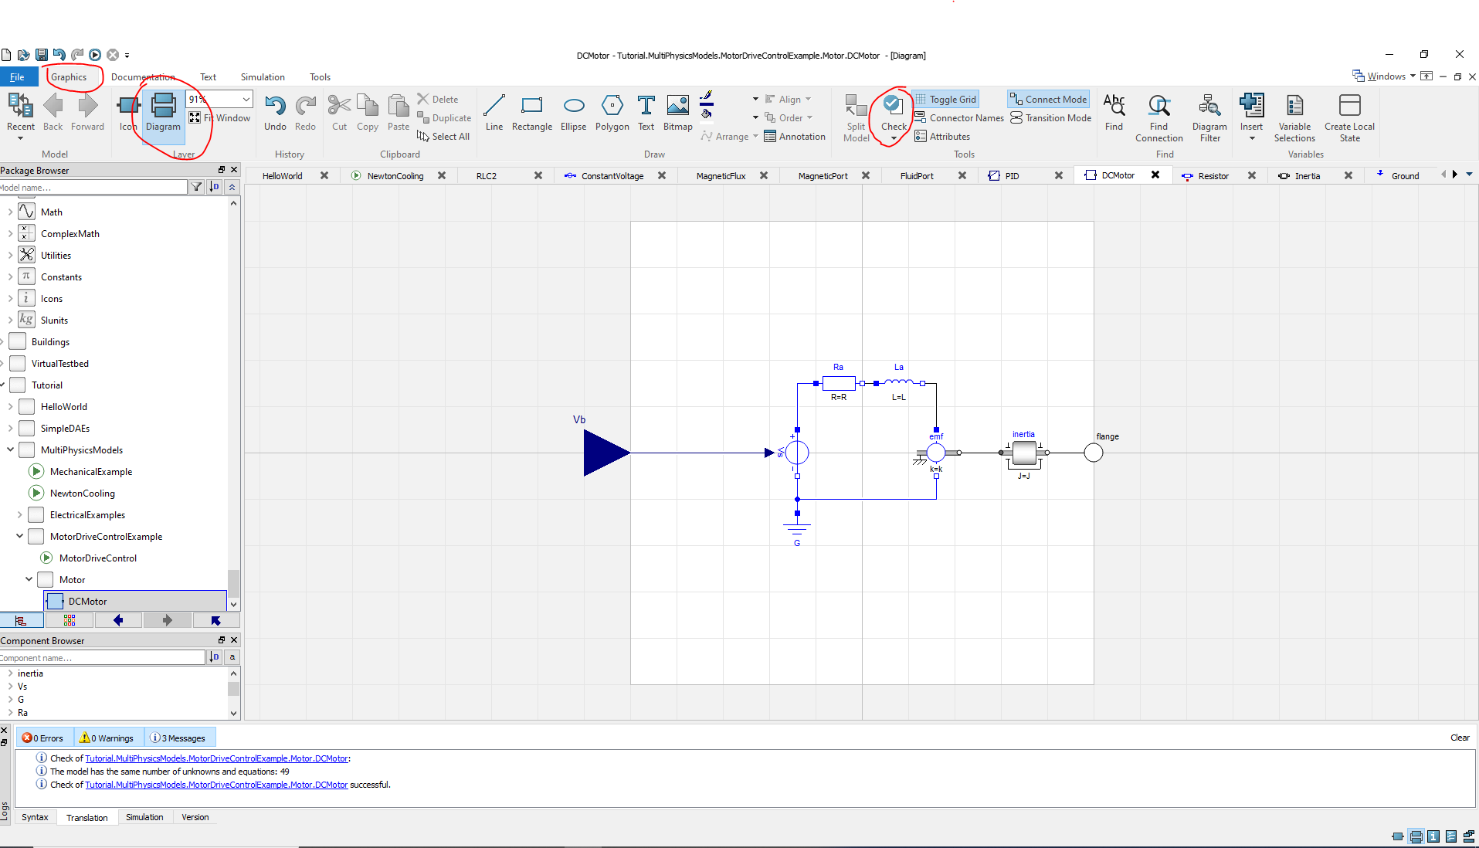
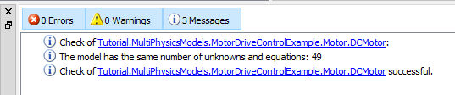
Step 1: DC-Motor Model
A Ideal DC-Motor Model
Understand the dc motor model assumptions
Build a dc-motor model
Connect each component in the graphic editor
Propagate component parameters to the top level
Define R in Ra
Define L in La, k in emf, J in inertia
Check your model – on the graphics mode, click “Check”
Find and fix errors ASAP before you use it for simulation
Make some beautiful icons if you need – In Graphics, click Icon, and start to design

Slide 34
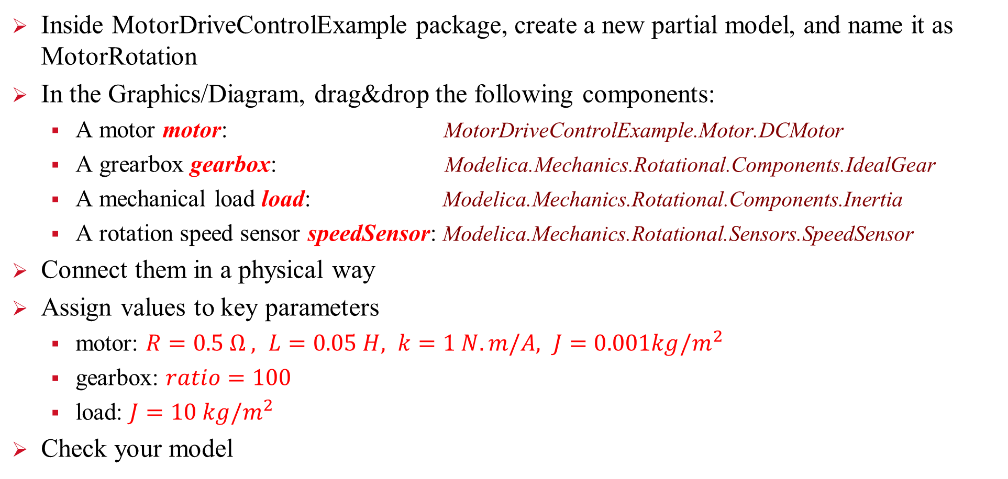
Step 2: DC-motor with Rotation System
Inside MotorDriveControlExample package, create a new partial model, and name it as MotorRotation
In the Graphics/Diagram, drag&drop the following components:
A motor motor: MotorDriveControlExample.Motor.DCMotor
A grearbox gearbox: Modelica.Mechanics.Rotational.Components.IdealGear
A mechanical load load: Modelica.Mechanics.Rotational.Components.Inertia
A rotation speed sensor speedSensor: Modelica.Mechanics.Rotational.Sensors.SpeedSensor
Connect them in a physical way
Assign values to key parameters
motor: $R=0.5 Ω , L=0.05 H, k=1 N.m/A, J=0.001kg/m^{2}$
gearbox: $ratio=100$
load: $J=10 kg/m^{2}$
Check your model

Slide 35
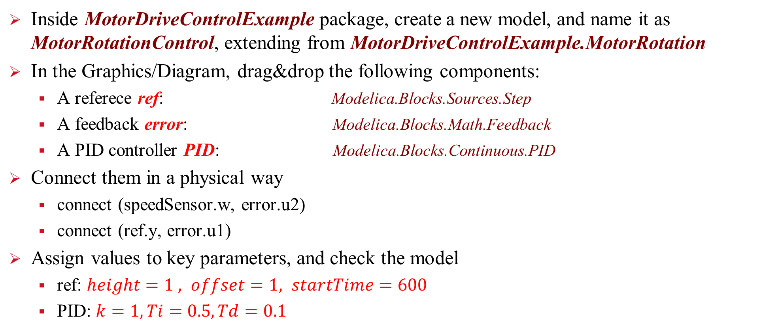
Step 3: Control Rotation System
Inside MotorDriveControlExample package, create a new model, and name it as MotorRotationControl, extending from MotorDriveControlExample.MotorRotation
In the Graphics/Diagram, drag&drop the following components:
A referece ref: Modelica.Blocks.Sources.Step
A feedback error: Modelica.Blocks.Math.Feedback
A PID controller PID: Modelica.Blocks.Continuous.PID
Connect them in a physical way
connect (speedSensor.w, error.u2)
connect (ref.y, error.u1)
Assign values to key parameters, and check the model
ref: $height=1 , offset=1, startTime=600$
PID: $k=1,Ti=0.5,Td=0.1$

Slide 36
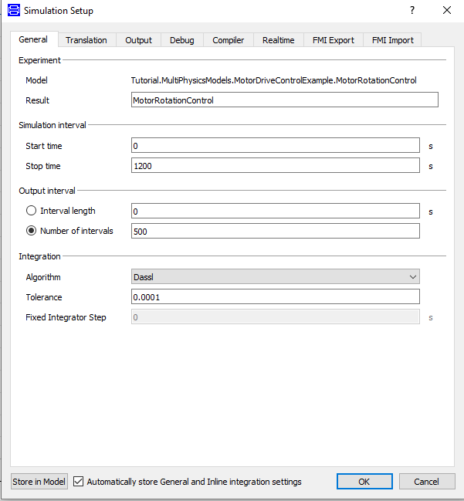
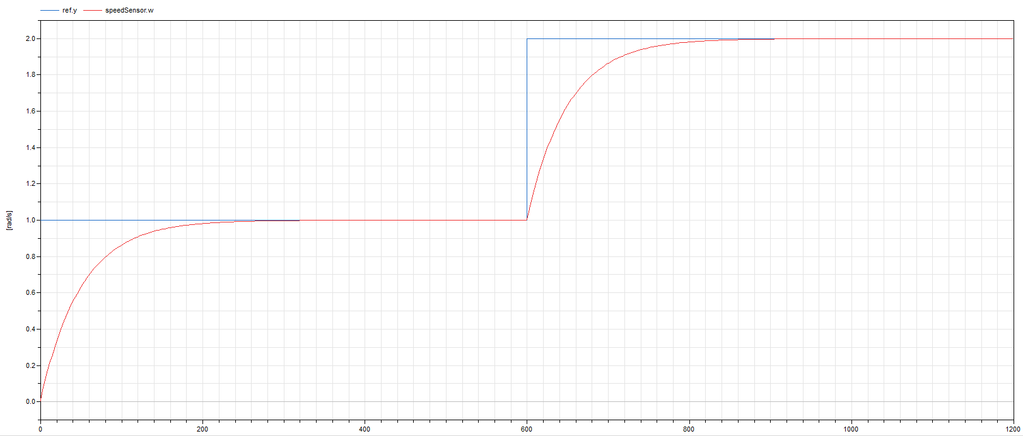
Step 3: Control Rotation System
Simulate MotorRotationControl
Go to Simulation/Setup
Set start time to 0, stop time to 1200 s
Click OK and exit
Click Simulation/Simulate to simulate model. Simulation results will be ready for plotting.
Plot response
In the Variable Browser tab, find and plot:
ref.y – reference speed
speedSensor.w – measured speed

Slide 37
Revisit Some Basics
Flat and hierarchical models
data types, attributes, components, interface-variables, package concept, inheritance
Special model classes
class types in Modelica
type, connector, model, package

