Slide 1
MPC vs DRL
Updates
Yangyang Fu
7/19/2021

Slide 2
Preliminary Case Studies
Fan Coil Unit System
Zone
DX System
Zone
Env1: Single Zone FCU system:
Control variable: air flow rate
Objective: minimize energy cost while maintaining comfort level
Env2: Single Zone DX system:
Control variable: zone air temperature cooling setpoint
Objective: minimize energy cost while maintaining comfort level

Slide 3


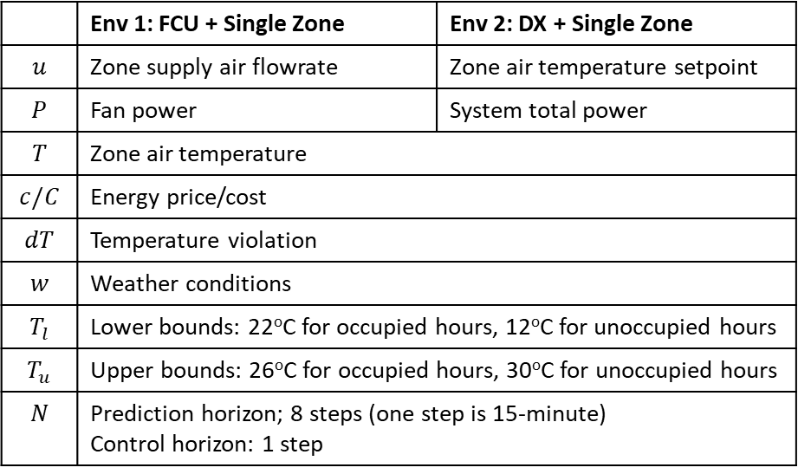

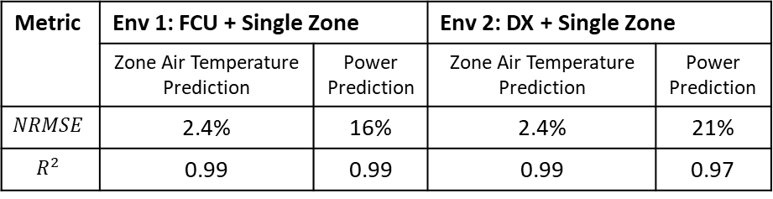

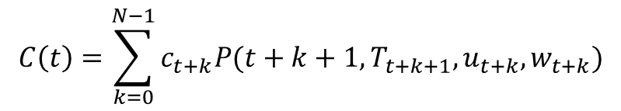
MPC Formulations
MPC Formulations
MPC Settings
 | Env 1: FCU + Single Zone | Env 2: DX + Single Zone
$$u$$ | Zone supply air flowrate | Zone air temperature setpoint
$$P$$ | Fan power | System total power
$$T$$ | Zone air temperature
$$c/C$$ | Energy price/cost
$$dT$$ | Temperature violation
$$w$$ | Weather conditions
$$T_{l}$$ | Lower bounds: 22ºC for occupied hours, 12ºC for unoccupied hours
$$T_{u}$$ | Upper bounds: 26ºC for occupied hours, 30ºC for unoccupied hours
$$N$$ | Prediction horizon; 8 steps (one step is 15-minute) Control horizon: 1 step
$$\min_{u(t)}{C(t)}+α\max_{t∈[t,t+N−1]}{(dT(t))}$$
Energy cost
Temperature violation penalty
$$C\left(t\right)=\sum_{k=0}^{N−1}{c_{t+k}P(t+k+1,T_{t+k+1},u_{t+k},w_{t+k})}$$
$$T_{t+k+1}=f\left(t+k,T_{t+k},u_{t+k},w_{t+k}\right), k=0,…, N−1$$
$$T_{t+k}∈[T_{l},T_{u}], k=0,…, N$$
$$dT\left(t\right)=\{{dT}_{t+1},…,{dT}_{t+N}\}$$
Metric | Env 1: FCU + Single Zone |  | Env 2: DX + Single Zone
 | Zone Air Temperature Prediction | Power Prediction | Zone Air Temperature Prediction | Power Prediction
$$NRMSE$$ | 2.4% | 16% | 2.4% | 21%
$$R^{2}$$ | 0.99 | 0.99 | 0.99 | 0.97
$$dT_{t+k}=\max\left(T_{t+k}−T_{u},T_{l}−T_{t+k},0\right), k=1,…, N$$
$$u\left(t\right)=\{u_{t},…,u_{t+N−1}\}∈U$$

Slide 4

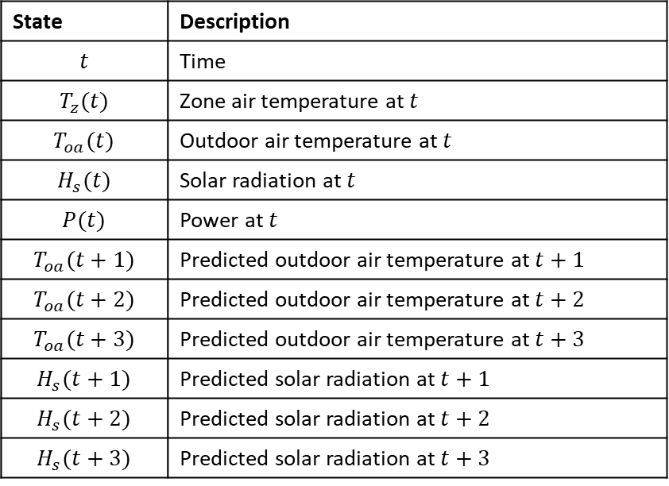
DRL Formulations
Reward
States Design
$$−(C(t)+α\max_{t∈[t,t+1]}{(dT(t)))}$$
Same settings as MPC
State | Description
$$t$$ | Time
$$T_{z}(t)$$ | Zone air temperature at $t$
$$T_{oa}(t)$$ | Outdoor air temperature at $t$
$$H_{s}(t)$$ | Solar radiation at $t$
$$P(t)$$ | Power at $t$
$$T_{oa}(t+1)$$ | Predicted outdoor air temperature at $t+1$
$$T_{oa}(t+2)$$ | Predicted outdoor air temperature at $t+2$
$$T_{oa}(t+3)$$ | Predicted outdoor air temperature at $t+3$
$$H_{s}(t+1)$$ | Predicted solar radiation at $t+1$
$$H_{s}(t+2)$$ | Predicted solar radiation at $t+2$
$$H_{s}(t+3)$$ | Predicted solar radiation at $t+3$
Energy cost
Temperature violation penalty
Learning Algorithm Settings
Learning Algorithm – DQN
Deep learning ANN architecture – [nStates, 50, 100, 200, 400, nActions]
Learning rate: 0.0003
Decay factor: 0.99
Training Settings
Number of epochs: 50
Control time step: 15 min

Slide 5
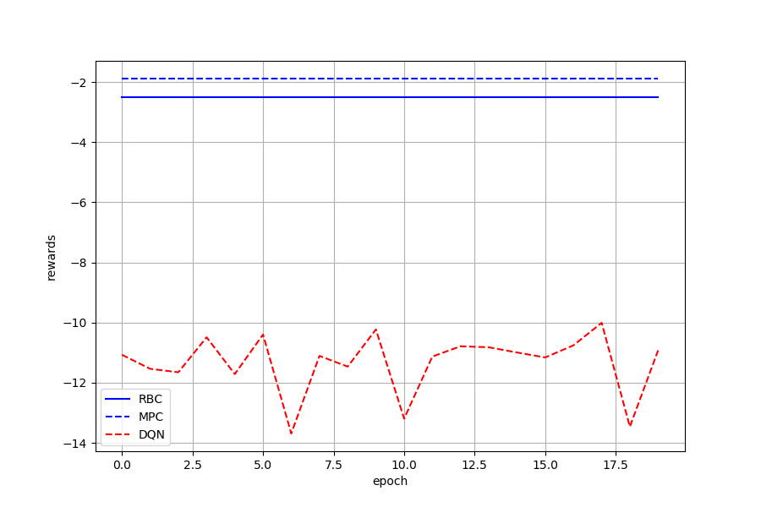
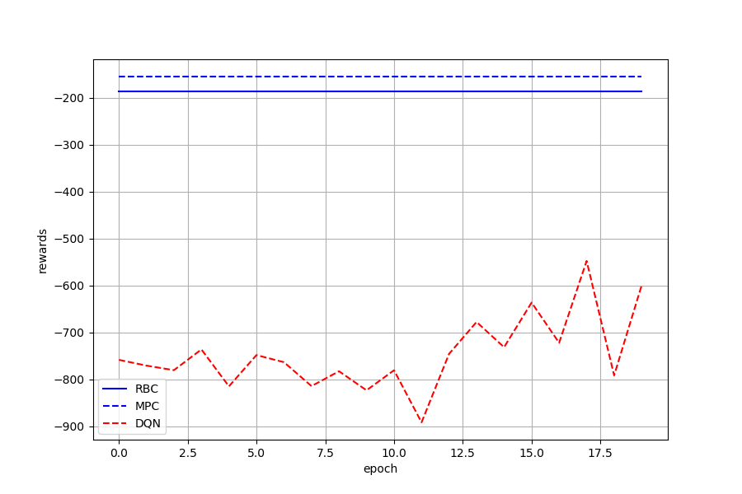
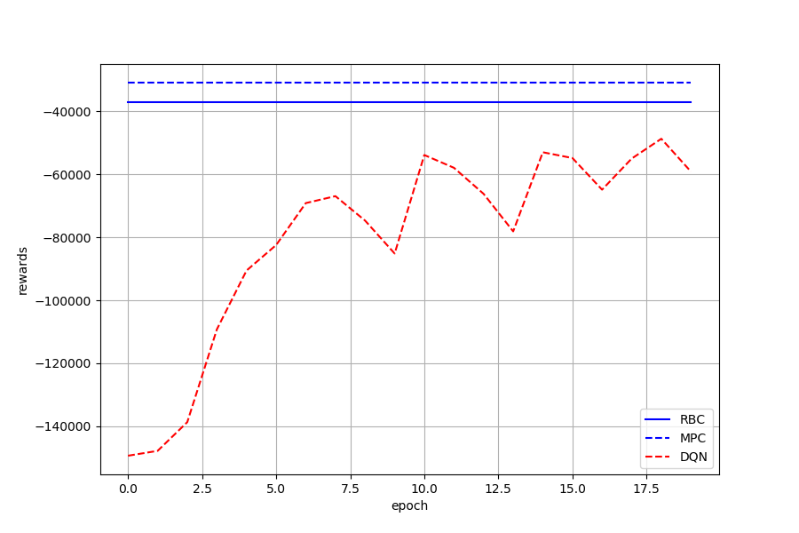
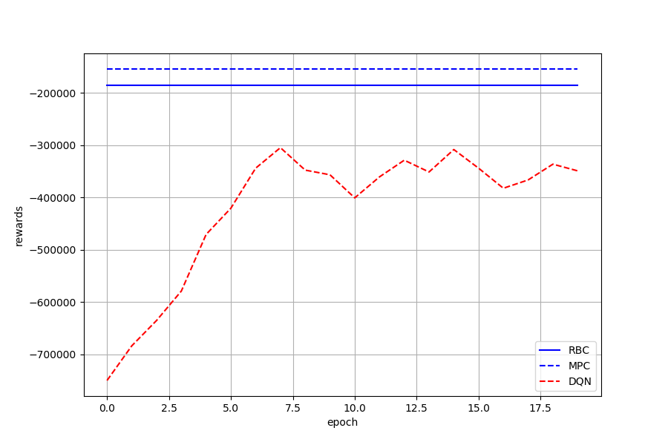




Env 1: Previous Results
FCU Fan Speed Control – Epochs=20
$α$=0.01
$α$=1
$α$=100
$α$=1000

Slide 6
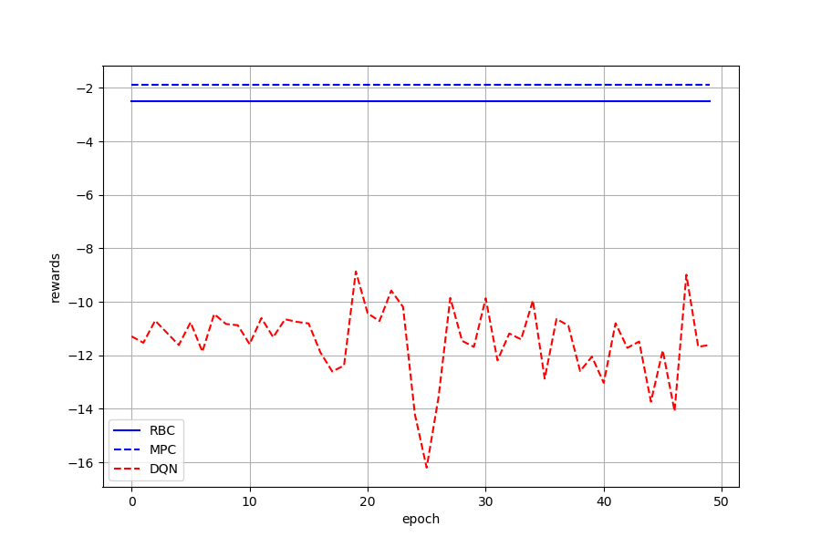
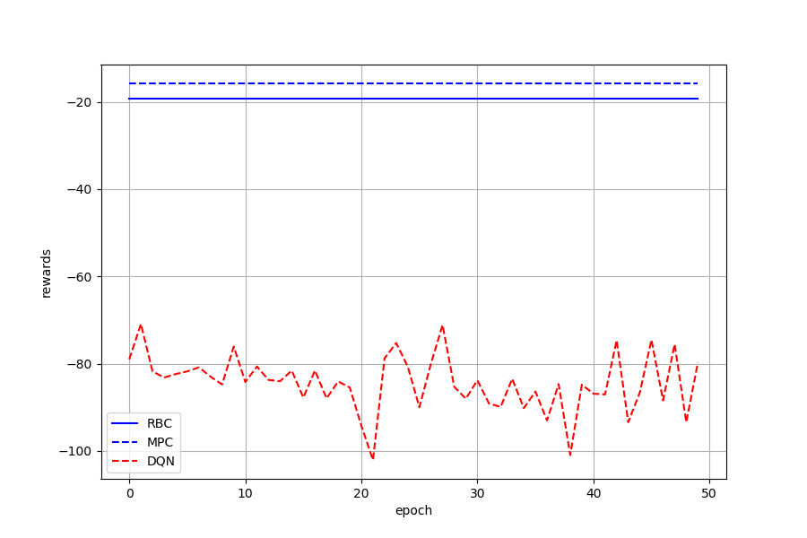
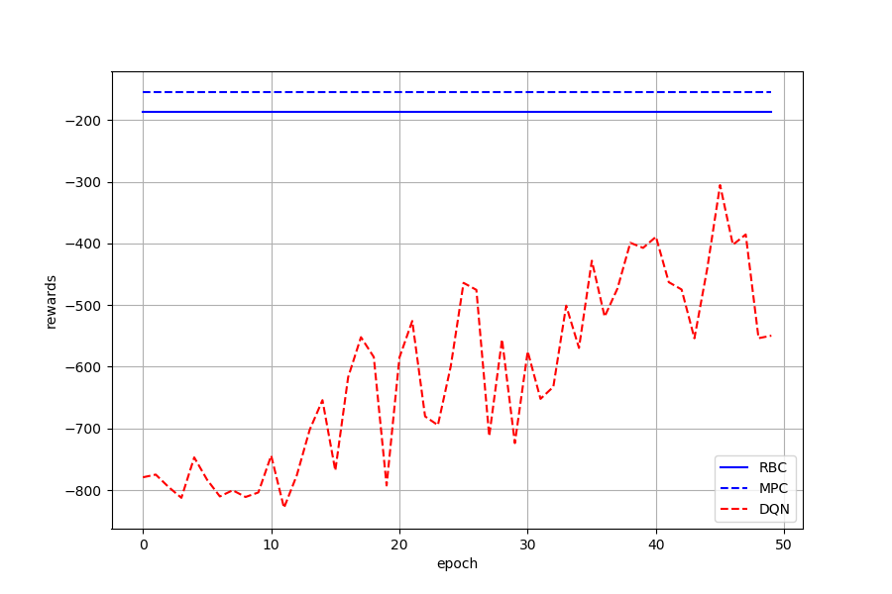
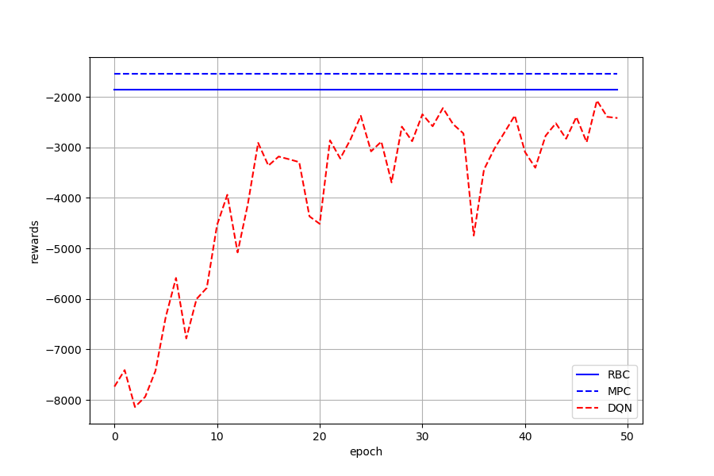
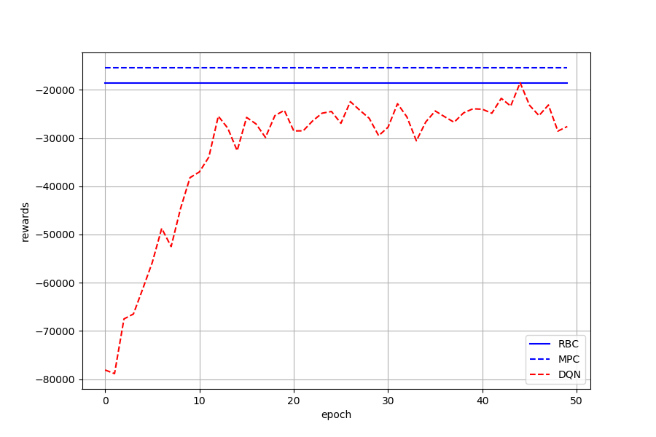
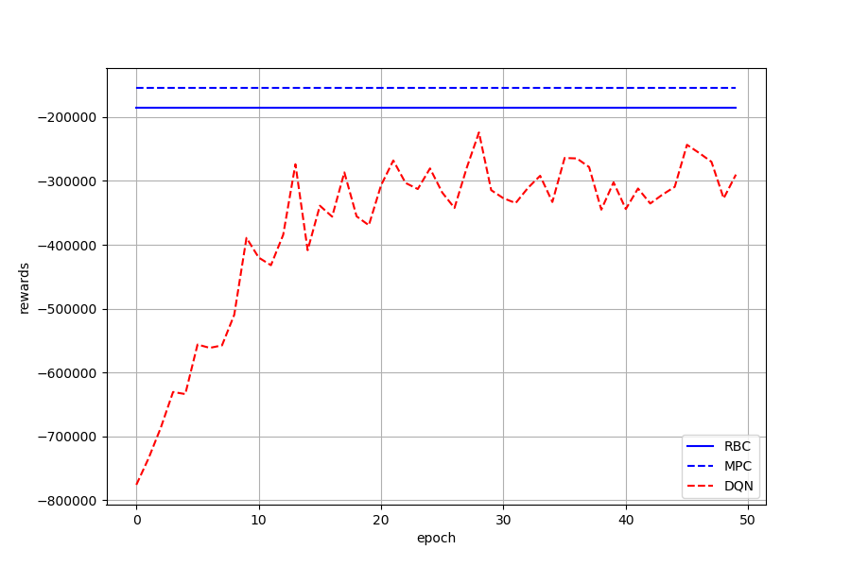






Env 1: FCU Fan Speed Control – Epochs=50
$α$=0.01
$α$=0.1
$α$=1
$α$=10
$α$=100
$α$=1000

Slide 7
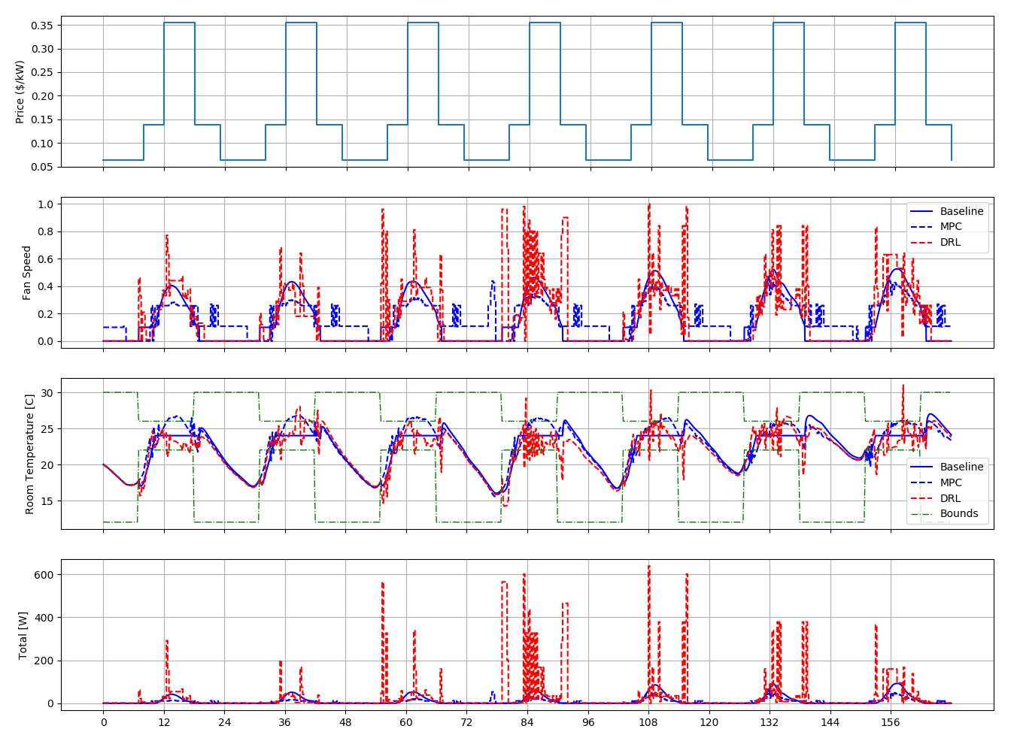
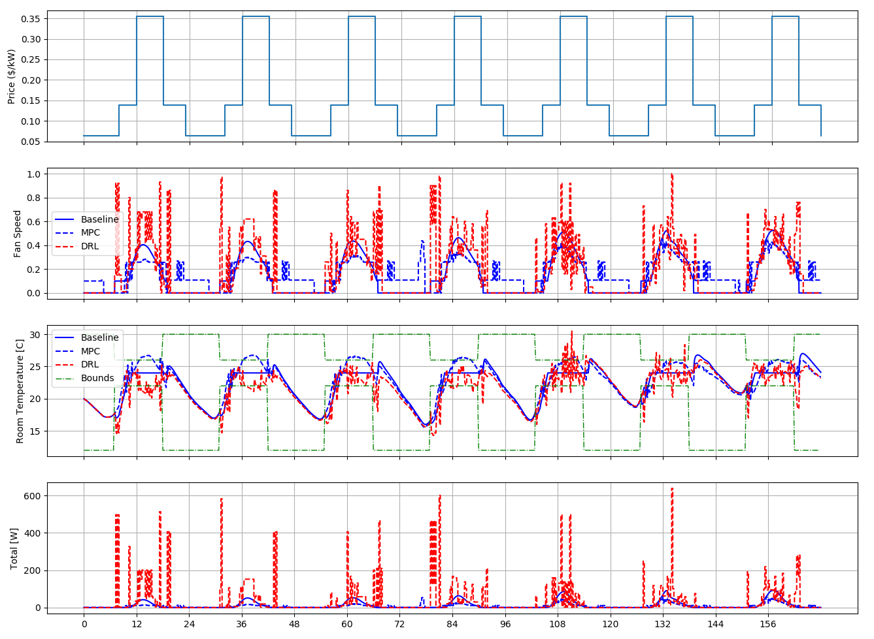


epoch=50, $α$=10
epoch=50, $α$=1000

Slide 8
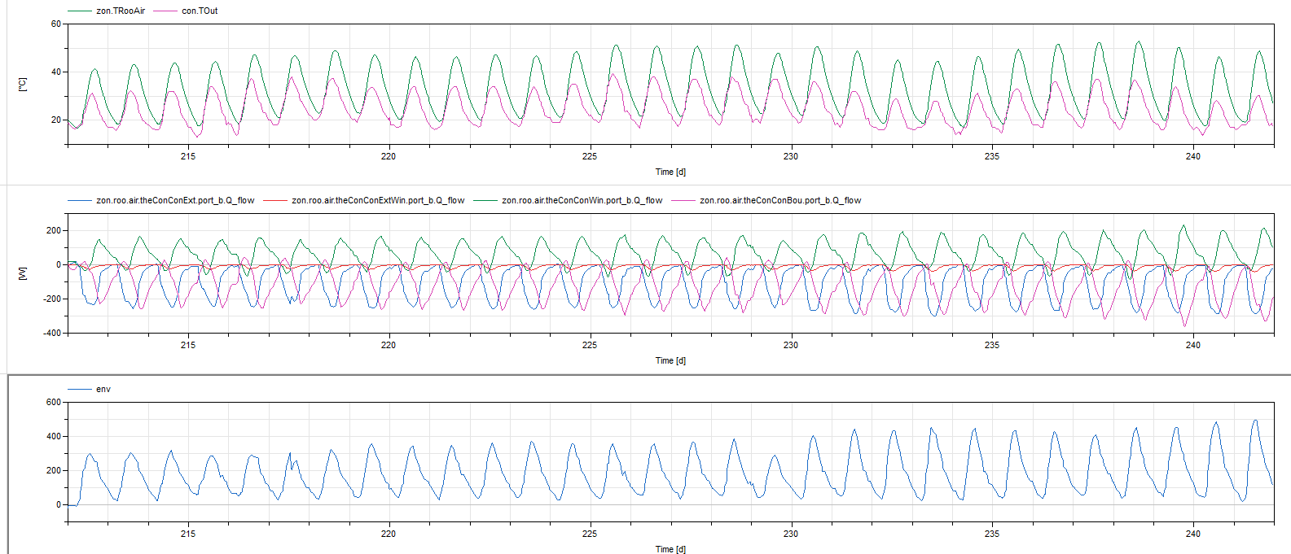
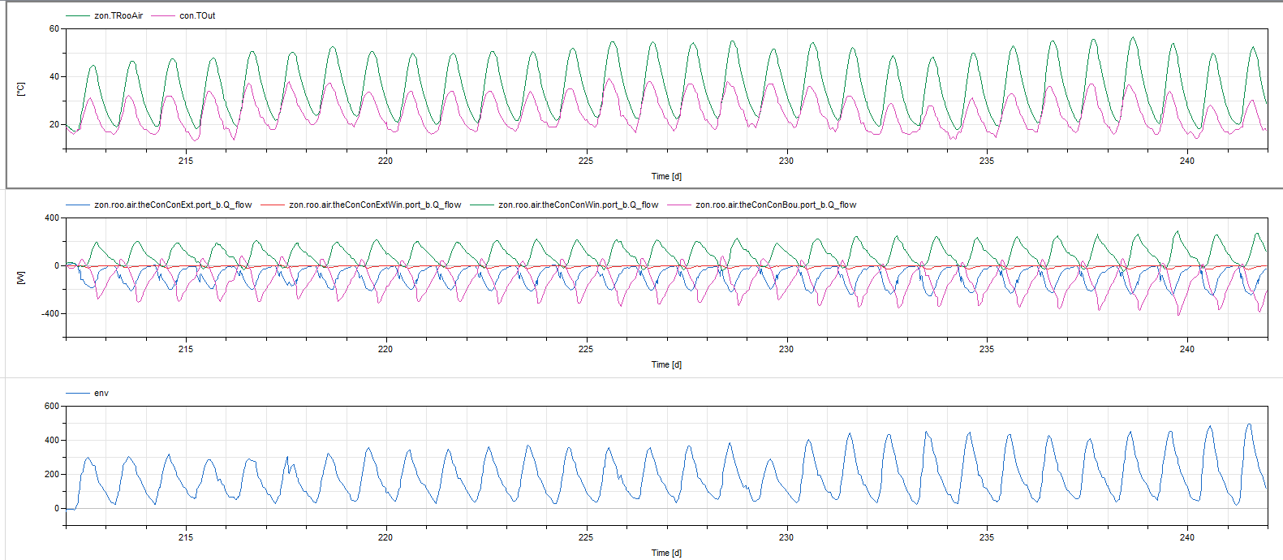
Env1: Latest Results
Environment Response Study
Fan off all day, without internal heat gain
Room temperature increase to 50ºC due to envelope heat transfer
Fan off all day, with internal heat gain
Room temperature increase to 55ºC due to envelope heat transfer

Slide 9
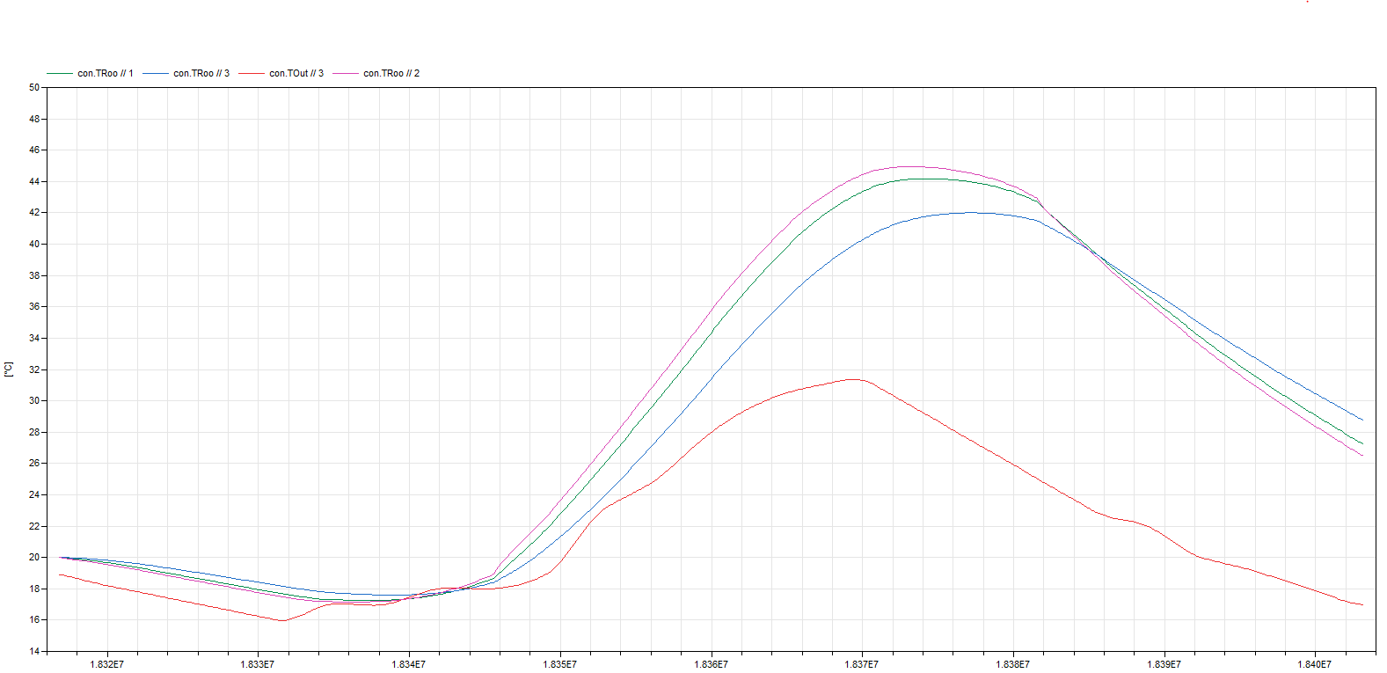
Thermal Mass
m=1
m=2
m=5

Slide 10
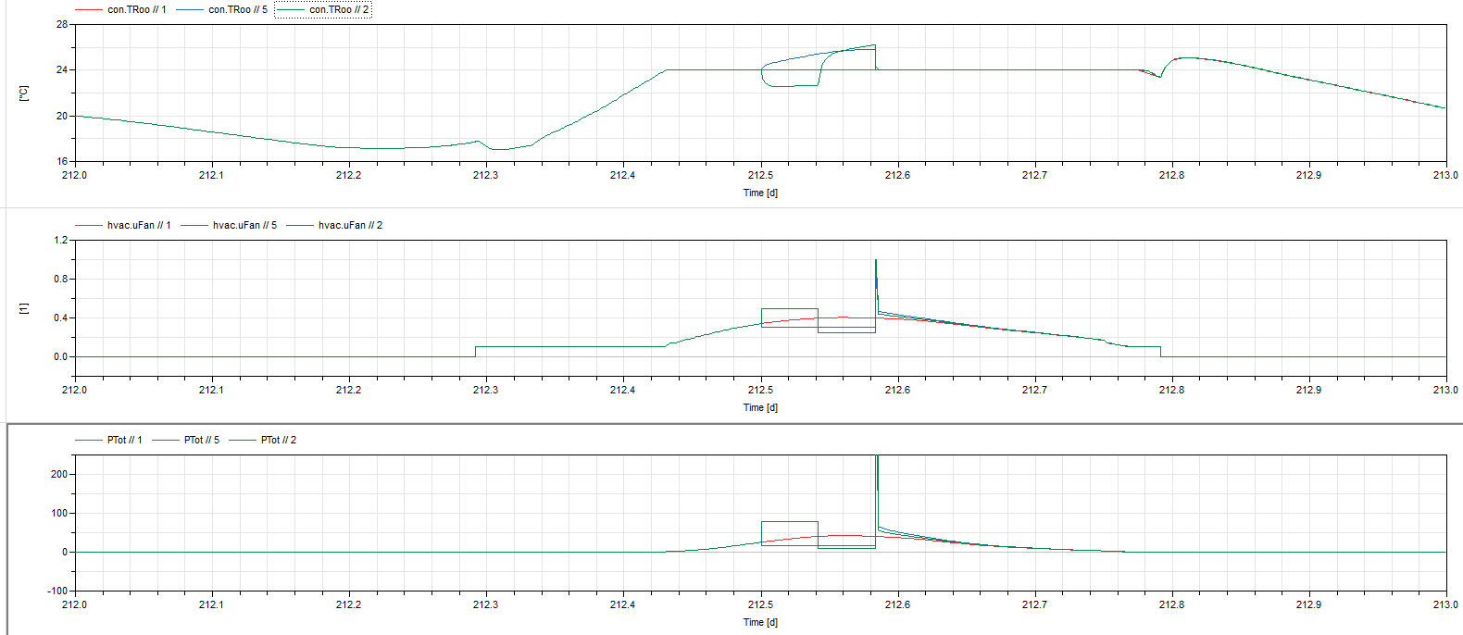
Precooling Test
Case | Energy [kWh] | Cost($)
Upper bound | 17.2/1000*2 | 0.0085
precool | 79.7/1000+10/1000 | 0.0146

