Slide 1
MPC vs DRL

Slide 2

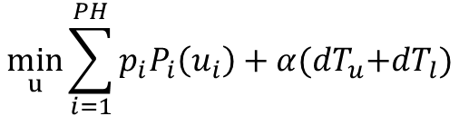
MPC Formulation
Objective
Design Variable
$$\min_{u}{\sum_{i=1}^{PH}{p_{i}P_{i}\left(u_{i}\right)+α{(dT}_{u}+dT_{l})}}$$
$$u=[u_{1},u_{2},…,u_{PH}]$$
Zone Air Flow Setpoint
OBJ: ALPHA tuning, Fan power , normalizing two terms on objective function

Slide 3
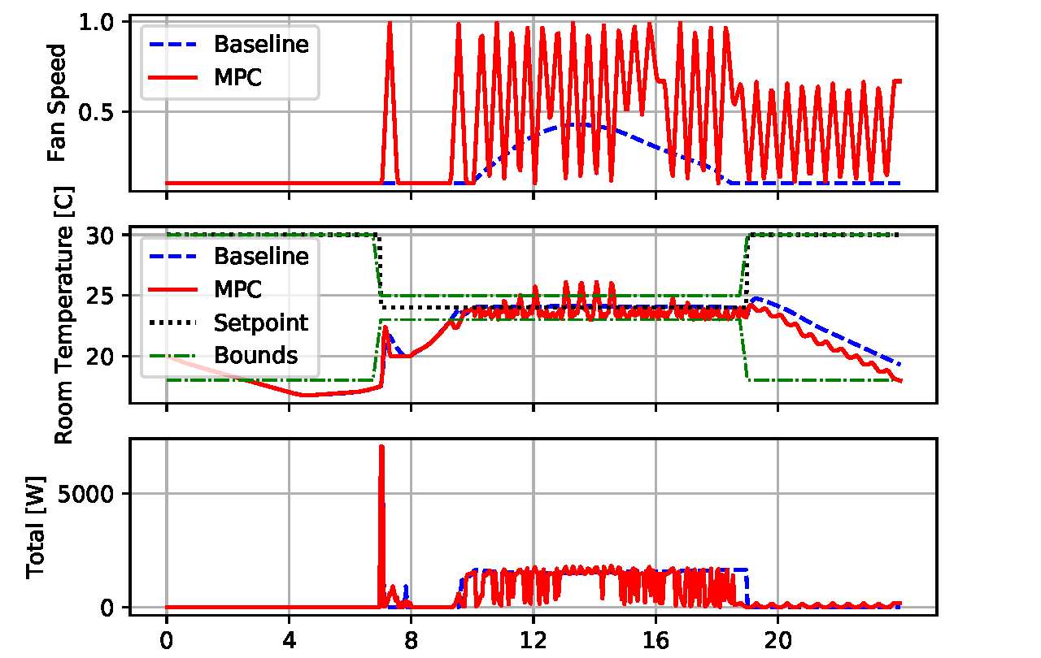
MPC Results

Slide 4
Debug MPC
Fast fan dynamics
Exceed constraints

Slide 5
Minimize fan power instead of system-level power
Make sure supply air temperature can be controlled at any time by enlarging water side size of the cooling coil

Slide 6
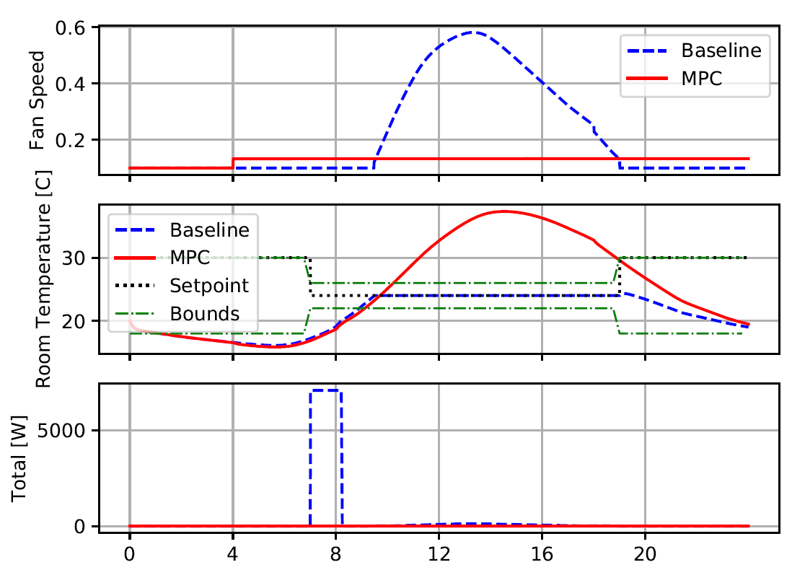
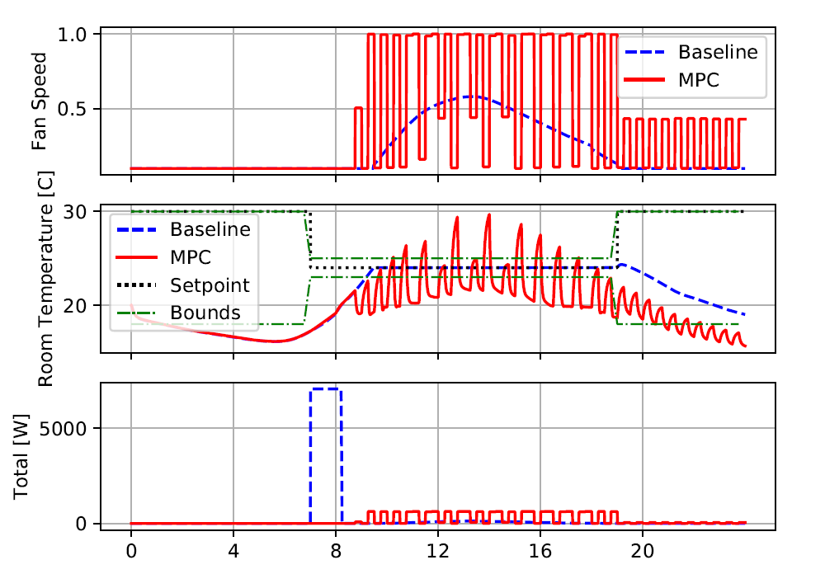


3/23
MPC model accuracy
$$\min_{u}{\sum_{i=1}^{PH}{p_{i}P_{i}\left(u_{i}\right)}}$$
$$\min_{u}{\sum_{i=1}^{PH}{{(dT}_{u}+dT_{l})}}$$
PH=1
PH=1

Slide 7
Zone Temperature Dynamics
Model 1: polynomial
Model 2: ANN
1. one history step
2. four history step

Slide 8
Zone Dynamics Identification
Model 1: instant measurement
Model 2: instant measurement
Model 1: average measurement
Model 2: average measurement

Slide 9
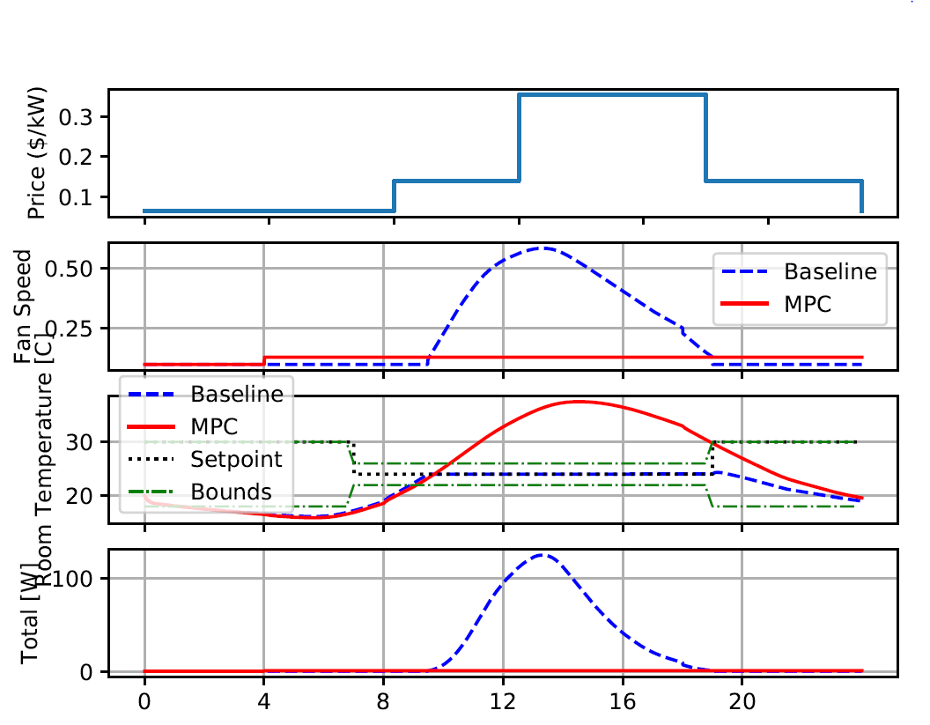
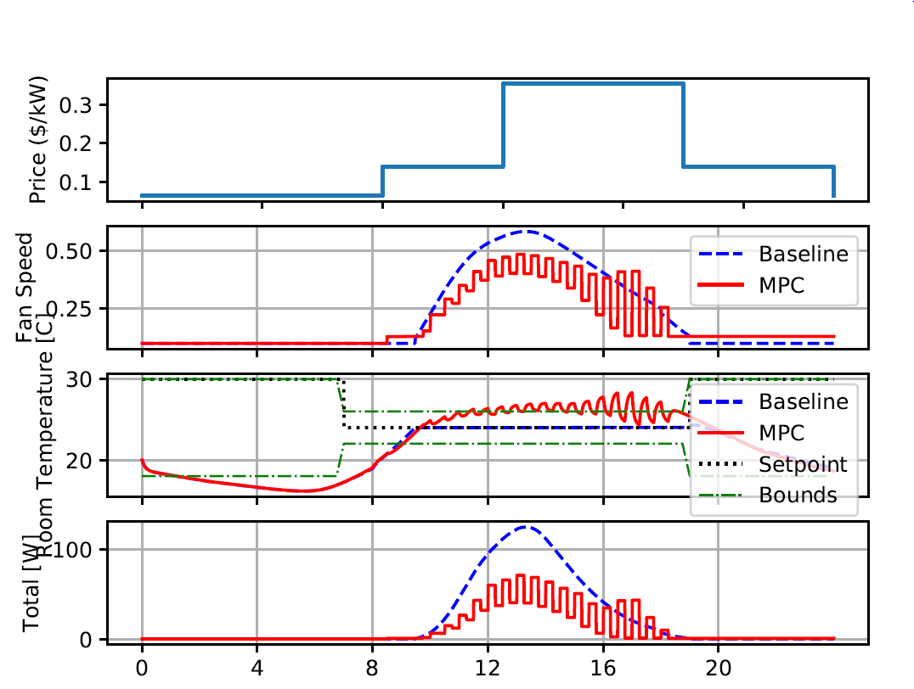
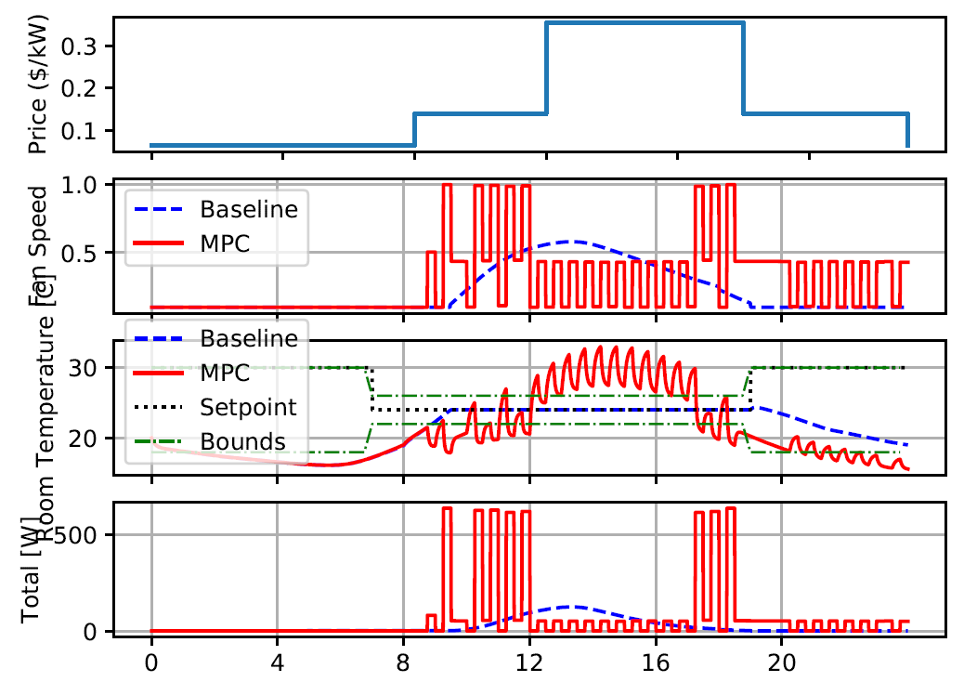
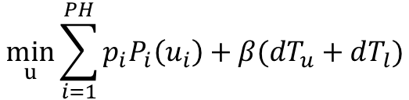
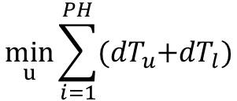
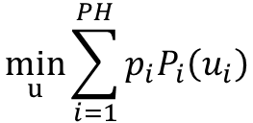
MPC
Model 1.2: PH=1
$$\min_{u}{\sum_{i=1}^{PH}{p_{i}P_{i}\left(u_{i}\right)}}$$
$$\min_{u}{\sum_{i=1}^{PH}{{(dT}_{u}+dT_{l})}}$$
$$\min_{u}{\sum_{i=1}^{PH}{{p_{i}P_{i}\left(u_{i}\right)+β(dT}_{u}+dT_{l})}}$$

Slide 10
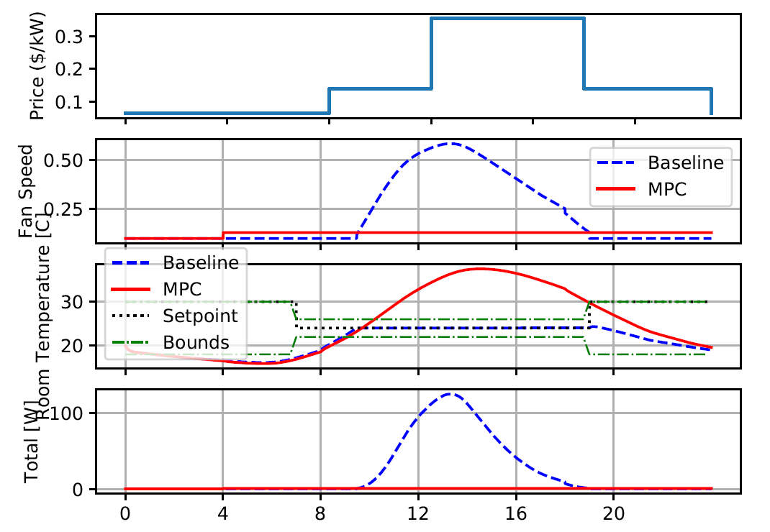
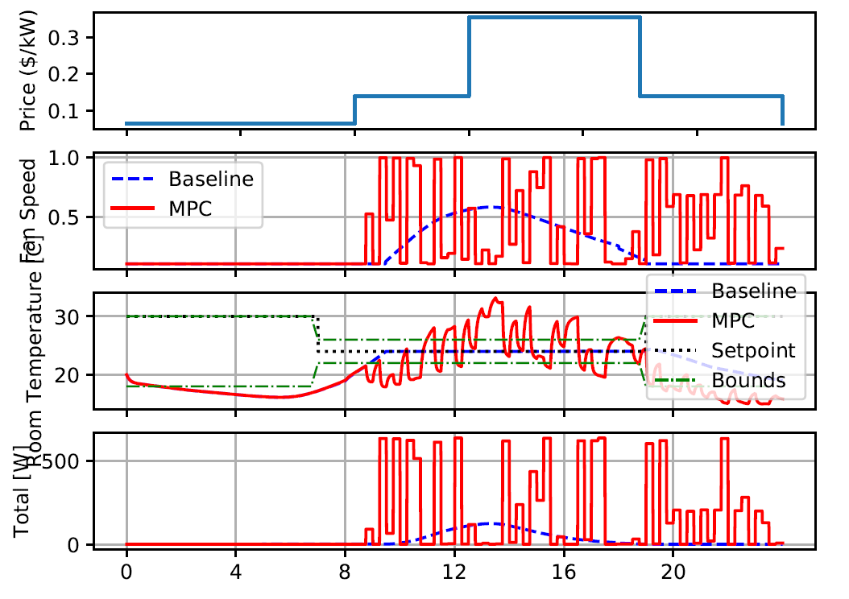
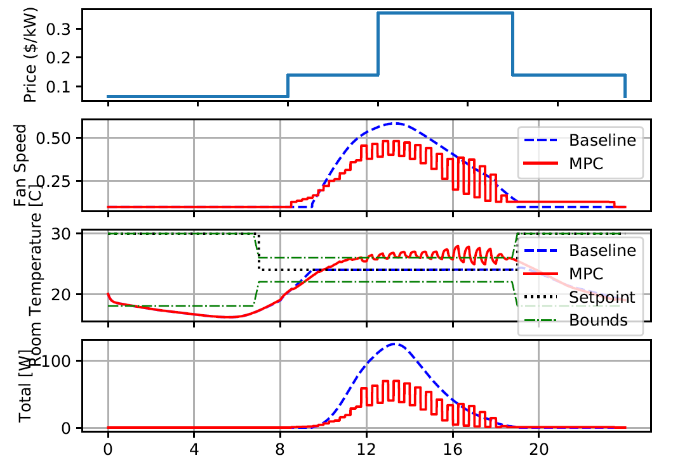
MPC
Model 1.2: PH=4
$$\min_{u}{\sum_{i=1}^{PH}{p_{i}P_{i}\left(u_{i}\right)}}$$
$$\min_{u}{\sum_{i=1}^{PH}{{(dT}_{u}+dT_{l})}}$$
$$\min_{u}{\sum_{i=1}^{PH}{{p_{i}P_{i}\left(u_{i}\right)+β(dT}_{u}+dT_{l})}}$$

Slide 11
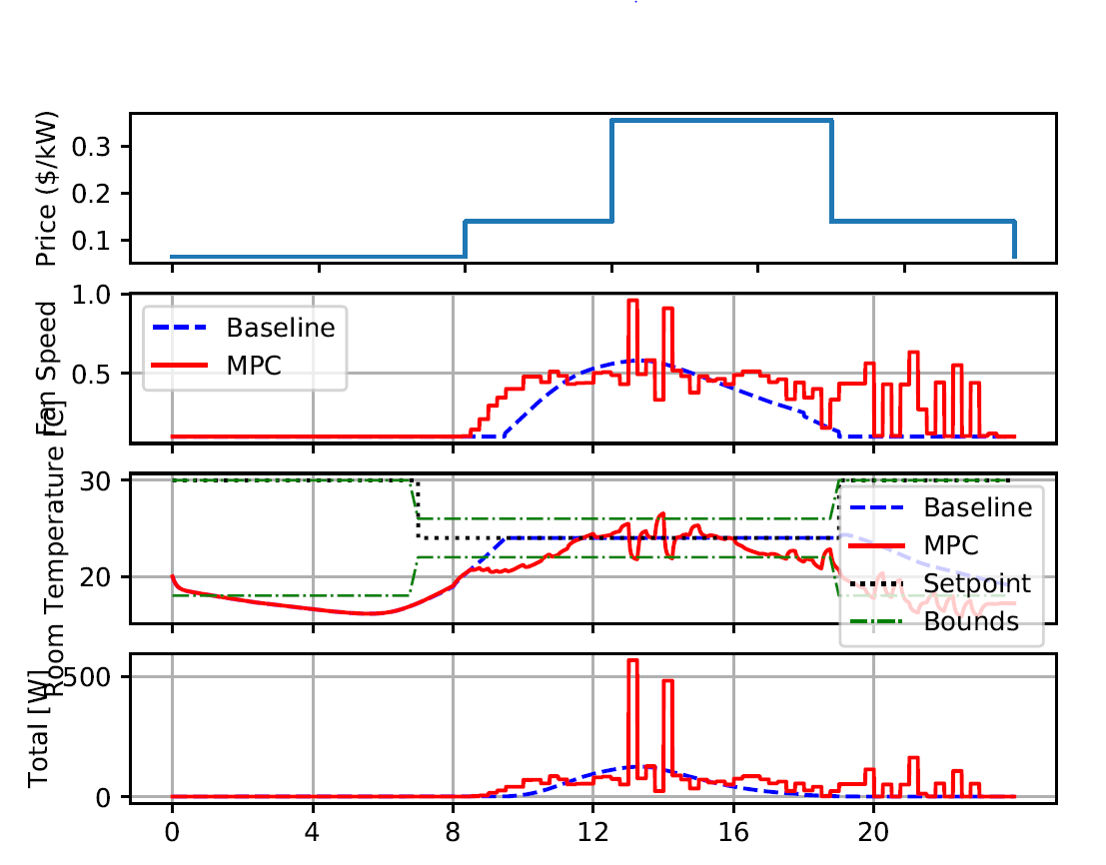
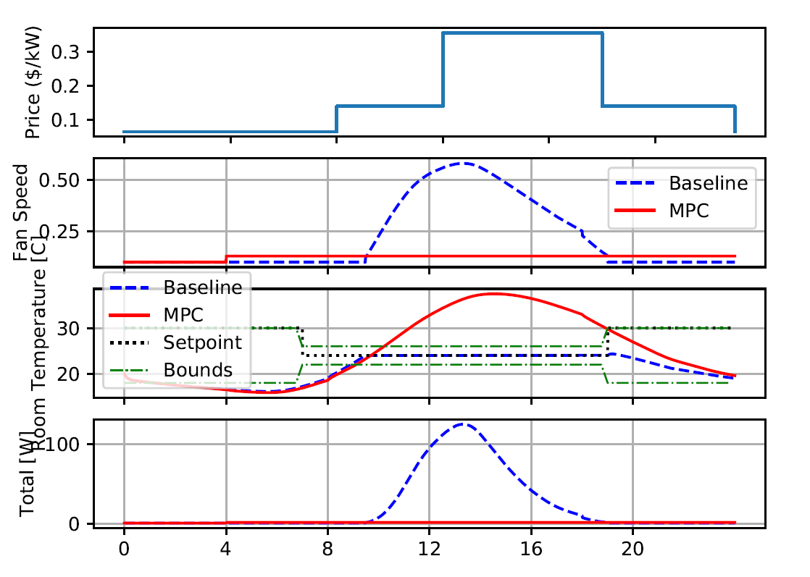
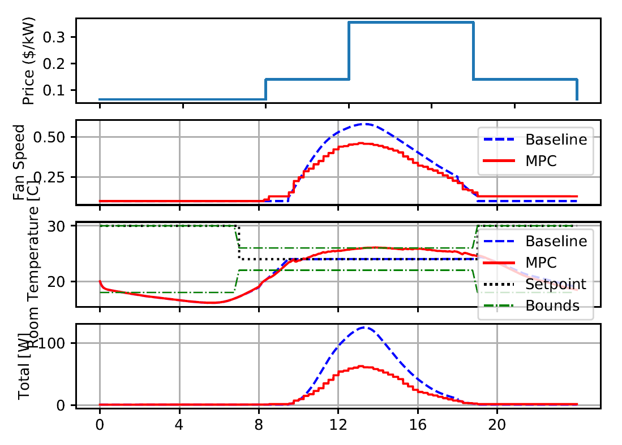
MPC
Model 2.2: PH=1
$$\min_{u}{\sum_{i=1}^{PH}{p_{i}P_{i}\left(u_{i}\right)}}$$
$$\min_{u}{\sum_{i=1}^{PH}{{(dT}_{u}+dT_{l})}}$$
$$\min_{u}{\sum_{i=1}^{PH}{{p_{i}P_{i}\left(u_{i}\right)+β(dT}_{u}+dT_{l})}}$$

Slide 12
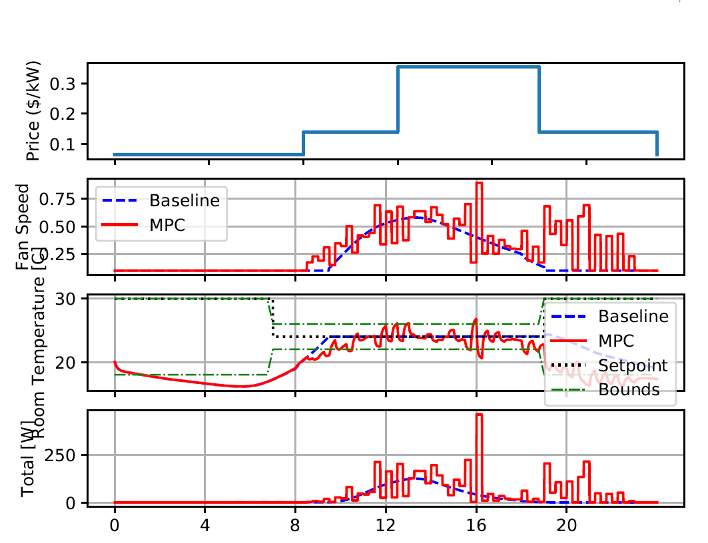
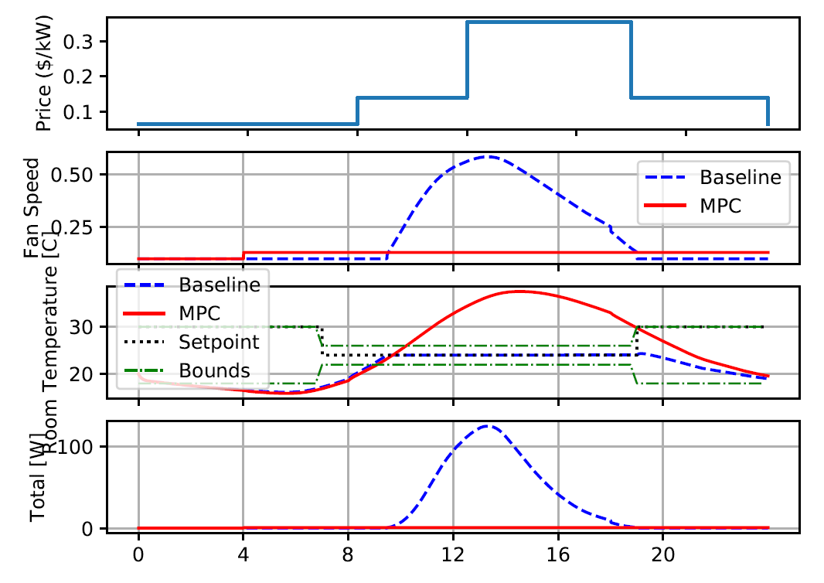
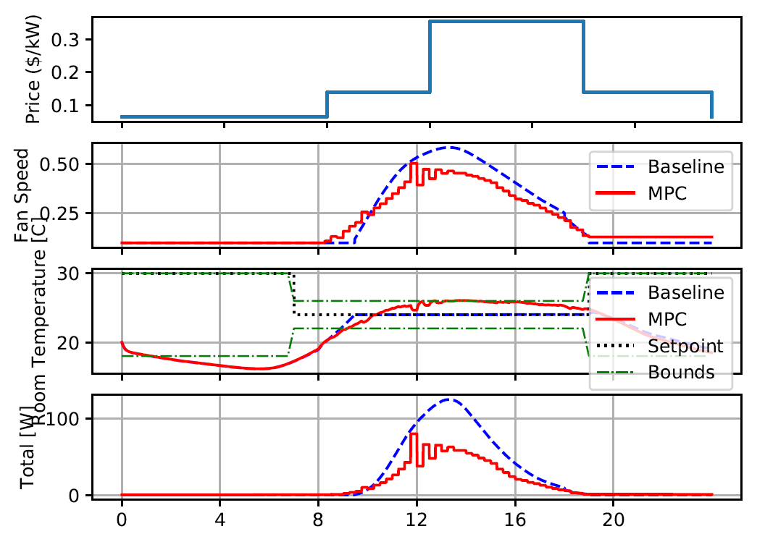
MPC
Model 2.2: PH=4
$$\min_{u}{\sum_{i=1}^{PH}{p_{i}P_{i}\left(u_{i}\right)}}$$
$$\min_{u}{\sum_{i=1}^{PH}{{(dT}_{u}+dT_{l})}}$$
$$\min_{u}{\sum_{i=1}^{PH}{{p_{i}P_{i}\left(u_{i}\right)+β(dT}_{u}+dT_{l})}}$$

Slide 13
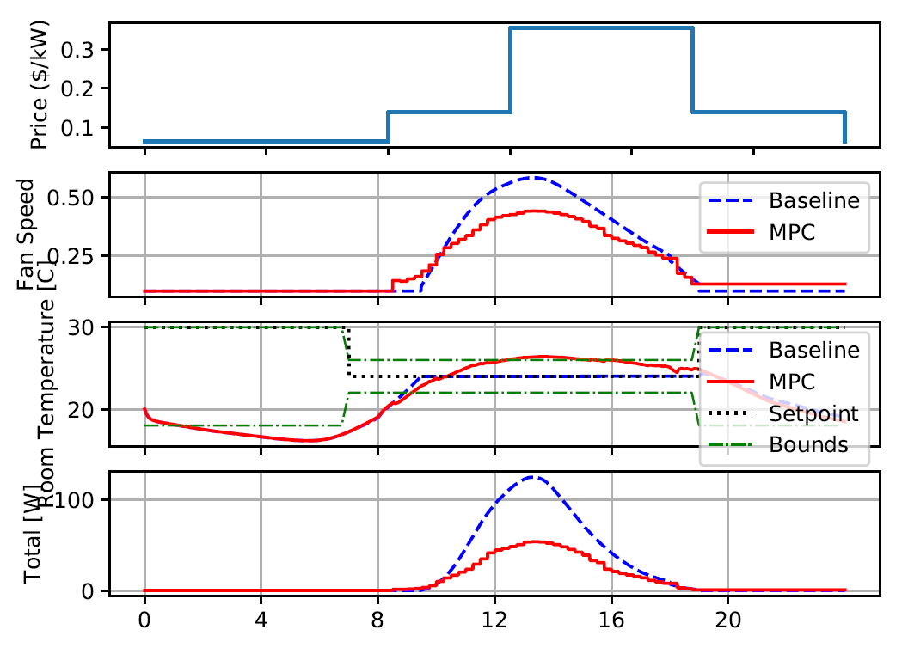
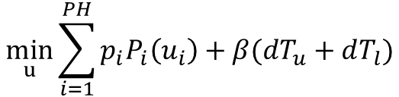
MPC
$$\min_{u}{\sum_{i=1}^{PH}{{p_{i}P_{i}\left(u_{i}\right)+β(dT}_{u}+dT_{l})}}$$
Instant Measurement
Average Measurement

