Slide 1
Model Predictive Control VS Deep Reinforcement Learning Control
Building HVAC System
Yangyang Fu
Texas A$M University
11/25/2020

Slide 2
Agenda
Goal and Scope
Progresses

Slide 3
Goal and Scope
Goal
Compare the performance of MPC vs DRL/TL on building HVAC control
Fault-tolerant control: MPC vs DRL
Scope
Comparison:
Single zone
Multi-zones – 1 for now
Fault tolerant control:
Single zone
Multi-zone – 1 for now

Slide 4
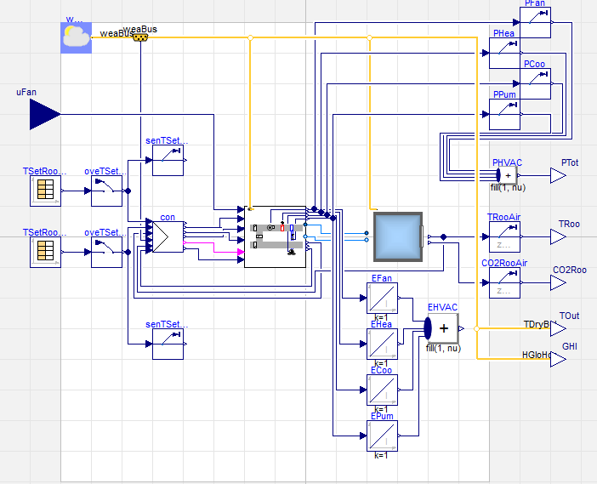
System Description: Single Zone
Building HVAC – air side
Single Zone
Guideline 36 for air-side supervisory control
Control Testbed
Inputs: air flow rate in kg/s

Slide 5
MPC Development
Objective: minimize energy cost while satisfying zone thermal constraints
Control inputs
Supply air flow rate – 5 level, same as DRL?
Continuous or discrete: discrete for MPC
CONTIOUS FOR fault-tolerant
MPC models
Zone dynamics:
Power Predictor:
Experiment
Period: August
Training Data
Excitation Experiment
Period: July? Or August?

Slide 6
DRL: OpenGym Environment
Github: https://github.com/YangyangFu/mpc-drl-tl.
Integrated environment for deep reinforcement learning using Modelica
Jmodelica: simulate Modelica-based building energy system
Opengym: interface for using Modelica models as DRL environment
Pytorch: develop DRL algorithms
Build an openGym environment for single zone model
Contained in a Docker file, which represents a virtual Ubuntu development environment
Tested installation
Future work:
Reward policy – NU
Test with DRL algorithm – q-learning example TAMU

Slide 7
Next steps
TAMU:
MPC development
Help NU on integrating openGym environment with DRL
NU
Test DRL in the openGym environment
Develop fault-tolerant DRL

