Slide 1
MPC vs DRL

Slide 2

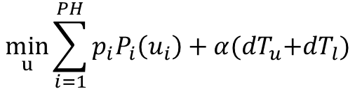
MPC Formulation
Objective
Design Variable
$$\min_{u}{\sum_{i=1}^{PH}{p_{i}P_{i}\left(u_{i}\right)+α{(dT}_{u}+dT_{l})}}$$
$$u=[u_{1},u_{2},…,u_{PH}]$$
Zone Air Flow Setpoint
OBJ: ALPHA tuning, Fan power , normalizing two terms on objective function

Slide 3
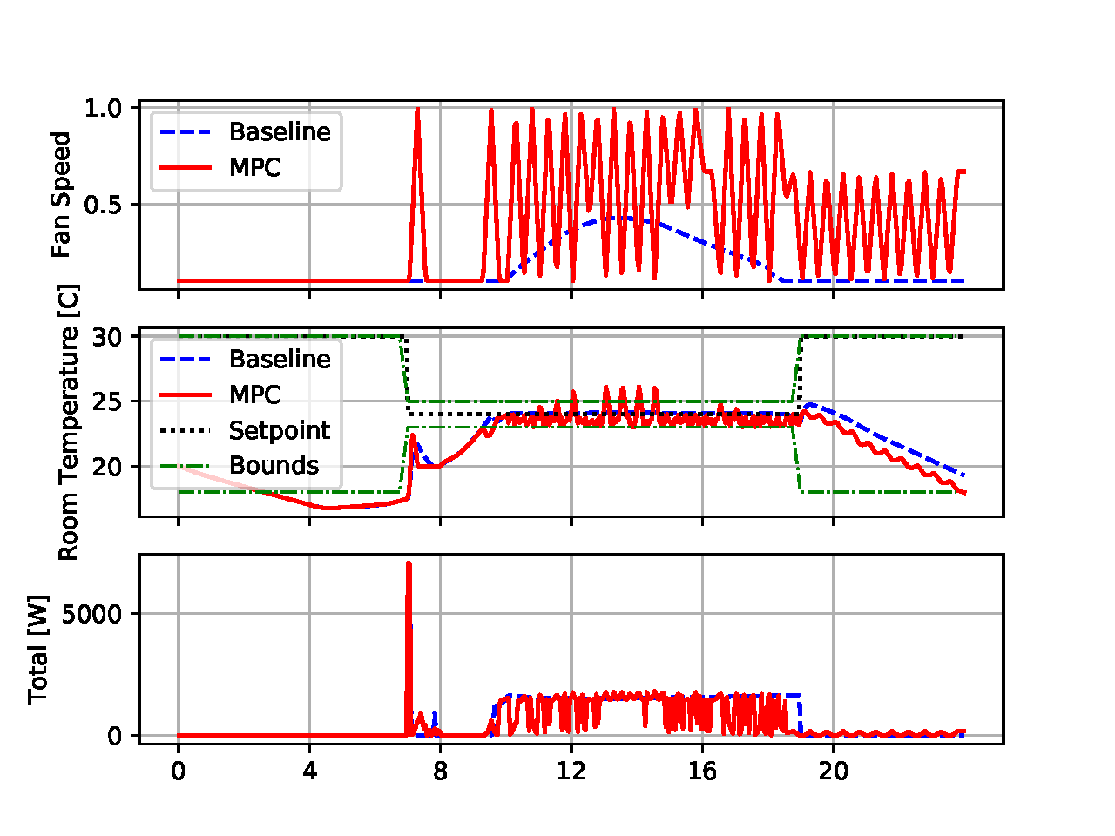
MPC Results

Slide 4
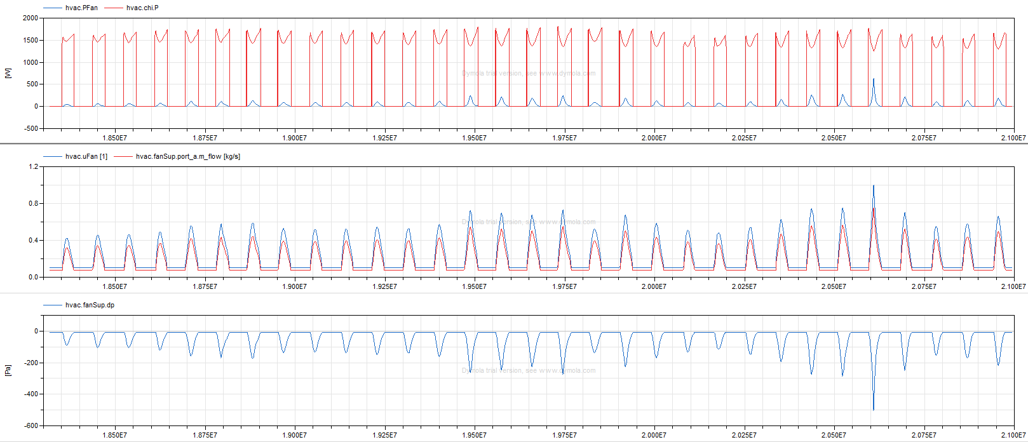
Issue 1
System total power is not sensitive to air flow control

Slide 5
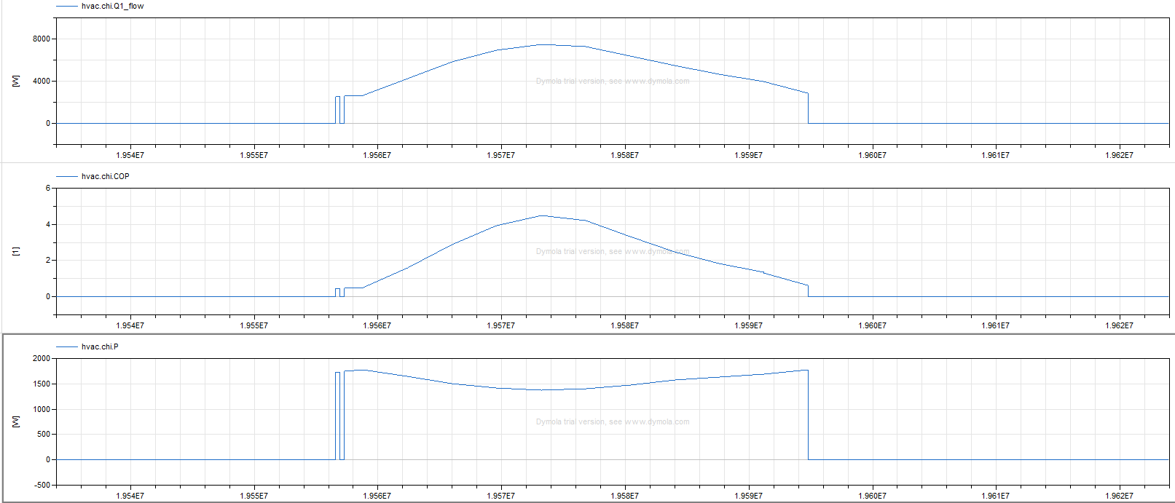
Issue 2
Possible: PLR~0.8, most efficient

Slide 6
Issue 3
Exceed constraint bounds
MPC optimizer may not converge
Alpha is not well-tuned
Is this a good MPC optimization problem???

Slide 7
To-Do
1. remove chiller power; normalize objective function, tune alpha
2. change application to control setpoints
3. Five-zone DRL environment

Slide 8
Debug MPC
Fast fan dynamics
Exceed constraints

Slide 9
Minimize fan power instead of system-level power
Make sure supply air temperature can be controlled at any time by enlarging water side size of the cooling coil

Slide 10
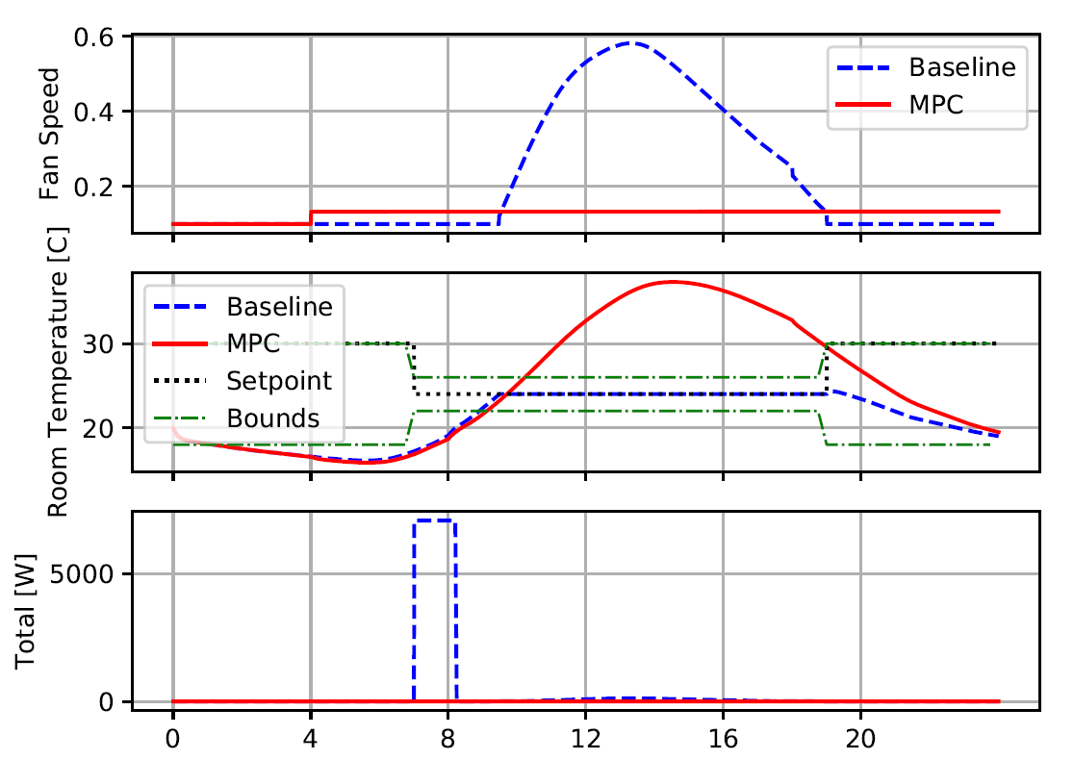
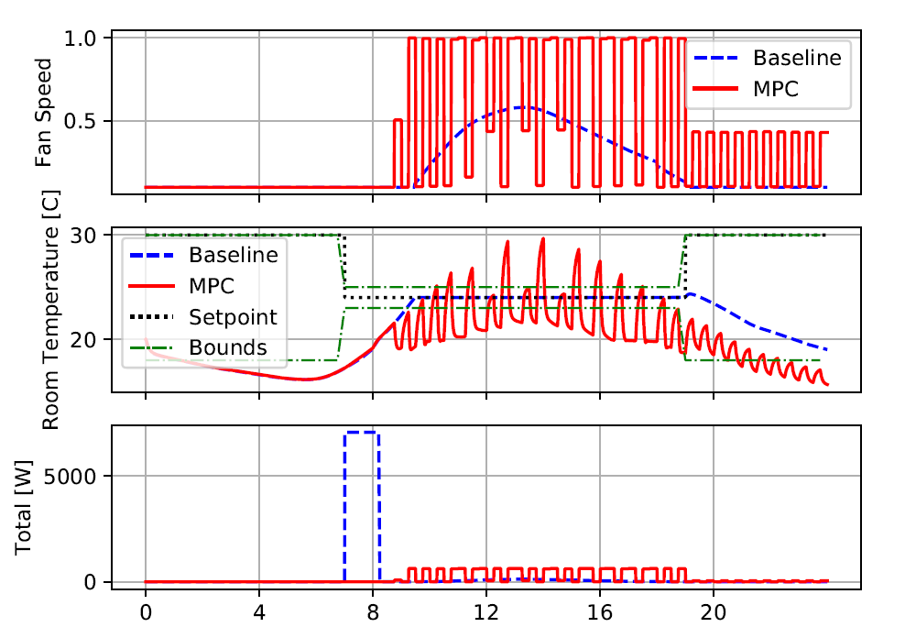


3/23
MPC model accuracy
$$\min_{u}{\sum_{i=1}^{PH}{p_{i}P_{i}\left(u_{i}\right)}}$$
$$\min_{u}{\sum_{i=1}^{PH}{{(dT}_{u}+dT_{l})}}$$
PH=1
PH=1

Slide 11
Zone Temperature Dynamics
Model 1: polynomial
Model 2: ANN
1. one history step
2. four history step

Slide 12
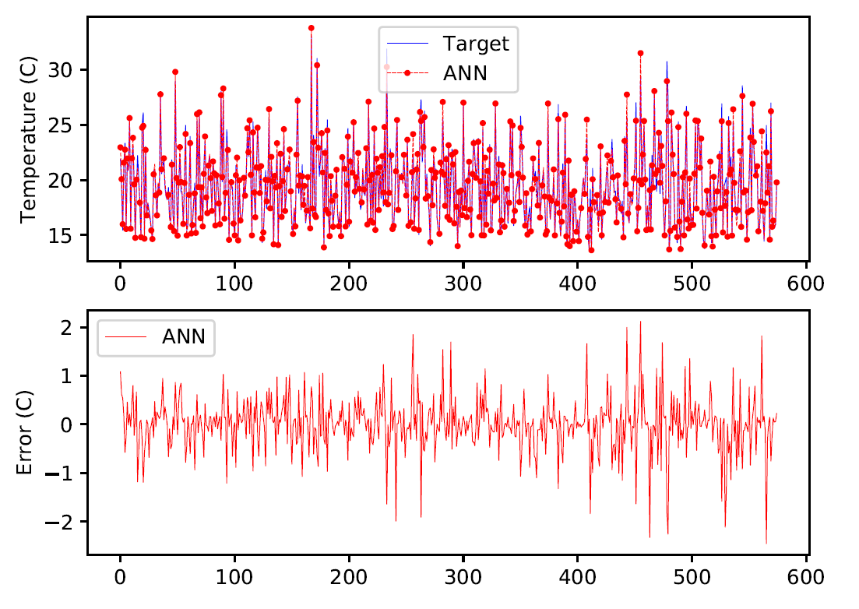
Model 2:
2.2

Slide 13
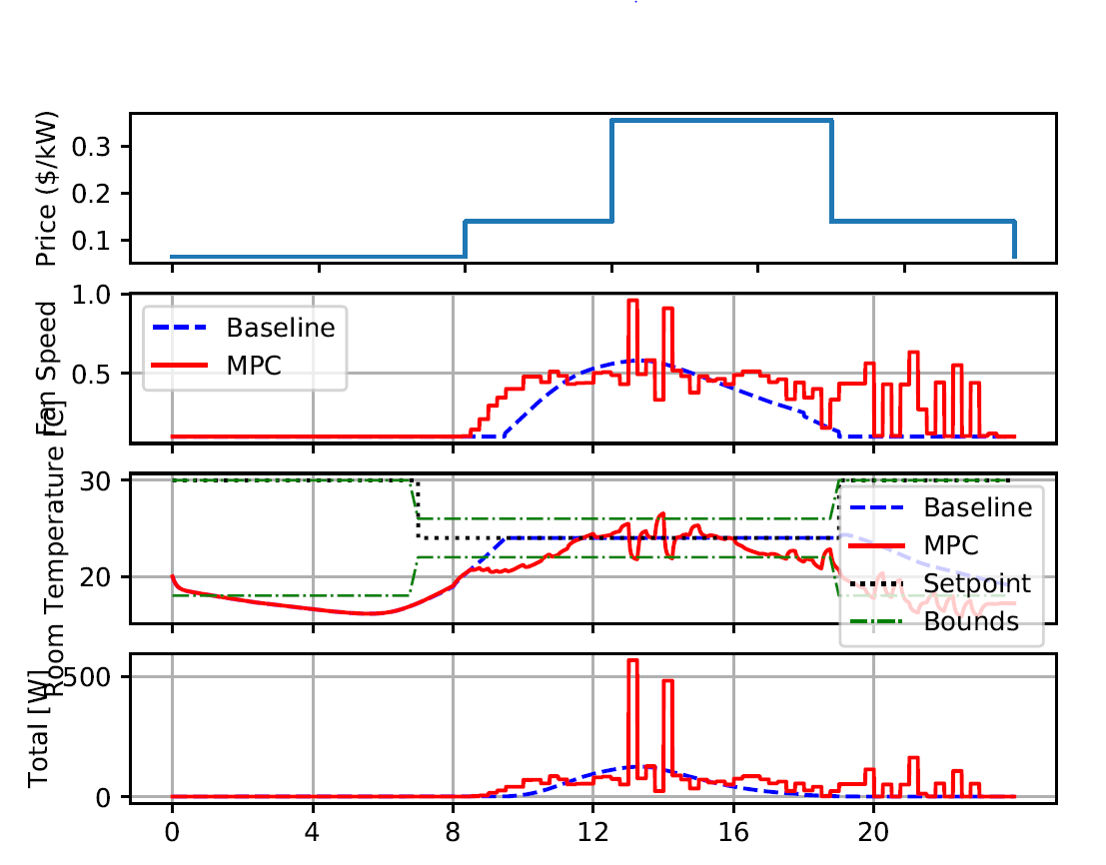
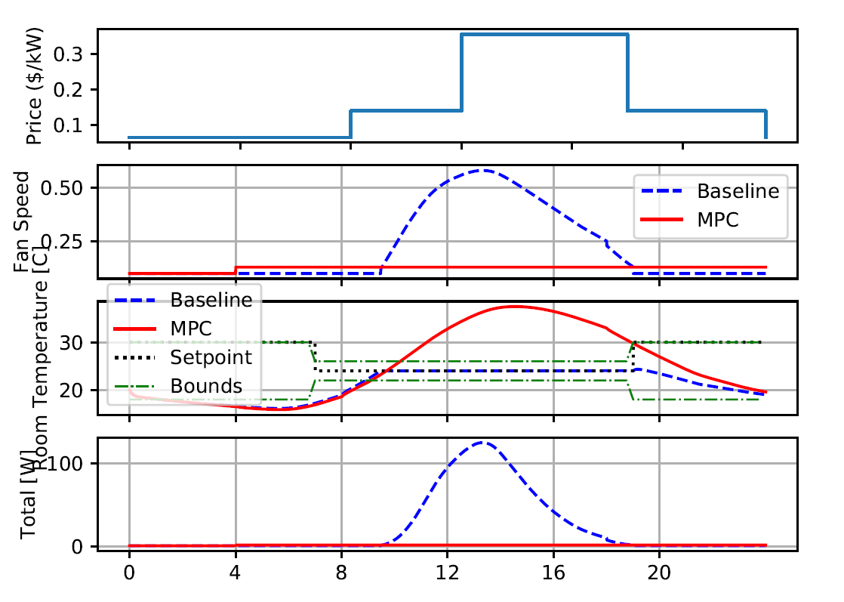
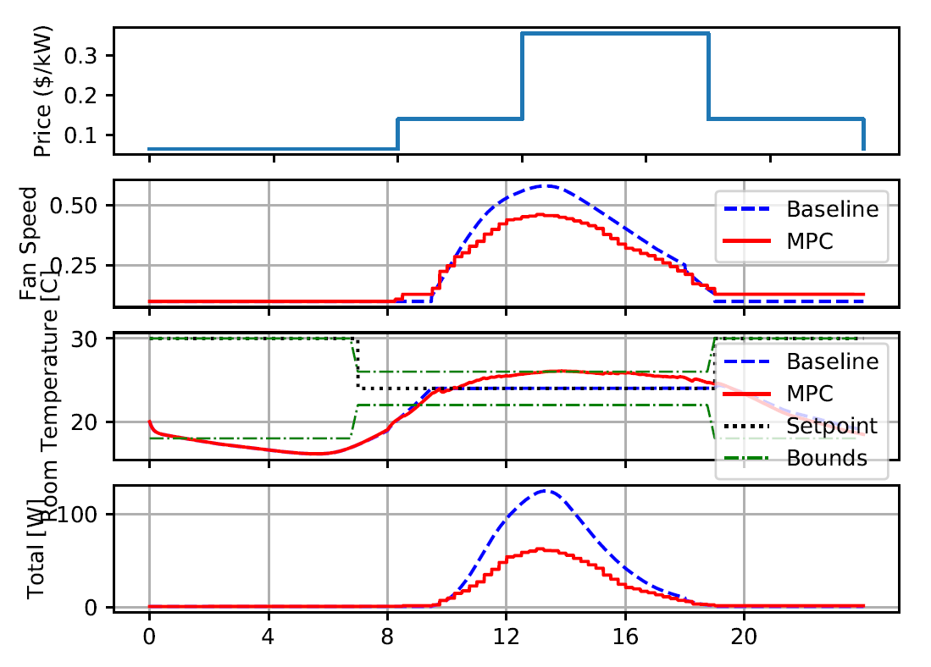
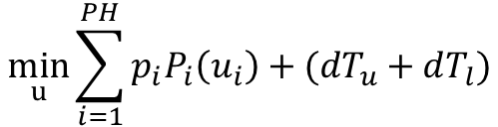

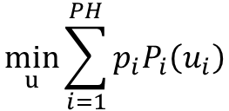
MPC
Model 2.2: PH=1
$$\min_{u}{\sum_{i=1}^{PH}{p_{i}P_{i}\left(u_{i}\right)}}$$
$$\min_{u}{\sum_{i=1}^{PH}{{(dT}_{u}+dT_{l})}}$$
$$\min_{u}{\sum_{i=1}^{PH}{{p_{i}P_{i}\left(u_{i}\right)+(dT}_{u}+dT_{l})}}$$

Slide 14
MPC
Model 2.2: PH=4
$$\min_{u}{\sum_{i=1}^{PH}{p_{i}P_{i}\left(u_{i}\right)}}$$
$$\min_{u}{\sum_{i=1}^{PH}{{(dT}_{u}+dT_{l})}}$$
$$\min_{u}{\sum_{i=1}^{PH}{{p_{i}P_{i}\left(u_{i}\right)+(dT}_{u}+dT_{l})}}$$

