Slide 1
MPC vs DRL

Slide 2

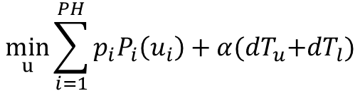
MPC Formulation
Objective
Design Variable
$$\min_{u}{\sum_{i=1}^{PH}{p_{i}P_{i}\left(u_{i}\right)+α{(dT}_{u}+dT_{l})}}$$
$$u=[u_{1},u_{2},…,u_{PH}]$$
Zone Air Flow Setpoint
OBJ: ALPHA tuning, Fan power , normalizing two terms on objective function

Slide 3
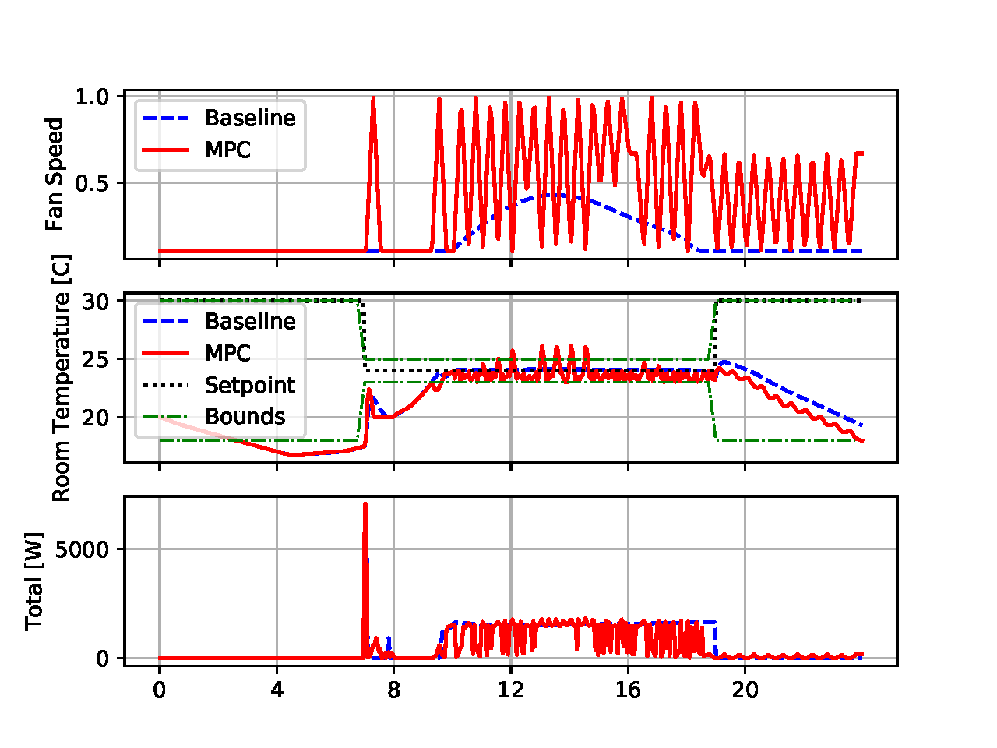
MPC Results

Slide 4
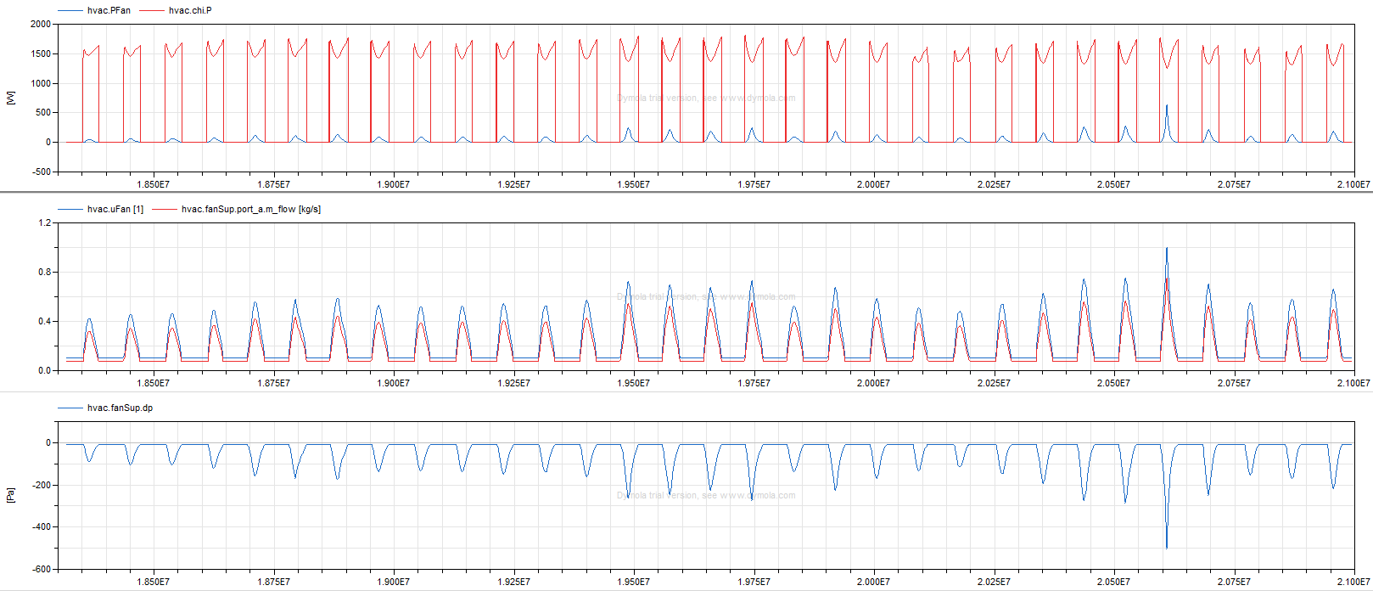
Issue 1
System total power is not sensitive to air flow control

Slide 5
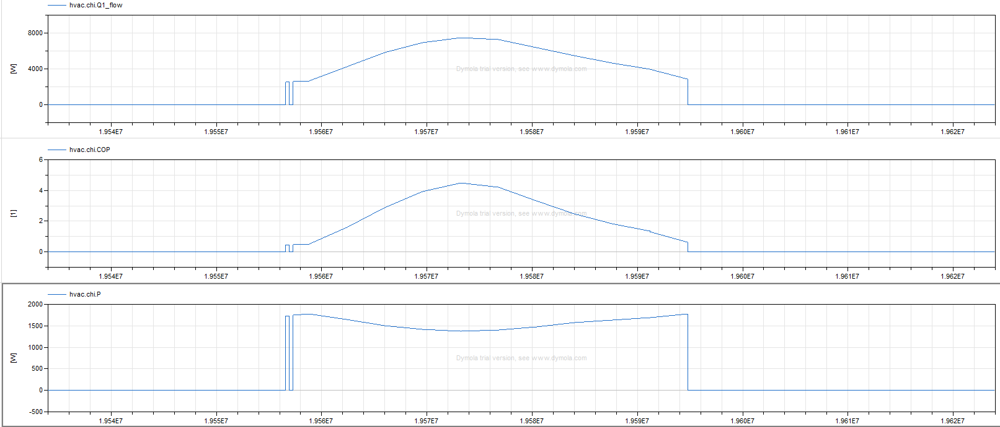
Issue 2
Possible: PLR~0.8, most efficient

Slide 6
Issue 3
Exceed constraint bounds
MPC optimizer may not converge
Alpha is not well-tuned
Is this a good MPC optimization problem???

Slide 7
To-Do
1. remove chiller power; normalize objective function, tune alpha
2. change application to control setpoints
3. Five-zone DRL environment

Slide 8
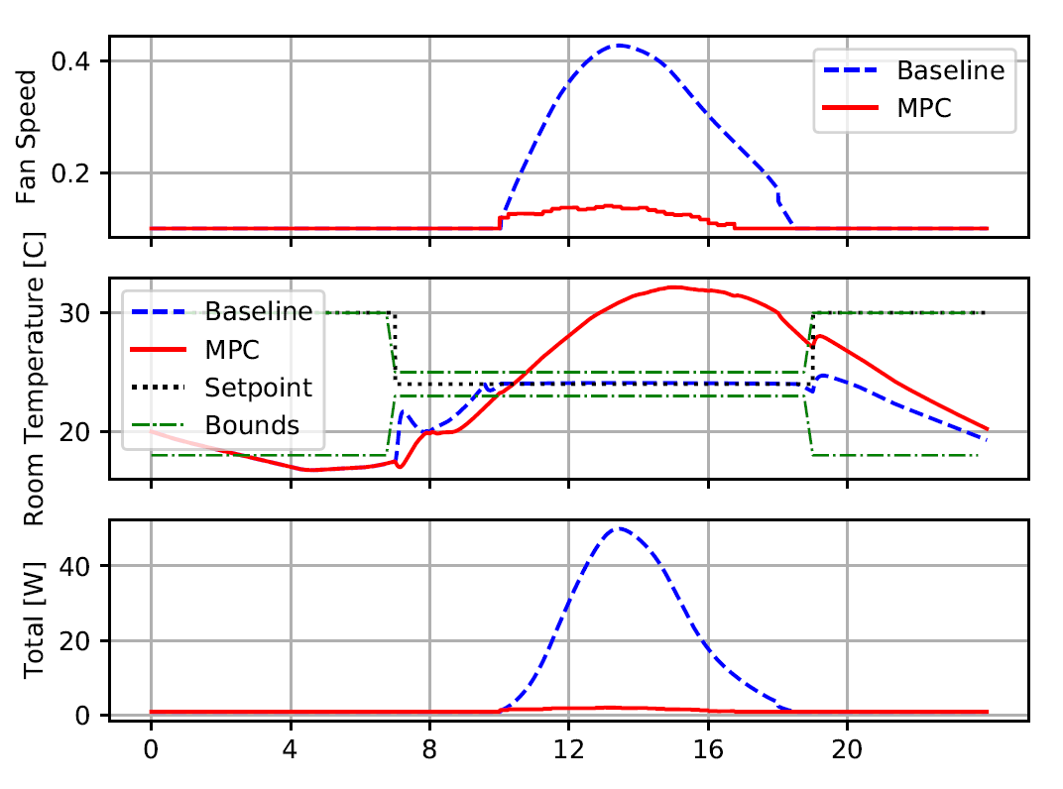
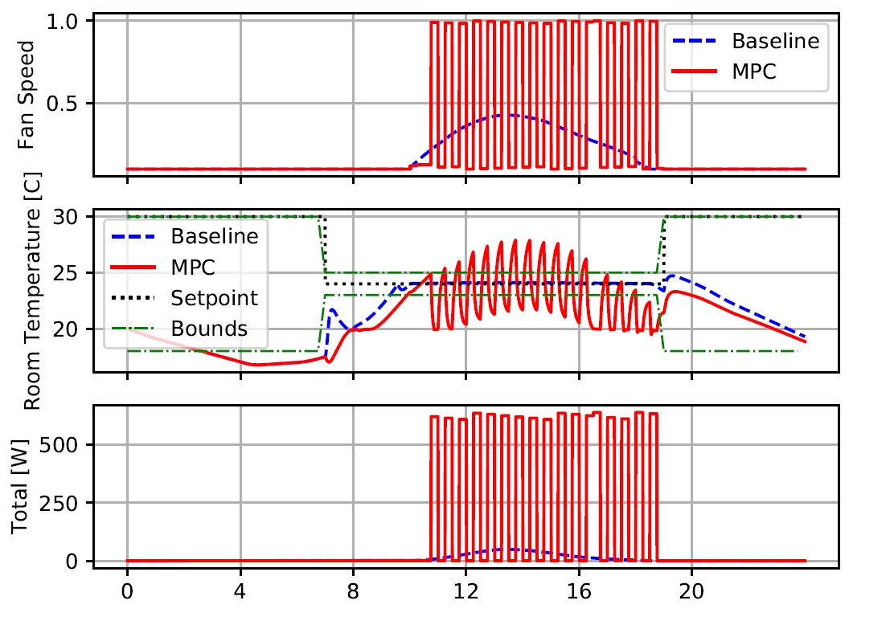
PH=1
Obj = power + temperature penalty
Obj = minimize fan power
Temperature predictor might have unacceptable errors
Power model uses only control inputs (fan air flow)

Slide 9
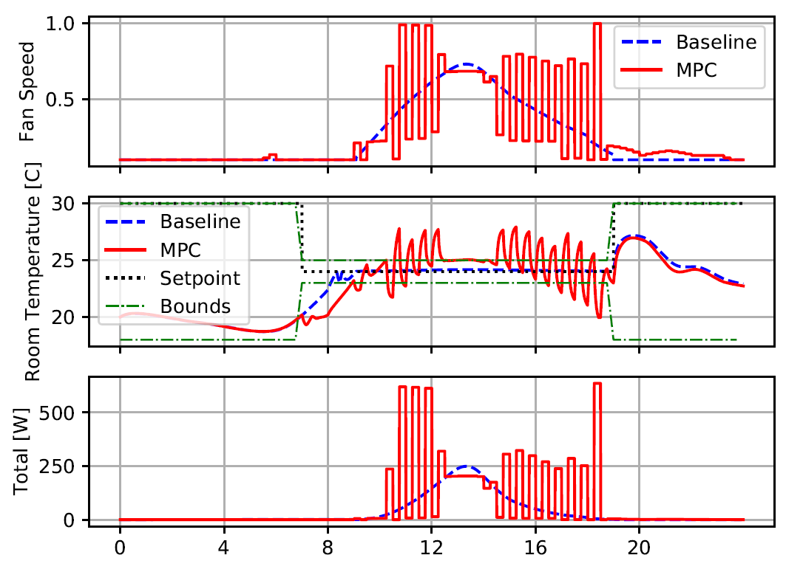
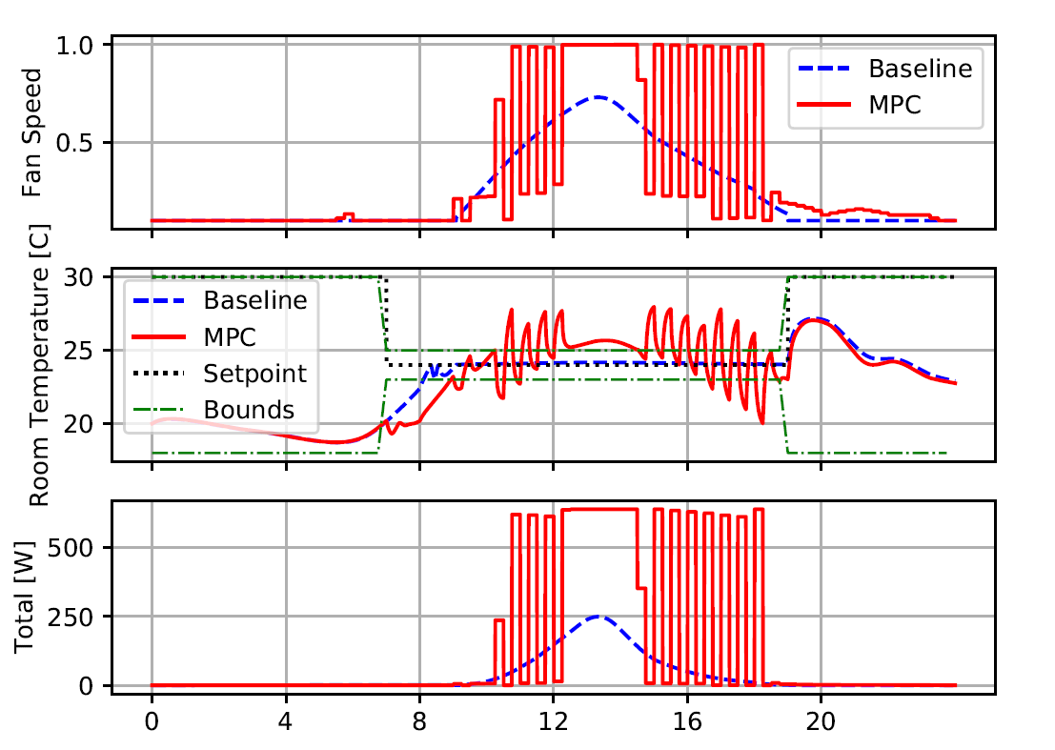
Alpha=0.1
Alpha=1.0

