Slide 1
MPC vs DRL

Slide 2
Preliminary Case Studies
Fan Coil Unit System
Zone
DX System
Zone
Env1: Single Zone FCU system:
Control variable: air flow rate
Objective: minimize energy cost while maintaining comfort level
Env2: Single Zone DX system:
Control variable: zone air temperature cooling setpoint
Objective: minimize energy cost while maintaining comfort level

Slide 3


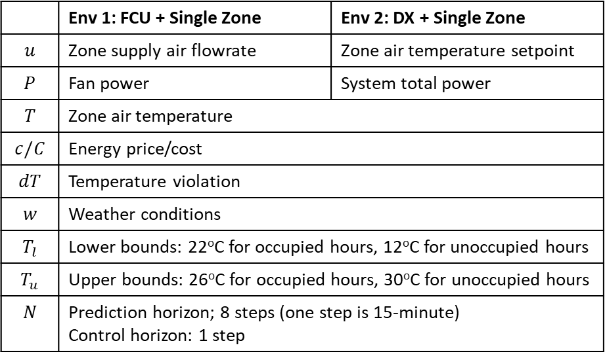

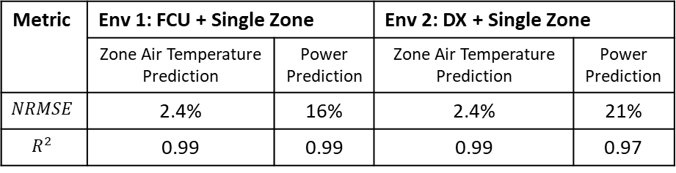

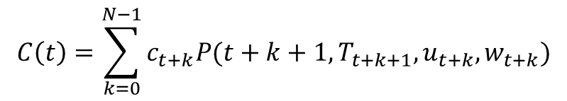
MPC Formulations
MPC Formulations
Max usuallt not used in MPC obj
Square \delta T
MPC Settings
 | Env 1: FCU + Single Zone | Env 2: DX + Single Zone
$$u$$ | Zone supply air flowrate | Zone air temperature setpoint
$$P$$ | Fan power | System total power
$$T$$ | Zone air temperature
$$c/C$$ | Energy price/cost
$$dT$$ | Temperature violation
$$w$$ | Weather conditions
$$T_{l}$$ | Lower bounds: 22ºC for occupied hours, 12ºC for unoccupied hours
$$T_{u}$$ | Upper bounds: 26ºC for occupied hours, 30ºC for unoccupied hours
$$N$$ | Prediction horizon; 8 steps (one step is 15-minute) Control horizon: 1 step
$$\min_{u(t)}{C(t)}+α\max_{t∈[t,t+N−1]}{(dT(t))}$$
Energy cost
Temperature violation penalty
$$C\left(t\right)=\sum_{k=0}^{N−1}{c_{t+k}P(t+k+1,T_{t+k+1},u_{t+k},w_{t+k})}$$
$$T_{t+k+1}=f\left(t+k,T_{t+k},u_{t+k},w_{t+k}\right), k=0,…, N−1$$
$$T_{t+k}∈[T_{l},T_{u}], k=0,…, N$$
$$dT\left(t\right)=\{{dT}_{t+1},…,{dT}_{t+N}\}$$
Metric | Env 1: FCU + Single Zone |  | Env 2: DX + Single Zone
 | Zone Air Temperature Prediction | Power Prediction | Zone Air Temperature Prediction | Power Prediction
$$NRMSE$$ | 2.4% | 16% | 2.4% | 21%
$$R^{2}$$ | 0.99 | 0.99 | 0.99 | 0.97
$$dT_{t+k}=\max\left(T_{t+k}−T_{u},T_{l}−T_{t+k},0\right), k=1,…, N$$
$$u\left(t\right)=\{u_{t},…,u_{t+N−1}\}∈U$$

Slide 4

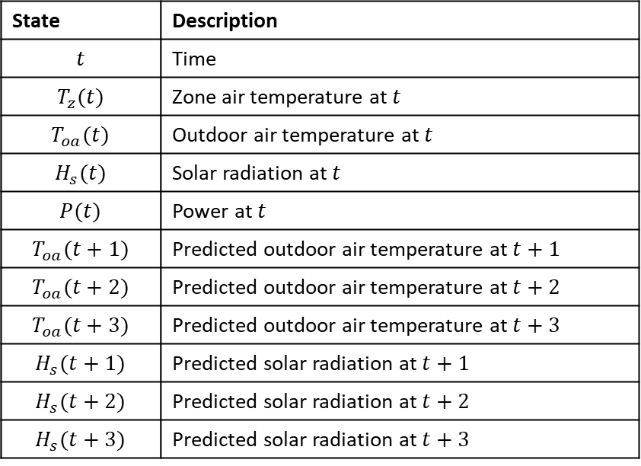
DRL Formulations
Reward
States Design
$$−(C(t)+α\max_{t∈[t,t+1]}{(dT(t)))}$$
Same settings as MPC
State | Description
$$t$$ | Time
$$T_{z}(t)$$ | Zone air temperature at $t$
$$T_{oa}(t)$$ | Outdoor air temperature at $t$
$$H_{s}(t)$$ | Solar radiation at $t$
$$P(t)$$ | Power at $t$
$$T_{oa}(t+1)$$ | Predicted outdoor air temperature at $t+1$
$$T_{oa}(t+2)$$ | Predicted outdoor air temperature at $t+2$
$$T_{oa}(t+3)$$ | Predicted outdoor air temperature at $t+3$
$$H_{s}(t+1)$$ | Predicted solar radiation at $t+1$
$$H_{s}(t+2)$$ | Predicted solar radiation at $t+2$
$$H_{s}(t+3)$$ | Predicted solar radiation at $t+3$
Energy cost
Temperature violation penalty
Learning Algorithm Settings
Learning Algorithm – DQN
Deep learning ANN architecture – [nStates, 50, 100, 200, 400, nActions]
Learning rate: 0.0003
Decay factor: 0.99
Training Settings
Number of epochs: 50
Control time step: 15 min

Slide 5
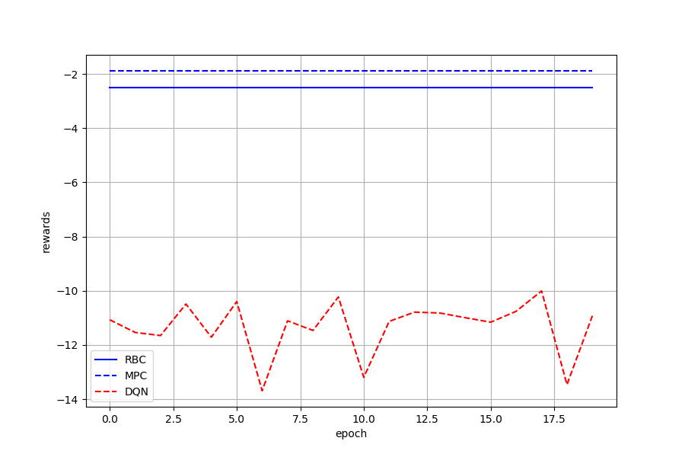
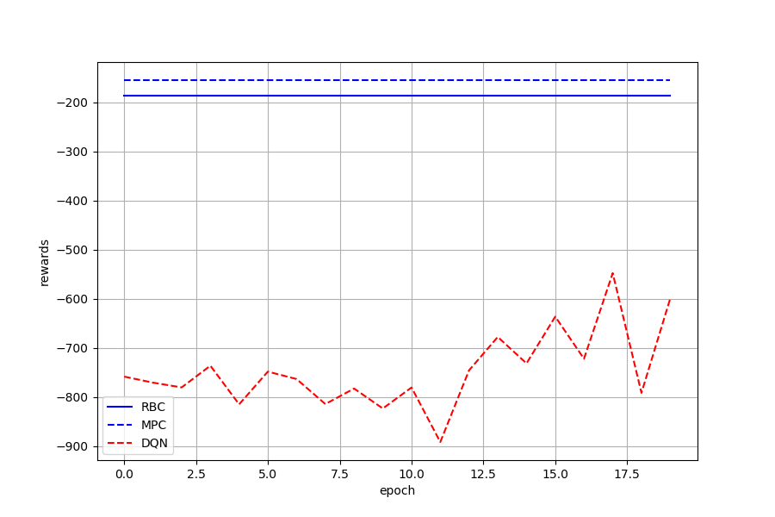
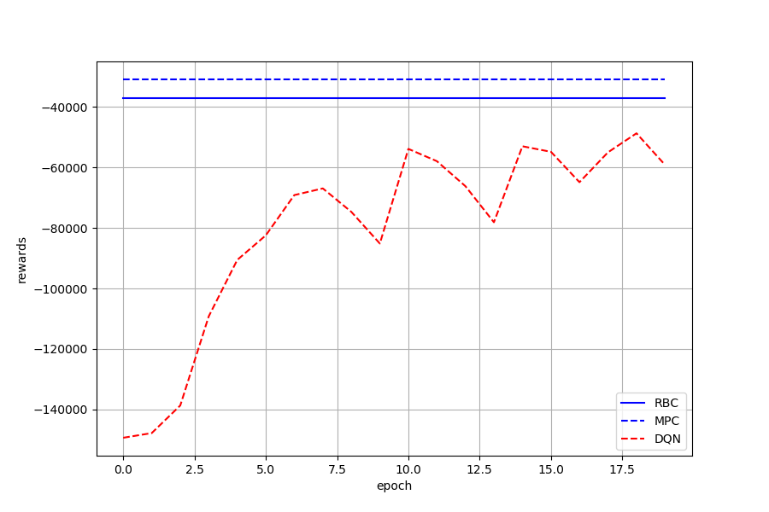
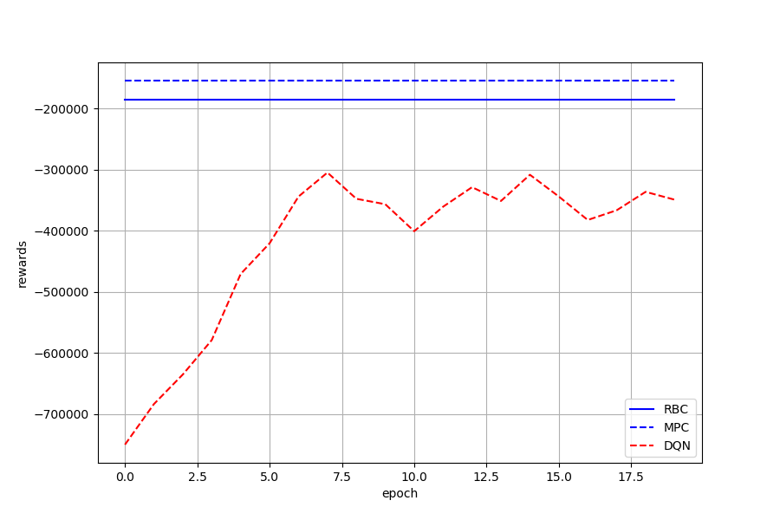




Env 1: FCU Fan Speed Control – Epochs=20
$α$=0.01
$α$=1
$α$=100
$α$=1000

Slide 6
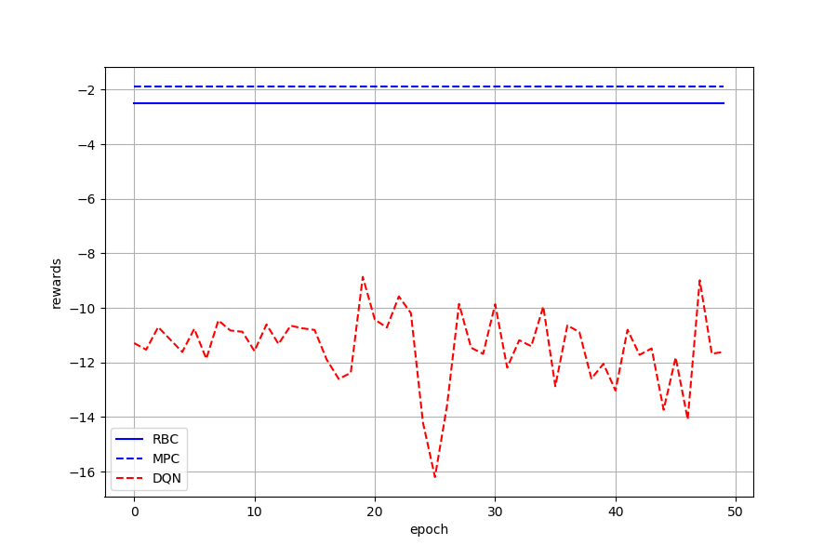
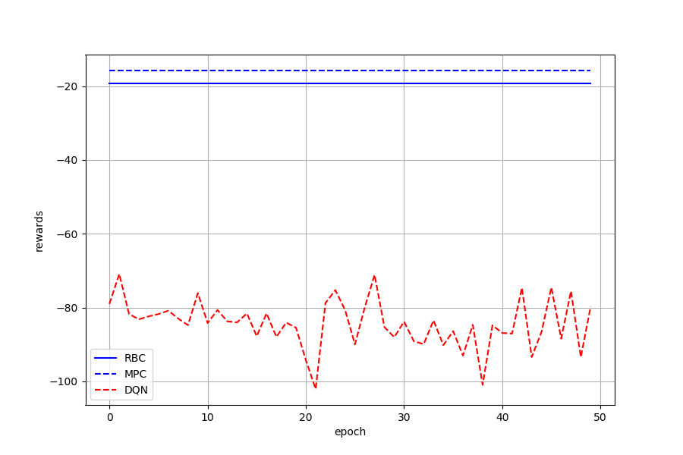
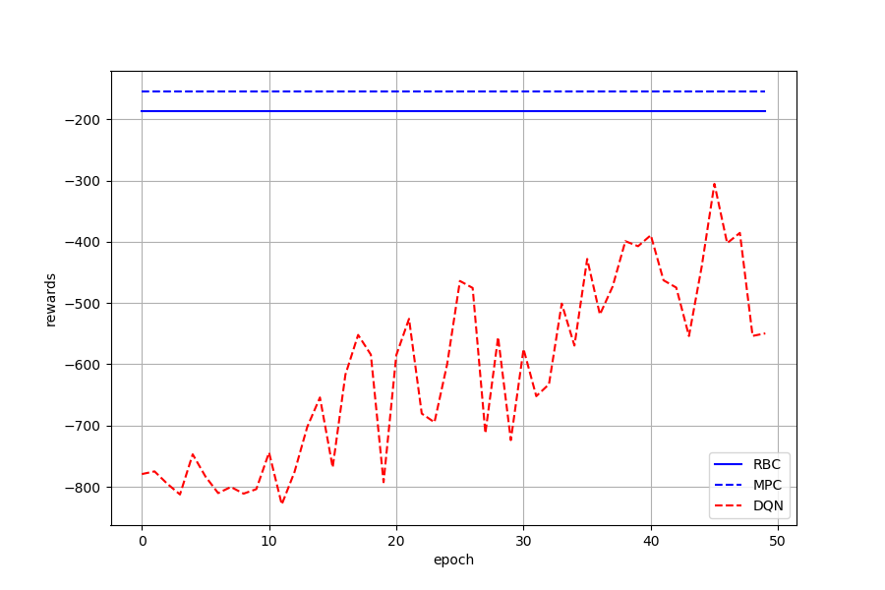
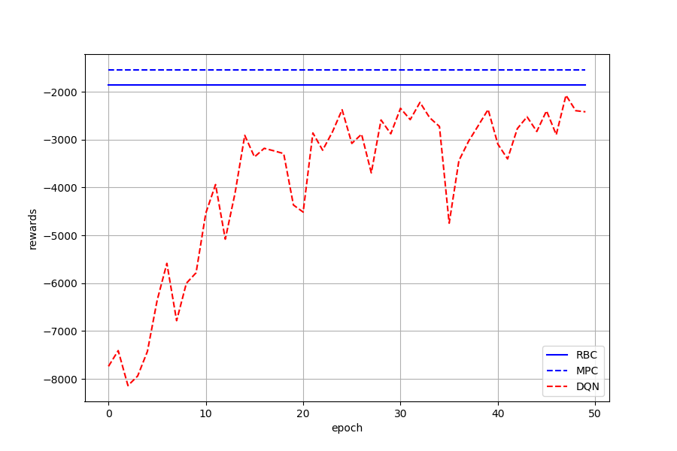
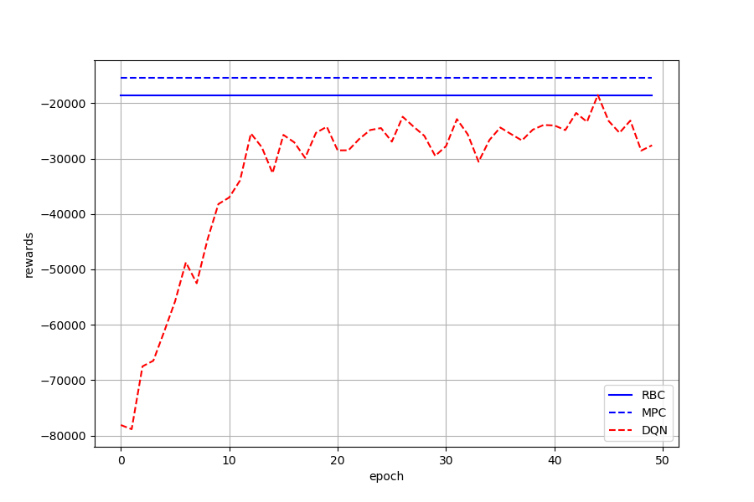
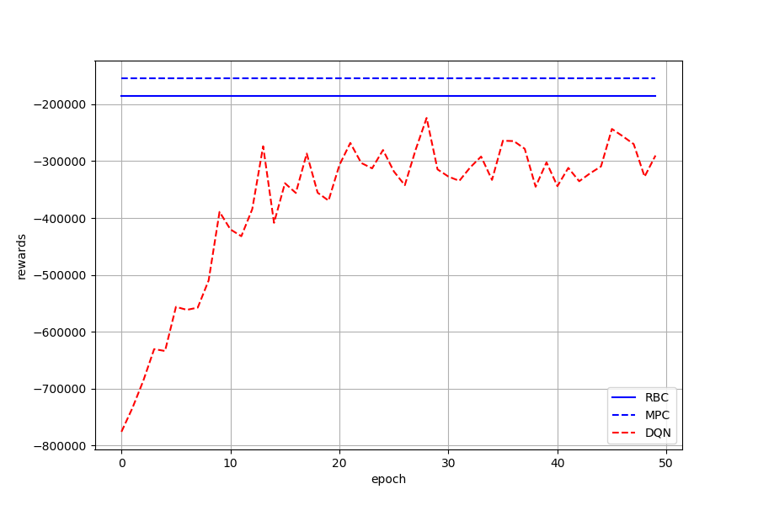






Env 1: FCU Fan Speed Control – Epochs=50
$α$=0.01
$α$=0.1
$α$=1
$α$=10
$α$=100
$α$=1000

Slide 7
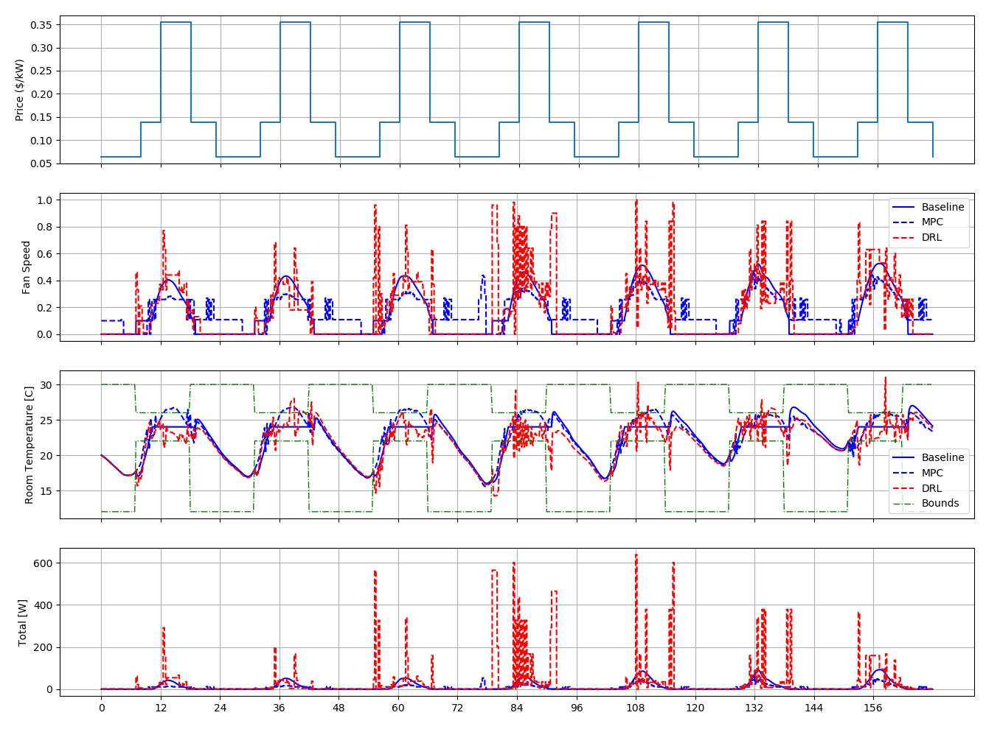
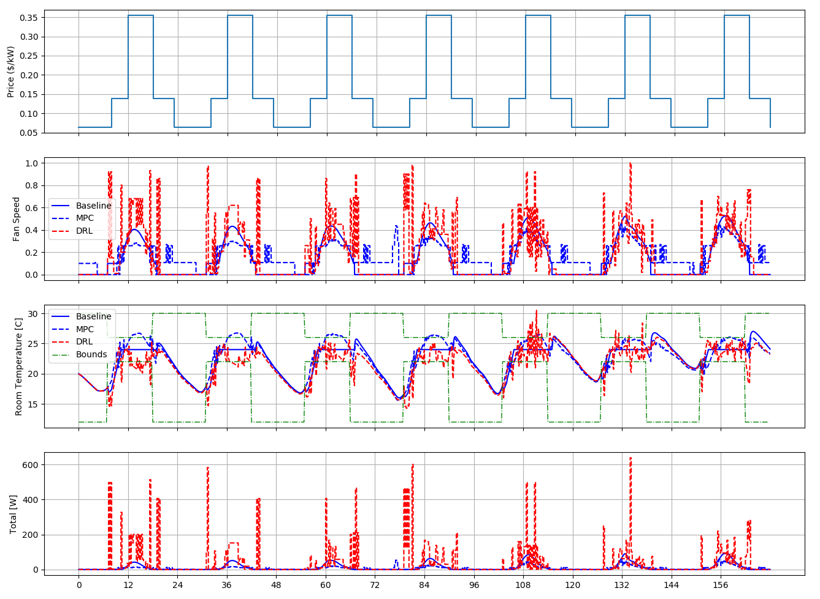


epoch=50, $α$=10
epoch=50, $α$=1000

Slide 8
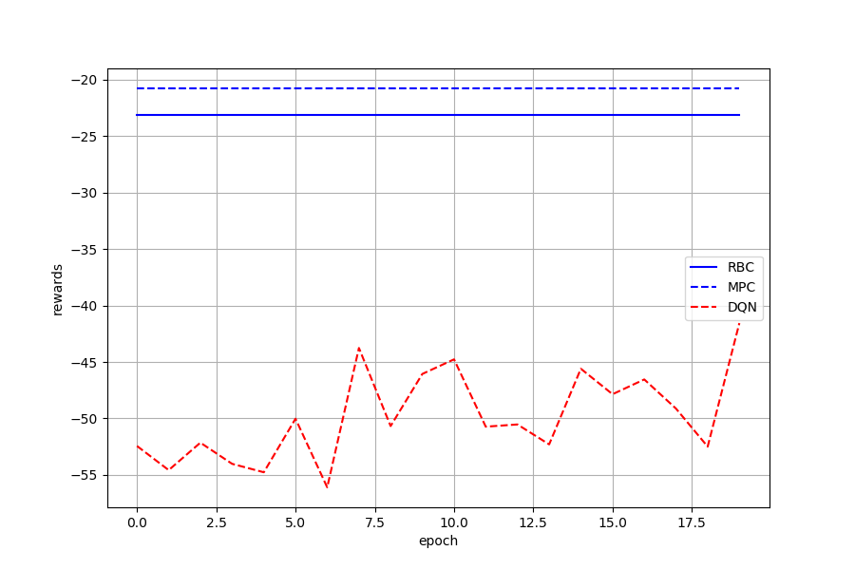
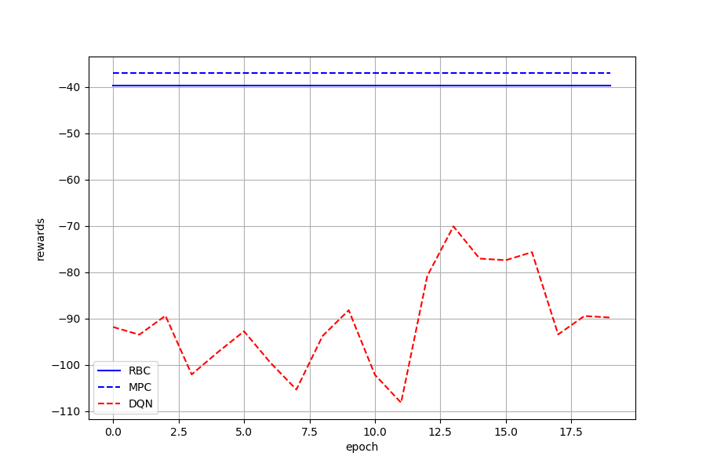
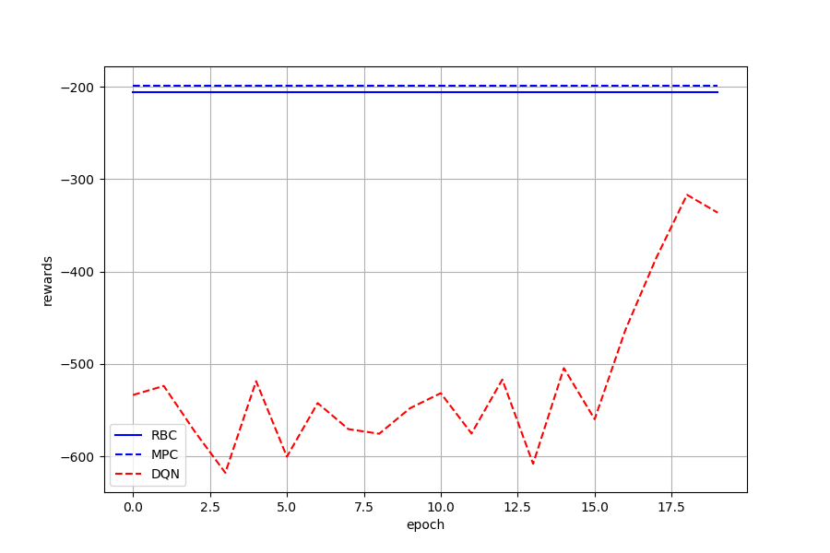
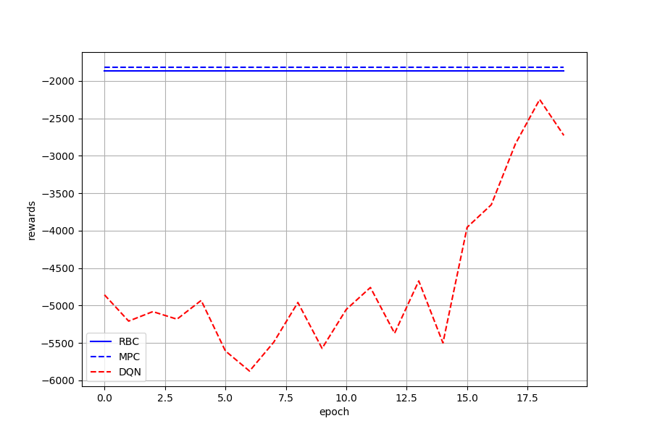
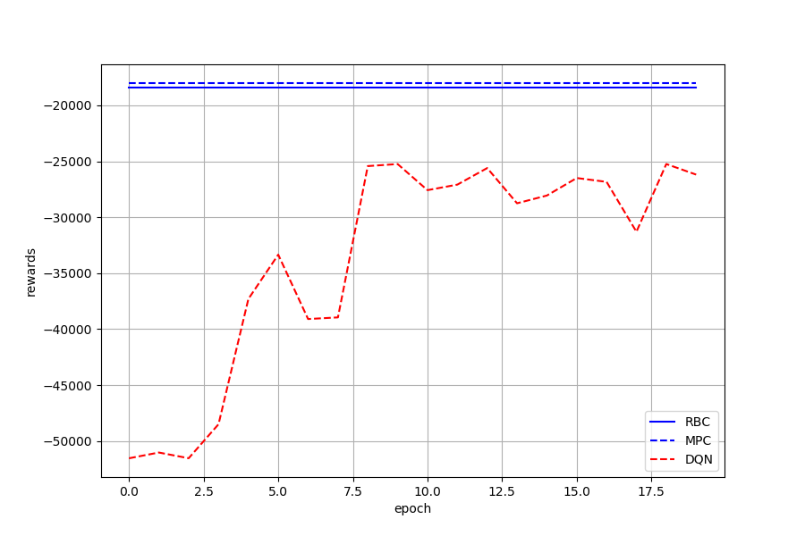
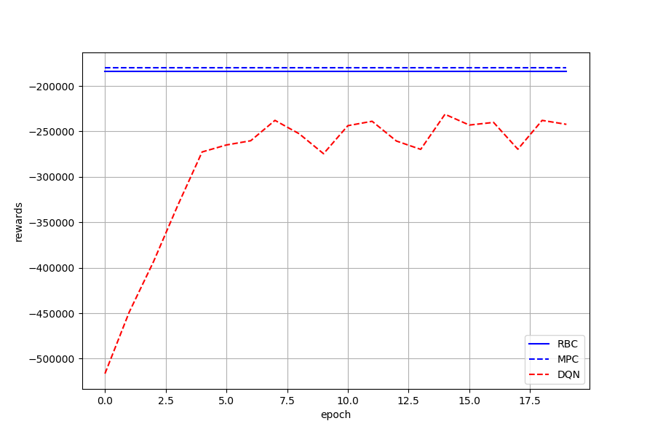
Env 2: DX System Control – Epochs=20
$α$=0.01
$α$=0.1
$α$=1
$α$=10
$α$=100
$α$=1000

Slide 9
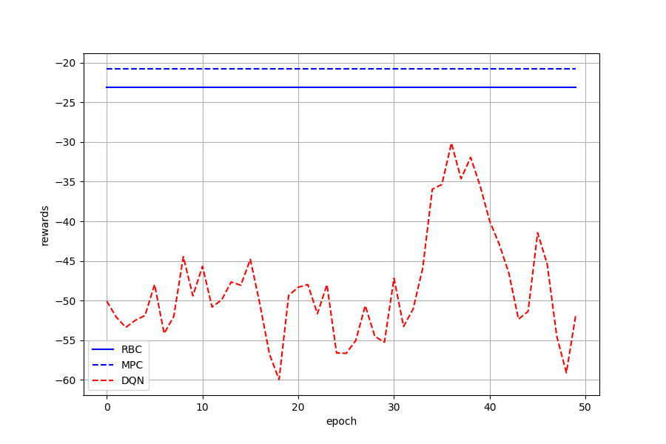
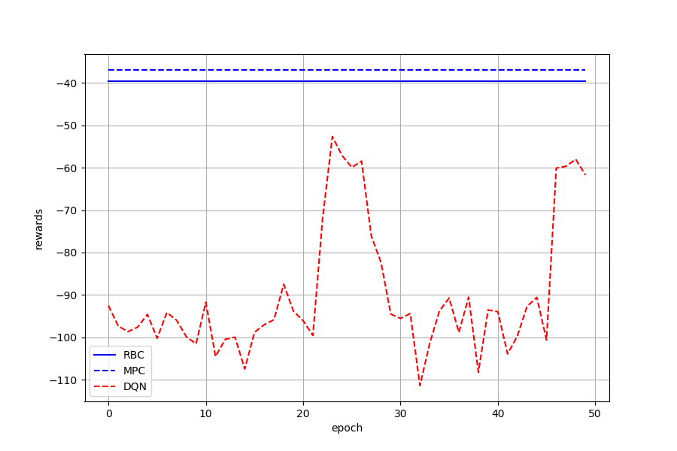
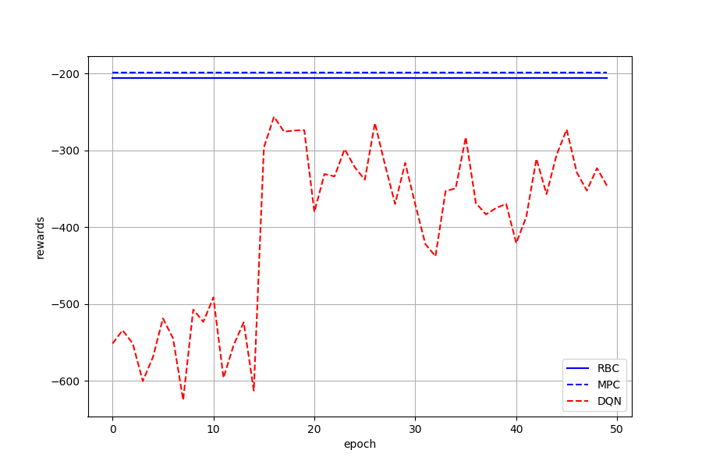
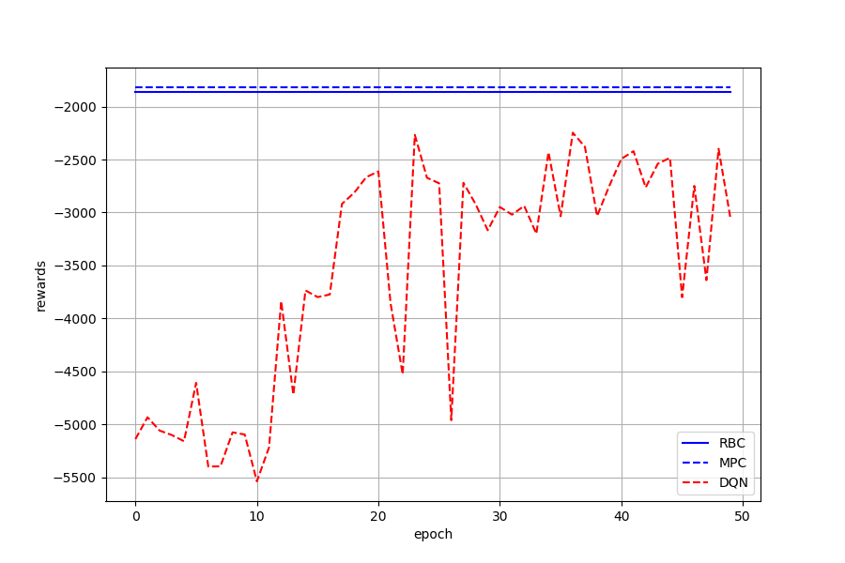
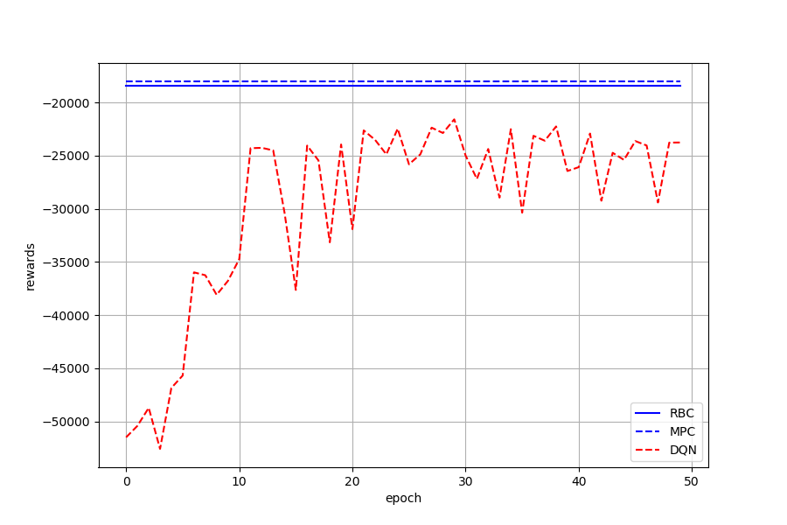
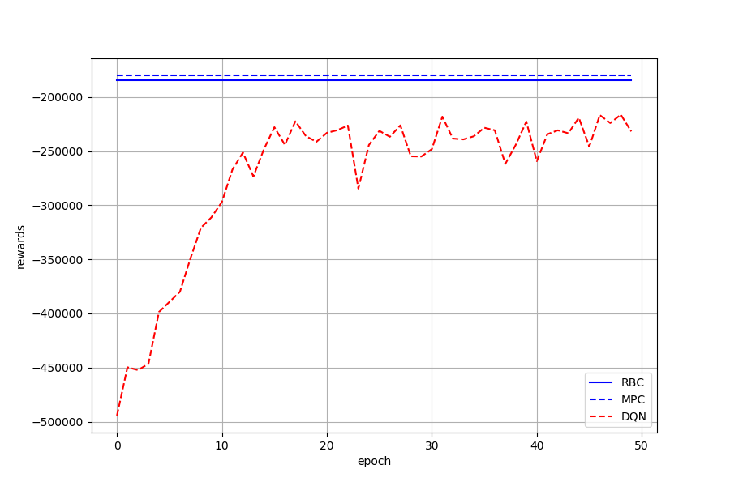
Env 2: DX System Control – Epochs=50
$α$=0.01
$α$=0.1
$α$=1
$α$=10
$α$=100
$α$=1000

Slide 10
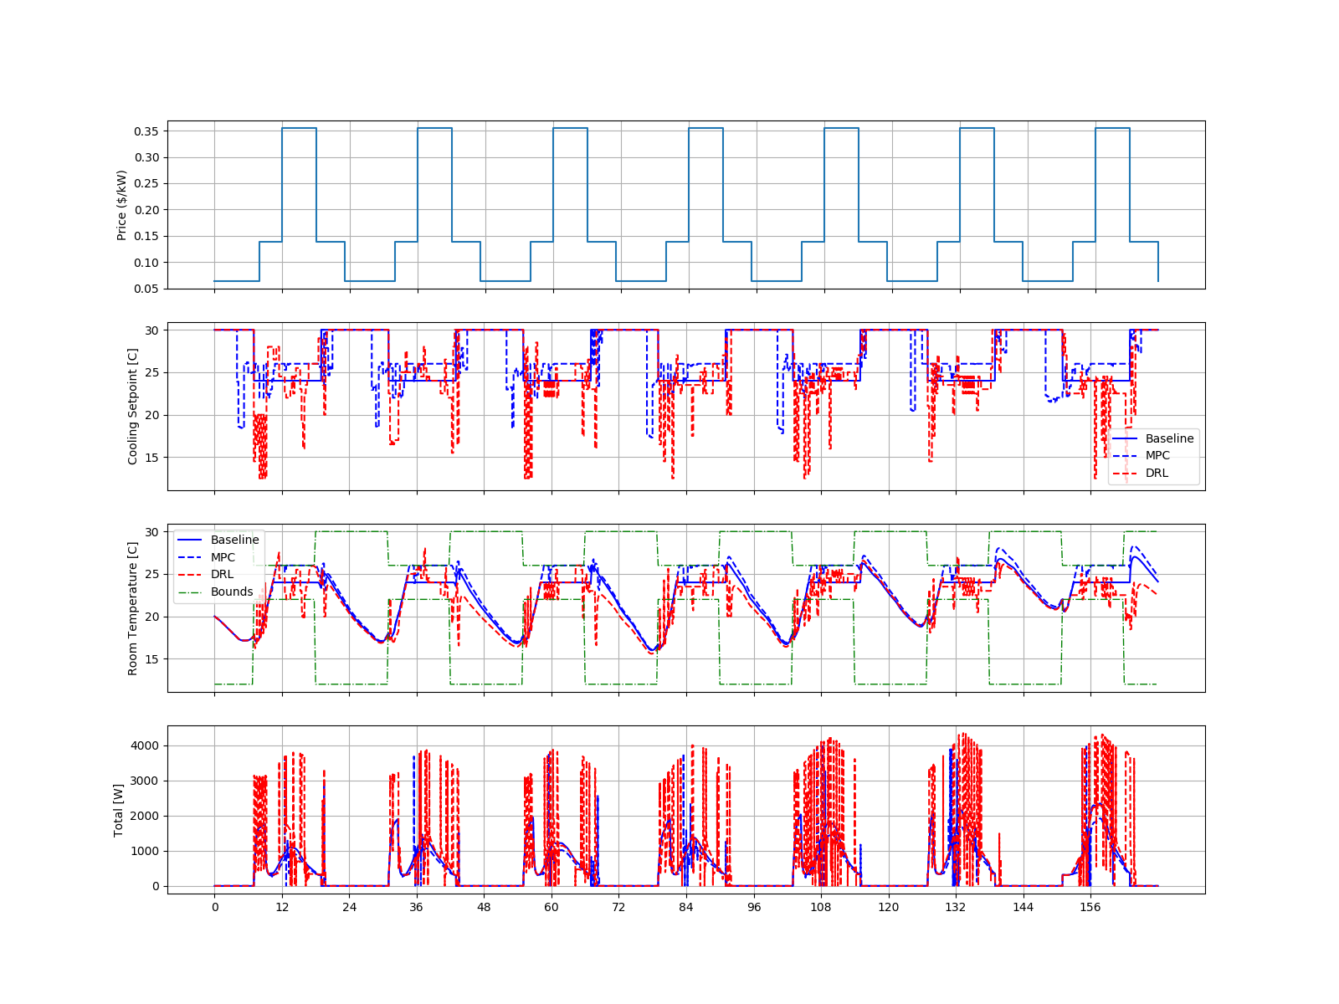
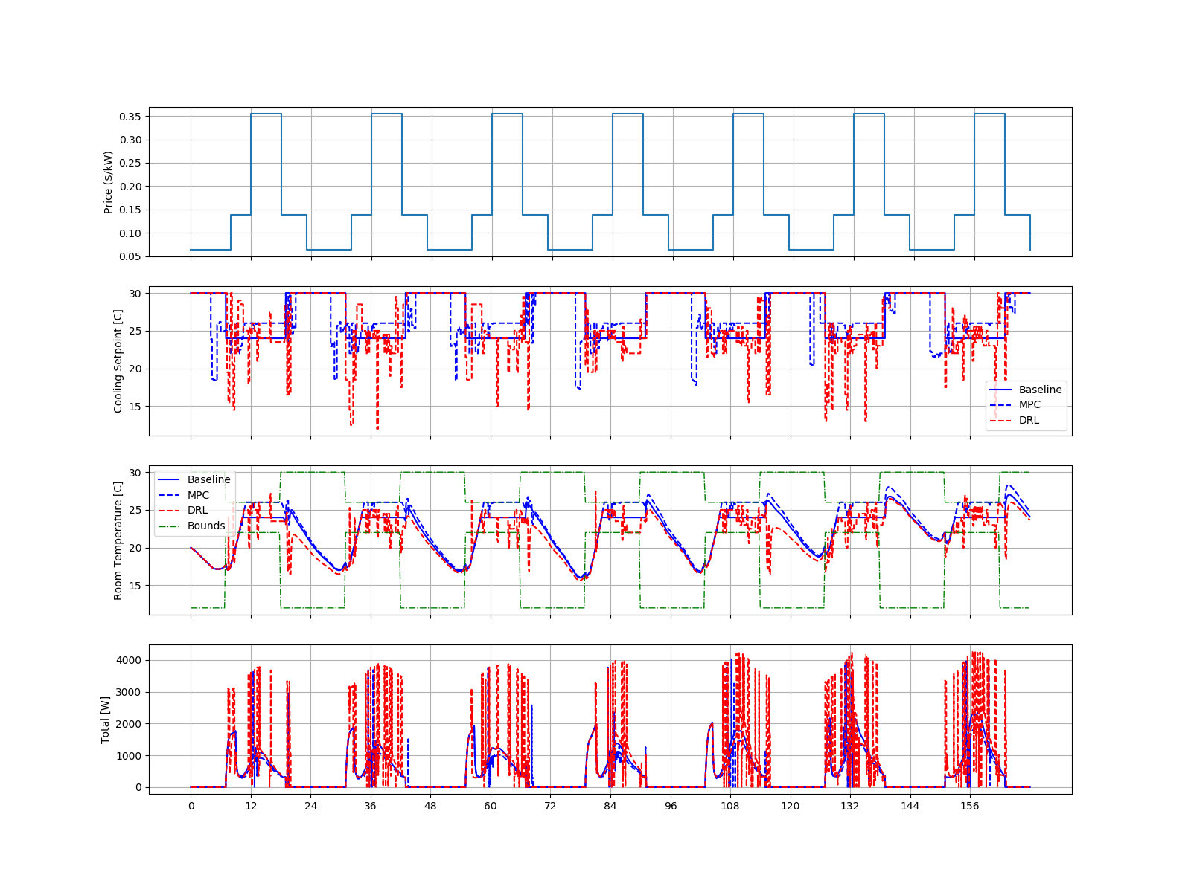

epoch=50, $α$=100
epoch=50, $α$=1000

Slide 11
Some thoughts
1. Comparison Matrix:
- Reward is not the only metric
- Other control objectives should also be compared
2. Tuning DRL is time-consuming
- Multiple factors – need significant tome to figure out the impact of each parameter
3. What information we can get from “training epochs”?
- How to interpret training epochs to the number of data required for training DRL?
- How this can guide practical training

Slide 12
!!! Formulation; states?reward? Reference-tracking problem?
DRL for linear
cost function – setpoint tracking
! - Other DRL? - Tianshou DRL package in docker: https://tianshou.readthedocs.io/en/master/index.html
Should include historical measurements in DRL states? As in MPC
Noisy inputs might be useful
X. DRL reward – how many steps ahead
6. Compare real performance instead of only rewards
Done
. Implementaion of controls for comparison
. Objective formulation (value) might not be of interest
. Setpoints/control actions
. Energy cost,
. Tmeperature …
7. MPC is better maybe because of MPC is nosiy-free.
8. Max make the reward function nonlinear? For MPC
10. Can we get future rewards from DRL and compare??
11. DRL trianinig time – continuous states more time consuming than discrete
(1). Speed up from historical measurement?

