Slide 1
Model Predictive Control VS Deep Reinforcement Learning Control
Building HVAC System
Yangyang Fu
Texas A$M University
10/28/2020

Slide 2
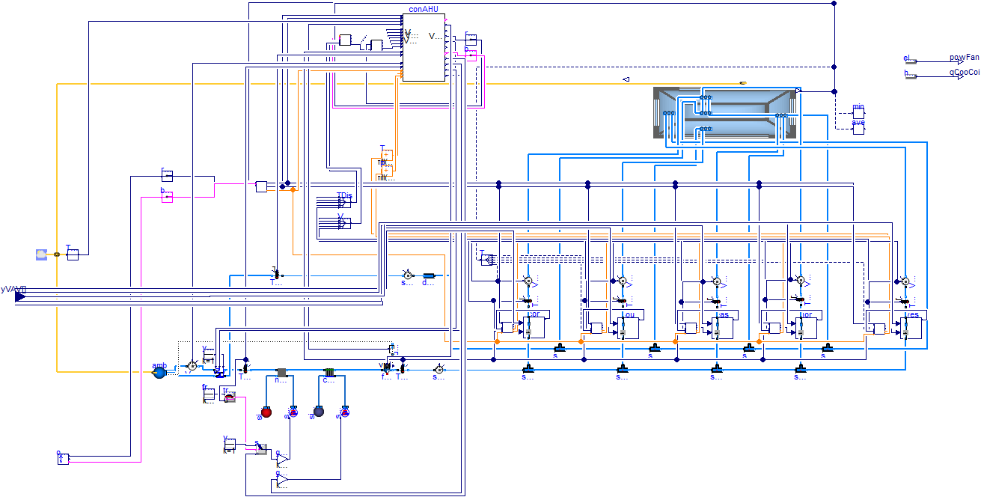
System Description
Building HVAC – air side
Five Zones – medium office
Control Testbed
Inputs: VAV damper position:
States: zone temperatures
Output: power or heat flow

Slide 3
Simulation Environment (Ongoing)
Github: https://github.com/YangyangFu/mpc-drl-tl.
Integrated environment for deep reinforcement learning using Modelica
Jmodelica: simulate Modelica-based building energy system
Opengym: interface for using Modelica models as DRL environment
Pytorch: develop DRL algorithms
Environment is contained as a Docker file.
Build a tutorial of using this environment to solve the “pole-cart” problem

Slide 4
Simulation Environment: To-do
To-do:
Test VAV.fmu compilation and simulation - TAMU
Configure DRL environement using VAV.fmu - TAMU
Develop MPC for VAV model - TAMU
Develop DRL/TL for VAV model - NU

