Slide 1
ETL Project
COVID-19 Deaths vs Unemployment Claims In the US
Minhua Wu, Rachael McLaughlin, Yangzi Xin, Shailaja Madasu
Notes:
Jas

Slide 2
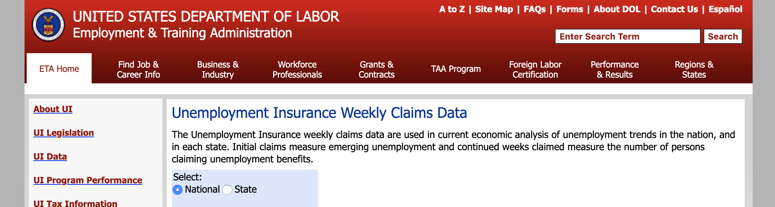

EXTRACTED data from two csv files
https://oui.doleta.gov/unemploy/claims.asp
https://datahub.io/core/covid-19
Notes:
Shailaja

Slide 3
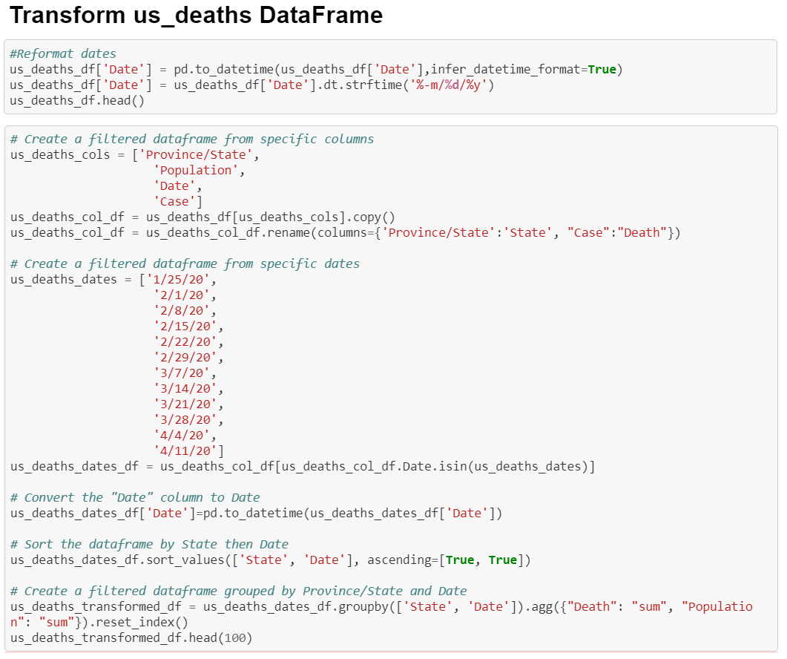
Transformed tables in Jupyter Notebook
Dropped some columns and renamed them to better clarify the variables and for easier reference
Filtered dates then convert the data type from string to date
Grouped by “State” and “Date”, summing “Population” and “Death” columns
Notes:
Minhua

Slide 4
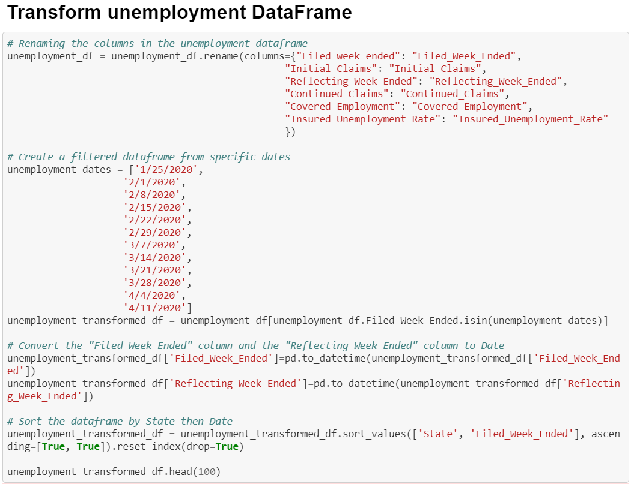
Transformed tables in Jupyter Notebook
Unemployment Weekly Claims data is already grouped by state, so we didn't have to group any data.
Kept all the columns and renamed them for easier reference
Converted the columns that contain dates: from string to date
Converted the columns that contain numbers: from string to float
Filtered date range: using the "Filed_Week_Ended" column to filter from 1/25/20 to 4/11/20
Notes:
Minhua

Slide 5
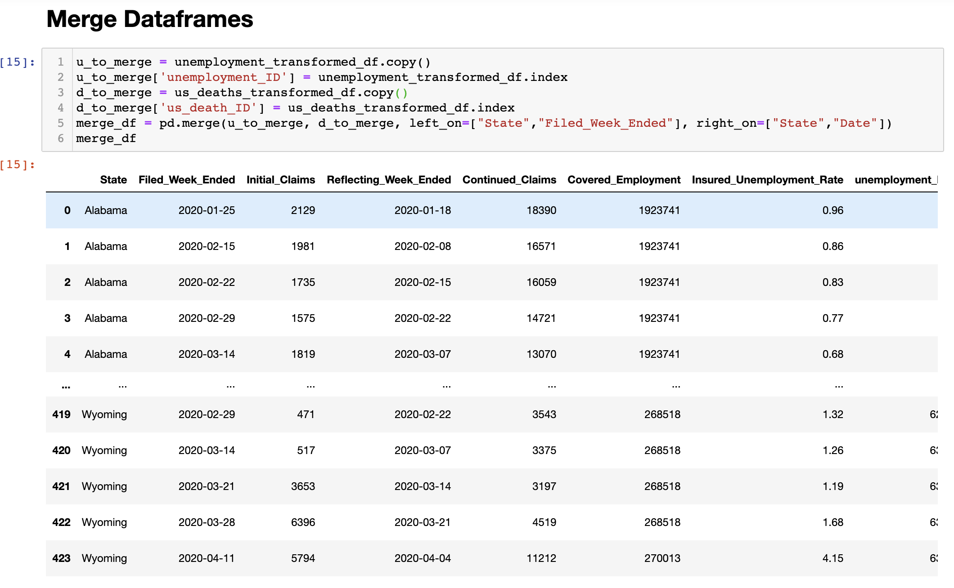
Merging Tables
Merged tables by “State” and “Date”, requiring a left_on and right_on join
To establish relationship of tables, required creating columns of each table’s IDs in merged table
Notes:
Rachael

Slide 6
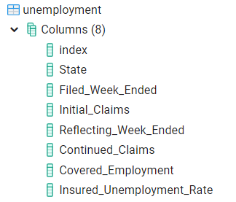
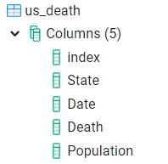
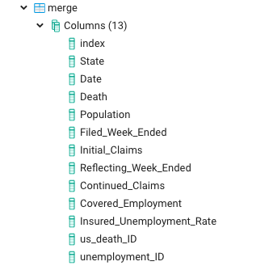
Loaded tables in Postgres
Notes:
Shailaja

Slide 7
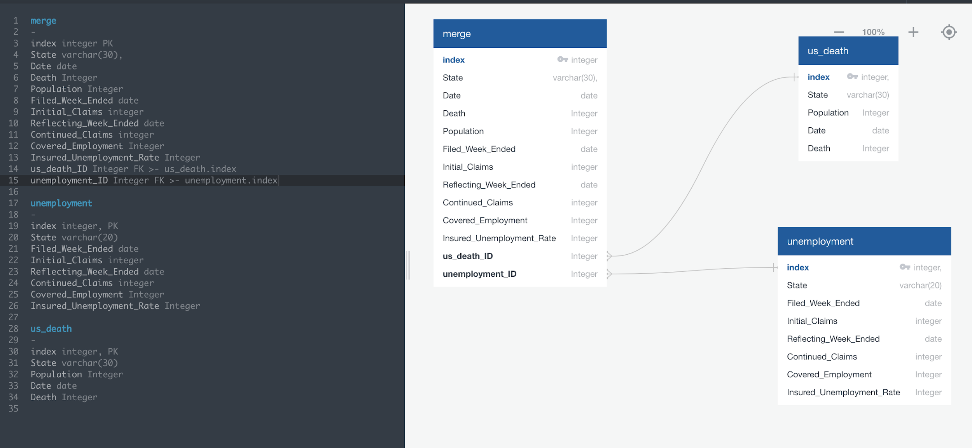
ERD
Primary Keys: Respective Indices
Foreign Keys: Connection between indices
Notes:
Rachael

Slide 8
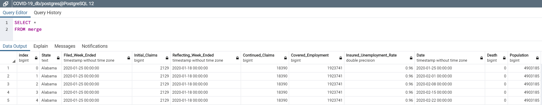
Postgres Simple Query
Notes:
Shailaja

Slide 9
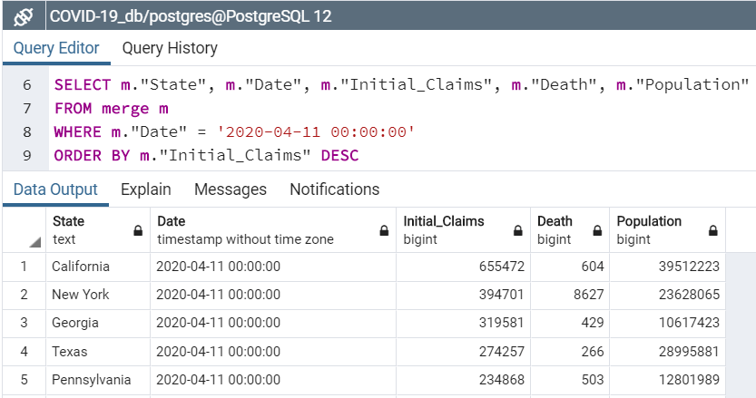
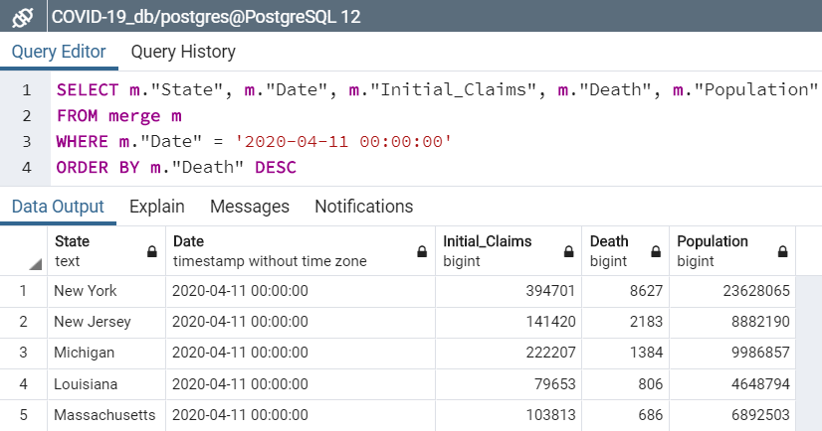
Postgres Queries
← Order by unemployment claims as of 4/11/20
Order by death counts as of 4/11/20 →
Notes:
Shailaja

Slide 10
Things We Learned
ERD took some time to figure out the appropriate primary and foreign keys, but helped to better understand the data and merging of tables
We realized that US Death Count data was cumulative and collected by day, which required more in the transformation stage
Notes:
Rachael

Slide 11
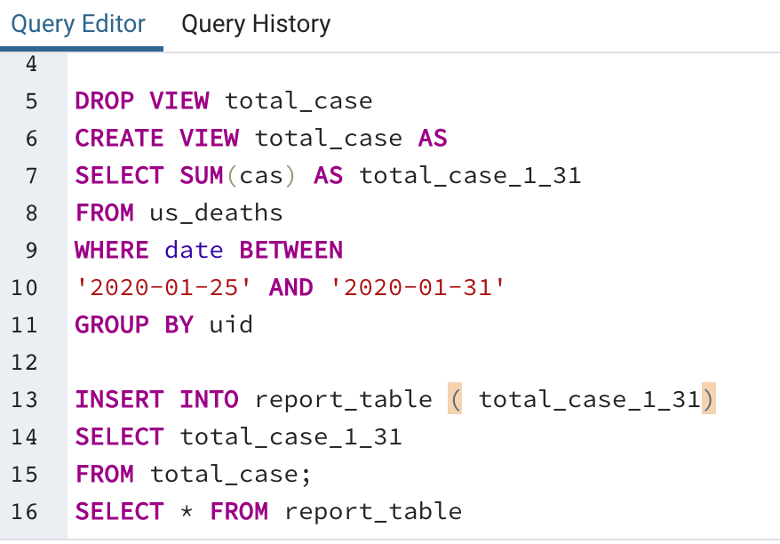
Things We Learned (Continued)
The vast majority of the operations done with SQL can be done more easily with Pandas when dealing with large datasets.
Notes:
Jas

