Slide 1
Love Read Application
Info 5100 Final Project
Yanhong Chen
Huayi Zou
Qianru Yi

Slide 2
PREFACE
Love Read is a sweet assistant to help ecosystem management and work request communication.

Slide 3
Problem Statement
In this era, when people are attracted by short information, fewer and fewer people spend their time reading books. we expect that more people can concentrate on reading books. At the same time, we also hope that people can recycle old books, not only save resources but also share knowledge with others.

Slide 4
Problem Statement
For our ecosystem, we are trying to provide quality books for people and build a robust old book recycling system. We establish an ecosystem which includes networks in different areas such as Boston and London. Each network has two enterprises: BookRecycleEnterprise and BookStoreEnterprise. We achieve communication between networks: transfer books between BookStore under different networks, communication between enterprises: BookRecycleEnterprise supply second-hand books to BookStore, communication between organizations: commit books, rate books, buy books, manage book inventory, price books, book recycling and other work requests flow between multi-enterprises.

Slide 5
Our Team Timeline
Select topic of project, design program architecture
Implement functionality and merge together
Before November 20
Before December 1
After December 1
Implement structure and role functions

Slide 6
Project Overview
Teamwork - Functionalities
CONTENTS
Project Demo Screenshots

Slide 7
Project Overview
Approach & Object Model

Slide 8
Approach
The project is based on JAVA Language
The front panels are implemented through Java Swing technique
The panel layout includes absolute layout and card layout, importing AbsoluteLayout.jar
The data storage module is based on DB4O database technique, importing db4o jar in java 5 version
The project is implemented through Netbeans IDE 8.0.2

Slide 9
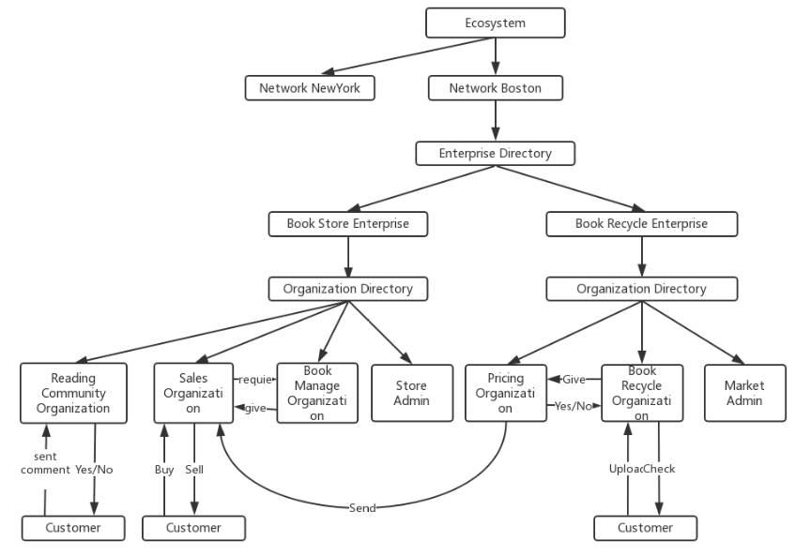

Project Structure
PPT模板下载：www.1ppt.com/moban/ 行业PPT模板：www.1ppt.com/hangye/
节日PPT模板：www.1ppt.com/jieri/ PPT素材下载：www.1ppt.com/sucai/
PPT背景图片：www.1ppt.com/beijing/ PPT图表下载：www.1ppt.com/tubiao/
优秀PPT下载：www.1ppt.com/xiazai/ PPT教程： www.1ppt.com/powerpoint/
Word教程： www.1ppt.com/word/ Excel教程：www.1ppt.com/excel/
资料下载：www.1ppt.com/ziliao/ PPT课件下载：www.1ppt.com/kejian/
范文下载：www.1ppt.com/fanwen/ 试卷下载：www.1ppt.com/shiti/
教案下载：www.1ppt.com/jiaoan/
字体下载：www.1ppt.com/ziti/

Slide 10
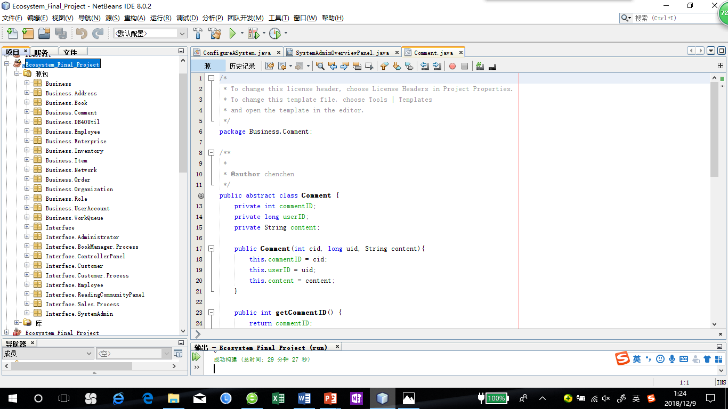
Class Structure

Slide 11
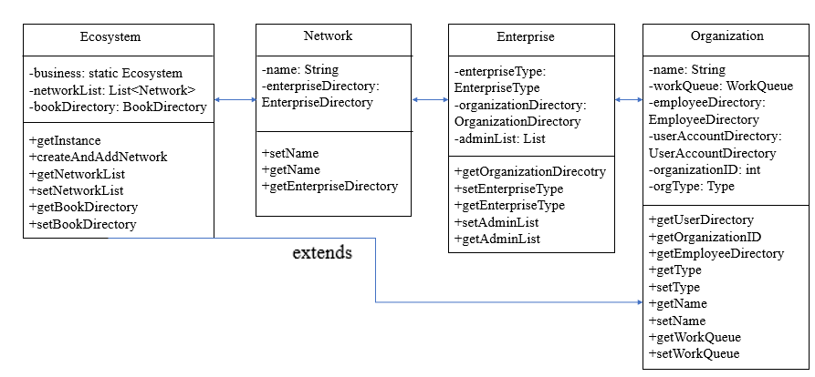
Review – Project Object Model

Slide 12
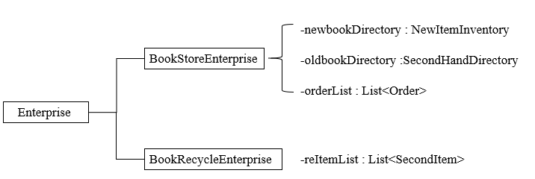
Review – Project Object Model

Slide 13
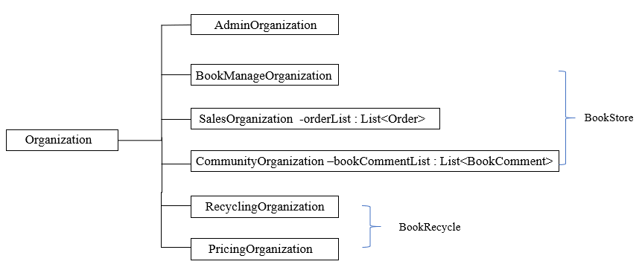
Review – Project Object Model

Slide 14
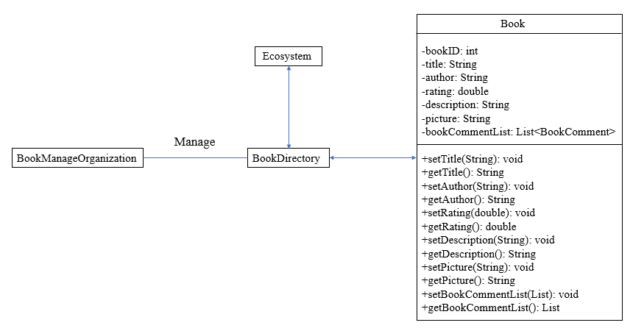
Review – Project Object Model

Slide 15
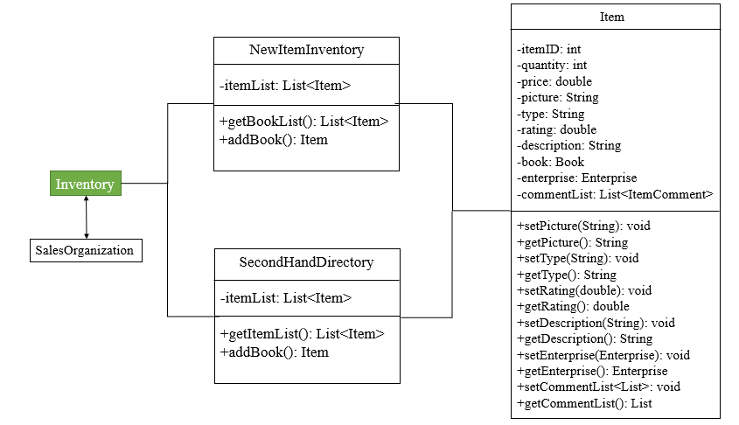
Review – Project Object Model

Slide 16
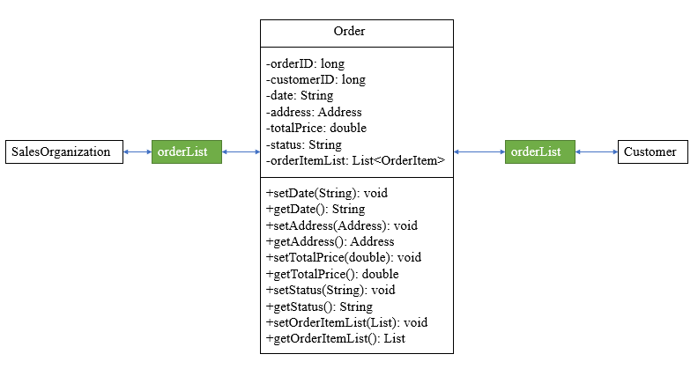
Review – Project Object Model

Slide 17
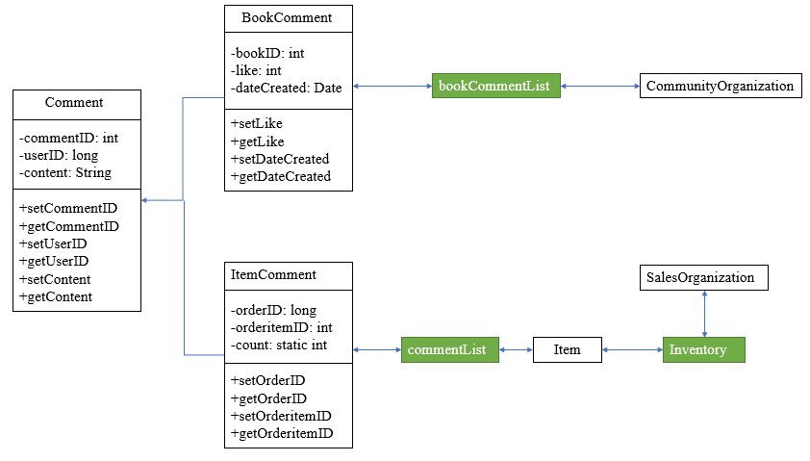
Review – Project Object Model

Slide 18
Teamwork - Functionalities
Functionalities Implementation

Slide 19
Functionallities
System administrator manages the structure of application. First it creates new network of area to the system and then add different types of enterprise to networks. The administrators in enterprise level are also manage by it. All administrator accounts are created by system admin.
Network
Manage
System Administrator
Enterprise
Enterprise Admin

Slide 20
Functionallities
Administrator in enterprise level manages organizations and employees. It creates new organizations supporting different functions for enterprise, and then add employees to work in organizations. All employee accounts are created by enterprise admin.
Organization
Manage
Enterprise Administrator
Employee

Slide 21
Functionallities
Book Manage Organization manages the book list in the whole system. The list stores book entities with details instead of real items. All items stored in inventory have related entity in the list.
Book adding reply
Book Manage Org
Sales Org
Book requested to add
Manage
Book Directory
Work Request

Slide 22
Functionallities
Community Organization manages customer comment function. All book comments submitted by customers are checked by this org, and push on the panel after publish. The org will receive work request when customer submit comment in reading community function module, and process it after checking submitted comment.
Submit
Comment List
Comment Panel
Customer
Check Result
Community Org
Start
Work Queue
Work Request

Slide 23
Functionallities
Sales Organization mainly deal work requests with book manage organization and pricing organization. It send request to book manager to add book entities when it’s first time sale, and process work request form pricing org to add second hand book item to inventory.
Work Queue
Items for sale
Book to add
Pricing Org
Sales Org
Book Manage Org
Add Result
Item List

Slide 24
Functionallities
Sales Organization is the department managing inventory and orders. For inventory management, the org could add, update and remove book items in the item lists including new book list and second hand book list.
Work Queue
New Book List
Sales Org
Manage
Inventory
Second Hand Book List

Slide 25
Functionallities
Sales Organization is the department managing inventory and orders. For order management, it is responsible to ship orders placed by customer.
Work Queue
Check & Ship
Place Order
Sales Org
Order List
Customer
Status Feedback
Status

Slide 26
Functionallities
Book Recycle Organization receive and check book information uploaded by customer. When customers submit information of second hand books they want to share, the organization will receive work request to check them and decide whether to receive uploaded books.
Upload
Second Item List
Upload Panel
Customer
Check Result
Recycle Org
Start
Work Queue
Work Request

Slide 27
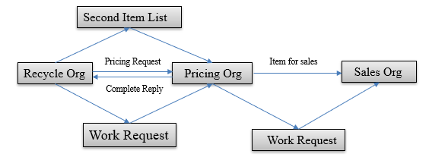
Functionallities
Second hand pricing organization receives work requests from book recycle organization and is responsible to set price for second hand books in the item list. After pricing, the organization will send work request to sales organization for adding the second items to inventory and share them to customers who in need.

Slide 28
Project Demo Screenshots
Show Love Read System

Slide 29
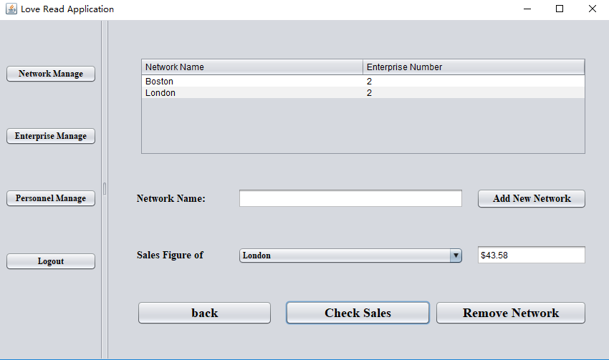
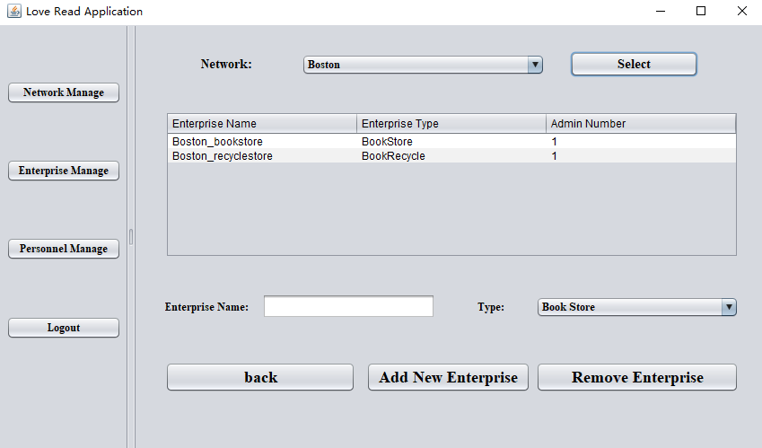
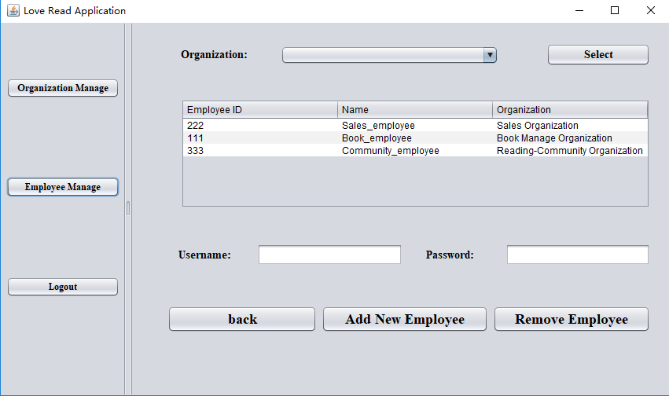
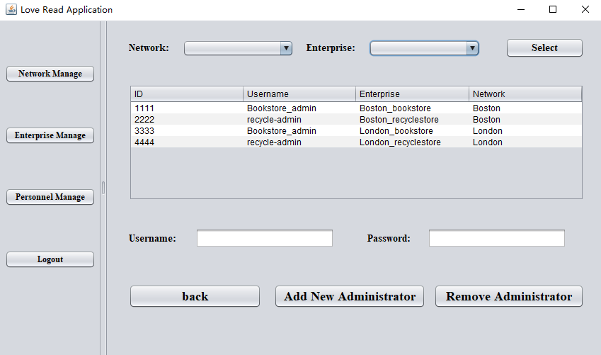
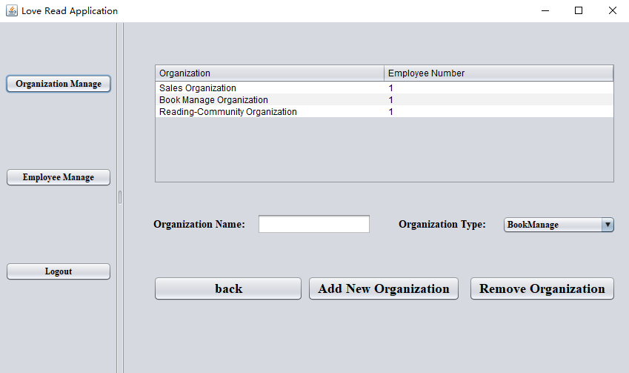
Demo - Administrator

Slide 30
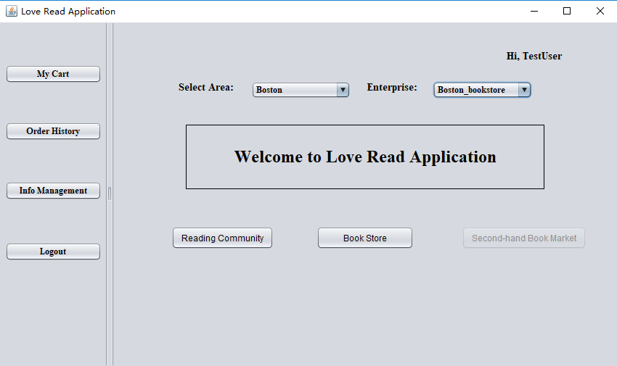
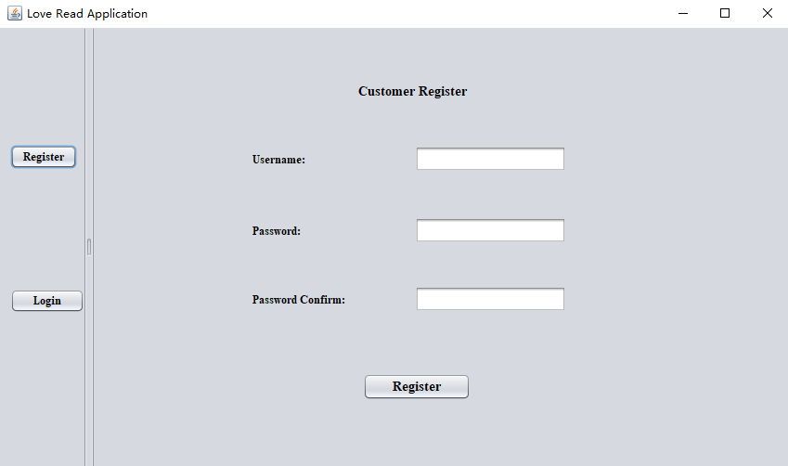
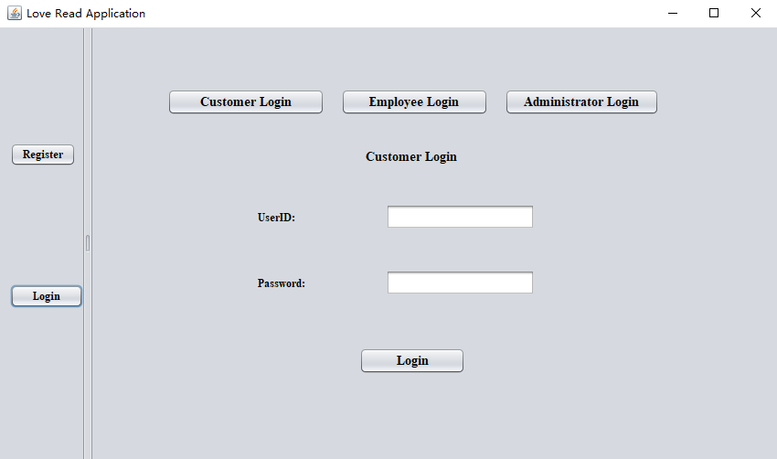
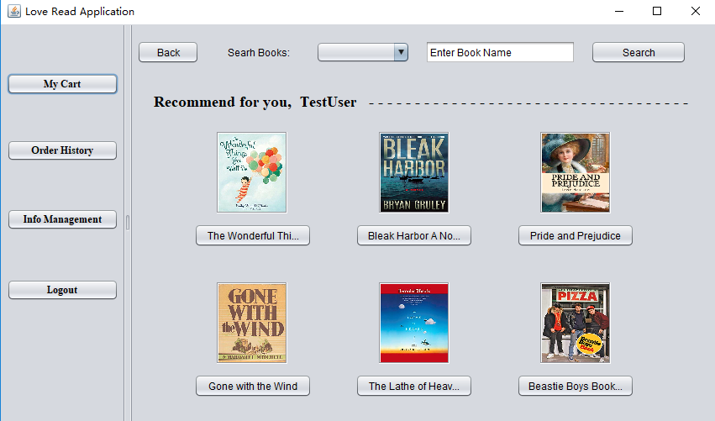
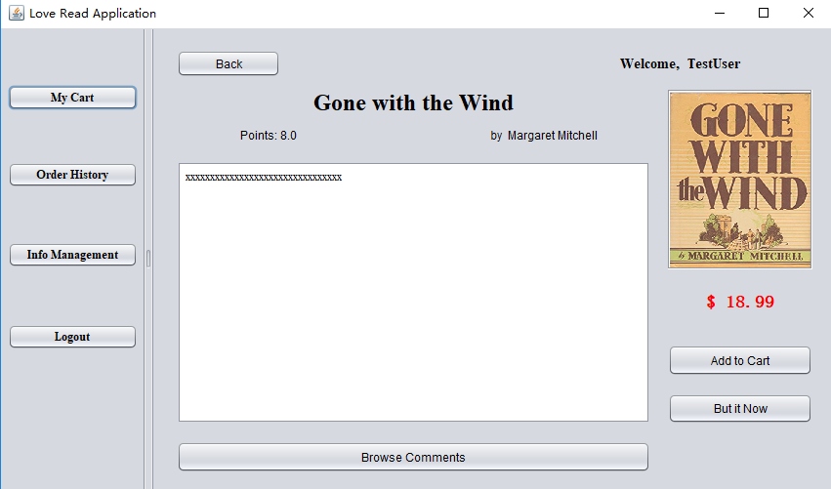
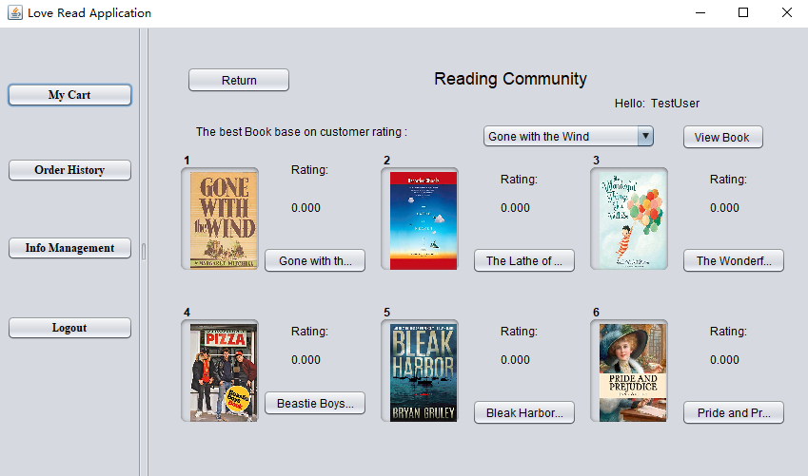
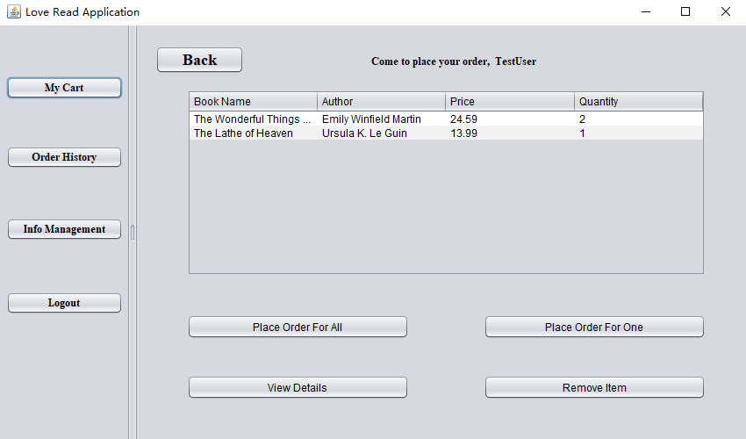
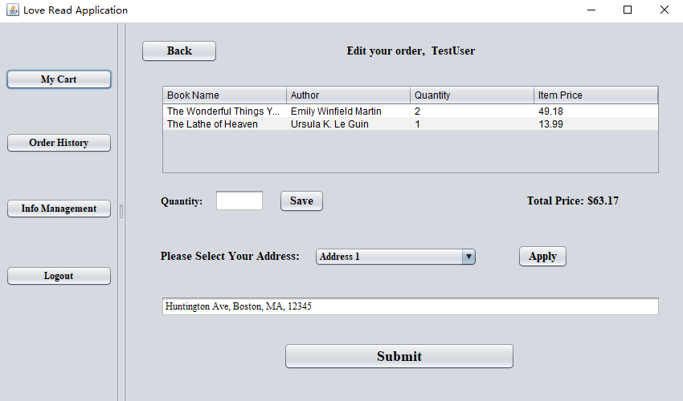
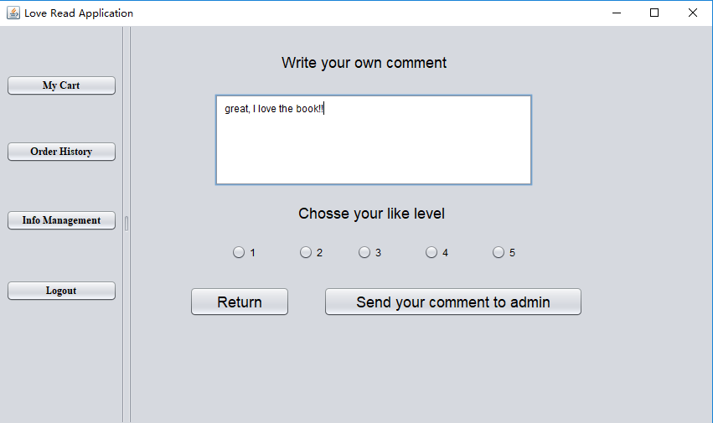
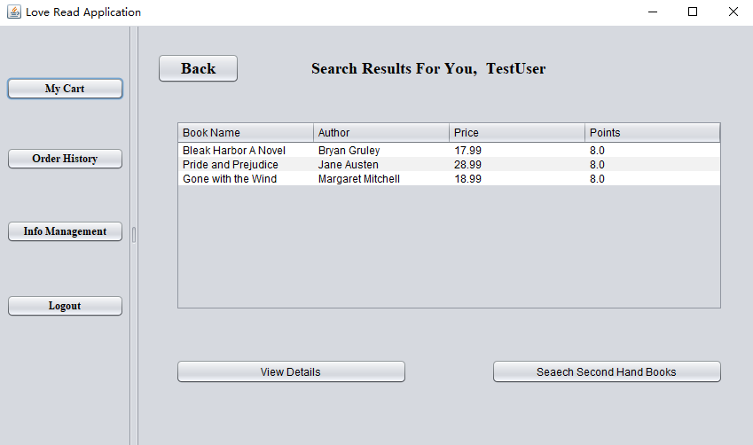
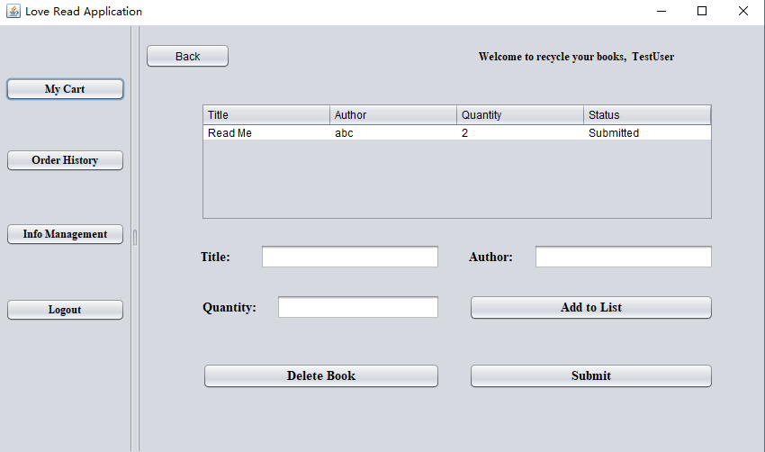
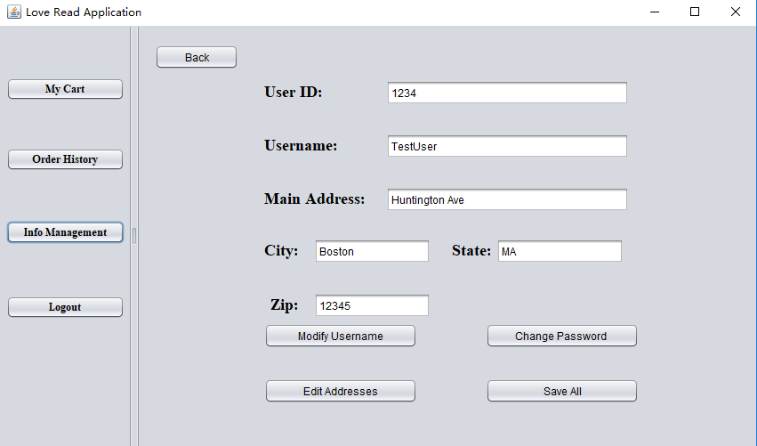
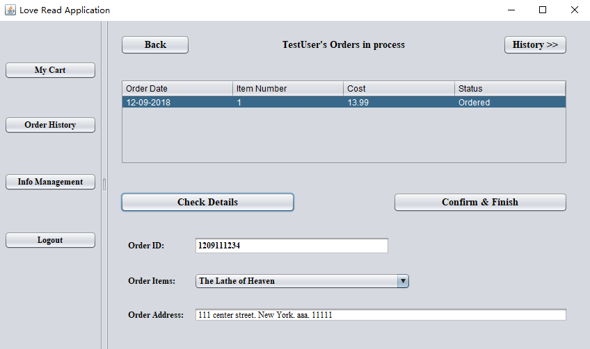
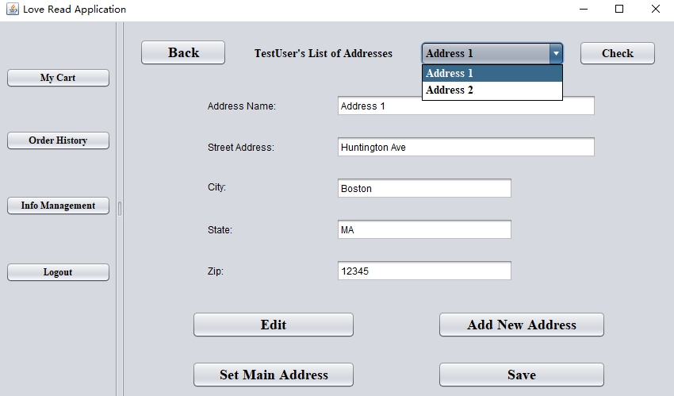
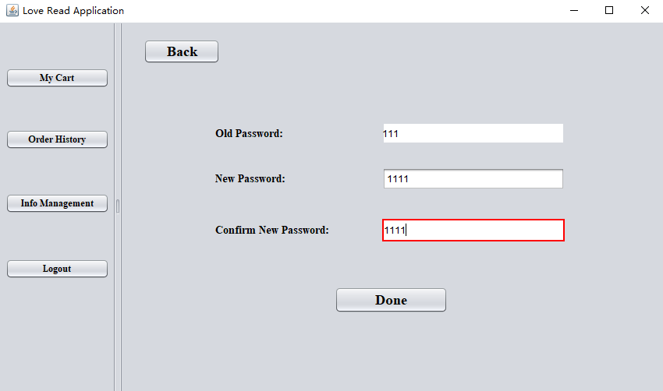
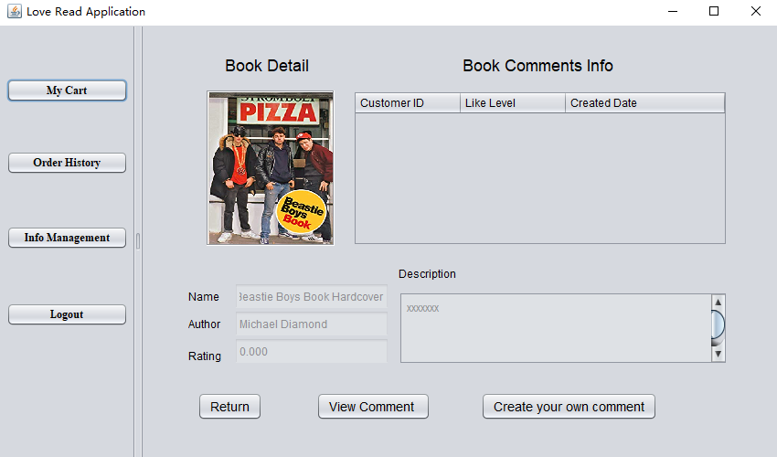
Demo - Customer

Slide 31
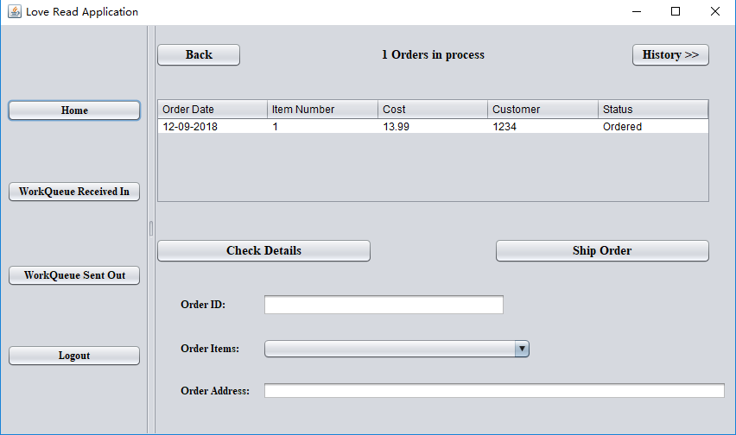
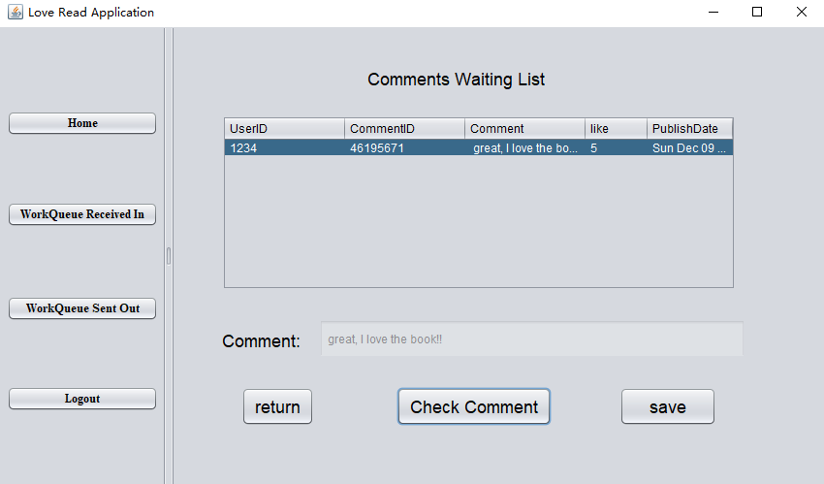
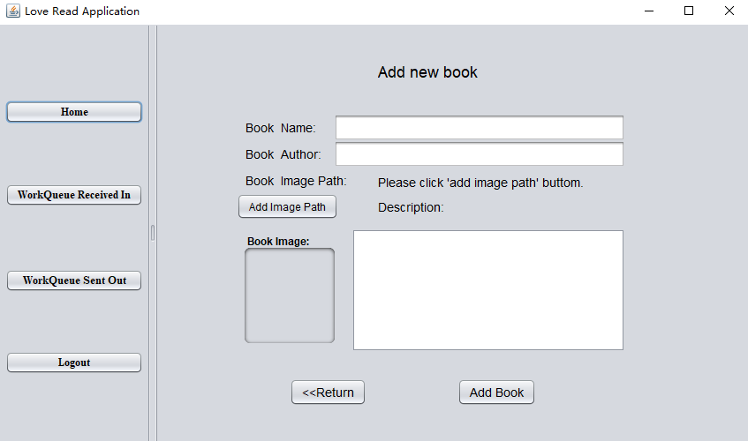
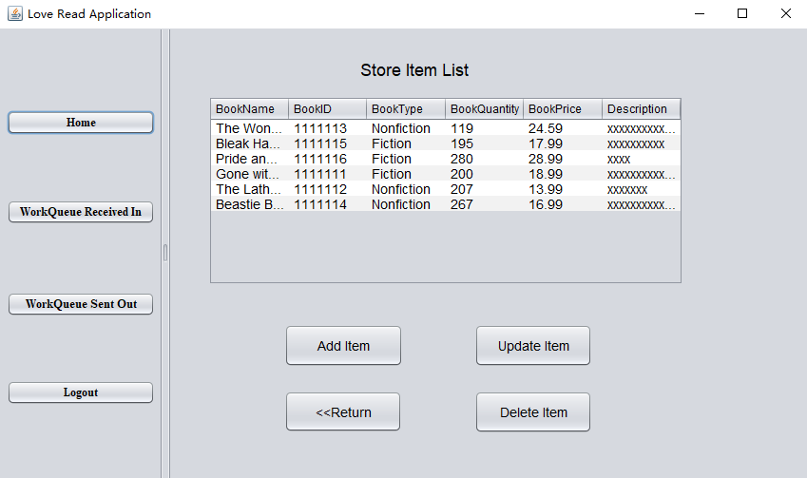
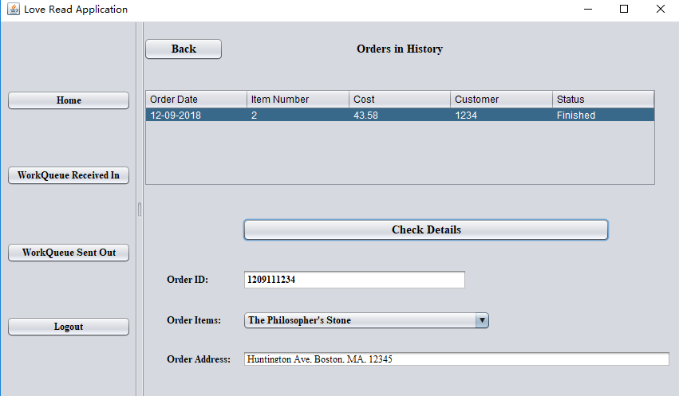
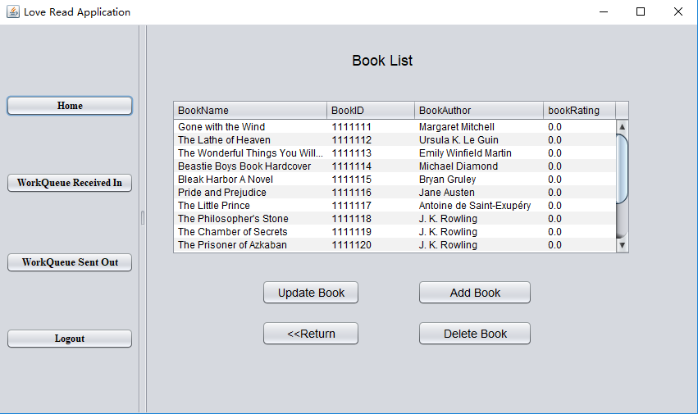
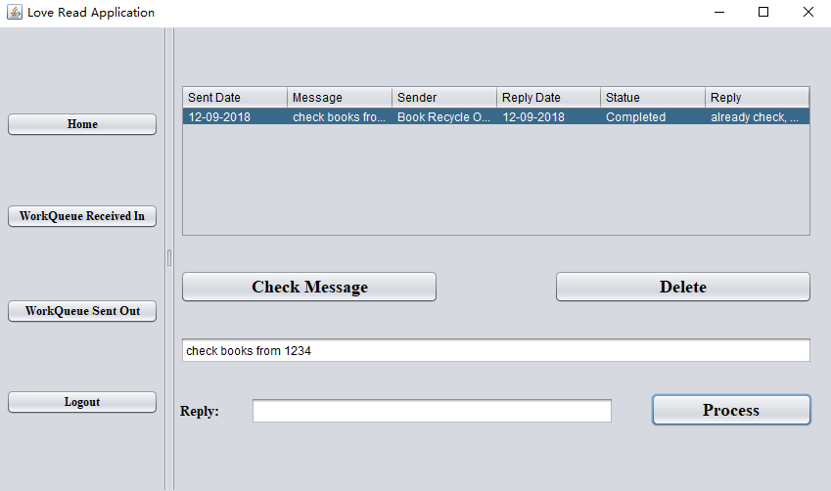
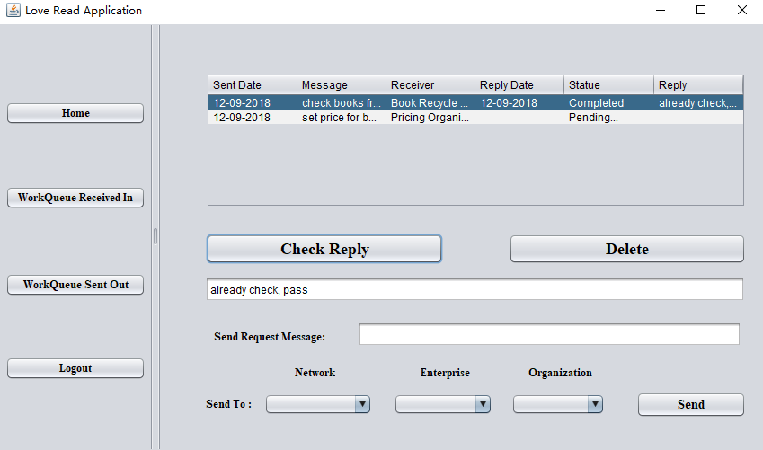
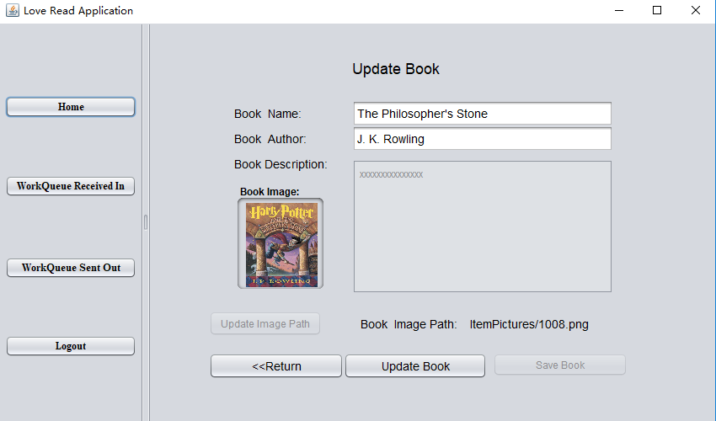
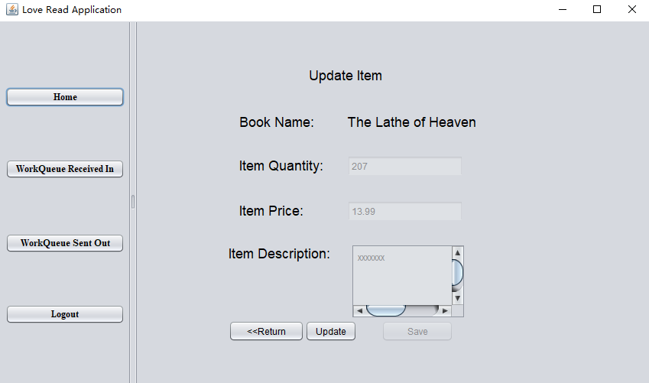
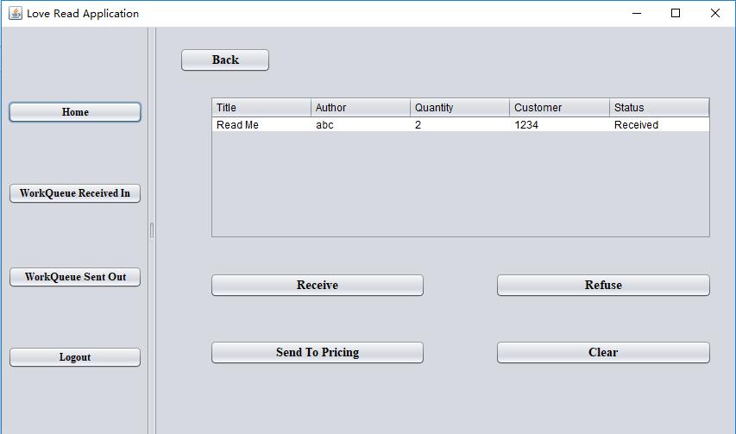
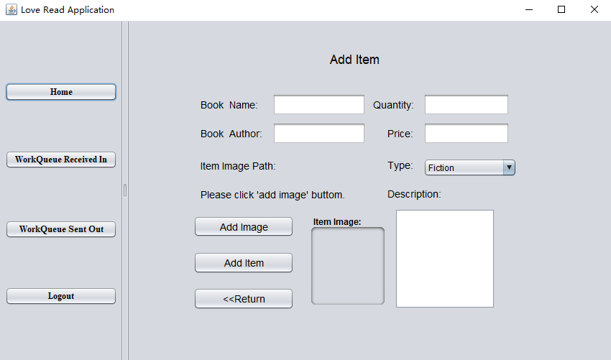
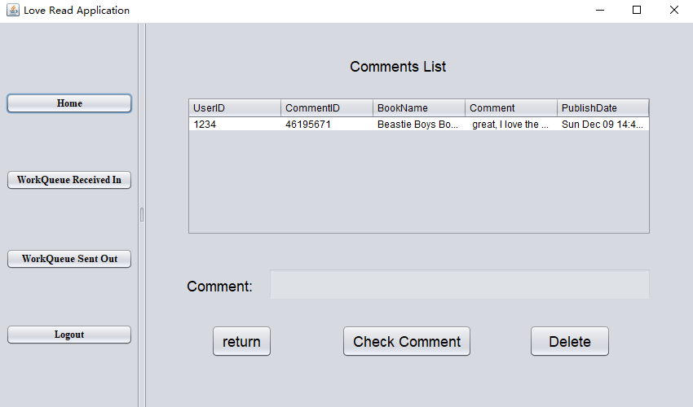
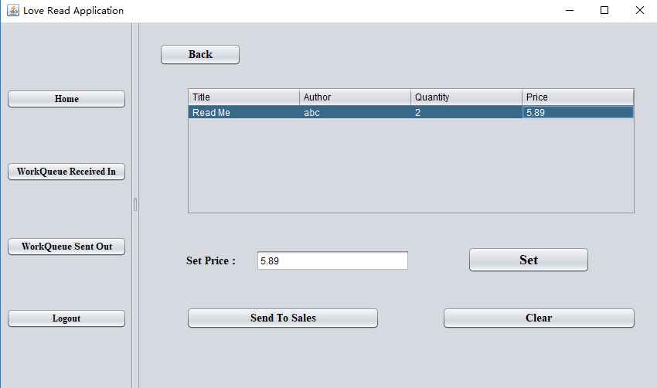
Demo – Employee

Slide 32
Thank you for listening

