Slide 1
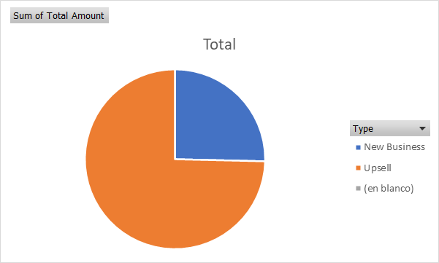
Acme Corporation
FY2020 Overview
Quarter Overview
New Business/Upsell
<Chart_Placeholder>

Slide 2
Acme Corporation
New Business

Slide 3
Acme Corporation
Upsell

