Slide 1

NLP M.Sc. FINAL PROJECT · TRACK 3 — DATA-DRIVEN NLP
הנגשת זכויות חברתיות באמצעות NLP
Hebrew Semantic Retrieval for Social-Rights Questions
Can meaning-based search beat keyword search for citizens' everyday questions — and can fusing them beat both?
Yanik Gotie · ID 318553526 · HIT · Dr. Igor Kleiner

Slide 2


THE PROBLEM
A gap between how people ask and how rights are written
Citizens describe their situation in plain, emotional language. Official sources answer in formal, legal-administrative Hebrew. Keyword search falls into the gap between them.
HOW PEOPLE ASK
HOW SOURCES ARE TITLED
“פיטרו אותי מהעבודה, מה מגיע לי?”
“התינוק שלי מתעכב בהתפתחות, לאן פונים?”
“יש לי אוטו, זה פוסל אותי מקצבה?”
“זכאות לדמי אבטלה”
“אבחון רפואי התפתחותי לילדים”
“זכאות לגמלת הבטחת הכנסה ובעלות על רכב”
Same meaning · often zero shared words
1

Slide 3
RESEARCH QUESTION
Does meaning-based retrieval help — and does combining it with keyword search help more?
H1
Semantic > Lexical
H2
Hybrid > both
Hebrew sentence embeddings (AlephBERT) beat TF-IDF, especially when the question is phrased far from the source.
Fusing lexical + semantic ranks beats either single method on ranking quality (MRR, nDCG).
Spoiler: one hypothesis holds, one does not — and that contrast is the finding.

Slide 4





OVERVIEW
The end-to-end pipeline
›
›
›
›
1. Collect
2. Preprocess
3. Index
4. Fuse
5. Evaluate
Kol-Zchut API + Bituach Leumi scrape
clean · tokenize · stopwords · chunk
TF-IDF · BM25 · AlephBERT
RRF + weighted hybrid
Recall@k · MRR · nDCG · MAP
One shared interface, one CLI: python src/run_all.py → scrape → corpus → retrievers → metrics → figures
2

Slide 5


DATA
A self-collected Hebrew rights corpus
296
1,602
122,928
6
DOCUMENTS
PASSAGES
TOKENS
LIFE-DOMAINS
Kol-Zchut · primary
Bituach Leumi · supplementary
Official MediaWiki API → clean section text
6 categories: disability, unemployment, health, family, income-support, parenting
License: CC-BY-SA (reuse with attribution)
Curated benefit pages, #mainContent only
robots.txt-checked · rate-limited · UA-identified
Adds the formal register that contrasts with Kol-Zchut
Evaluation set: 40 hand-authored colloquial questions → ground-truth documents, tagged by phrasing-gap.
3

Slide 6
CLASSICAL NLP · 1
From raw Hebrew to clean tokens
Every passage passes a textbook preprocessing chain before lexical indexing.
1 · Raw
...שכירים שפוטרו או התפטרו, כולל מי שעבדו בשני מקומות עבודה...
2 · Normalize
strip niqqud [֑-ׇ] · drop punctuation/Latin · lowercase · collapse spaces
3 · Tokenize
שכירים · שפוטרו · או · התפטרו · כולל · מי · שעבדו · בשני · מקומות · עבודה
4 · Remove stop-words
removed: או · מי · וכן · כדי · על · עד → 33 tokens → 26 content tokens
Token stream feeds TF-IDF & BM25 →
4

Slide 7

CLASSICAL NLP · 2
Vectorizing the corpus with TF-IDF
The document–term matrix
One passage as a sparse vector
Shape
1,602 × 20,981
passage: “דמי אבטלה” — top weighted terms
לחל ת
0.175
Vocabulary
20,981 terms
לעבוד
0.160
Unigrams / bigrams
7,323 / 13,658
בקצרה שכירים
0.157
בתנאים מסוימים
0.157
Non-zero entries
141,493
זכאי דמי
0.157
Sparsity
99.58 %
לשכירים
0.157
Each passage = a point in 20,981-dim space; ranking = cosine similarity to the query vector.
5

Slide 8

CLASSICAL NLP · 3
Hebrew morphology inflates the vocabulary
Hebrew glues particles (ב·ל·מ·ה·ו·ש·כ) onto words, so the same root appears as many surface forms — a real challenge for keyword matching.
Light prefix-stripping (stemming demo)
EFFECT ON VOCABULARY
13,415 → 8,963
לעובדים
→
עובדים
והמעסיק
→
המעסיק
vocabulary types → after stripping one prefix
כשעובד
→
עובד
− 33 %
בתקופת
→
תקופת
מהמוסד
→
מוסד
Morphology — not topic — drives much of the sparsity. Full lemmatization is future work.
6

Slide 9


MODELS
Five retrievers, one interface
TF-IDF
BM25
AlephBERT
LEXICAL BASELINE
LEXICAL (BONUS)
SEMANTIC
sparse cosine over the term matrix
Okapi BM25 ranking
Hebrew sentence embeddings, dense cosine
Hybrid · RRF
Hybrid · weighted
FUSION
FUSION
reciprocal-rank fusion of lexical + semantic
min-max score fusion α·sem + (1-α)·lex
7

Slide 10
HOW WE FUSE & MEASURE
Hybrid fusion and the metrics
Reciprocal Rank Fusion
Evaluation metrics
score(d) = Σ 1 / (k + rank_i(d))
Recall@k
is a relevant doc in the top-k?
MRR
1 / rank of the first relevant doc
Rank-based — no score calibration needed
A doc ranked high by either model rises
We also test weighted min-max score fusion
nDCG@10
rewards relevant docs ranked higher
MAP
mean average precision over the ranking
Scored at document level: a chunk counts for its parent page.
8

Slide 11
RESULTS
How the five models compare
Mean Reciprocal Rank (MRR)
 | R@1 | R@5 | R@10 | MRR | nDCG | MAP
TF-IDF | 0.475 | 0.825 | 0.850 | 0.618 | 0.649 | 0.588
BM25 | 0.500 | 0.825 | 0.875 | 0.612 | 0.647 | 0.578
AlephBERT | 0.475 | 0.725 | 0.775 | 0.579 | 0.597 | 0.540
Hybrid-RRF | 0.550 | 0.800 | 0.875 | 0.668 | 0.704 | 0.652
Hybrid-wtd | 0.550 | 0.800 | 0.850 | 0.653 | 0.681 | 0.632
Bold row = best. Hybrid-RRF leads every ranking metric.
9

Slide 12



THE FINDING
Semantic alone lost. The hybrid won.
H1 rejected
H2 confirmed
Why
AlephBERT alone is the weakest model — MRR 0.579, 9/40 misses — and does not beat lexical even on high phrasing-gap queries (R@1 0.44 vs 0.48).
Hybrid-RRF leads everything: MRR 0.668, nDCG 0.704, fewest misses (5/40). Fusion is the practical winner.
The two models fail differently. Semantic rescues zero-overlap paraphrases lexical can't; fused, we keep precision and add recall — complementary, not superior.
10

Slide 13

RESULTS · DETAIL
Recall@k and the phrasing-gap test
Recall@k vs. k
Recall@1 by phrasing-gap (H1 test)
gap | n | TF-IDF | AlephBERT | Hybrid
low | 4 | 0.25 | 0.50 | 0.75
medium | 11 | 0.55 | 0.55 | 0.64
high | 25 | 0.48 | 0.44 | 0.48
Even on the hardest, most-rephrased queries, semantic does not pull ahead (0.44 vs 0.48). The expected semantic advantage simply isn't there for this off-the-shelf model.
11

Slide 14
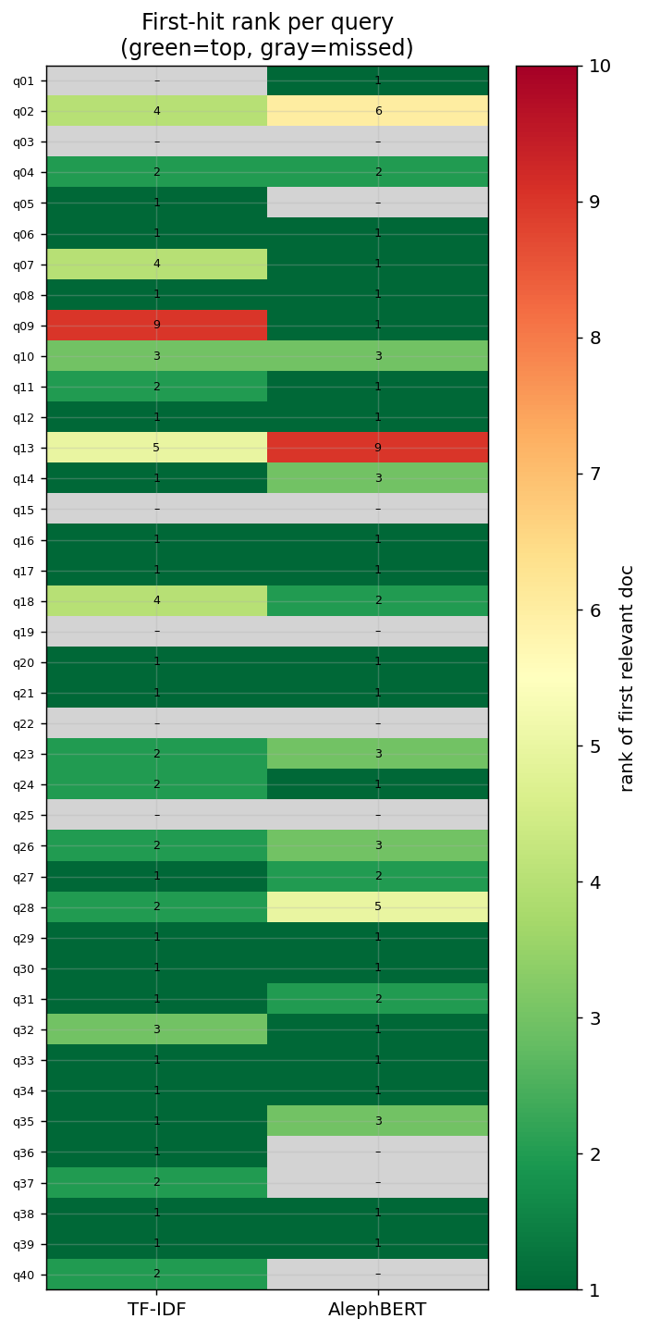
RESULTS · PER QUERY
Where each model wins, query by query
Reading the heatmap
Each row is one of the 40 questions; color = rank of the first correct document (green = top, red = deep, grey = missed).
Greens and greys swap between columns — the two models succeed and fail on different queries.
That disagreement is exactly what makes fusion pay off.
misses (gold not in top-10): TF-IDF 6 · AlephBERT 9 · Hybrid 5
12

Slide 15

ERROR ANALYSIS
Three patterns, real examples
A · Semantic wins
“חייבים להגיע ללשכת התעסוקה כל הזמן?”
4 CASES
Gold: התייצבות בשירות התעסוקה. Zero shared words → lexical rank 4, semantic rank 1.
B · Lexical wins
“כיסא גלגלים ומכשירי שיקום?”
5 CASES
Gold: אביזרי ומכשירי שיקום. A sharp exact term → lexical rank 1, semantic misses.
C · Both fail
“איך מקבלים קצבת נכות?”
7 CASES
Closest page is a short BTL stub, drowned by many specific קביעת-נכות pages.
13

Slide 16
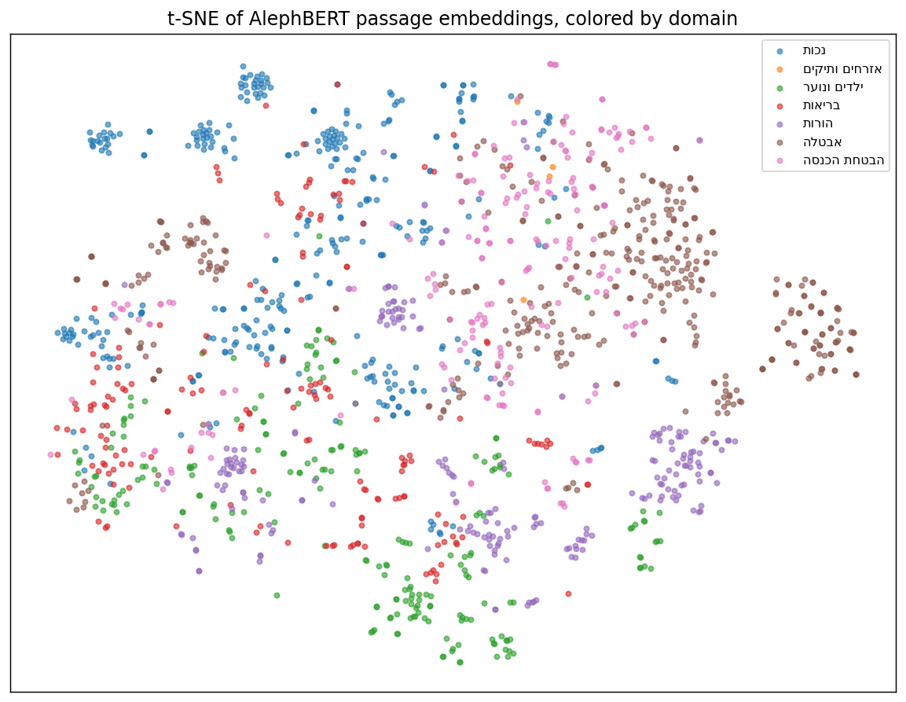
INSIDE THE MODEL
What the embedding space looks like
t-SNE of passage vectors
AlephBERT embeddings projected to 2-D, colored by life-domain.
Domains form clusters — the model does capture topical meaning.
But clusters overlap, which is why fine-grained ranking still needs the lexical signal.
14

Slide 17

CONCLUSIONS
What the project shows
A full Hebrew IR pipeline
Hybrid is the recommendation
Self-collected corpus → preprocessing → 5 retrievers → rigorous evaluation, fully reproducible.
It is the only model that beats both baselines on every ranking metric.
Off-the-shelf ≠ free win
Next
A masked-LM Hebrew encoder is a useful complement, not a drop-in upgrade for retrieval.
Retrieval-tuned model (E5), Hebrew lemmatization, larger graded eval set.
15

Slide 18
RESPONSIBLE NLP
Ethics & limitations
Public, licensed data
Not legal advice
Kol-Zchut (CC-BY-SA) + public BTL info. No personal data, no scraping of user content.
A research prototype. Real use must show source links and defer to the authority.
Bias & coverage
Small eval set
Six domains only; Hebrew morphology penalizes lexical models; AlephBERT may carry pre-training bias.
40 single-annotator questions: indicative, not statistically tight.
16

Slide 19

Thank you
Hebrew Semantic Retrieval for Social-Rights Questions
Yanik Gotie · github.com/YanikGotie/hebrew-rights-retrieval
AI Usage Disclosure
An AI assistant was used as a code-writing helper (boilerplate, docstrings, debugging). Research design, data, evaluation set, and conclusions are the author's own; all code was reviewed and is understood.

