Slide 1
量子计算研讨课 第十三讲
清华大学计算机系
陈建鑫

Slide 2
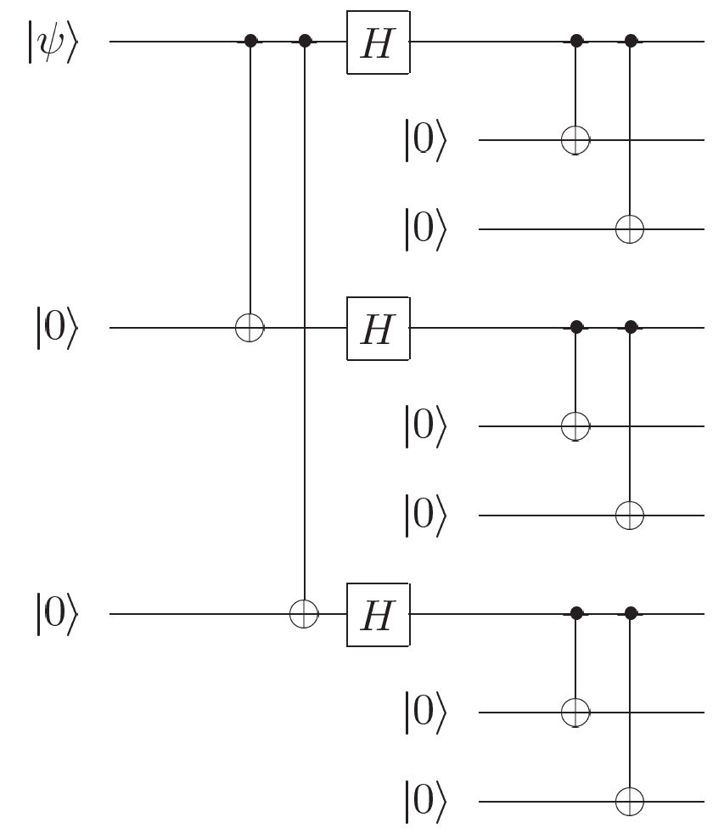
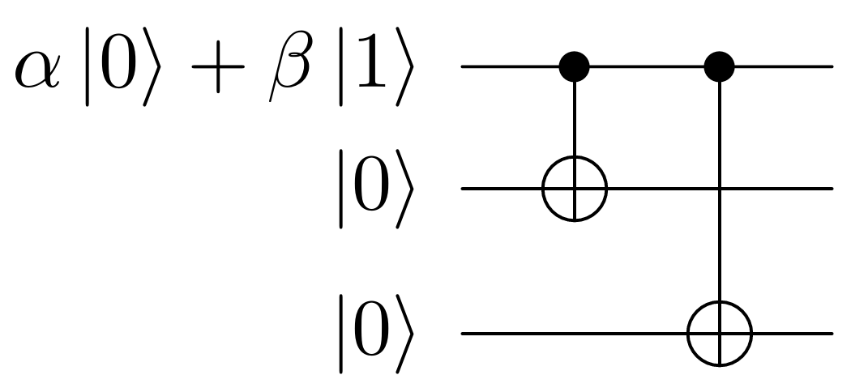
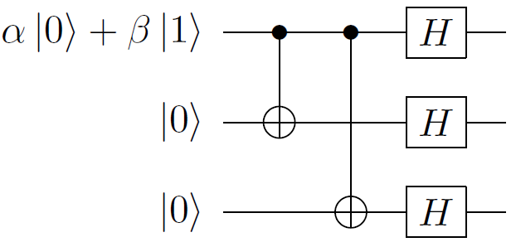
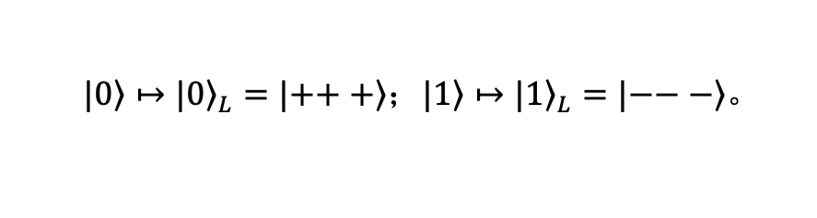
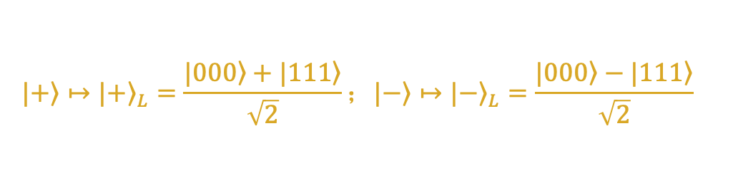
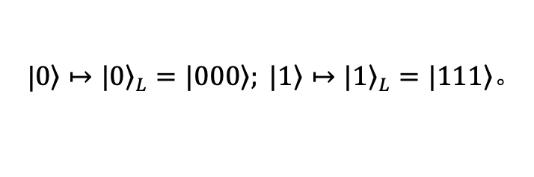
课程回顾（Recap）
纠正比特翻转错误
$$|\left.+\right\rangle ↦{|\left.+\right\rangle }_{L}=\frac{|\left.000\right\rangle +|\left.111\right\rangle }{\sqrt{2}}；|\left.−\right\rangle ↦{|\left.−\right\rangle }_{L}=\frac{|\left.000\right\rangle −|\left.111\right\rangle }{\sqrt{2}}$$
|$\left.0\right\rangle ↦{|\left.0\right\rangle }_{L}=|00\left.0\right\rangle ; |\left.1\right\rangle ↦{|\left.1\right\rangle }_{L}=|\left.111\right\rangle 。$
纠正相位翻转错误
$$|\left.0\right\rangle ↦{|\left.0\right\rangle }_{L}=|\left.+++\right\rangle ；|\left.1\right\rangle ↦{|\left.1\right\rangle }_{L}=|\left.−−−\right\rangle 。$$

Slide 3
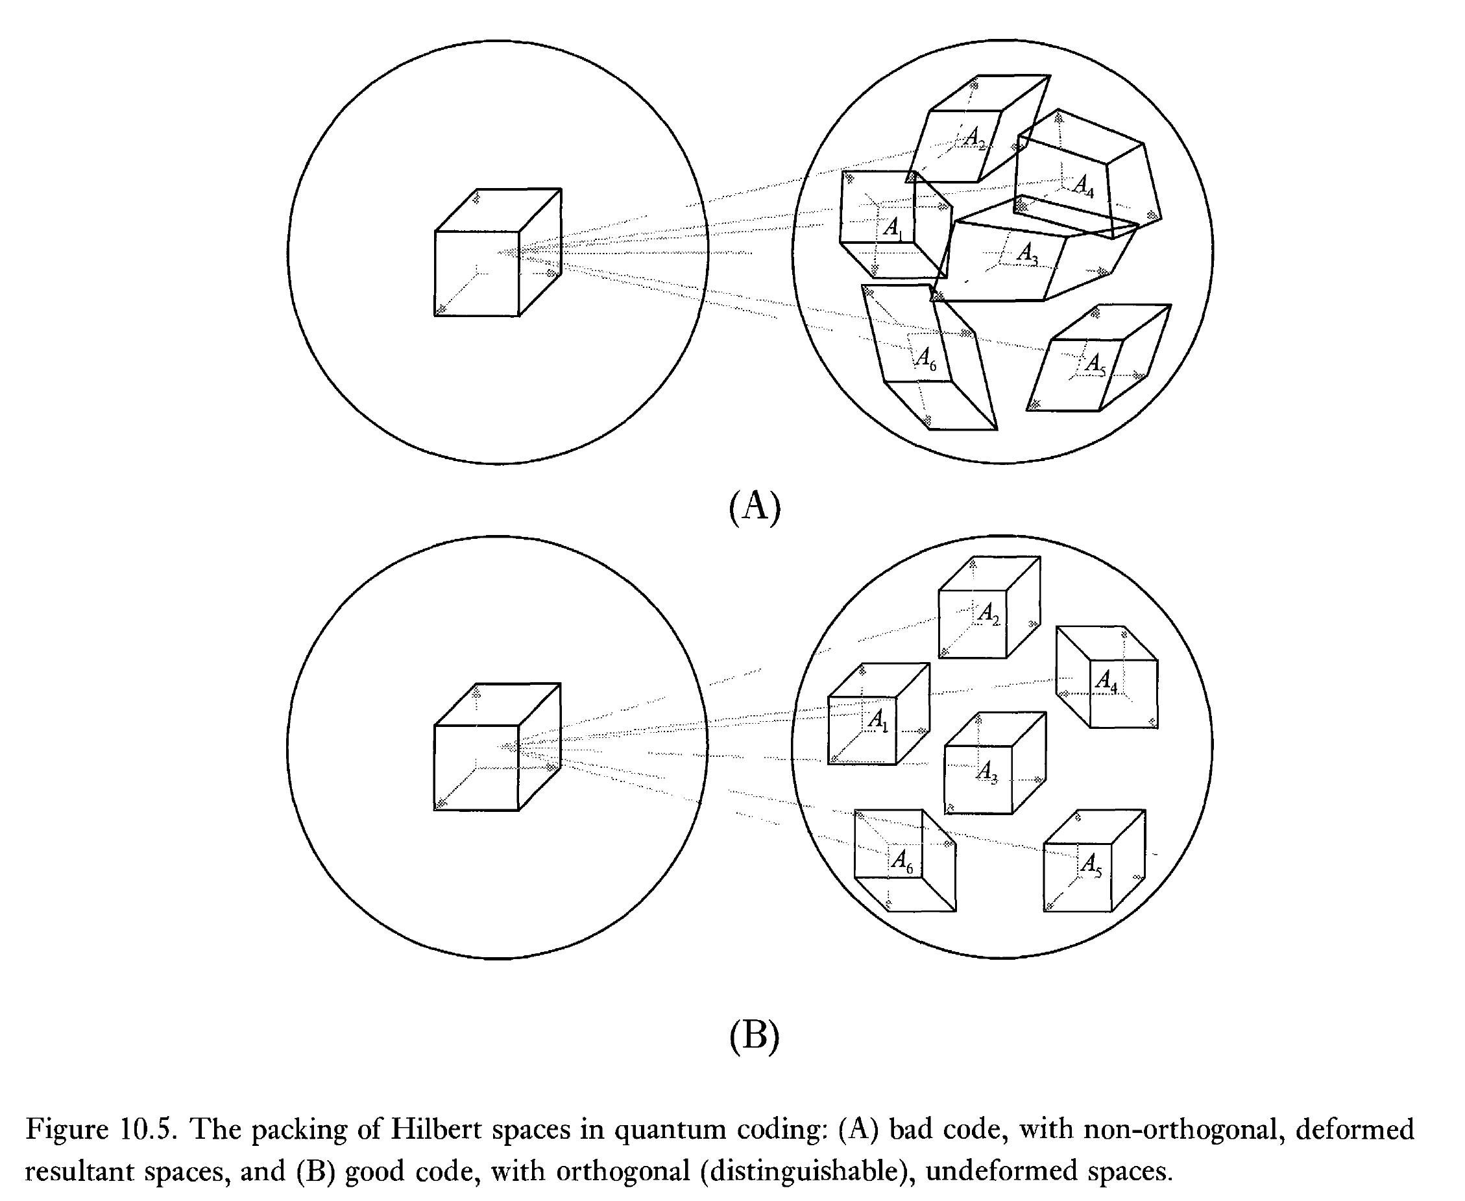
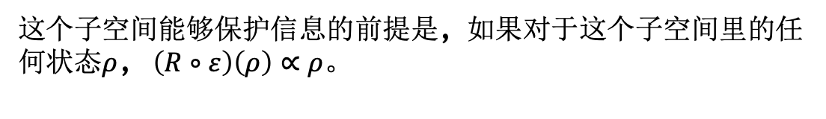
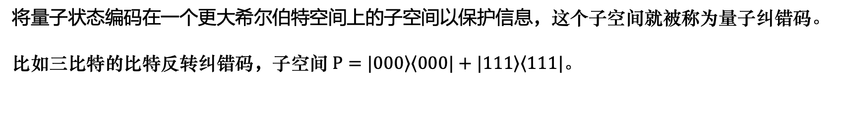
什么是量子纠错码
将量子状态编码在一个更大希尔伯特空间上的子空间以保护信息，这个子空间就被称为量子纠错码。
比如三比特的比特反转纠错码，子空间$P=|\left.000\right\rangle \left\langle 000\right.|+|\left.111\right\rangle \left\langle 111\right.|。$
量子信息
噪声
含噪量子信息
恢复后的量子信息
错误检测
状态恢复
这个子空间能够保护信息的前提是，如果对于这个子空间里的任何状态$ρ$，$\left(R∘ε\right)\left(ρ\right)∝ρ$。
如何设计好的量子纠错码

Slide 4
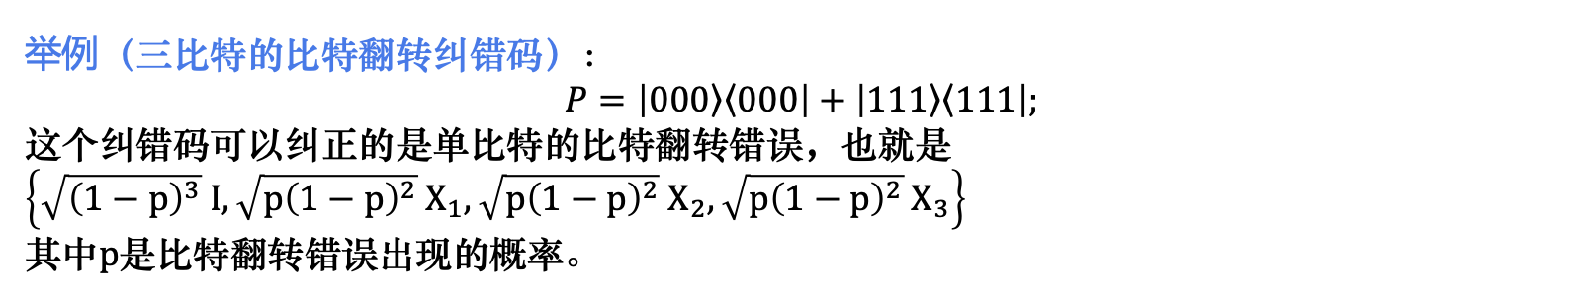
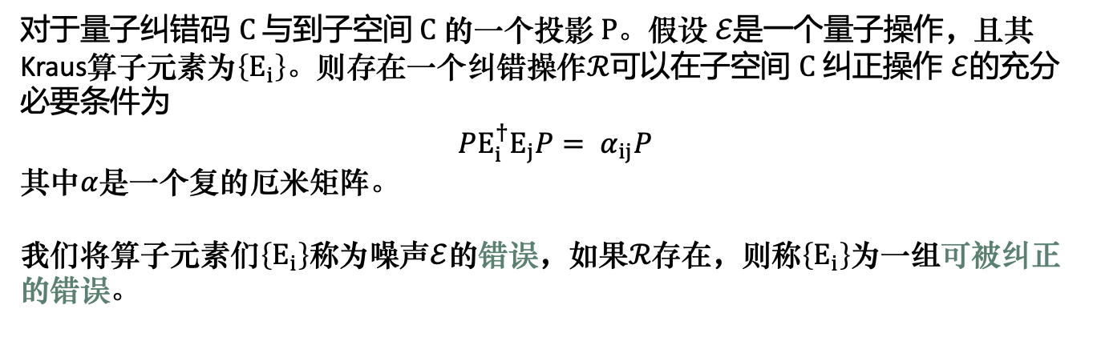
量子纠错的判断条件
对于量子纠错码 $C$ 与到子空间 $C$ 的一个投影 $P$。假设 $ℰ$是一个量子操作，且其Kraus算子元素为$\left\{E_{i}\right\}$。则存在一个纠错操作$ℛ$可以在子空间 $C$ 纠正操作 $ℰ$的充分必要条件为
$$PE_{i}^{†}E_{j}P= α_{ij}P$$
其中$α$是一个复的厄米矩阵。
我们将算子元素们$\left\{E_{i}\right\}$称为噪声$ℰ$的错误，如果$ℛ$存在，则称$\left\{E_{i}\right\}$为一组可被纠正的错误。
举例（三比特的比特翻转纠错码）：
$$P=\left|\left.000\right\rangle \left\langle 000\right.\right|+\left|\left.111\right\rangle \left\langle 111\right.\right|;$$
这个纠错码可以纠正的是单比特的比特翻转错误，也就是 $\left\{\sqrt{{\left(1−p\right)}^{3}} I,\sqrt{{p\left(1−p\right)}^{2}} X_{1},\sqrt{{p\left(1−p\right)}^{2}} X_{2},\sqrt{{p\left(1−p\right)}^{2}} X_{3}\right\}$
其中$p$是比特翻转错误出现的概率。

Slide 5
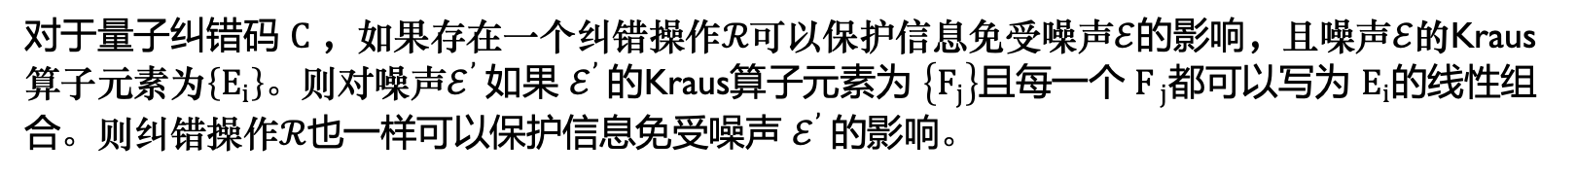
量子错误的离散化
对于量子纠错码 $C$ ，如果存在一个纠错操作$ℛ$可以保护信息免受噪声$ℰ$的影响，且噪声$ℰ$的Kraus算子元素为$\left\{E_{i}\right\}$。则对噪声$ℰ^{’}$如果 $ℰ^{’}$的Kraus算子元素为 $\left\{F_{j}\right\}$且每一个 $F_{ j}$都可以写为 $E_{i}$的线性组合。则纠错操作$ℛ$也一样可以保护信息免受噪声 $ℰ^{’}$的影响。
课后习题：上一堂课所介绍过的其它两个纠错码，三比特相位翻转纠错码与九比特的Shor码，分别可以抵抗哪些噪声？分别验证它们是否满足量子纠错码的判断条件。

Slide 6
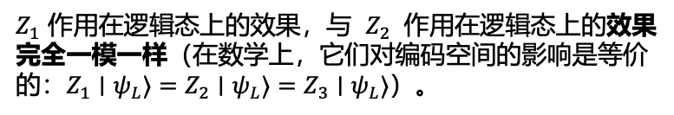
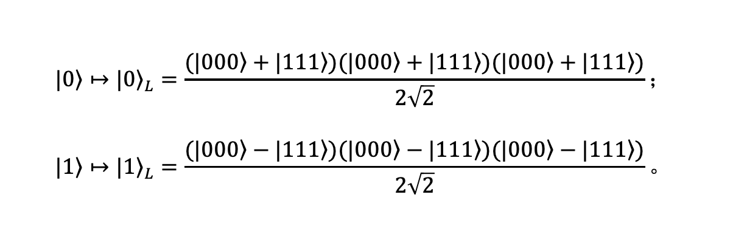
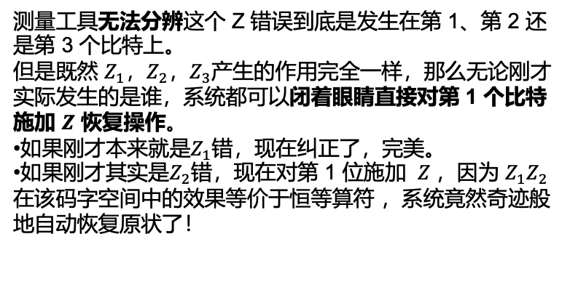
简并码（Degenerate Codes）
肖尔码
$Z_{1}$​ 作用在逻辑态上的效果，与 $Z_{2}$ 作用在逻辑态上的效果完全一模一样（在数学上，它们对编码空间的影响是等价的：$Z_{1}∣ψ_{L}​⟩=Z_{2}​∣ψ_{L}​⟩=Z_{3}​∣ψ_{L}​⟩$）。
$$|\left.0\right\rangle ↦{|\left.0\right\rangle }_{L}=\frac{(|\left.000\right\rangle +|\left.111\right\rangle )(|\left.000\right\rangle +|\left.111\right\rangle )(|\left.000\right\rangle +|\left.111\right\rangle )}{2\sqrt{2}}；$$
$$|\left.1\right\rangle ↦{|\left.1\right\rangle }_{L}=\frac{(|\left.000\right\rangle −|\left.111\right\rangle )(|\left.000\right\rangle −|\left.111\right\rangle )(|\left.000\right\rangle −|\left.111\right\rangle )}{2\sqrt{2}}。$$
测量工具无法分辨这个 Z 错误到底是发生在第 1、第 2 还是第 3 个比特上。
但是既然 $Z_{1}$​，$Z_{2}$，$Z_{3}$​产生的作用完全一样，那么无论刚才实际发生的是谁，系统都可以闭着眼睛直接对第 1 个比特施加 $Z$ 恢复操作。
如果刚才本来就是$Z_{1}$错，现在纠正了，完美。
如果刚才其实是$Z_{2}$​​错，现在对第 1 位施加 $Z$，因为 $Z_{1}Z_{2}$在该码字空间中的效果等价于恒等算符 ，系统竟然奇迹般地自动恢复原状了！

Slide 7
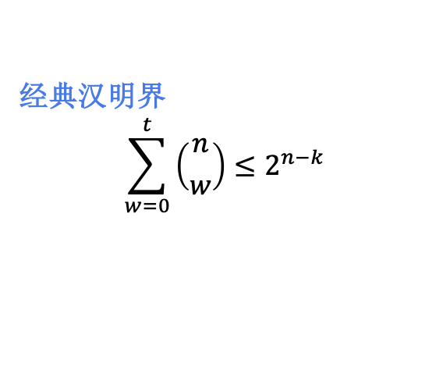
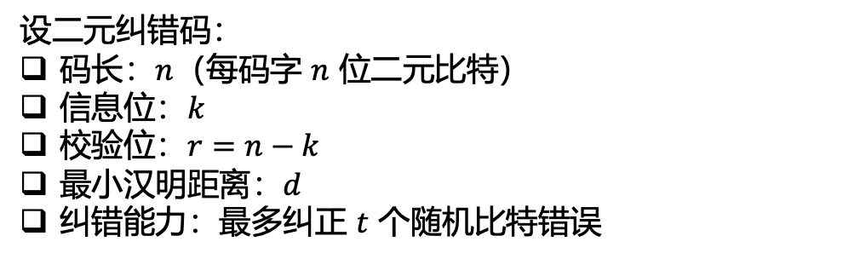
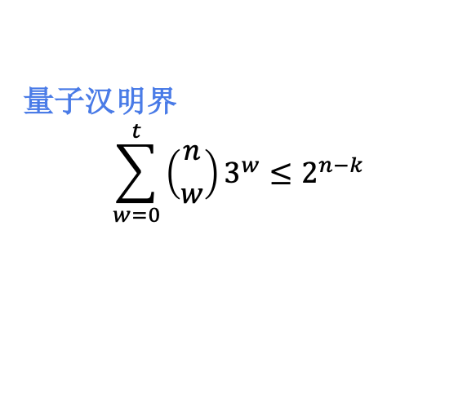
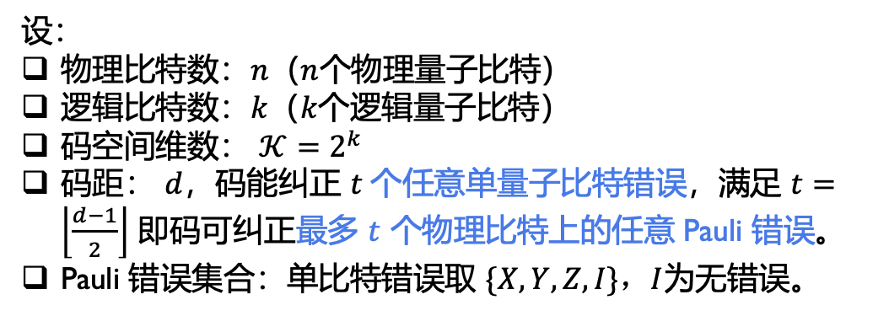
量子汉明界 （The Quantum Hamming Bound)
球装载界（Sphere-packing Bound）
设二元纠错码：
码长：$n$（每码字 $n$ 位二元比特）
信息位：$k$
校验位：$r=n−k$
最小汉明距离：$d$
纠错能力：最多纠正 $t$ 个随机比特错误
经典汉明距离
经典汉明界
$$\sum_{w=0}^{t}{\left({n \atop w}\right)≤2^{n−k}}$$
设：
物理比特数：$n$（$n$个物理量子比特）
逻辑比特数：$k$（$k$个逻辑量子比特）
码空间维数： $𝒦=2^{k}$
码距： $d$，码能纠正 $t$个任意单量子比特错误，满足 $t=\left\lfloor \frac{d−1}{2}\right\rfloor$ 即码可纠正最多 $t$ 个物理比特上的任意 Pauli 错误。
Pauli 错误集合：单比特错误取 $\{X,Y,Z,I\}，I$为无错误。
量子汉明距离
量子汉明界
$$\sum_{w=0}^{t}{\left({n \atop w}\right)3^{w}≤2^{n−k}}$$

Slide 8
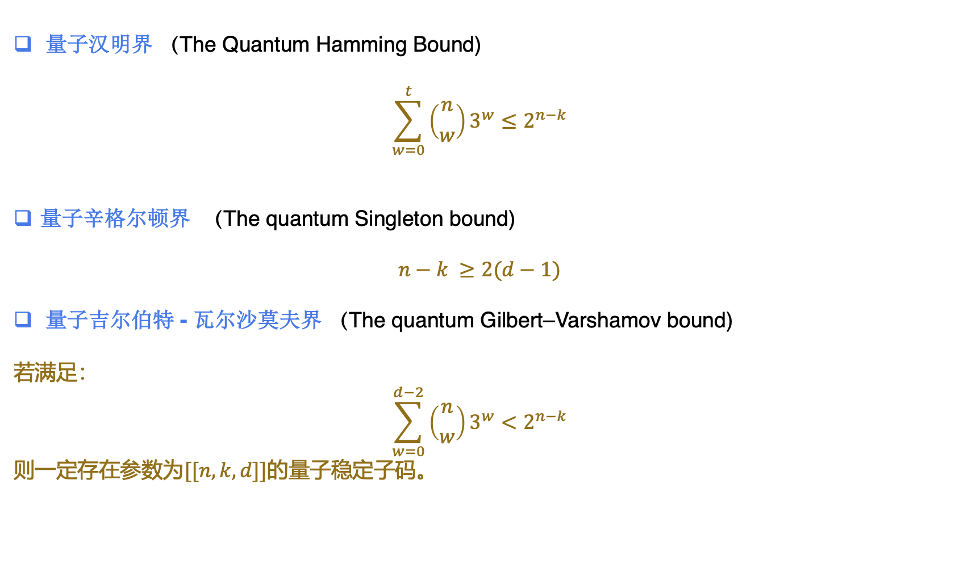
量子码的三大界
量子汉明界 （The Quantum Hamming Bound)
$$\sum_{w=0}^{t}{\left({n \atop w}\right)3^{w}≤2^{n−k}}$$
量子辛格尔顿界 （The quantum Singleton bound)
$$n−k ≥2(d−1)$$
量子吉尔伯特 - 瓦尔沙莫夫界 （The quantum Gilbert–Varshamov bound)
若满足：
$$\sum_{w=0}^{d−2}{\left({n \atop w}\right)3^{w}}<2^{n−k}$$
则一定存在参数为$[[n,k,d]]$的量子稳定子码。

Slide 9
纠错码的构造— 从经典线性码说起
A linear code $C$ encoding $k$ bits of information into an $n$ bit code space is specified by an $n$ by $k$ generator matrix $G$ whose entries are all elements of $ℤ_{2}$, that is, zeroes and ones.
$$G=\left[\begin{matrix}1 \\ 1 \\ 1\end{matrix}\right]$$
3-bit repetition code
, a [3,1] code.
$$G=\left[\begin{matrix}\begin{matrix}1 \\ 1 \\ 1\end{matrix} & \begin{matrix}0 \\ 0 \\ 0\end{matrix} \\ \begin{matrix}0 \\ 0 \\ 0\end{matrix} & \begin{matrix}1 \\ 1 \\ 1\end{matrix}\end{matrix}\right]$$
Similarly, encode two bits using three repetitions of each bit - a [6, 2] code.
Exercise:
Show that adding one column of G to another results in a generator matrix generating the same code.
Why linear code instead of general [n,k] code?
Alternatively, an [$n$,$k$] code is defined to consist of all $n$-element vectors $x$ over $ℤ_{2}$ such that $Hx=0$
where $H$ is an $(n−k)$by $n$matrix known as the parity check matrix, with entries all zeroes and ones.
A code encoding $k$ bits has $2^{k}$ possible codewords so the kernel of $H$ must be $k$-dimensional, and therefore we require that $H$ have linearly independent rows.
The parity check matrix has the standard form $[A|I_{n−k}]$, where A is an $(n−k)$by $k$matrix.

Slide 10
纠错码的构造— 从经典线性码说起 (continued)
Generator matrix $G_{n×k}$
Parity-check matrix $H_{\left(n−k\right)×n}$
The parity check matrix H and generator matrix G for the same linear code satisfy HG = 0
We define the distance of a code to be the minimum distance between any two codewords, and define the corresponding [n,k,d] code.
Let H be a parity check matrix such that any d-1 columns are linearly independent, but there exists a set of d linearly dependent columns. Then the code defined by H has distance d.
Show that an [n,k,d] code must satisfy n-k>=d-1.

Slide 11
纠错码的构造— 从经典线性码说起 (continued)
Hamming code: The parity check matrix H of a [7,4] code is $\left[\begin{matrix}0 & 0 & 0 & 1 & 1 & 1 & 1 \\ 0 & 1 & 1 & 0 & 0 & 1 & 1 \\ 1 & 0 & 1 & 0 & 1 & 0 & 1\end{matrix}\right]$
Suppose $C$ is an [n, k] code with generator matrix $G$ and parity check matrix $H$. Then we can define another code, the dual of $C$, denoted $C^{⊥}$, to be the code with generator matrix $H^{T}$ and parity check matrix $G^{T}$. Equivalently, the dual of $C$ consists of all codewords $y$ such that $y$ is
orthogonal to all the codewords in $C$. A code is said to be weakly self-dual if ${C⊆C}^{⊥}$,
and strictly self-dual if ${C=C}^{⊥} .$
Rather remarkably, the dual construction for classical linear codes arises naturally in the study of quantum error-correction, and is the key to the construction of an important class of quantum codes known as CSS codes.
A code with generator matrix $G$ is weakly self-dual if and only if ${GG}^{T}=0 .$

Slide 12
纠错码的构造 — Calderbank-Shor-Steane codes
Suppose $C_{1}$and $C_{2}$ are ${[n,k}_{1}]$ and ${[n,k}_{2}]$ classical linear codes, respectively, such that ${C_{2}⊂C}_{1}$, and both $C_{1}$and $C_{2}^{⊥}$ can correct errors on up to $t$ bits. Then ${CSS(C}_{1},C_{2})$ is an ${[n,k_{1}−k}_{2}]$ quantum error-correcting code which can correct arbitrary errors on up to $t$ qubits.

Slide 13
纠错码的构造 — The Steane code
A $\left[7,4,3\right]$ code $C$ with party check matrix $H=\left[\begin{matrix}0 & 0 & 0 & 1 & 1 & 1 & 1 \\ 0 & 1 & 1 & 0 & 0 & 1 & 1 \\ 1 & 0 & 1 & 0 & 1 & 0 & 1\end{matrix}\right]$, let $C_{1}=C$ and $C_{2}=C^{⊥}$, (check ${C_{2}⊂C}_{1}$)

Slide 14
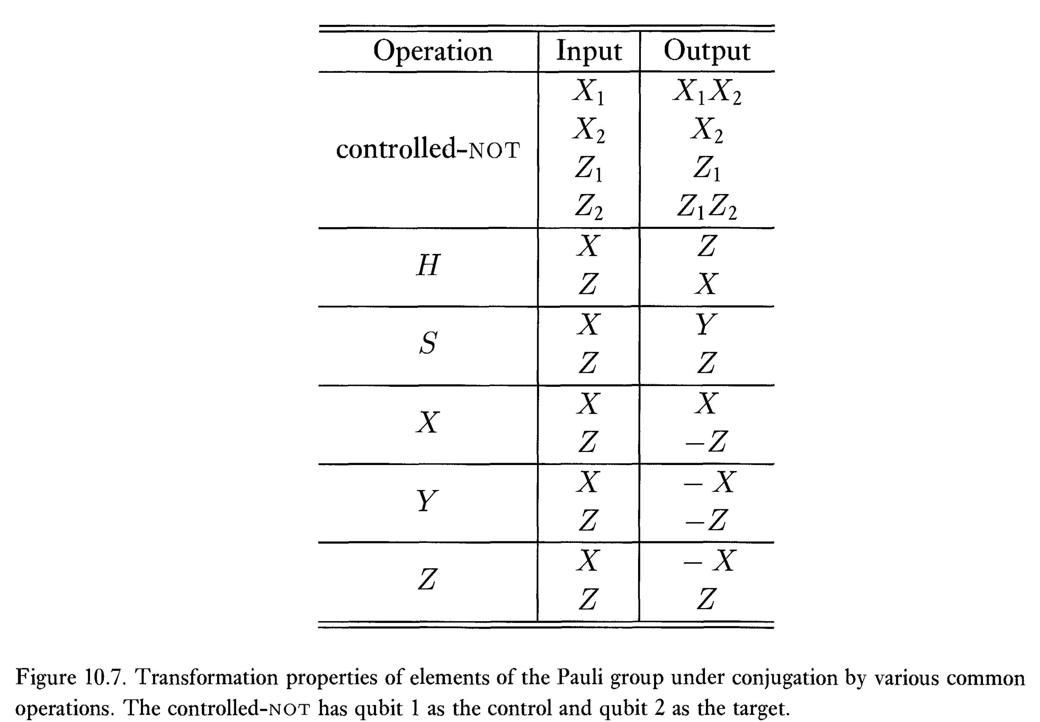
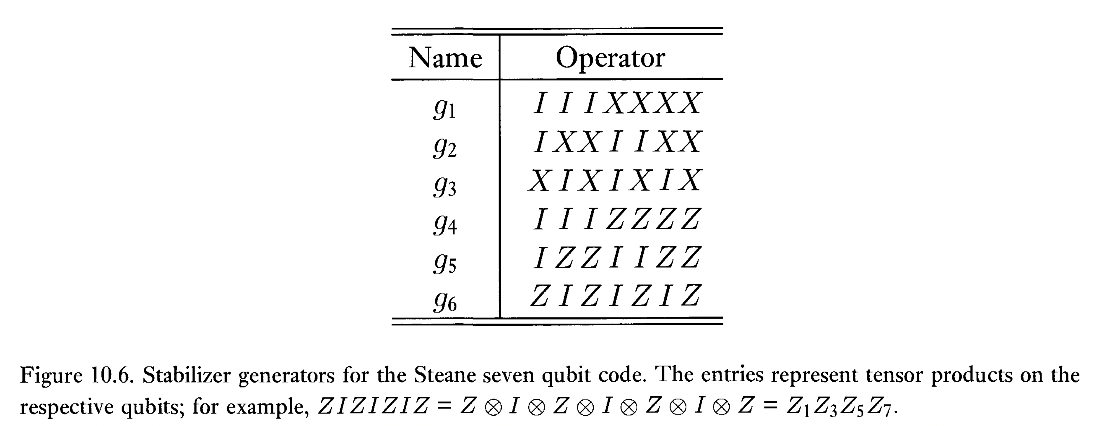
纠错码的构造 — Stabilizer codes
The stabilizer formalism:
State:
Operation:

Slide 15
纠错码的构造 — Stabilizer codes
The stabilizer formalism:
Measurement:
Assuming g is a product of Pauli matrices with no multiplicative factor of $−1$ or $±i$ out the front. The system is assumed to be in a state with stabilizer <$g_{1},g_{2},…,g_{k}$>.

Slide 16
Practical Quantum Error Correction
The Quantum LDPC Codes
Towards a Robust Quantum Memory
The Surface Code
Leave to Lecture 14

Slide 17

课后阅读材料与作业
本周作业
无，请准备大作业

