Slide 1
CAPSTONE PROJECT PHASE B
Predicting Where a Fly Will Be,
a Fraction of a Second From Now
A learned motion-prediction model for autonomous fly tracking
Yaniv Bodaga · Daniel Lachmakov
Advisors: Dr. Dan Lemberg · Mrs. Elena Kramer

Slide 2
THE PROBLEM
Flies don't move the way our systems expect
1
Extremely fast & irregular flight
Abrupt direction changes on a timescale of tens of milliseconds.
2
Reactive tracking is too slow
By the time a system responds to where a fly WAS, it has already moved.
3
Classical prediction assumes smooth motion
Kalman filters, straight-line extrapolation — all break down on real fly turns.
The system needs to predict the future, not just track the present.
2

Slide 3
THIS PHASE
The question this work answers
Can a learned model predict where a fly will be, a fraction of a
second ahead, more accurately than simply assuming it keeps
going in a straight line?
If yes — by how much, over what time horizon, and for which kinds of movement?
Answered on 326 real flies — not synthetic data.
3

Slide 4
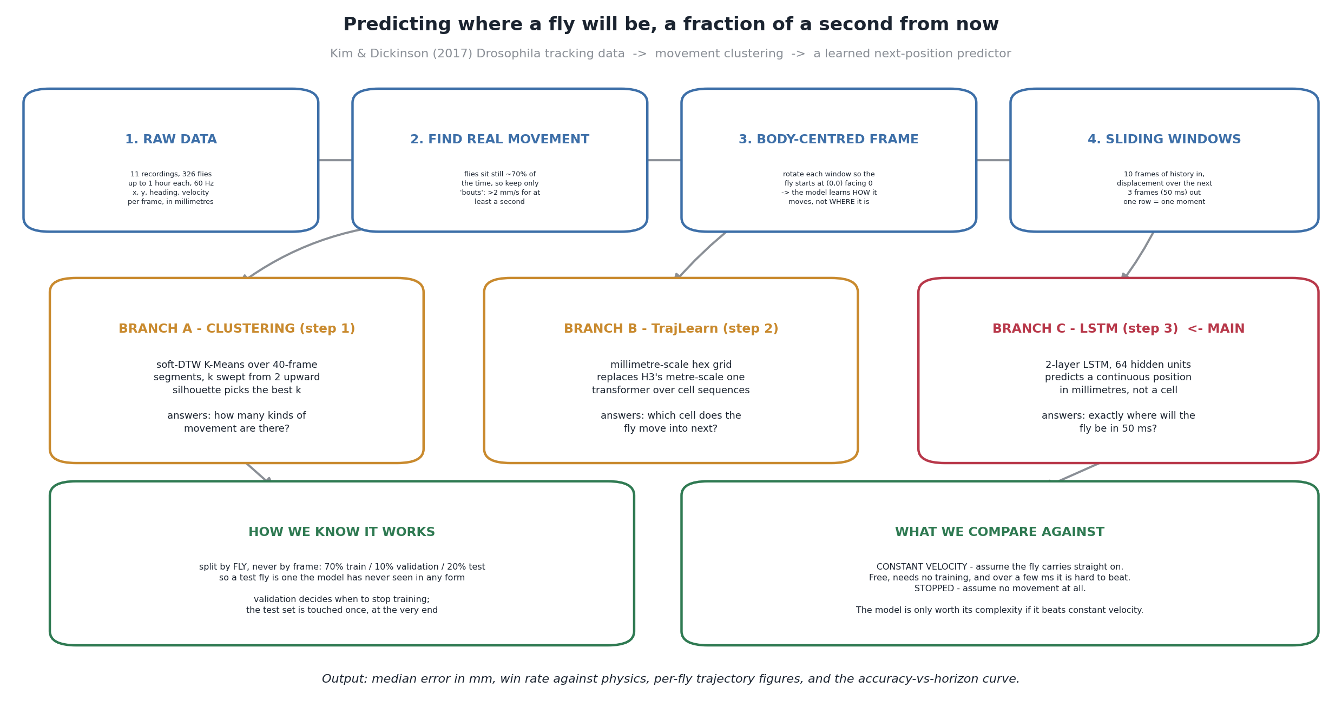
APPROACH
From raw tracking data to a trained predictor
4

Slide 5
DATA
Real, published fly-tracking data
326
11
60 Hz
~4,900
flies tracked
recordings
frame rate
movement segments analyzed
Kim & Dickinson (Current Biology, 2017) — free-walking Drosophila trajectories
Flies are stationary ~70% of the time — every analysis focuses on genuine movement bouts (>2 mm/s, 1s+)
5

Slide 6
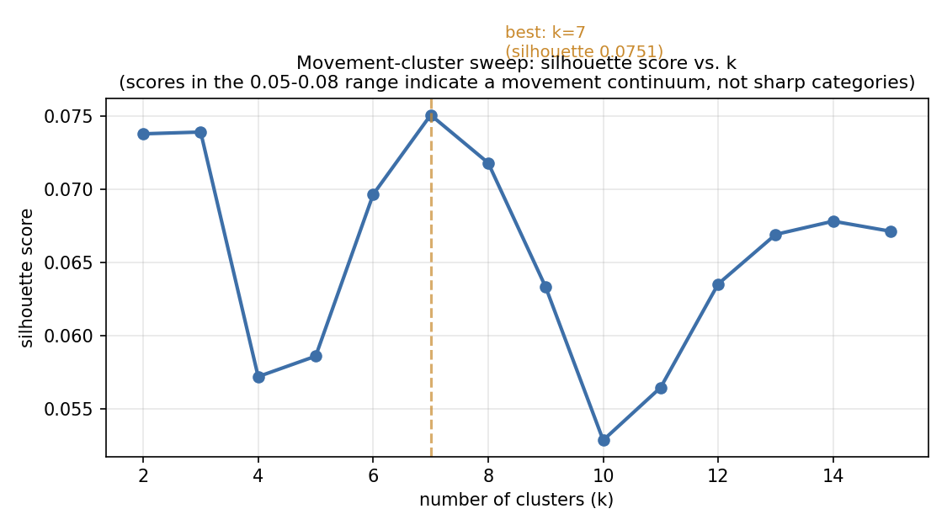
STEP 1
How many kinds of fly movement are there?
Movement segments clustered by shape
(soft-DTW, k swept 2–15)
Best fit: k = 7 clusters
Low silhouette scores are expected here — fly movement is a continuum of turn sharpness and speed, not a set of sharply separated behaviors.
6

Slide 7
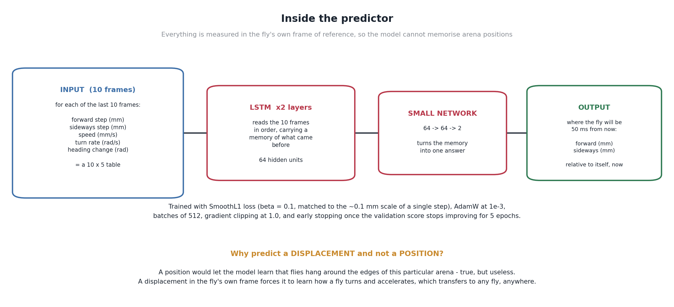
STEP 2
The prediction model
7

Slide 8
METHOD
Testing it honestly
Split by fly, not by frame
Compared to two baselines
Two metrics, always together
70% train / 10% val / 20% test — no fly's movement appears in more than one set.
“constant velocity” (keep going straight) and “stopped” (don't move at all).
Median error in mm, and win rate — % of moments the model beats physics.
8

Slide 9
THE RESULT
At 50 ms ahead, the model beats simple physics by
81.2%
median prediction error: 0.023 mm (model) vs. 0.122 mm (constant velocity)
closer to the truth than physics on 95.3% of individual moments — worst test fly still wins 88.8% of the time
9

Slide 10
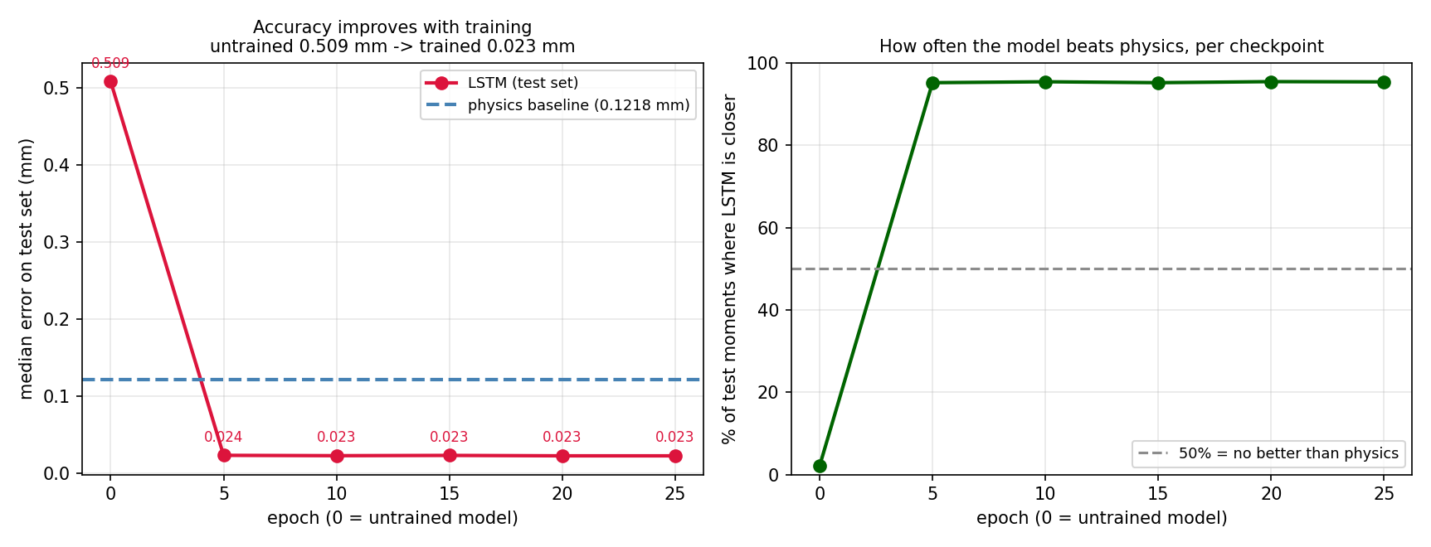
EVIDENCE
Does training actually help? Yes — measured, not assumed
Every checkpoint scored on the same held-out test set, never seen during training.
10

Slide 11
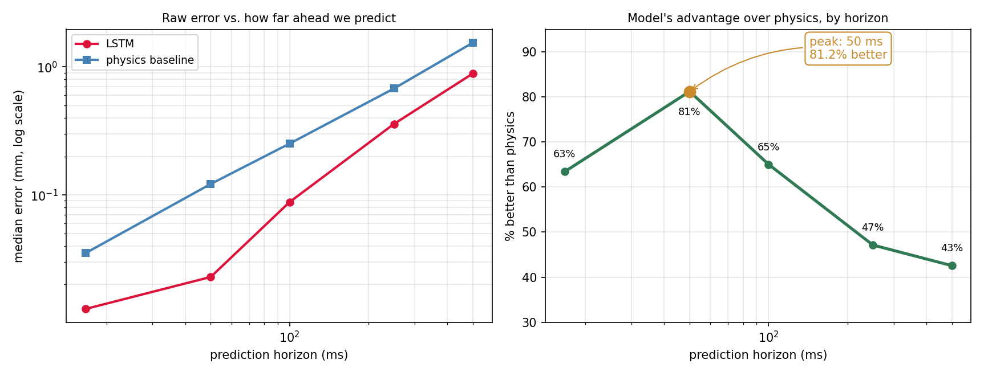
KEY FINDING
Why 50 ms? The model's advantage peaks there
Too short: physics is already a great guess. Too long: neither method sees far enough ahead.
11

Slide 12
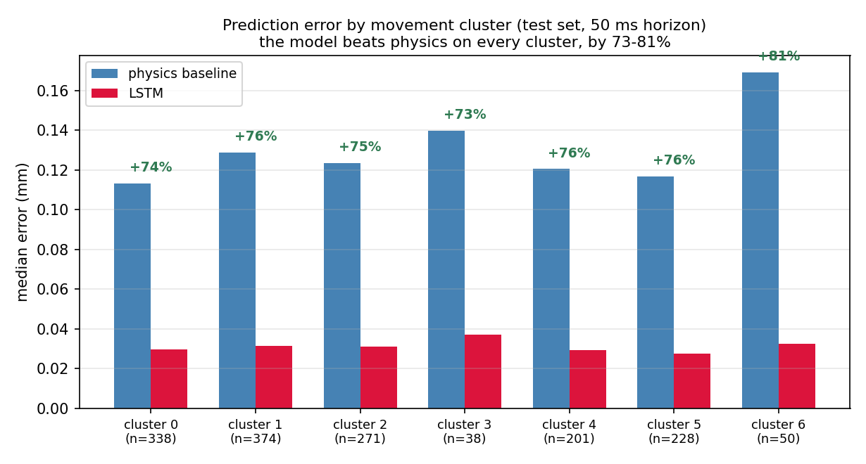
ROBUSTNESS
It helps on every kind of movement, not just one
+73% to +81% improvement across all 7 independently discovered movement clusters
12

Slide 13
CONCLUSIONS
Did we meet our Phase A goals?
Accurate motion prediction
Met
Robustness & generalizability
Met
Adaptability to diverse motion
Met
Noise tolerance (dataset-level)
Met
Real-time hardware integration
Next phase
13

Slide 14
REFLECTION
What we'd do differently
1
Match the architecture to the data — a small continuous LSTM outperformed the plan to adapt a large discrete Transformer (TrajLearn) for this problem.
2
Baselines aren't a formality — comparing every result to constant-velocity is what turned “it works” into a specific, falsifiable, convincing claim.
3
Define the evaluation protocol first — the by-fly train/test split should have been decided before any modeling began.
14

Slide 15
Thank you
Questions?
Yaniv Bodaga · Daniel Lachmakov | Advisors: Dr. Dan Lemberg · Mrs. Elena Kramer

