Slide 1
P-QEMU: A Parallel Multi-core System Emulator Based On QEMU
Po-Chun Chang (張柏駿)

Slide 2
How QEMU Works for Multi-core Guest
QEMU
Host OS scheduler
Guest processor
Thread on host machine
Physical core
G0
T0
P0
G1
P1
G2
P2
G3
Round-Robin
P3

Slide 3
How PQEMU Works For Multi-core Guest
QEMU
Host OS scheduler
Guest processor
Thread on host machine
Physical core
G0
T0
P0
G1
T1
P1
G2
T2
P2
G3
T3
P3

Slide 4
Computer System in QEMU
Emulation thread
IO thread
CPU 0, 1
CPU Idle
Memory
Find
Invalidate
Flush
Build
Chain
Code
Cache
SDRAM
RAM
Block
Execute
Restore
FLASH
Help Function
Soft MMU
RAM
Block
Keystroke receive
Exception/Interrupt Check
Screen update
IO
Interrupt notification: Unchain
I/O Device Model
Alarm signal

Slide 5
Computer System in PQEMU
Emulation threads group
Emulation thread #0
Emulation thread #1
Unified Code
Cache
CPU 0
CPU 1
IO thread
Memory
IO

Slide 6
QEMU CPU Events
CPU Idle
Find Slow
Hit
Miss
Find Fast
Miss
Build
Done
Hit
Full
Chain
Flush
SMC
Invalidate
Execute
Interrupt
Unchain
Check
Interrupt
Exception
Restore
No
Halt?
Yes

Slide 7
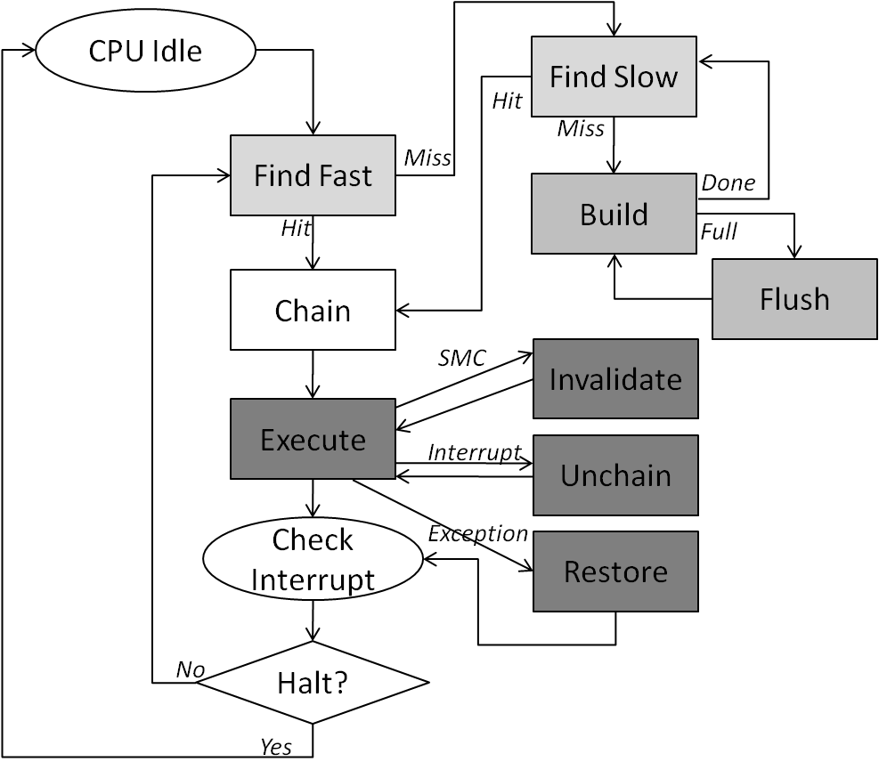
PQEMU CPU Events
CPU 0
CPU 1

Slide 8
Shared Resources in CPU Events
Restore
Execute
Flush
Invalidate
TCG
CC
TBD
TBDA
TBHT
MPD
Chain
Unchain
Build
Find Slow

Slide 9
Synchronizations for Share-all PQEMU
Unified Code Cache (UCC) design
Synchronized
Dependent, but intrinsically synchronized
Independent

Slide 10
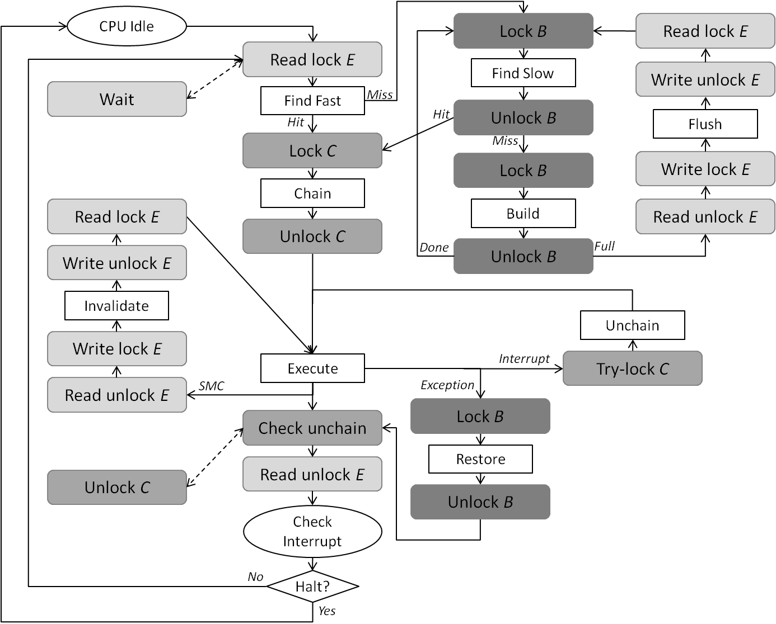
Lock Deployment in UCC Design

Slide 11
Synchronizations for Share-nothing PQEMU
Separate Code Cache (SCC) design
Duplicate all shared resources except MPD
MPD is a linked-list array for quick SMC detection

Slide 12
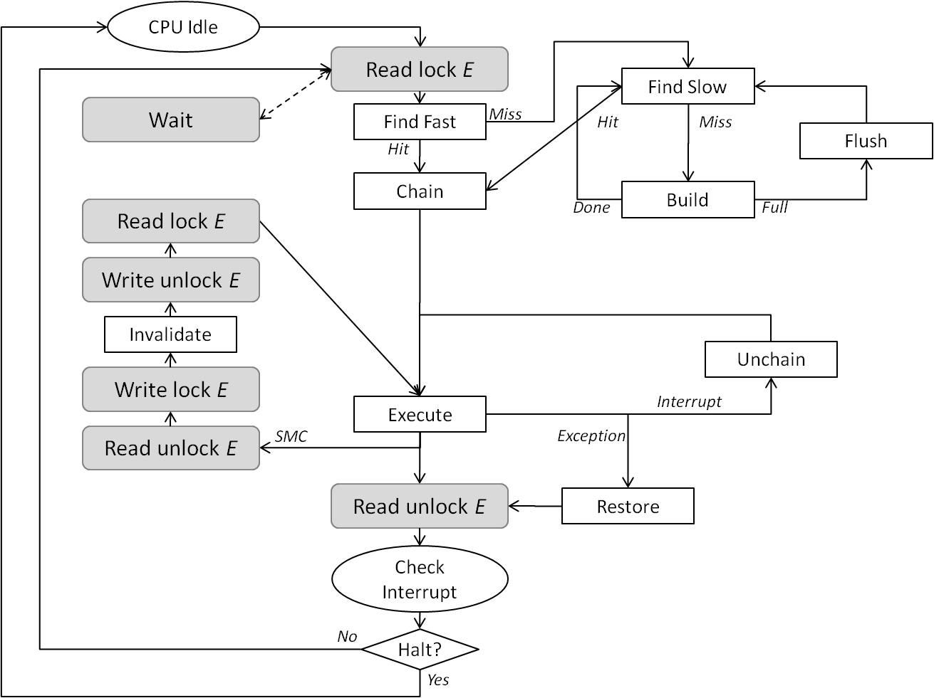
Lock Deployment in SCC Design

Slide 13
PQEMU Memory - Cache
We did not emulate the cache in PQEMU
No cache coherence problem
But we have code cache
Synchronizations in CPU events
Use the idea of read/write lock for maximum flexibility
Read: Build, Execute…
Write: Flush, SMC (modify something related to code cache)
Exclusive code cache access when doing write
Halt all other virtual CPUs in the emulation manager

Slide 14
PQEMU Memory – Order (1/)
No load-store re-ordering at code translation
Memory order in source ISA depends purely on target (host memory system)
Host memory system
Weakly-ordered memory
Target ISA has explicit interfaces for memory serialization
Acquire/release suffix (ia64)
l/s/mfence instructions (x86)
CP15,C7,C10, 4/5 registers (ARMv6)
Strongly-ordered memory
All memory operations serialize

Slide 15
PQEMU Memory – Order (2/)
Memory order from source to target ISA
Weak – Weak
Translate all guest memory serialization requests to corresponded host instructions
Weak – Strong
Memory order follows the guest program order exactly
Strong – Weak
How to efficiently serialize all memory operations?
Strong – Strong

Slide 16
PQEMU Memory – Order (3/)
PQEMU deals with Case 1, only
ARM on x86, both are weakly-ordered
Yet QEMU simply ignores guest memory serialization request (currently, we inherit it)
Then why there is no fatal error when emulating a (SMP) machine by QEMU/PQEMU?

Slide 17
PQEMU Memory – Order (4/)
Where people use memory serialization?
Synchronization primitive
In Kernel, especially the device codes
smp_mb()/smp_rmb()/smp_wmb() in Linux
Other application programs
Not found in Gentoo ARMv6 distribution
libc-2.11.1.so in x86 ubuntu distribution
Assure the visibility of memory operations
To other CPU cores (cache hierarchy indeed)
To peripheral devices

Slide 18
PQEMU Memory – Order (5/)
Not that weakly-ordered as we thought
In x86 case, only SSE instructions matter
MOVNTxxx, move with non-temporal hint
Use weakly-ordered model in Write Back/Through/ Combine memory regions
Memory Type Range Register (MTRR) from our x86 ubuntu system
Using dmesg or read /var/log/…

Slide 19
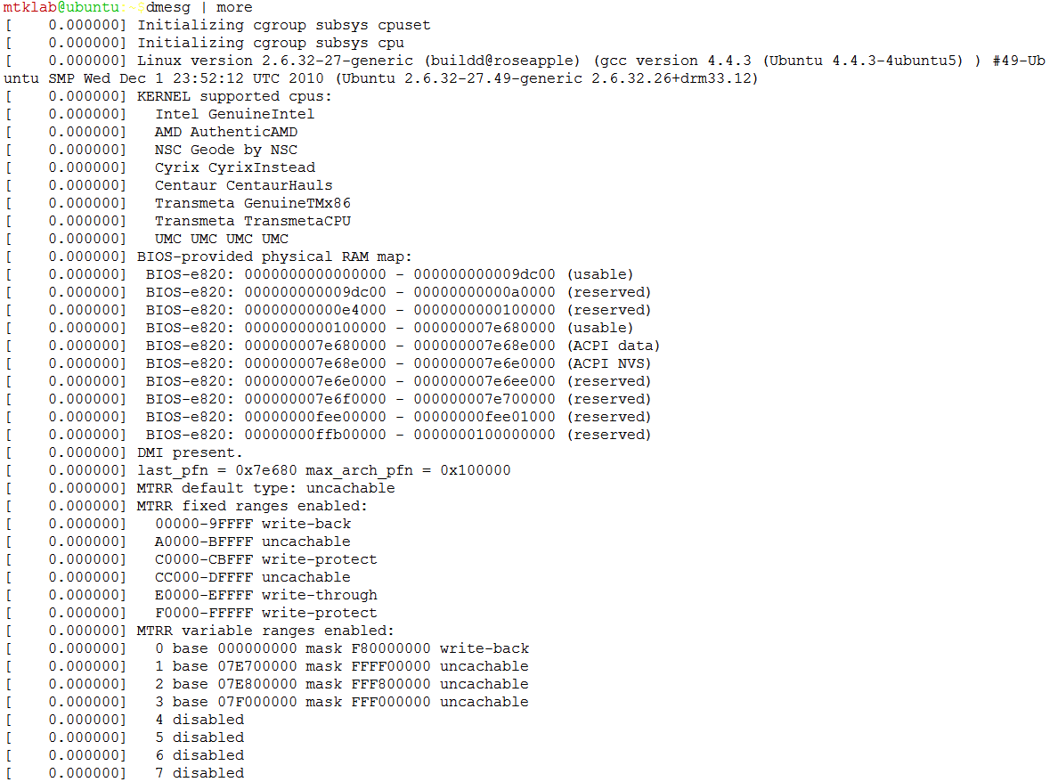
PQEMU Memory – Order (6/)

Slide 20
PQEMU Memory – Order (7/)
Assumption and strategy in QEMU
Generate instructions using no weakly-ordered memory model
What if there are no such instruction?
All guest synchronization primitives are constructed in atomic instructions
De facto approach
Emulate all pseudo devices on CPU thread
I/O devices are essentially synchronized to CPU core

Slide 21
PQEMU Memory – Atomic (1/)
Type of atomic instructions
Bus locking, e.g. #LOCK in x86
Hardware monitoring, e.g. LL-SC pairs in MIPS
Both have similar usage pattern
Memory read – Operation – Memory write
Software visible or not

Slide 22
PQEMU Memory – Atomic (2/)
Software
Hardware
x86 (bus locking)
MOV %EAX, m(v1)
MOV %EDX, m(v2)
LOCK; CMPXCHG %EDX, m(m1)
MOV m(v1), %EAX
Mem read
CMP & XCHG
C language
atomic_cmpxchg(v1, m1, v2);
Pseudo code :
Atomic start;
If v1 == Value(m1)
Value(m1) = v2;
Else
v1 = Value(m1)
Atomic end;
Mem write
ARM (hardware monitoring)
mov R1, m(v1)
mov R2, m(v2)
L_again:
ldrex R_temp, m(m1)
cmp R_temp, R1
bne L_done
strex R2, m(m1)
cmpeq R0, #0
bne L_again
L_done:
mov m(v1), R_temp
Mem read
CMP
BNE
Mem write

Slide 23
PQEMU Memory – Atomic (3/)
Provide atomicity without hardware support
Free-run, no check
Round-robin virtual CPU execution (QEMU)
One lock for all guest memory operations
One lock for all guest atomic instructions
Slow, and address aliasing is rare
Multiple locks for all guest atomic instructions
How many? 1G?
Transaction Memory-like mechanism

Slide 24
PQEMU Memory – Atomic (4/)
Simplified Software Transactional Memory
At most one write commit
Small write data (1/2/4/8 bytes)
Short transaction in scale of few instructions
General procedure
Take snapshot (few bytes)
Do operation
Commit
Go to step 1 if failed (memory content is changed)

Slide 25
PQEMU Memory – Atomic (4/)
More for hardware monitoring atomics
A table keeping all on-the-fly LL addresses and their snapshots
Entry is invalidated by an LL with colliding address
SC succeeds when address exists and its snapshot is valid (memory content unchanged)
Similar to ia64 Advanced Load Address Table
Snapshot valid = atomic?

Slide 26
PQEMU Memory – TLB (1/)
TLB in QEMU system emulator
Guest memory is an malloc-ed trunk
Share address space with guest as in process VM? Nearly impossible
Full path of guest memory address translation
TLB entry for different accesses
Read/Write: GVA/GPA -> HVA
Execute(code): GVA/GPA -> GPA

Slide 27
PQEMU Memory – TLB (2/)
TLB operates in a per-CPU basis
Free to invalidate CPU-private TLB at any time
Invalidate other CPU’s TLB entry
No such hardware instruction (x86, ARM)
Invalidate CPU event (SMC) inside PQEMU
All other virtual CPUs are halted
TLB does not keep the translated code address, GPA instead

Slide 28
PQEMU I/O (1/)
I/O system in real world
CPU 0
IO
CPU 1
1
CPU
IO
2
1
Time
1
3
2
2
Time
4
3
4
3
5
5

Slide 29
PQEMU I/O (2/)
I/O system in QEMU’s world
CPU 0
IO
CPU 1
CPU
IO
1
2
1
Time
4
2
5
Time
4
5
1
3
2
3
4
5
3

Slide 30
PQEMU I/O (3/)
Sequential device access pattern
Enforced by OS, not hardware
QEMU’s I/O device model
Assume no race-condition
Re-entrant device emulation functions? not required
Finish before executing next guest instruction
Synchronized to this CPU (self)
Synchronized to other CPU (non weakly-order region)
No memory serialization problem

Slide 31
PQEMU I/O (4/)
SMC from memory-content-modifying device
Overwrite a translated code page by DMA
Trigger Invalidate CPU event
The dark side of this I/O model
Waste the parallelism between CPU and I/O
Use host OS to alleviate data-moving operations (aio)
I/O completes in no time (from guest binary’s point of view)
Violate the characteristic of a real hardware
Case from our PQEMU

Slide 32
PQEMU I/O (5/)
Problem: guest console (from UART) sometimes will freeze
Linux employs an facility to turn off “spurious” interrupt lines
Pseudo UART generates “a lot” spurious IRQs
Eventually UART IRQ is disabled, and we are dead
But we still could login from VNC/SDL interface
VGA/keyboard are alive
Guest Linux works perfectly

Slide 33
PQEMU I/O – Future
Classification of I/O registers
Setup
Operational
Interrupt (status)
Move the operational parts to an I/O thread
Synchronization between CPU and I/O threads
Survey list
ARM: PL011(UART), PL031(RTC), PL050(KMI), PL080(DMA), PL110(LCD control)
Peripheral: SMSC91c111(ethernet), PHILIPS ISP1716(USB 2.0 host controller)

Slide 34
Experiment Environment
Experimental Parameters
Benchmark | Splash-2 programs for ARM v6 ISA
Guest OS | Linux 2.6.27
Guest HW | ARM 11 MPCore architecture (x4 ARM 11 processor)
Emulator | QEMU 0.12.1 with parallel emulation model (UCC & SCC)
Host OS | x86_64 Fedora 12 Linux (2.6.31.12)
Host Machine | Intel Core i7 Quad Cores (4 cores, 8 SMT)

Slide 35
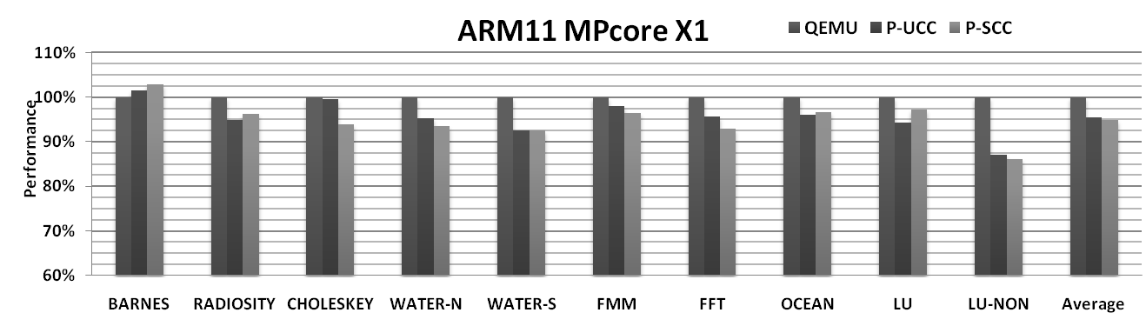
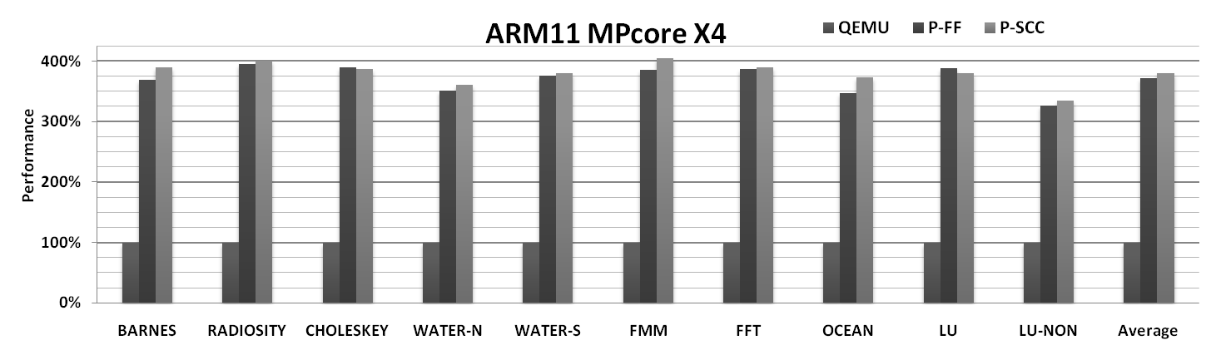
Experimental Result

Slide 37
CPU Idle
Lock B
Read lock E
Read lock E
Find Slow
Write unlock E
Wait
Find Fast
Miss
Hit
Hit
Unlock B
Flush
Lock C
Miss
Lock B
Write lock E
Chain
Read lock E
Build
Read unlock E
Unlock C
Done
Unlock B
Full
Write unlock E
Full
Invalidate
Unchain
Write lock E
Execute
Interrupt
Try-lock C
Read unlock E
SMC
Exception
Check unchain
Lock B
Read unlock E
Restore
Unlock C
Unlock B
Check
Interrupt
No
Halt?
Yes

Slide 38
CPU Idle
Read lock E
Find Slow
Wait
Find Fast
Miss
Hit
Miss
Hit
Flush
Chain
Build
Read lock E
Done
Full
Write unlock E
Invalidate
Unchain
Write lock E
Execute
Interrupt
Read unlock E
SMC
Exception
Read unlock E
Restore
Check
Interrupt
No
Halt?
Yes

