Slide 1
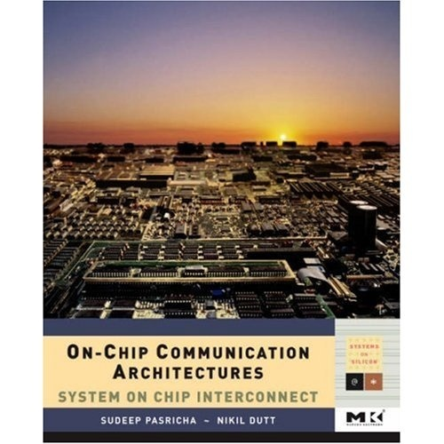
On-Chip Communication Architectures
Networks-on-Chip
ICS 295
Sudeep Pasricha and Nikil Dutt
Slides based on book chapter 12
© 2008 Sudeep Pasricha & Nikil Dutt

Slide 2
Outline
Introduction
NoC Topology
Switching strategies
Routing algorithms
Flow control schemes
Clocking schemes
QoS
NoC Architecture Examples
Status and Open Problems
© 2008 Sudeep Pasricha & Nikil Dutt

Slide 3
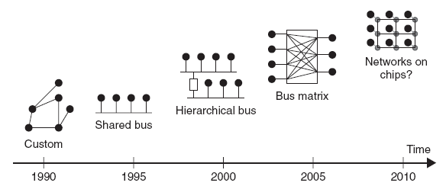
Introduction
Evolution of on-chip communication architectures
© 2008 Sudeep Pasricha & Nikil Dutt

Slide 4
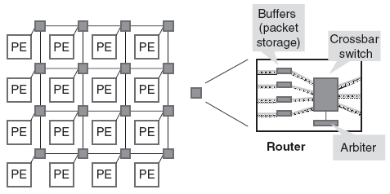
Introduction
Network-on-chip (NoC) is a packet switched on-chip communication network designed using a layered methodology
  “routes packets, not wires”
NoCs use packets to route data from the source to the destination PE via a network fabric that consists of
    switches (routers)
    interconnection links (wires)
© 2008 Sudeep Pasricha & Nikil Dutt

Slide 5
Introduction
NoCs are an attempt to scale down the concepts of largescale networks, and apply them to the embedded system-on-chip (SoC) domain
NoC Properties
  Regular geometry that is scalable
  Flexible QoS guarantees
  Higher bandwidth
  Reusable components
    Buffers, arbiters, routers, protocol stack
  No long global wires (or global clock tree)
    No problematic global synchronization
    GALS: Globally asynchronous, locally synchronous design
  Reliable and predictable electrical and physical properties
© 2008 Sudeep Pasricha & Nikil Dutt

Slide 6
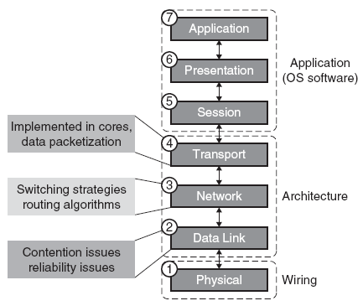
Introduction
ISO/OSI network protocol stack model
© 2008 Sudeep Pasricha & Nikil Dutt

Slide 7
Outline
Introduction
NoC Topology
Switching strategies
Routing algorithms
Flow control schemes
Clocking schemes
QoS
NoC Architecture Examples
Status and Open Problems
© 2008 Sudeep Pasricha & Nikil Dutt

Slide 8
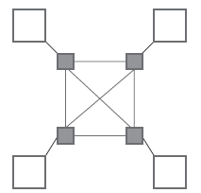
NoC Topology
Direct Topologies
  each node has direct point-to-point link to a subset of other nodes in the system called neighboring nodes
  nodes consist of computational blocks and/or memories, as well as a NI block that acts as a router
  e.g. Nostrum, SOCBUS, Proteo, Octagon
  as the number of nodes in the system increases, the total available communication bandwidth also increases
  fundamental trade-off is between connectivity and cost
© 2008 Sudeep Pasricha & Nikil Dutt

Slide 9
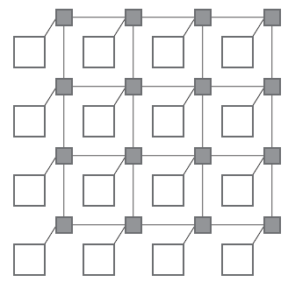
NoC Topology
Most direct network topologies have an orthogonal implementation, where nodes can be arranged in an
n-dimensional orthogonal space
  routing for such networks is fairly simple
  e.g. n-dimensional mesh, torus, folded torus, hypercube, and octagon
2D mesh is most popular topology
  all links have the same length
    eases physical design
  area grows linearly with the number
  of nodes
  must be designed in such a way as to
  avoid traffic accumulating in the
  center of the mesh
© 2008 Sudeep Pasricha & Nikil Dutt

Slide 10

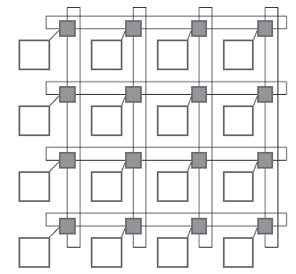
NoC Topology
Torus topology, also called a k-ary n-cube, is an n-dimensional grid with k nodes in each dimension
  k-ary 1-cube (1-D torus) is essentially a ring network with k nodes
    limited scalability as performance decreases when more nodes
  k-ary 2-cube (i.e., 2-D torus) topology is
  similar to a regular mesh
    except that nodes at the edges are connected
    to switches at the opposite edge via wrap-
    around channels
    long end-around connections can, however,
    lead to excessive delays
© 2008 Sudeep Pasricha & Nikil Dutt

Slide 11
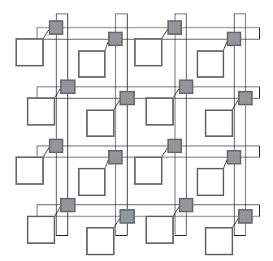
NoC Topology
Folding torus topology overcomes the long link limitation of a 2-D torus
  links have the same size
Meshes and tori can be extended by adding bypass links to increase performance at the cost of higher area
© 2008 Sudeep Pasricha & Nikil Dutt

Slide 12
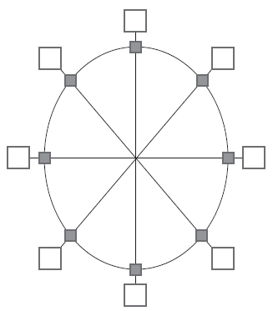
NoC Topology
Octagon topology is another example of a direct network
  messages being sent between any 2 nodes require at most two hops
  more octagons can be tiled together to accommodate larger designs
    by using one of the nodes is used as a bridge node
© 2008 Sudeep Pasricha & Nikil Dutt

Slide 13
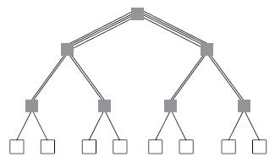
NoC Topology
Indirect Topologies
  each node is connected to an external switch, and switches have point-to-point links to other switches
  switches do not perform any information processing, and correspondingly nodes do not perform any packet switching
  e.g. SPIN, crossbar topologies
Fat tree topology
  nodes are connected only to the leaves of the tree
  more links near root, where bandwidth requirements are higher
© 2008 Sudeep Pasricha & Nikil Dutt

Slide 14
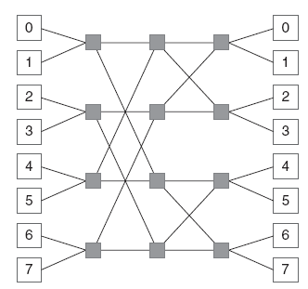
NoC Topology
k-ary n-fly butterfly network
  blocking multi-stage network – packets may be temporarily blocked or dropped in the network if contention occurs
  k^{n} nodes, and n stages of k^{n-1} k x k crossbar
  e.g. 2-ary 3-fly butterfly network
© 2008 Sudeep Pasricha & Nikil Dutt

Slide 15
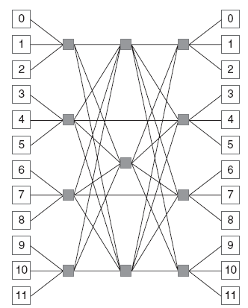
NoC Topology
(m, n, r) symmetric Clos network
  three-stage network in which each stage is made up of a number of crossbar switches
  m is the no. of middle-stage switches
  n is the number of input/output
  nodes on each input/output switch
  r is the number of input and output
  switches
  e.g. (3, 3, 4) Clos network
  non-blocking network
  expensive (several full crossbars)
© 2008 Sudeep Pasricha & Nikil Dutt

Slide 16
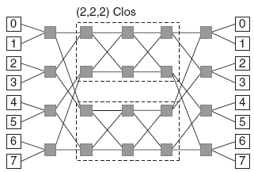
NoC Topology
Benes network
  rearrangeable network in which paths may have to be rearranged to provide a connection, requiring an appropriate controller
  Clos topology composed of 2 x 2 switches
  e.g. (2, 2, 4) re-arrangeable Clos network constructed using two (2, 2, 2) Clos networks with 4 x 4 middle switches
© 2008 Sudeep Pasricha & Nikil Dutt

Slide 17
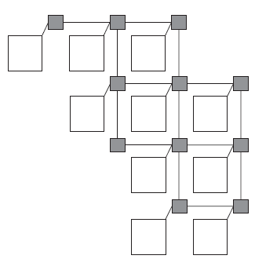
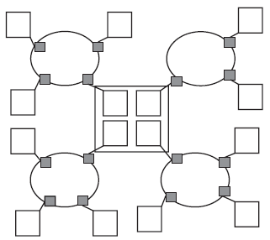
NoC Topology
Irregular or ad hoc network topologies
  customized for an application
  usually a mix of shared bus, direct, and indirect network topologies
  e.g. reduced mesh, cluster-based hybrid topology
© 2008 Sudeep Pasricha & Nikil Dutt

Slide 18
Outline
Introduction
NoC Topology
Switching strategies
Routing algorithms
Flow control schemes
Clocking schemes
QoS
NoC Architecture Examples
Status and Open Problems
© 2008 Sudeep Pasricha & Nikil Dutt

Slide 19
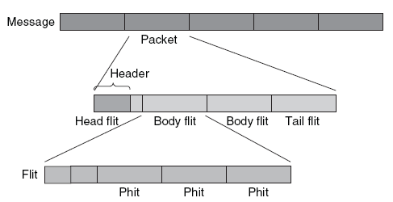
Switching strategies
Determine how data flows through routers in the network
Define granularity of data transfer and applied switching technique
  phit is a unit of data that is transferred on a link in a single cycle
  typically, phit size = flit size
© 2008 Sudeep Pasricha & Nikil Dutt

Slide 20
Switching strategies
Two main modes of transporting flits in a NoC are circuit switching and packet switching
Circuit switching
  physical path between the source and the destination is reserved prior to the transmission of data
  message header flit traverses the network from the source to the destination, reserving links along the way
  Advantage: low latency transfers, once path is reserved
  Disadvantage: pure circuit switching does not scale well with NoC size
    several links are occupied for the duration of the transmitted data, even when no data is being transmitted
      for instance in the setup and tear down phases
© 2008 Sudeep Pasricha & Nikil Dutt

Slide 21
Switching strategies
Virtual circuit switching
  creates virtual circuits that are multiplexed on links
  number of virtual links (or virtual channels (VCs)) that can be supported by a physical link depends on buffers allocated to link
  Possible to allocate either one buffer per virtual link or one buffer per physical link
  Allocating one buffer per virtual link
    depends on how virtual circuits are spatially distributed in the NoC, routers can have a different number of buffers
    can be expensive due to the large number of shared buffers
    multiplexing virtual circuits on a single link also requires scheduling at each router and link (end-to-end schedule)
    conflicts between different schedules can make it difficult to achieve bandwidth and latency guarantees
© 2008 Sudeep Pasricha & Nikil Dutt

Slide 22
Switching strategies
  Allocating one buffer per physical link
    virtual circuits are time multiplexed with a single buffer per link
    uses time division multiplexing (TDM) to statically schedule the usage of links among virtual circuits
    flits are typically buffered at the NIs and sent into the NoC according to the TDM schedule
    global scheduling with TDM makes it easier to achieve end-to-end bandwidth and latency guarantees
    less expensive router implementation, with fewer buffers
© 2008 Sudeep Pasricha & Nikil Dutt

Slide 23
Switching strategies
Packet Switching
  packets are transmitted from source and make their way independently to receiver
    possibly along different routes and with different delays
  zero start up time, followed by a variable delay due to contention in routers along packet path
  QoS guarantees are harder to make in packet switching than in circuit switching
  three main packet switching scheme variants
SAF switching
  packet is sent from one router to the next only if the receiving router has buffer space for entire packet
  buffer size in the router is at least equal to the size of a packet
  Disadvantage: excessive buffer requirements
© 2008 Sudeep Pasricha & Nikil Dutt

Slide 24
Switching strategies
VCT Switching
  reduces router latency over SAF switching by forwarding first flit of a packet as soon as space for the entire packet is available in the next router
  if no space is available in receiving buffer, no flits are sent, and the entire packet is buffered
  same buffering requirements as SAF switching
WH switching
  flit from a packet is forwarded to receiving router if space exists for that flit
  parts of the packet can be distributed among two or more routers
  buffer requirements are reduced to one flit, instead of an entire packet
  more susceptible to deadlocks due to usage dependencies between links
© 2008 Sudeep Pasricha & Nikil Dutt

Slide 25
Outline
Introduction
NoC Topology
Switching strategies
Routing algorithms
Flow control schemes
Clocking schemes
QoS
NoC Architecture Examples
Status and Open Problems
© 2008 Sudeep Pasricha & Nikil Dutt

Slide 26
Routing algorithms
Responsible for correctly and efficiently routing packets or circuits from the source to the destination
Choice of a routing algorithm depends on trade-offs between several potentially conflicting metrics
  minimizing power required for routing
  minimizing logic and routing tables to achieve a lower area footprint
  increasing performance by reducing delay and maximizing traffic utilization of the network
  improving robustness to better adapt to changing traffic needs
Routing schemes can be classified into several categories
  static or dynamic routing
  distributed or source routing
  minimal or non-minimal routing
© 2008 Sudeep Pasricha & Nikil Dutt

Slide 27
Routing algorithms
Static and dynamic routing
  static routing: fixed paths are used to transfer data between a particular source and destination
    does not take into account current state of the network
  advantages of static routing:
    easy to implement, since very little additional router logic is required
    in-order packet delivery if single path is used
  dynamic routing: routing decisions are made according to the current state of the network
    considering factors such as availability and load on links
  path between source and destination may change over time
    as traffic conditions and requirements of the application change
  more resources needed to monitor state of the network and dynamically change routing paths
  able to better distribute traffic in a network
© 2008 Sudeep Pasricha & Nikil Dutt

Slide 28
Routing algorithms
Distributed and source routing
  static and dynamic routing schemes can be further classified depending on where the routing information is stored, and where routing decisions are made
  distributed routing: each packet carries the destination address
    e.g., XY co-ordinates or number identifying destination node/router
    routing decisions are made in each router by looking up the destination addresses in a routing table or by executing a hardware function
  source routing: packet carries routing information
    pre-computed routing tables are stored at a nodes’ NI
    routing information is looked up at the source NI and routing information is added to the header of the packet (increasing packet size)
    when a packet arrives at a router, the routing information is extracted from the routing field in the packet header
    does not require a destination address in a packet, any intermediate routing tables, or functions needed to calculate the route
© 2008 Sudeep Pasricha & Nikil Dutt

Slide 29
Routing algorithms
Minimal and non-minimal routing
  minimal routing: length of the routing path from the source to the destination is the shortest possible length between the two nodes
    e.g. in a mesh NoC topology (where each node can be identified by its XY co-ordinates in the grid) if source node is at (0, 0) and destination node is at (i, j), then the minimal path length is |i| + |j|
    source does not start sending a packet if minimal path is not available
  non-minimal routing: can use longer paths if a minimal path is not available
    by allowing non-minimal paths, the number of alternative paths is increased, which can be useful for avoiding congestion
    disadvantage: overhead of additional power consumption
© 2008 Sudeep Pasricha & Nikil Dutt

Slide 30
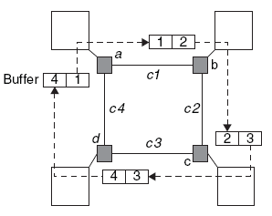
Routing algorithms
Routing algorithm must ensure freedom from deadlocks
  common in WH switching
  e.g. cyclic dependency shown below
  freedom from deadlocks can be ensured by allocating additional hardware resources or imposing restrictions on the routing
  usually dependency graph of the shared network resources is built and analyzed either statically or dynamically
© 2008 Sudeep Pasricha & Nikil Dutt

Slide 31
Routing algorithms
Routing algorithm must ensure freedom from livelocks
  livelocks are similar to deadlocks, except that states of the resources involved constantly change with regard to one another, without making any progress
    occurs especially when dynamic (adaptive) routing is used
    e.g. can occur in a deflective “hot potato” routing if a packet is bounced around over and over again between routers and never reaches its destination
  livelocks can be avoided with simple priority rules
Routing algorithm must ensure freedom from starvation
  under scenarios where certain packets are prioritized during routing, some of the low priority packets never reach their intended destination
  can be avoided by using a fair routing algorithm, or reserving some bandwidth for low priority data packets
© 2008 Sudeep Pasricha & Nikil Dutt

Slide 32
Outline
Introduction
NoC Topology
Switching strategies
Routing algorithms
Flow control schemes
Clocking schemes
QoS
NoC Architecture Examples
Status and Open Problems
© 2008 Sudeep Pasricha & Nikil Dutt

Slide 33
Flow control schemes
Goal of flow control is to allocate network resources for packets traversing a NoC
  can also be viewed as a problem of resolving contention during packet traversal
At the data link-layer level, when transmission errors occur, recovery from the error depends on the support provided by the flow control mechanism
  e.g. if a corrupted packet needs to be retransmitted, flow of packets from the sender must be stopped, and request signaling must be performed to reallocate buffer and bandwidth resources
Most flow control techniques can manage link congestion
But not all schemes can (by themselves) reallocate all the resources required for retransmission when errors occur
  either error correction or a scheme to handle reliable transfers must be implemented at a higher layer
© 2008 Sudeep Pasricha & Nikil Dutt

Slide 34
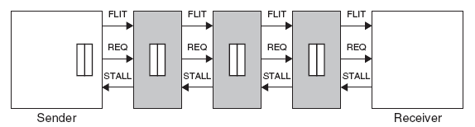
Flow control schemes
STALL/GO
  low overhead scheme
  requires only two control wires
    one going forward and signaling data availability
    the other going backward and signaling either a condition of buffers filled (STALL) or of buffers free (GO)
  can be implemented with distributed buffering (pipelining) along link
  good performance – fast recovery from congestion
  does not have any provision for fault handling
    higher level protocols responsible for handling flit interruption
© 2008 Sudeep Pasricha & Nikil Dutt

Slide 35
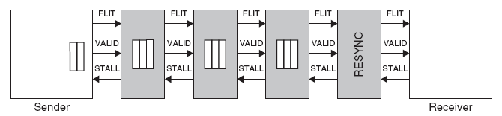
Flow control schemes
T-Error
  more aggressive scheme that can detect faults
    by making use of a second delayed clock at every buffer stage
  delayed clock re-samples input data to detect any inconsistencies
    then emits a VALID control signal
  resynchronization stage added between end of link and receiving switch
    to handle offset between original and delayed clocks
  timing budget can be used to provide greater reliability by configuring links with appropriate spacing and frequency
  does not provide a thorough fault handling mechanism
© 2008 Sudeep Pasricha & Nikil Dutt

Slide 36
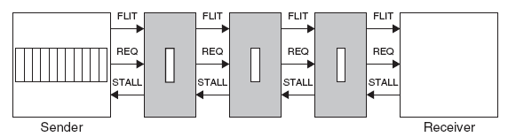
Flow control schemes
ACK/NACK
  when flits are sent on a link, a local copy is kept in a buffer by sender
  when ACK received by sender, it deletes copy of flit from its local buffer
  when NACK is received, sender rewinds its output queue and starts resending flits, starting from the corrupted one
  implemented either end-to-end or switch-to-switch
  sender needs to have a buffer of size 2N + k
    N is number of buffers encountered between source and destination
    k depends on latency of logic at the sender and receiver
  overall a minimum of 3N + k buffers are required
  fault handling support comes at cost of greater power, area overhead
© 2008 Sudeep Pasricha & Nikil Dutt

Slide 37
Flow control schemes
Network and Transport-Layer Flow Control
  Flow Control without Resource Reservation
    Technique #1: drop packets when receiver NI full
      improves congestion in short term but increases it in long term
    Technique #2: return packets that do not fit into receiver buffers to sender
      to avoid deadlock, rejected packets must be accepted by sender
    Technique #3: deflection routing
      when packet cannot be accepted at receiver, it is sent back into network
      packet does not go back to sender, but keeps hopping from router to router till it is accepted at receiver
  Flow Control with Resource Reservation
    credit-based flow control with resource reservation
    credit counter at sender NI tracks free space available in receiver NI buffers
    credit packets can piggyback on response packets
    end-to-end or link-to-link
© 2008 Sudeep Pasricha & Nikil Dutt

Slide 38
Outline
Introduction
NoC Topology
Switching strategies
Routing algorithms
Flow control schemes
Clocking schemes
QoS
NoC Architecture Examples
Status and Open Problems
© 2008 Sudeep Pasricha & Nikil Dutt

Slide 39
Clocking schemes
Fully synchronous
  single global clock is distributed to synchronize entire chip
    hard to achieve in practice, due to process variations and clock skew
Mesochronous
  local clocks are derived from a global clock
  not sensitive to clock skew
  phase between clock signals in different modules may differ
    deterministic for regular topologies (e.g. mesh)
    non-deterministic for irregular topologies
      synchronizers needed between clock domains
Pleisochronous
  clock signals are produced locally
Asynchronous
  clocks do not have to be present at all
© 2008 Sudeep Pasricha & Nikil Dutt

Slide 40
Outline
Introduction
NoC Topology
Switching strategies
Routing algorithms
Flow control schemes
Clocking schemes
QoS
NoC Architecture Examples
Status and Open Problems
© 2008 Sudeep Pasricha & Nikil Dutt

Slide 41
Quality of Service (QoS)
QoS refers to the level of commitment for packet delivery
  refers to bounds on performance (bandwidth, delay, and jitter)
Three basic categories
  best effort (BE)
    only correctness and completion of communication is guaranteed
    usually packet switched
    worst case times cannot be guaranteed
  guaranteed service (GS)
    makes a tangible guarantee on performance, in addition to basic guarantees of correctness and completion for communication
    usually (virtual) circuit switched
  differentiated service
    prioritizes communication according to different categories
    NoC switches employ priority based scheduling and allocation policies
    cannot provide strong guarantees
© 2008 Sudeep Pasricha & Nikil Dutt

Slide 42
Outline
Introduction
NoC Topology
Switching strategies
Routing algorithms
Flow control schemes
Clocking schemes
QoS
NoC Architecture Examples
Status and Open Problems
© 2008 Sudeep Pasricha & Nikil Dutt

Slide 43
Æthereal
Developed by Philips
Synchronous indirect network
WH switching
Contention-free source routing based on TDM
GT as well as BE QoS
GT slots can be allocated statically at initialization phase, or dynamically at runtime
BE traffic makes use of non-reserved slots, and any unused reserved slots
  also used to program GT slots of the routers
Link-to-link credit-based flow control scheme between BE buffers
  to avoid loss of flits due to buffer overflow
© 2008 Sudeep Pasricha & Nikil Dutt

Slide 44
HERMES
Developed at the Faculdade de Informática PUCRS, Brazil
Direct network
2-D mesh topology
WH switching with minimal XY routing algorithm
8 bit flit size; first 2 flits of packet contain header
Header has target address and number of flits in the packet
Parameterizable input queuing
  to reduce the number of switches affected by a blocked packet
Connectionless: cannot provide any form of bandwidth or latency GS
© 2008 Sudeep Pasricha & Nikil Dutt

Slide 45
MANGO
Message-passing Asynchronous Network-on-chip providing GS over open core protocol (OCP) interfaces
Developed at the Technical University of Denmark
Clockless NoC that provides BE as well as GS services
NIs (or adapters) convert between the synchronous OCP domain and asynchronous domain
Routers allocate separate physical buffers for VCs
  For simplicity, when ensuring GS
BE connections are source routed
  BE router uses credit-based buffers to handle flow control
  length of a BE path is limited to five hops
static scheduler gives link access to higher priority channels
  admission controller ensures low priority channels do not starve
© 2008 Sudeep Pasricha & Nikil Dutt

Slide 46
Nostrum
Developed at KTH in Stockholm
Direct network with a 2-D mesh topology
SAF switching with hot potato (or deflective) routing
Support for
  switch/router load distribution
  guaranteed bandwidth (GB)
  multicasting
GB is realized using looped containers
  implemented by VCs using a TDM mechanism
  container is a special type of packet which loops around VC
  multicast: simply have container loop around on VC having recipients
Switch load distribution requires each switch to indicate its current load by sending a stress value to its neighbors
© 2008 Sudeep Pasricha & Nikil Dutt

Slide 47
Octagon
Developed by STMicroelectronics
direct network with an octagonal topology
8 nodes and 12 bidirectional links
Any node can reach any other node with a max of 2 hops
Can operate in packet switched or circuit switched mode
Nodes route a packet in packet switched mode according to its destination field
  node calculates a relative address and then packet is routed either left, right, across, or into the node
Can be scaled if more than 8 nodes are required
  Spidergon
© 2008 Sudeep Pasricha & Nikil Dutt

Slide 48
QNoC
Developed at Technion in Israel
Direct network with an irregular mesh topology
WH switching with an XY minimal routing scheme
Link-to-link credit-based flow control
Traffic is divided into four different service classes
  signaling, real-time, read/write, and block-transfer
  signaling has highest priority and block transfers lowest priority
  every service level has its own small buffer (few flits) at switch input
Packet forwarding is interleaved according to QoS rules
  high priority packets able to preempt low priority packets
Hard guarantees not possible due to absence of circuit switching
  Instead statistical guarantees are provided
© 2008 Sudeep Pasricha & Nikil Dutt

Slide 49
SOCBUS
Developed at Linköping University
Mesochronous clocking with signal retiming is used
Circuit switched, direct network with 2-D mesh topology
Minimum path length routing scheme is used
Circuit switched scheme is
  deadlock free
  requires simple routing hardware
  very little buffering (only for the request phase)
  results in low latency
Hard guarantees are difficult to give because it takes a long time to set up a connection
© 2008 Sudeep Pasricha & Nikil Dutt

Slide 50
SPIN
Scalable programmable integrated network (SPIN)
fat-tree topology, with two one-way 32-bit link data paths
WH switching, and deflection routing
Virtual socket interface alliance (VSIA) virtual component interface (VCI) protocol to interface between PEs
Flits of size 4 bytes
First flit of packet is header
  first byte has destination address (max. 256 nodes)
  last byte has checksum
Link level flow control
Random hiccups can be expected under high load
  GS is not supported
© 2008 Sudeep Pasricha & Nikil Dutt

Slide 51
Xpipes
Developed by the Univ. of Bologna and Stanford University
Source-based routing, WH switching
Supports OCP standard for interfacing nodes with NoC
Supports design of heterogeneous, customized (possibly irregular) network topologies
go-back-N retransmission strategy for link level error control
  errors detected by a CRC (cycle redundancy check) block running concurrently with the switch operation
XpipesCompiler and NetChip compilers
  Tools to tune parameters such as flit size, address space of cores, max. number of hops between any two network nodes, etc.
  generate various topologies such as mesh, torus, hypercube, Clos, and butterfly
© 2008 Sudeep Pasricha & Nikil Dutt

Slide 52
Outline
Introduction
NoC Topology
Switching strategies
Routing algorithms
Flow control schemes
Clocking schemes
QoS
NoC Architecture Examples
Status and Open Problems
© 2008 Sudeep Pasricha & Nikil Dutt

Slide 53
Status and Open Problems
Power
  complex NI and switching/routing logic blocks are power hungry
  several times greater than for current bus-based approaches
Latency
  additional delay to packetize/de-packetize data at NIs
  flow/congestion control and fault tolerance protocol overheads
  delays at the numerous switching stages encountered by packets
  even circuit switching has overhead (e.g. SOCBUS)
  lags behind what can be achieved with bus-based/dedicated wiring
Lack of tools and benchmarks
Simulation speed
  GHz clock frequencies, large network complexity, greater number of PEs slow down simulation
© 2008 Sudeep Pasricha & Nikil Dutt

Slide 54
Trends
Move towards hybrid interconnection fabrics
  NoC-bus based
  Custom, heterogeneous topologies
New interconnect paradigms
  Optical
  Wireless
  Carbon nanotube
© 2008 Sudeep Pasricha & Nikil Dutt

Slide 55

© 2008 Sudeep Pasricha & Nikil Dutt

