Slide 1
Generate Graph Based on Topology
CommunicationGraph * GraphGenerator::GenerateGraphs()
{
CommunicationGraph * commGraph;
switch (mParams.TOPOLOGY) {
case 1: commGraph = GenerateMesh(mParams.K, mParams.N); break;
case 2: commGraph = GenerateFatTree(mParams.K, mParams.N); break;
case 3: commGraph = GenerateButterfly(mParams.K, mParams.N); break;
case 4: commGraph = GenerateClos(mParams.M, mParams.N, mParams.R, mParams.LEVELS); break;
case 5: commGraph = GenerateKaryNfly(mParams.K, mParams.N, false); break;
case 6: commGraph = GenerateRandomVertices(mParams.K, mParams.N); break;
case 7: commGraph = GenerateBenesh(mParams.R, mParams.N); break;
case 8: commGraph = GenerateKaryNfly(mParams.K, mParams.N, true); break;
case 9: commGraph = NULL; break;
default: throw std::exception("Unknown toplogy!");
}
if (commGraph)
RenameVertices(commGraph);
if (string(mParams.MCSL_FILENAME) != string(""))
commGraph = GenerateMCSL(commGraph);
commGraph->ComputeWireLength();
return commGraph;
}

Slide 2
Generate Graph: Example clos
CommunicationGraph * GraphGenerator::GenerateClos(int m, int n, int r, int levels) {
cout << "Generating clos m=" << m << ",n=" << n << ",r=" << r << ",levels=" << levels << endl;
CommunicationGraph * graph = new CommunicationGraph();
stringstream sstr;
sstr << "VariableBandWidthClos" << "_" << m << "_" << n << "_" << r << "_" << levels;
graph->SetName(sstr.str());
int vertexIdStart = 0;
int edgeIdStart = 0;
int placeX = 2;
int placeY = 0;
EFNocVertex * v;
EFNocEdge * e;
DblPoint p;
vector<int> portsIn;
vector<int> portsOut;
GenerateClos(m,n,r,levels,vertexIdStart,edgeIdStart,placeX,placeY,portsIn,portsOut,*graph);
for (int i = 0; i < r; i++) {
for (int j = 0; j < n; j++) {
v = new EFNocVertex(vertexIdStart++, true);
p.x = 100;
p.y = 100 * (i*n+j+1);
v->setLocation(p);
assert(graph->AddVertex(v));
e = new EFNocEdge(edgeIdStart++, v->GetVertexNum(), portsIn[i], true, 1.0);
assert(graph->AddEdge(e));
e = new EFNocEdge(edgeIdStart++, portsIn[i], v->GetVertexNum(), true, 1.0);
assert(graph->AddEdge(e));
v = new EFNocVertex(vertexIdStart++, true);
p.x = placeX*100;
p.y = 100 * (i*n + j + 1);
v->setLocation(p);
assert(graph->AddVertex(v));
e = new EFNocEdge(edgeIdStart++, v->GetVertexNum(), portsOut[i], true, 1.0);
assert(graph->AddEdge(e));
e = new EFNocEdge(edgeIdStart++, portsOut[i], v->GetVertexNum(), true, 1.0);
assert(graph->AddEdge(e));
}
}
return graph;
}
Notes:
Give a brief overview of the presentation. Describe the major focus of the presentation and why it is important.
Introduce each of the major topics.
To provide a road map for the audience, you can repeat this Overview slide throughout the presentation, highlighting the particular topic you will discuss next.

Slide 3
Simulator adaptation
Based on OMNET++
Relies on HNOCS
Updated:
Switch
Network-interface
MCSL traffic generation reader
Statistics generation

Slide 4
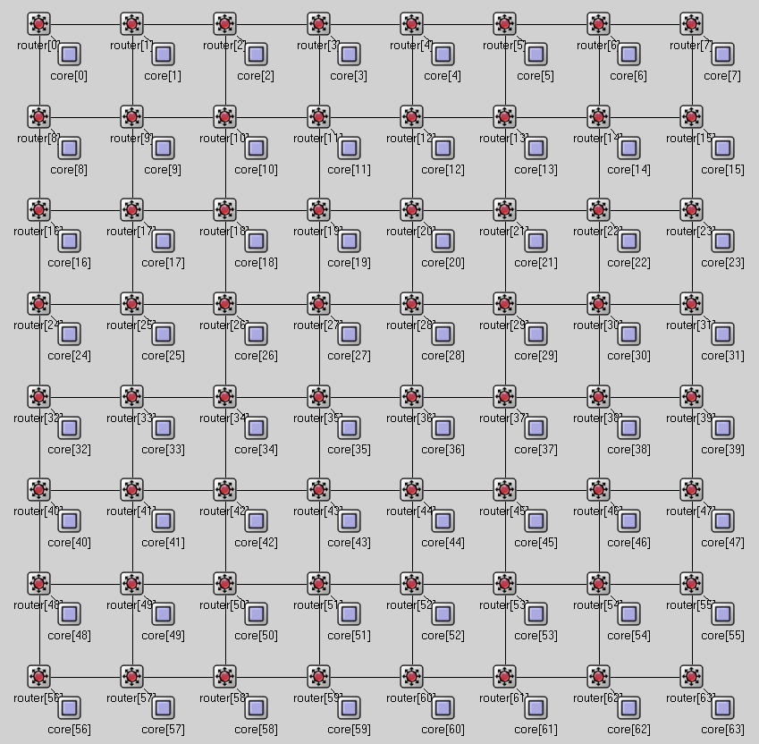
Mesh 8x8

Slide 5
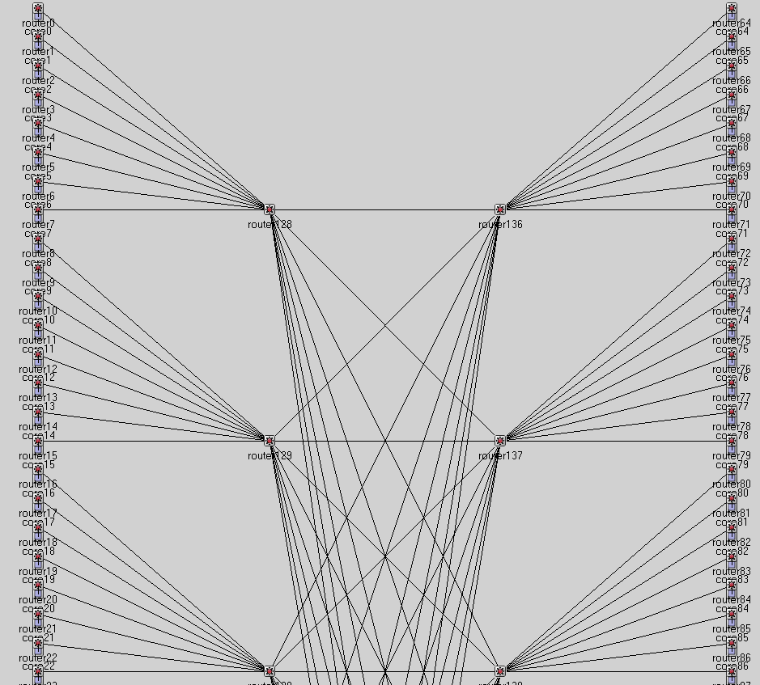
KaryNFly

Slide 6
Algorithm routing
bool Router::CalcRouting(CommunicationGraph & commGraph, RequestsCollection & requests,
SchedulingParams & params, std::vector<FlowPath> & paths)
{
time_t start,end;
double dif;
cout << "Start the routing using LP " << endl;
if (params.ROUTER_TYPE == 1)
{
bool successRoute = false;
do {
time(&start);
double * solution;
VarRepository * vars;
LPInterface lpSolver;
if (lpSolver.SolveLP(commGraph, requests, params,
solution, vars) == false)
{
cout << "Error solving the LP" << endl;
return false;
}
time(&end);
dif = difftime(end, start);
printf("time elapsed: %f\n", dif);
cout << "Decomposing Flow" << endl;
time(&start);
if (!FlowDecomposer::DecomposeFlow(commGraph, requests, params, solution, vars, paths))
{
cout << "Error decomposing paths" << endl;
successRoute = false;
}
else successRoute = true;
time(&end);
dif = difftime(end, start);
printf("time elapsed: %f\n", dif);
} while (!successRoute);
//
if (params.SCHEDULER_TYPE == 0)
{
vector<FlowPath> oldPaths = paths;
paths.clear();
vector<CommunicationRequest *> requestVec = requests.GetRequests();
int nRequests = (int) requestVec.size();
vector<vector<int>> pathIdsInReq(nRequests);
vector<double> flows(nRequests, 0.);
for (int i=0;i<(int) oldPaths.size();i++)
{
FlowPath & curr = oldPaths[i];
int reqNum = curr.GetRequest();
pathIdsInReq[reqNum].push_back(i);
flows[reqNum] += curr.GetFlow();
}
for (int i=0;i<nRequests;i++)
{
vector<int> & ids = pathIdsInReq[i];
int nPaths = (int) ids.size();
if (nPaths == 0)
continue;
FlowPath newPath(requestVec[i]->GetRequestNum(), flows[i]);
map<int, tr1::tuple<double, double>> edgesInRequest;
for (int j=0; j<nPaths; j++)
{
FlowPath & currPath = oldPaths[ids[j]];
vector<int> & edgesInPath = currPath.GetEdges();
for (int k=0; k<(int) edgesInPath.size(); k++)
{
int edgeId = edgesInPath[k];
tr1::tuple<double, double> edgeVal(currPath.GetCapacities()[k],
currPath.GetTimesRequiredOnEdge()[k]);
map<int, tr1::tuple<double, double>>::iterator iter =
edgesInRequest.find(edgeId);
if (iter == edgesInRequest.end())
{
edgesInRequest[edgeId] = edgeVal;
}
else
{
tr1::tuple<double, double > currVal = iter->second;
tr1::tuple<double, double> newVal(tr1::get<0>(currVal),
tr1::get<1>(currVal) + tr1::get<1>(edgeVal));
edgesInRequest[edgeId] = newVal;
}
}
}
map<int, tr1::tuple<double, double>>::iterator iter = edgesInRequest.begin();
for (; iter != edgesInRequest.end(); iter++)
{
tr1::tuple<double, double> currVal = iter->second;
newPath.AddEdge(iter->first, tr1::get<1>(currVal), tr1::get<0>(currVal));
}
paths.push_back(newPath);
}
}
}
else return false;
updateCapacity(commGraph, requests, params, paths);
return true;
}

Slide 7
Decompose Flow
bool FlowDecomposer::DecomposeFlow(CommunicationGraph & commGraph, RequestsCollection &requests,
SchedulingParams & params,
double * solution, VarRepository *vars, std::vector<FlowPath> & pathsOut)
{
vector<CommunicationRequest*> & req = requests.GetRequests();
int nRequests = (int)req.size();
// first expand capacity to fit flows with flit size..
for (int edgeId = 0; edgeId < commGraph.GetNumEdges(); edgeId++) {
double edgeFlow = 0;
EFNocEdge * edge = commGraph.GetEdge(edgeId);
for (int r = 0; r < nRequests; r++) {
int id = vars->VarToId(EDGE_REQ, r, edgeId);
double flow = solution[id];
edgeFlow += std::ceil(flow / params.FLIT_SIZE)*params.FLIT_SIZE;
}
edge->updateCapacityForFlitSize(params.FLIT_SIZE);
edge->SetCapacity(edgeFlow);
}
typedef std::list<std::pair<double, int> > RequestBySize;
RequestBySize requestsBySize;
for (int r = 0; r < nRequests; r++) {
requestsBySize.push_back(make_pair(requests.GetRequests()[r]->GetDemand(), r));
}
requestsBySize.sort();
RequestBySize::const_iterator it = requestsBySize.end();
for (int j = 0; j < nRequests;j++) {
it--;
int i = it->second;
CommunicationRequest* currReq = req[i];
int reqNum = currReq->GetRequestNum();
int source = currReq->GetSource();
int dest = currReq->GetFirstDestination();
double demand = currReq->GetDemand();
vector<FlowDetails> edgesForRequest;
double totalFlow;
GetEdgesUsedForRequest(commGraph, params, reqNum, demand, solution, vars,edgesForRequest, totalFlow,requests);
totalFlow = std::min(totalFlow, demand);
FindPathsOnEdges(currReq, reqNum, totalFlow, commGraph, params,edgesForRequest, pathsOut);
}
vector<int> flitsOnEdge(commGraph.GetNumEdges());
double maxFlits = 0;
for (int e = 0; e < commGraph.GetNumEdges(); e++) {
double flitsTime = 0;
for (int r = 0; r < pathsOut.size(); r++) {
for (int p = 0; p < pathsOut[r].GetEdges().size(); p++) {
if (pathsOut[r].GetEdges()[p] == e)
flitsTime += (int)pathsOut[r].GetTimesRequiredOnEdge()[p];
}
}
flitsOnEdge[e] = flitsTime;
if (flitsTime>maxFlits)
maxFlits = flitsTime;
}
maxFlits /= params.FLIT_SIZE;
if (maxFlits<=1)
return true;
else if ((maxFlits )<(1 + params.SLOTS_ROUNDING_FACTOR)) {
params.N_TIME_SLOTS *= maxFlits;
return true;
}
else {
params.SLOTS_ROUNDING_FACTOR = params.SLOTS_ROUNDING_FACTOR * 2;
return false;
}
}

Slide 8
Compute paths using linear program
void LPInterface::ConstructTypeOneAndTwo(int firstRowNum, CommunicationGraph & commGraph, RequestsCollection & requests,
double * rowlb, double * rowub, CoinPackedMatrix & matrix, CoinModel& coinModel,
VarRepository * vars,double *& obj,SchedulingParams& params,int nConstraints)
{
vector<CommunicationRequest*> requestsVec = requests.GetRequests();
int nReq = (int) requestsVec.size();
int rowNum = firstRowNum;
map<int,EFNocVertex*> & vertices = commGraph.GetVertices();
map<int,EFNocVertex*>::iterator vertIter;
int nVars = vars->GetNVars();
int * indices = new int [nVars];
double * values = new double[nVars];
int ll = 0;
for (vertIter = vertices.begin(); vertIter != vertices.end(); vertIter++)
{
ll = ll + 1;
cout << "I,II - Start constructing constraints for node " << ll << endl;
EFNocVertex * pVert = vertIter->second;
const vector<int> & ins = pVert->GetInEdges();
const vector<int> & outs = pVert->GetOutEdges();
for (int i=0;i<nReq;i++)
{
CommunicationRequest* pReq = requestsVec[i];
double demand = pReq->GetDemand()*(1+params.SLOTS_ROUNDING_FACTOR);
int src = pReq->GetSource();
int dest = pReq->GetFirstDestination();
int vertId = pVert->GetVertexNum();
int nVals = 0;
if (vertId != dest && vertId!=src) {
// type I - flow conservation \forall i,v
// \Sum_{j, e\in in(v)} f_{i} (e) - \Sum_{j, e\in out(v)} f_{i} (e) = 0
for (int j=0;j<(int)ins.size();j++)
{
int edgeId = ins[j];
EFNocEdge * pEdge = commGraph.GetEdge(edgeId);
int varNum = vars->VarToId(EDGE_REQ,pReq->GetRequestNum(),pEdge->GetFrom(),pEdge->GetTo());
assert(nVals < nVars);
indices[nVals] = varNum;
values[nVals] = -1;
nVals++;
// matrix.modifyCoefficient(rowNum,varNum,-1);
}
for (int j=0;j<(int)outs.size();j++)
{
int edgeId = outs[j];
EFNocEdge * pEdge = commGraph.GetEdge(edgeId);
int varNum = vars->VarToId(EDGE_REQ,pReq->GetRequestNum(),pEdge->GetFrom(),pEdge->GetTo());
assert(nVals < nVars);
indices[nVals] = varNum;
values[nVals] = 1;
nVals++;
// matrix.modifyCoefficient(rowNum,varNum,1);
}
rowlb[rowNum] = 0;
rowub[rowNum] = 0;
assert(rowNum < nConstraints);
#ifdef USE_MATRIX_MODEL
coinModel.addRow(nVals, indices, values);
#else
matrix.appendRow(nVals,indices, values);
#endif
rowNum++;
}
// type II - meet demand
// \Sum_{j, e \in out(s_i)} f_{i} (e) = d_i
if (src == vertId)
{
for (int j=0;j<(int)outs.size();j++)
{
int edgeId = outs[j];
EFNocEdge * pEdge = commGraph.GetEdge(edgeId);
int varNum = vars->VarToId(EDGE_REQ,pReq->GetRequestNum(),pEdge->GetFrom(),pEdge->GetTo());
indices[nVals] = varNum;
values[nVals] = 1.0;
assert(nVals < nVars);
nVals++;
// matrix.modifyCoefficient(rowNum,varNum,1);
}
rowlb[rowNum] = demand;
rowub[rowNum] = demand;
//cout << "Row " << rowNum << " nConstraints " << nConstraints <<"\n";
assert(rowNum < nConstraints);
#ifdef USE_MATRIX_MODEL
coinModel.addRow(nVals, indices, values);
#else
matrix.appendRow(nVals, indices, values);
#endif
rowNum++;
}
}
}
delete [] values;
delete [] indices;
}

