Slide 1
Scheduling in a Real-time Network-on-Chip
Period minimization using metaheuristics
Mark Ruvald Pedersen
Jaspur Højgaard
Rasmus Bo Sørensen

Slide 2
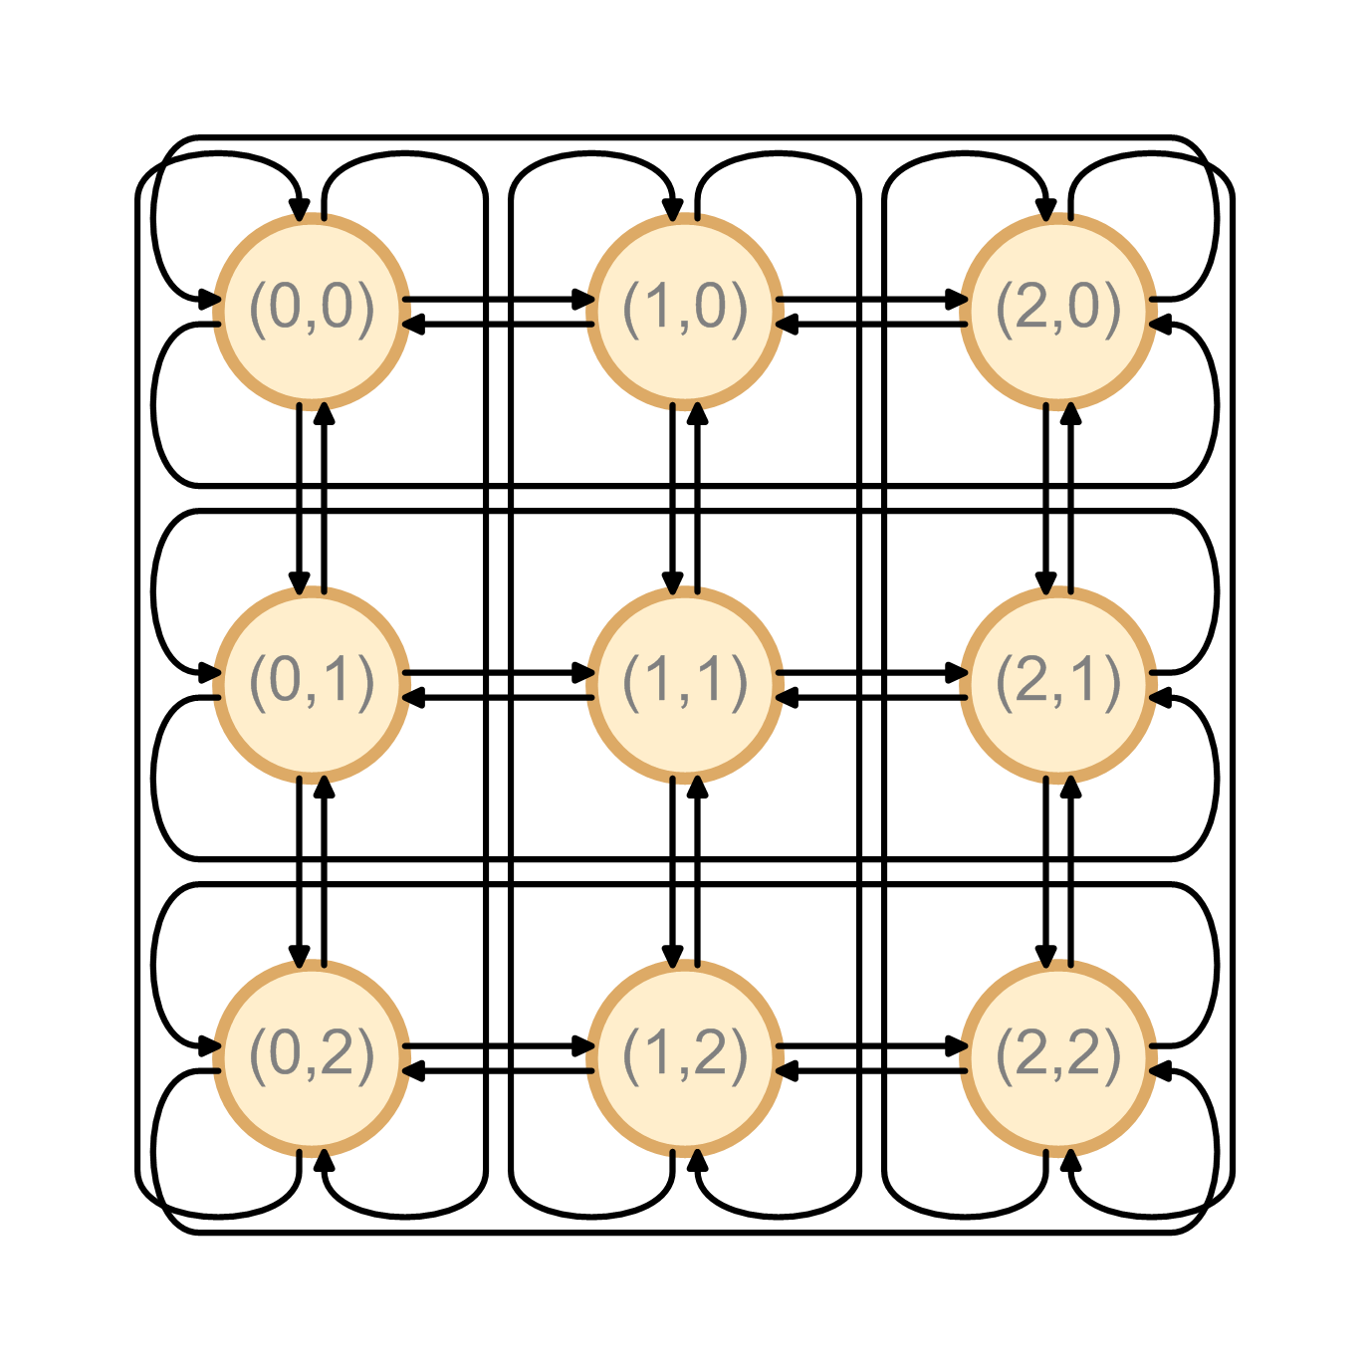
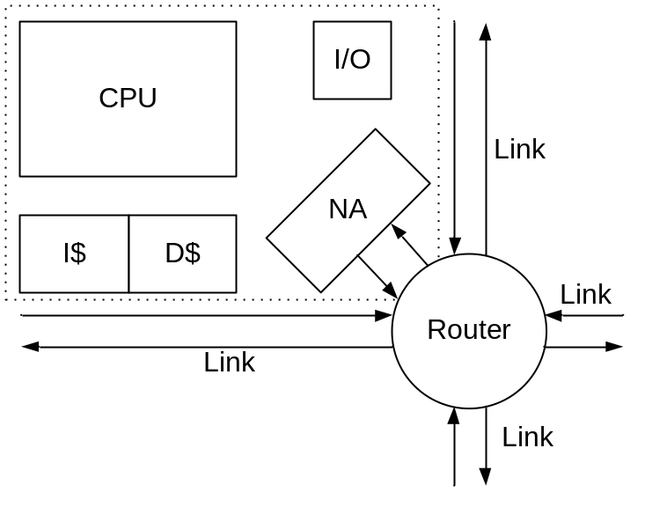
Problem domain
Real-time Network-on-Chip
Inter-processor communication
No buffering
Application specific
NP-complete: Integer multi-commodity flow problem
Minimizing schedule period

Slide 3
Solution space
No clear local neighborhood of feasible solutions.
Generate feasible initial solution.
  Greedy, Random, etc.
Improving an initial solution.
  How do we walk the solution space? - Operators

Slide 4
Operators
Destroy and rebuild paths.
Operators for destroy:
Dominating paths
Dominating rectangle
Late paths
Random
Operators are chosen adaptively.
Rebuild:
Greedy randomized first-fit.

Slide 5
Metaheuristics
Greedy randomized adaptive search procedure (GRASP)
Local search of GRASP is choose_operator, destroy and repair.
Random-operator not used.
Problems with no clear local neighborhood.
Very large solution spaces.
procedure our_grasp(β)
best = infinite
while (time left)
  current = initial_solution(β)
  if (current shorter than best) then best = current
  operator = choose_operator()
  chosen = operator()
  destroy(chosen)
  repair(chosen)
  if (current shorter than best) then best = current
  punish_reward(operator)
return best
Local search

Slide 6
Metaheuristics
Adaptive Large Neighborhood Search (ALNS)
Finds feasible solution easily.
Destroy and repair gives very large neighborhood.
Iteratively tries shortening the schedule.
procedure our_alns()
  best = current = initial_solution()
while (time left)
  operator = choose_operator()
  chosen = operator()
  destroy(chosen)
  repair(chosen)
  if (current shorter than best) then best = current
  punish_reward(operator)
return best

Slide 7
Parameter tuning
Running time – in the days range
Test run 2 hours
Limited parameter tuning
Choose operator
GRASP
  β
ALNS
  Initial solutions

Slide 8
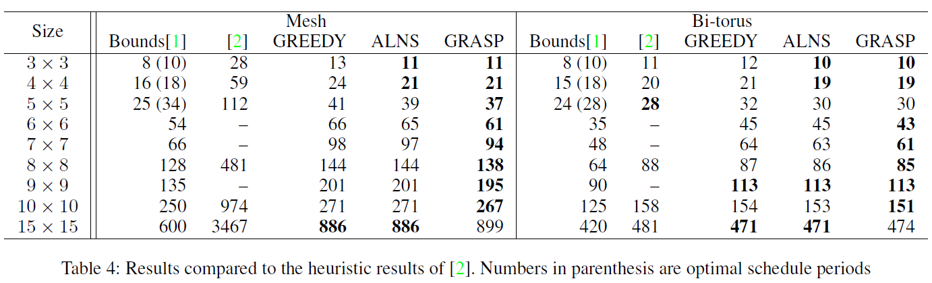
Results
Overall best metaheuristic GRASP.
Low relatedness between neighboring solutions. -> GRASP

Slide 9
Conclusion
Metaheuristics improve greedy initial solution.
All-to-all results within ~30% of the analytical bounds.
For all mesh networks, we improve by more than a factor of 2,0.
Needs to be tested with application specific cases.

Slide 10
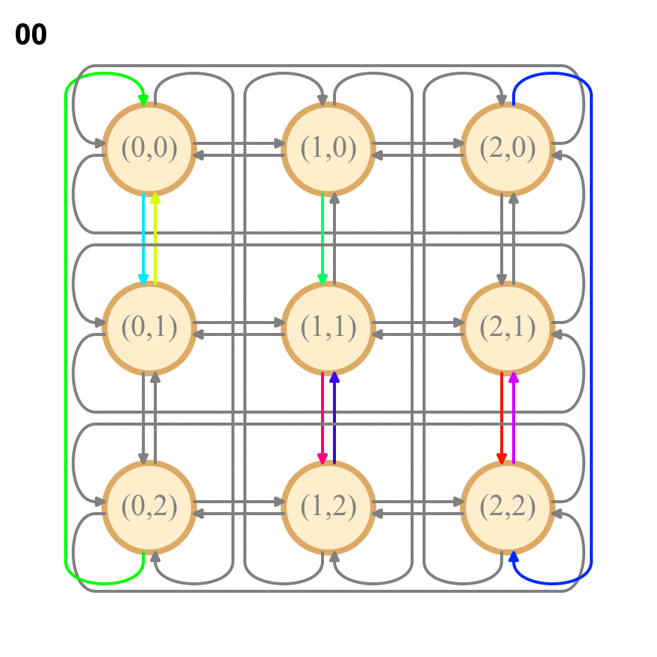
Scheduler output

