Slide 1


Slide 2



Transmission Power: 100mW,12Mbps
Noise: -100dBm
Receive power sensitivity: -105dBm
below this threshold a signal is considered as
noise instead of a packet for collision avoidance
S2
185m
R2
185m
S1
R1

Slide 3

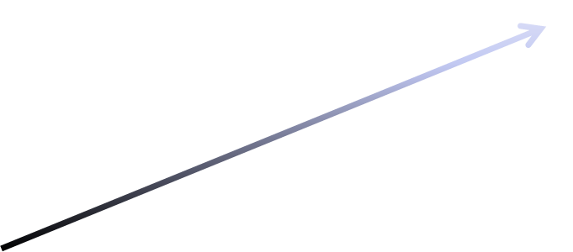

Transmission Power: 100mW,12Mbps
Noise: -100dBm
Receive power sensitivity: -105dBm
Node S1 sends RTS (for R1)
  Received by R1 , SNR ~1.3dB
  Ignored by S2,R2 (low receive power)
S2
-119dBm
570m
R2
-116dBm
475m
RTS
-99dBm
S1
185m
R1

Slide 4



Transmission Power: 100mW,12Mbps
Noise: -100dBm
Receive power sensitivity: -105dBm
Node R1 sends CTS (for S1)
  Received by S1 , SNR ~1.3dB
  Ignored by S2,R2 (very low receive power)
S2
-115dBm
R2
390m
-109dBm
-99dBm
235m
CTS
S1
185m
R1

Slide 5



Transmission Power: 100mW,12Mbps
Noise: -100dBm
Receive power sensitivity: -105dBm
Node S2 sends RTS (for R2)
  Received by R2 , SNR ~1.3dB
  Ignored by S1,R1 (very low receive power)
S2
185m
RTS
R2
570m
-99dBm
-119dBm
475m
-116dBm
S1
R1

Slide 6



Transmission Power: 100mW,12Mbps
Noise: -100dBm
Receive power sensitivity: -105dBm
Node R2 sends CTS (for S2)
  Received by S2 , SNR ~1.3dB
  Ignored by S1,R1 (very low receive power)
-99dBm
S2
CTS
185m
R2
390m
-115dBm
235m
-109dBm
S1
R1

Slide 7





Transmission Power: 100mW,12Mbps
Noise: -100dBm
Receive power sensitivity: -105dBm
S1 and S2 transmit long data
packets in parallel!
Interfere with each other
Causing high PER (~60%)
S2
R2
DATA
S1
R1

Slide 8

Detect RTS packet in longer range
Transmit 3 times short RTS packet
  Receivers senses 3 short close “noises” -> “RTS”
  Receivers stay quiet throughout packet duration
Reduces PER to ~10% (without collisions)
Can use other means for RTS:
different signal form
higher power or etc.
S2
R2
RTS
RTS
RTS
S1
R1

