Slide 1
Rescue simulator

Slide 2
Input scenario –
nodes on surface with request pairs and demand (Mbps)
1
8
15
22
29
36
43
1Km
2
9
16
23
30
37
44
3
10
17
24
31
38
45
500m
4
11
18
25
32
39
46
5
12
19
26
33
40
47
6
13
20
27
34
41
48
7
14
21
28
35
42
49
0
500m
1Km

Slide 3
Input scenario –
Transmission and interference ranges
1Km
Actual
Interference
Transmission
150m
Interference
model
250m
500m
0
500m
1Km

Slide 4
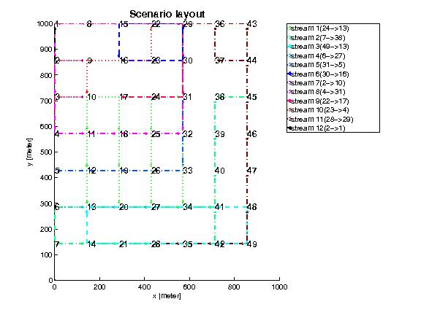
Routing result

Slide 5
Simulator log

