Slide 1
Real Time Video Streaming in Multi hop Ad-Hoc Wireless networks
Yaniv Fais
Under supervision of Prof. Guy Even
Part of project conducted with Prof. Guy Even, Moti Medina,
Moni Shachar and Alexander Zadorojniy

Slide 2
Agenda
Problem Definition
Real-Time Video
WiFi introduction
Scheduling
Interference models
Simulator
Flow Control
Experimental results
Video transmission
2

Slide 3
Problem Definition
Ad-Hoc Wireless Network model
Nodes in the plane with single radio and GPS
Nodes may transmit to each other in one of several channels (but interfere with each other)
Nodes synchronized (using GPS) and there exists a single node which holds network information (locations)
3

Slide 4
Problem Definition II
Several real-time video transmission requests:
Source , Destination , Mbps
Satisfy requests (max-min throughput) such that video can be received in good quality
4

Slide 5
Real-Time Video characteristics
High-bandwidth
several Mbps after encoding
Low end-to-end delay
Several seconds at most
Low packet-loss
< 5%
But: Adjusted bit rate using changing of encoding quality and compression !
5

Slide 6
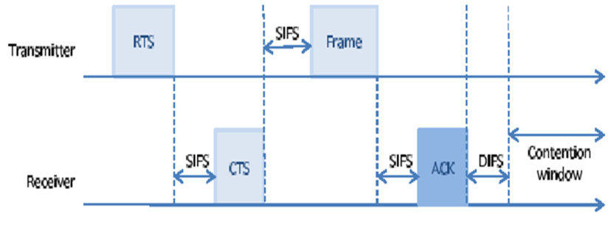
IEEE 802.11g (WiFi)
Carrier sense multiple access with collision detection (CSMA/CD)
Transmitter sends Request To Send (RTS)
6

Slide 7
IEEE 802.11g (WiFi)
Receiver sends “Clear To Send” (CTS)
All other nodes remain “quiet” throughout packet transmission
7

Slide 8
IEEE 802.11g (WiFi)
Transmitter sends frame with payload data (large frame – several KB)
8

Slide 9
IEEE 802.11g (WiFi)
Receiver sends “Acknowledge” (ACK) packet once complete
9

Slide 10
IEEE 802.11g (WiFi)
No collision
Independent nodes (no synchronization required ! )
But:
Large overhead (for each packet)
No quality of service (throughput, end-to-end)
Unfair
10

Slide 11
Solution sketch – Time division
Divide time unit into slots and allocate non-interfering slots to nodes for transmission/reception
Example:
Slot 1: Node 1 send to node 22 in channel 2, rate 48Mbps in stream 3
Slot 1: Node 10 send to node 2 in channel 2, rate 6Mbps in stream 5
Slot 2: ….
Compute schedule table from nodes locations in “master” node and transmit it to all nodes
Nodes follow table for transmit/receive and repeat every time-unit (1 second)
11

Slide 12
Wireless interference model
Protocol (Graph) model
Interference radius - only those who can sense (“listen”)
But actual signal goes beyond this range!
Actual
Interference
Interference
radius
Transmission
radius
12

Slide 13

Wireless interference model
Example
Node A sends to B
Node C sends to D
Node C/D can’t “hear” A
Node A/B can’t “hear" C
Transmission can be done in the
Same time
But: actually interference
Continues beyond range!
B
A
D
C
13

Slide 14
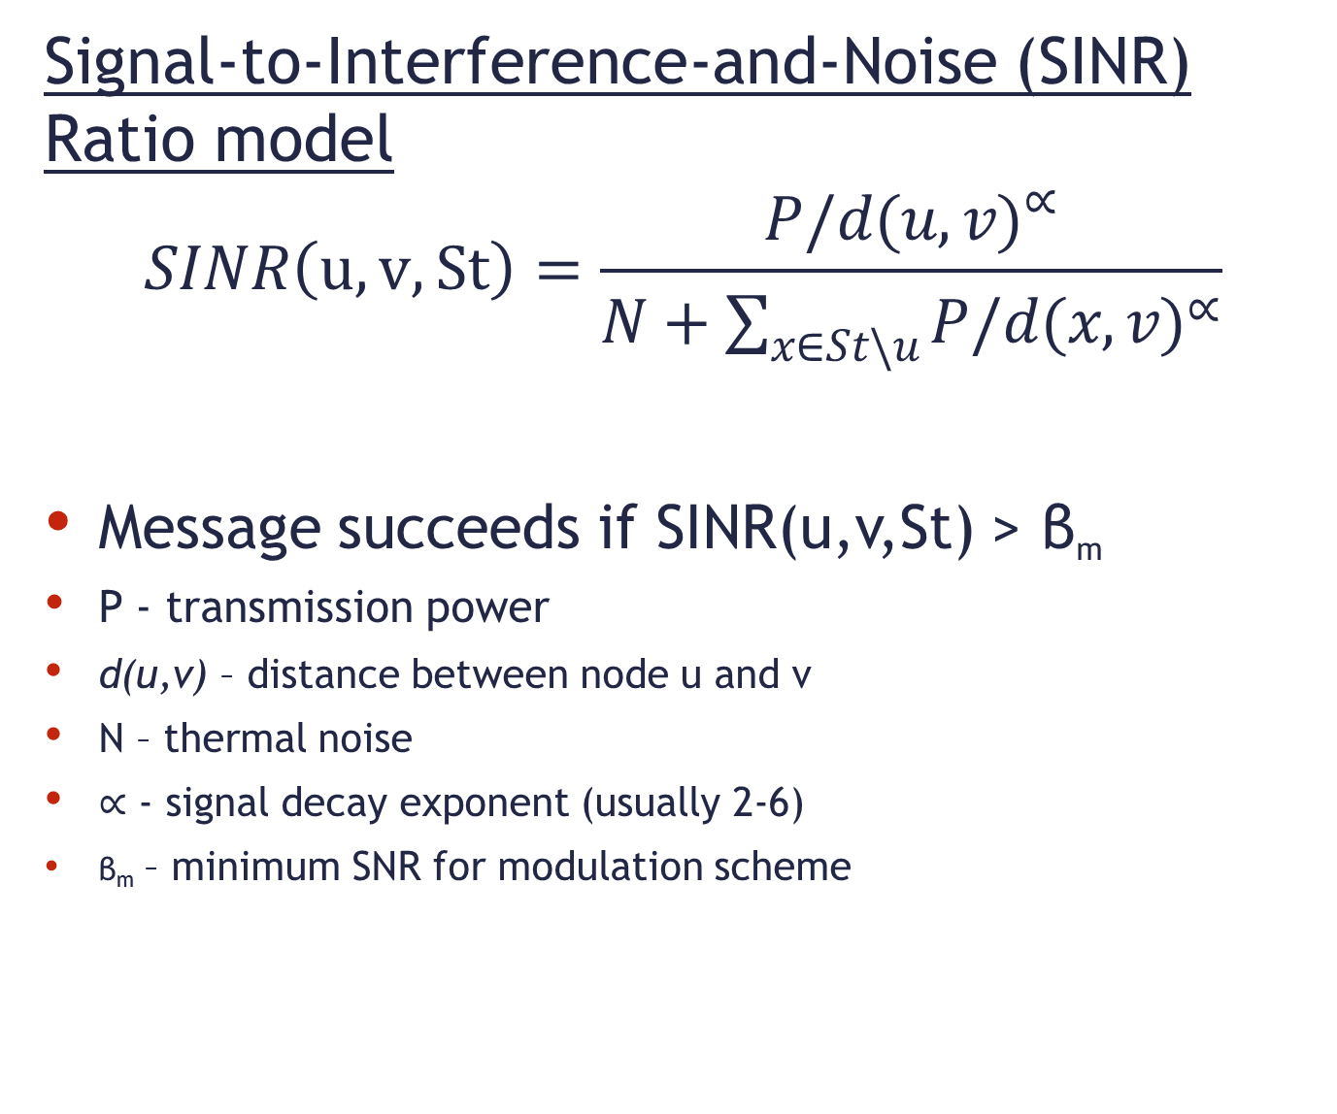
Wireless interference model
Signal-to-Interference-and-Noise (SINR) Ratio model
$$SINR\left(u, v, St\right)=\frac{{P/d(u,v)}^{∝}}{N+\sum_{x∈St\backslash u}{{P/d(x,v)}^{∝}}}$$
Message succeeds if SINR(u,v,St) > β_{m}
P - transmission power
d(u,v) – distance between node u and v
N – thermal noise
$∝$ - signal decay exponent (usually 2-6)
β_{m} – minimum SNR for modulation scheme
14

Slide 15
Scheduling
NP Hard problem in general
Formalize constraints:
Flow in equals flow out
Radio is not used simultaneously for transmit and receive and not used in more than one channel
Flow is smaller or equal edge capacity
No conflict between transmitting nodes - by interfering edges induces by graph interference model (adjusted for WiFi- both ends transmit and multiple MCS)
15

Slide 16
Scheduling algorithm
Solve equations using Linear Program (LP) and maximize minimum throughput and fit into table.
constant approximation ratio.
would the result work in the physical (SINR) model ?
16

Slide 17
Simulator
OMNET++/MiXiM – event driven network simulator
Extensible (C++)
Built-In wireless protocols (802.11b-Mac / Phy )
Wireless signal model (noise , interference , fading)
Mobility
Fast - Models packets (not symbols)
17

Slide 18
Flow Control
Scheduler assumes steady state but in network it is difficult to stay in steady state due to:
Real channel different than channel model (random noise)
Mobility
802.11 random quiet periods
Fluctuations would cause queues to grow
18

Slide 19
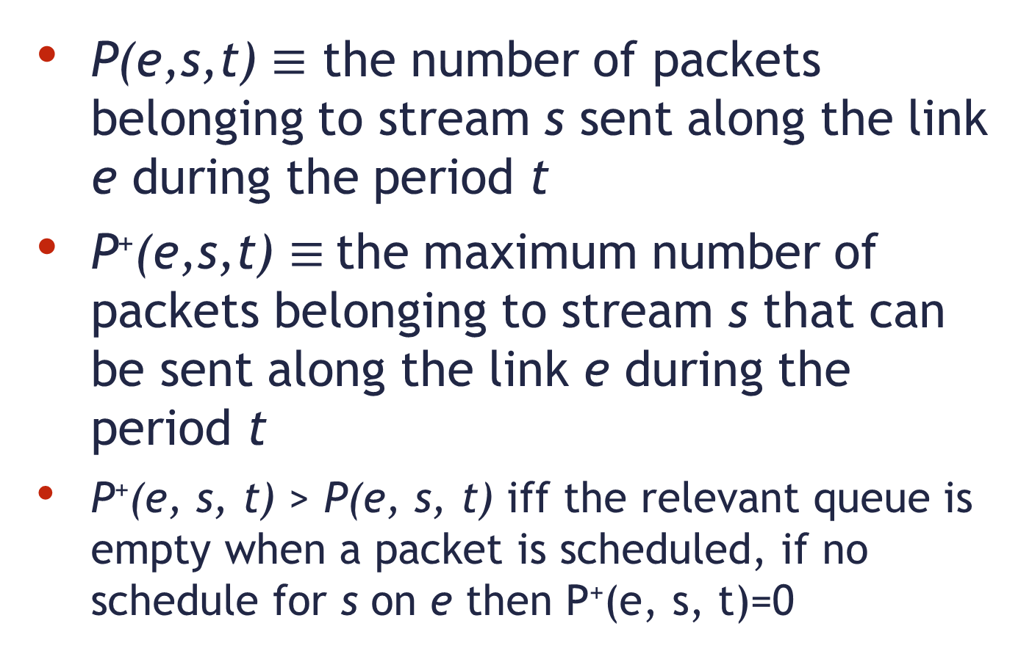
Flow Control algorithm - definitions
P(e,s,t) $≡$ the number of packets belonging to stream s sent along the link e during the period t
P⁺(e,s,t) $≡$the maximum number of packets belonging to stream s that can be sent along the link e during the period t
P⁺(e, s, t) > P(e, s, t) iff the relevant queue is empty when a packet is scheduled, if no schedule for s on e then P⁺(e, s, t)=0
19

Slide 20
Flow Control algorithm prelim.
Algorithm is executed locally for all nodes
Each node has a queue per stream
R(e, s) specifies the number of packets from stream s that the node is willing to receive along the link e in the next period t + 1
Initialize: for all e ∈ E_{in}(v)
R(e, s) ← [scheduler computed rate]
20

Slide 21
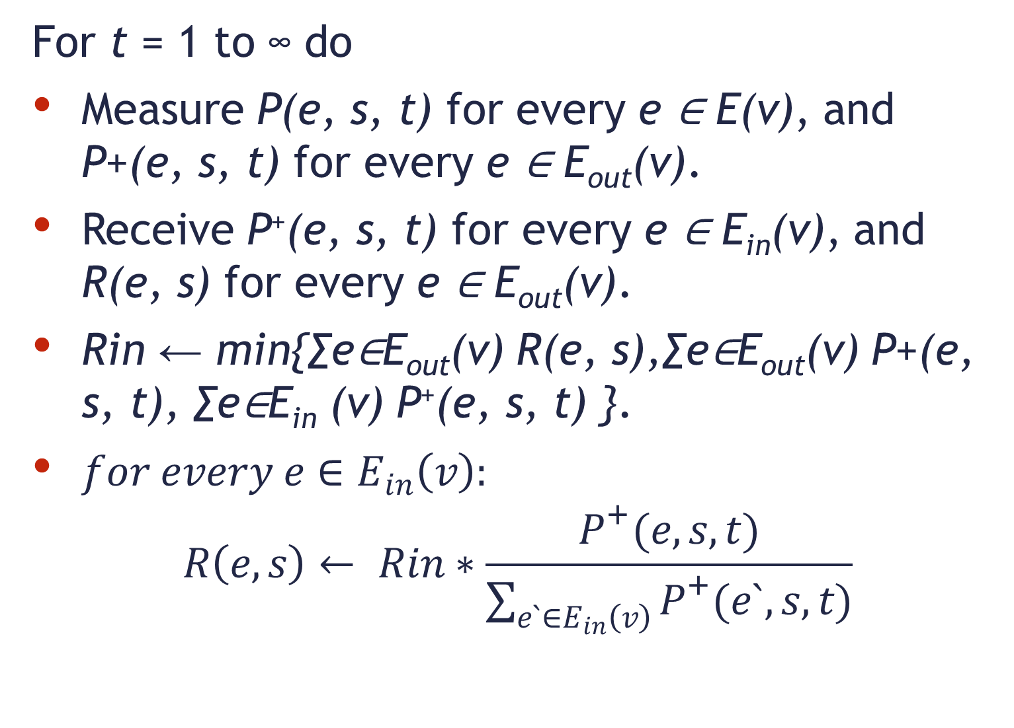
Flow Control algorithm
For t = 1 to ∞ do
Measure P(e, s, t) for every e ∈ E(v), and P+(e, s, t) for every e ∈ E_{out}(v).
Receive P⁺(e, s, t) for every e ∈ E_{in}(v), and R(e, s) for every e ∈ E_{out}(v).
Rin ← min{∑e∈E_{out}(v) R(e, s),∑e∈E_{out}(v) P+(e, s, t), ∑e∈E_{in} (v) P⁺(e, s, t) }.
$for every e∈E_{in}\left(v\right):$
$$R\left(e, s\right)← Rin∗\frac{P^{+}(e,s,t)}{\sum_{e`∈E_{in}\left(v\right)}{P^{+}(e`,s,t)}}$$
21

Slide 22
Flow Control algorithm
In addition at the end of each such round we drop the oldest packets from Q(v, s), if needed, so that |Q(v, s)| ≤ R_{in}
Intuitively the algorithms controls the rates and queues using minor changes according to what the wireless channels and queues can sustain.
22

Slide 23
Example Input scenario –
Nodes spaced equally on grid with random requests
1
8
15
22
29
36
43
1Km
2
9
16
23
30
37
44
3
10
17
24
31
38
45
500m
4
11
18
25
32
39
46
Example
Transmission
Range
5
12
19
26
33
40
47
6
13
20
27
34
41
48
7
14
21
28
35
42
49
0
500m
1Km

Slide 24
End-to-end delay histogram (one stream)
With flow control
Without flow control

Slide 25
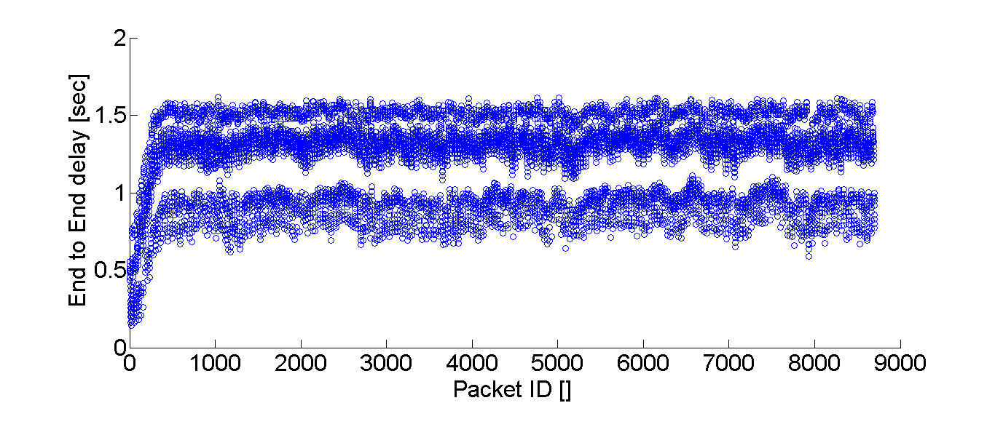
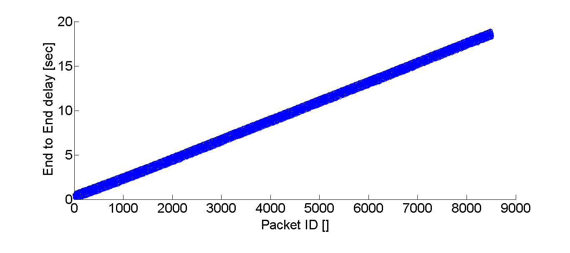
End-to-end delay (one stream)
With
flow
control
Without
flow
control
25

Slide 26
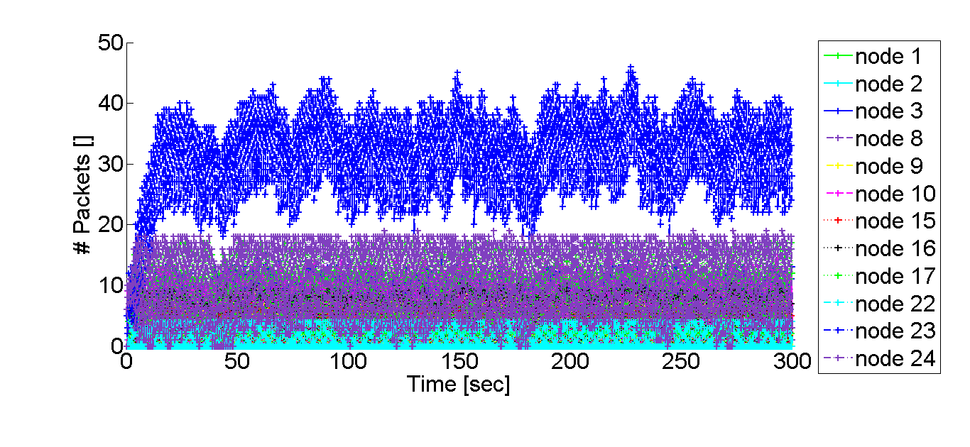
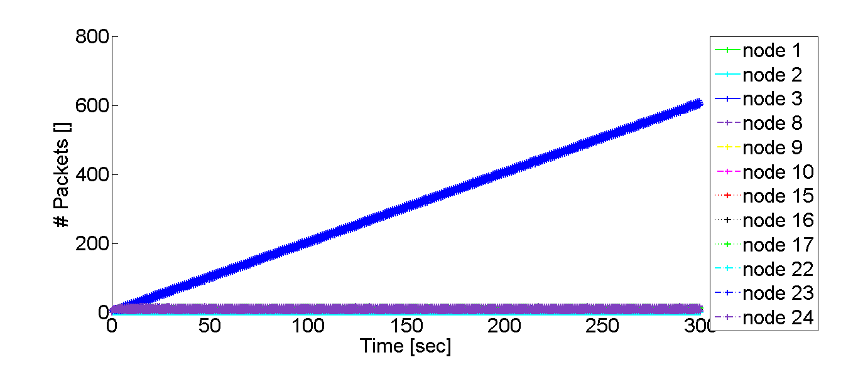
Queue size (one stream/different nodes)
With
flow control
Without
flow control
26

Slide 27
Rate (R(e,s)) changes over time
27

Slide 28
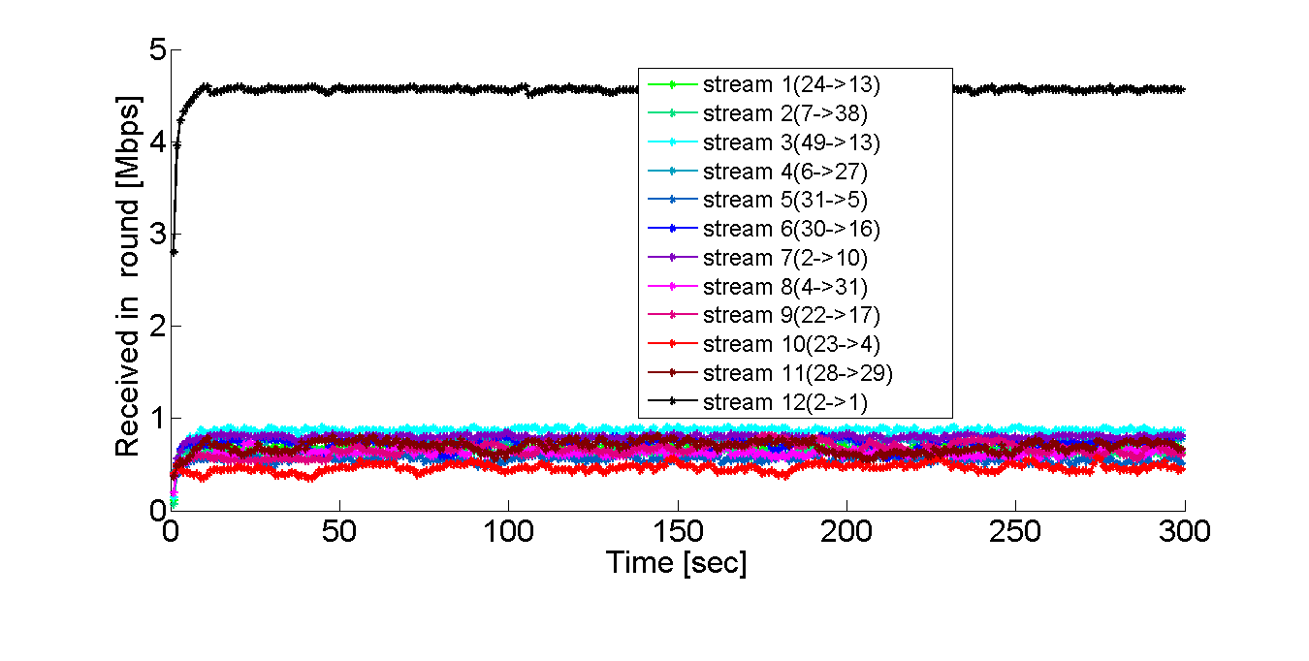
Throughput per stream
With flow control
Without flow control
May even increase ratio
28

Slide 29
Video playback example
29

Slide 30
Summary
Centralized scheduling approximation algorithm
Feasible in physical model (by simulation)
Local flow control algorithm
Supporting real-time video streaming properties
30

Slide 31
Questions ?
31

Slide 32
Backup slides
32

Slide 33
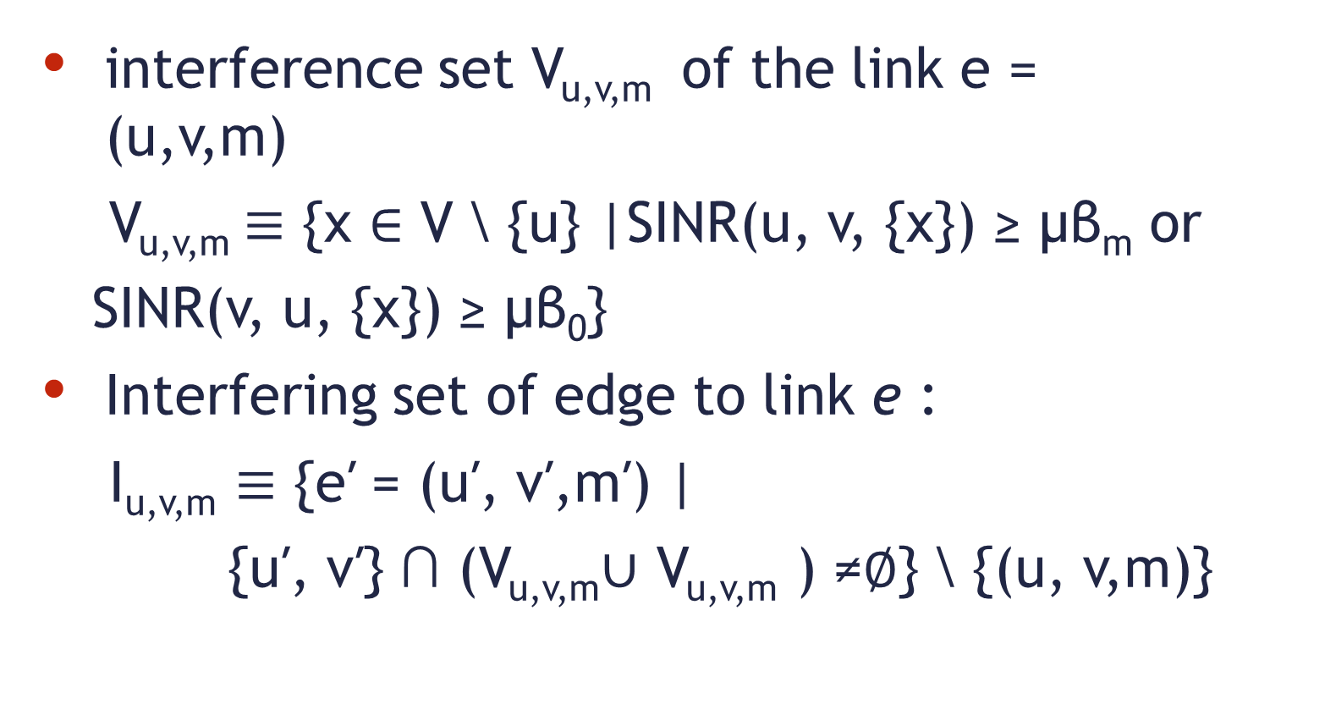
WiFi adjusted interference model
interference set V_{u,v,m} of the link e = (u,v,m)
V_{u,v,m}$≡$ {x ∈ V \ {u} |SINR(u, v, {x}) ≥ μβ_{m} or
SINR(v, u, {x}) ≥ μβ₀}
Interfering set of edge to link e :
I_{u,v,m} $≡$ {e′ = (u′, v′,m′) |
{u′, v′} ∩ (V_{u,v,m}∪ V_{u,v,m} ) ≠∅} \ {(u, v,m)}
33

Slide 34
Hidden node problem
A and B can communicate with N
A can’t “hear” B
B can’t hear A
A and B May
attempt to
transmit un the
same time and interfere
with each other!
N
B
A
34

Slide 35
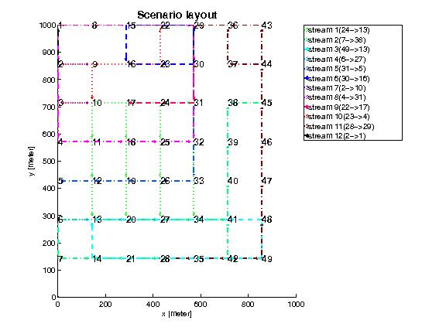
Routing result

Slide 36
Packet-Error-Rate / Signal-to-Noise Ratio
.

Slide 37
Raw Rate vs. Actual Rate
Payload size 1KB *

