Slide 1
Real Time Video Streaming in Multi hop Ad-Hoc Wireless networks
Yaniv Fais
Under supervision of Prof. Guy Even
Joint work with Prof. Guy Even, Moti Medina,
Moni Shahar and Alexander Zadorojniy

Slide 2
Background
Research part of consortium dedicated to communication for rescue teams
Quick deployment (no backbone)
Common technology (WiFi)
Dedicated system
Focused on video data
Practical solution
2

Slide 3
Agenda
Problem Definition
Real-Time Video
WiFi introduction
Routing & Scheduling
Interference models
Simulator
Flow Control
Experimental results
Video transmission
3

Slide 4
Problem Definition
Ad-Hoc Wireless Network model
Nodes in the plane , know location and time (using GPS)
Nodes with single radio
Multiple radio channels
4

Slide 5
Problem Definition II
Input:
Nodes / locations / transmission power
real-time video transmission requests:
Source , Destination , Bandwidth
(Source and destinations may not be neighbors)
Goal: serve requests fairly (maximize min-throughput)
5

Slide 6
Real-Time Video characteristics
High-bandwidth
~1Mbps after encoding
Require: low end-to-end delay
Few seconds at most
Require: small packet-loss
< 5%
Adjustable bit rate because encoder can be controlled (variable quality and compression ratio)
6

Slide 7
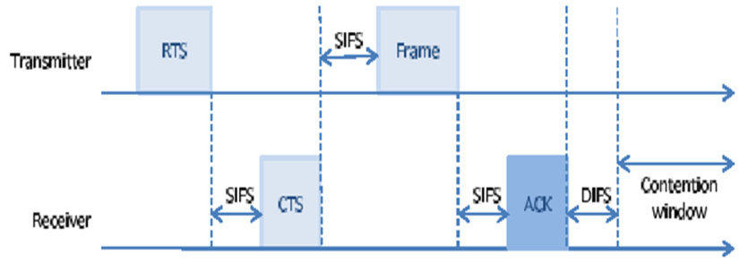
IEEE 802.11g (WiFi)
Carrier sense multiple access with collision detection (CSMA/CD)
Transmitter sends Request To Send (RTS)
7

Slide 8
IEEE 802.11g (WiFi)
Receiver sends “Clear To Send” (CTS)
All other nodes remain “quiet” throughout packet transmission
8

Slide 9
IEEE 802.11g (WiFi)
Transmitter sends frame with payload data (large frame – several KB)
9

Slide 10
IEEE 802.11g (WiFi)
Receiver sends “Acknowledge” (ACK) packet once completed
10

Slide 11
IEEE 802.11g (WiFi)
Distributed protocol that avoids collisions
But: (In multi-hop setting)
Large overhead (for each packet)
Unpredictable: no quality of service guarantee (throughput, end-to-end delay)
Unfair (starvation)
Unstable (unbounded queues)
11

Slide 12
Research goals
Full system solution for specific video streaming problem:
Inputs gathering
Scheduling & Routing computation
Flow control
Simulation
Results analysis
12

Slide 13
Solution sketch – Time division
Divide time unit into slots and in each time slot schedule a non-interfering set of links
Example:
Slot 1: Node 1 send to node 22 in channel 2, rate 48Mbps in stream 3
Slot 1: Node 10 send to node 2 in channel 2, rate 6Mbps in stream 5
Slot 2: ….
Compute schedule table from node locations in a central node and broadcast to all nodes
Nodes follow schedule periodically
13

Slide 14
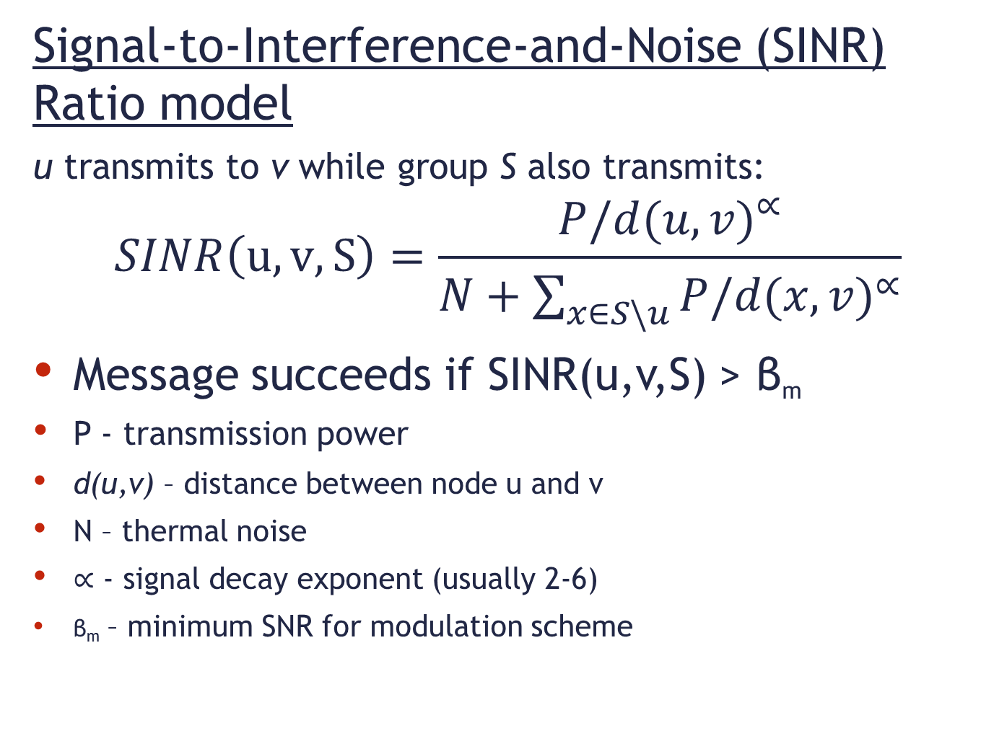
Wireless interference model
Signal-to-Interference-and-Noise (SINR) Ratio model
u transmits to v while group S also transmits:
$$SINR\left(u, v, S\right)=\frac{{P/d(u,v)}^{∝}}{N+\sum_{x∈S\backslash u}{{P/d(x,v)}^{∝}}}$$
Message succeeds if SINR(u,v,S) > β_{m}
P - transmission power
d(u,v) – distance between node u and v
N – thermal noise
$∝$ - signal decay exponent (usually 2-6)
β_{m} – minimum SNR for modulation scheme
Difficult for computation
14

Slide 15
Wireless interference model
Protocol (Graph) model
Reception radius – upper bound on distance of transmitter
Interference radius – reception is successful only if no other transmitter within interference radius
Actual
Interference
Interference
radius
Reception
radius
15

Slide 16
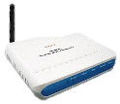
Graph model - problems
Optimistic
Ignores the additive effect of multiple interferences
Pessimistic
Excludes concurrent communication of two neighboring links
16

Slide 17
Adjusted interference model
Nonlinear behavior –
“waterfall”
Interference radius
depends on
SINR
(distance)
17
17
17

Slide 18
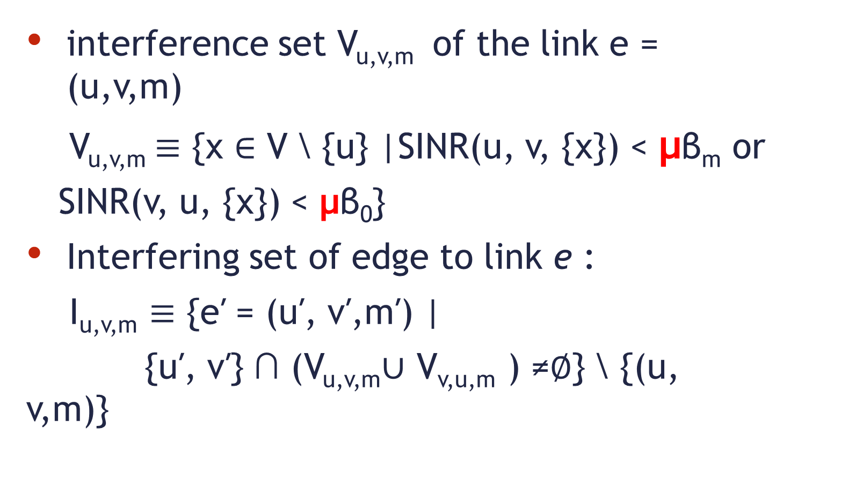
WiFi adjusted interference model
interference set V_{u,v,m} of the link e = (u,v,m)
V_{u,v,m}$≡$ {x ∈ V \ {u} |SINR(u, v, {x}) < μβ_{m} or
SINR(v, u, {x}) < μβ₀}
Interfering set of edge to link e :
I_{u,v,m} $≡$ {e′ = (u′, v′,m′) |
{u′, v′} ∩ (V_{u,v,m}∪ V_{v,u,m} ) ≠∅} \ {(u, v,m)}
18

Slide 19
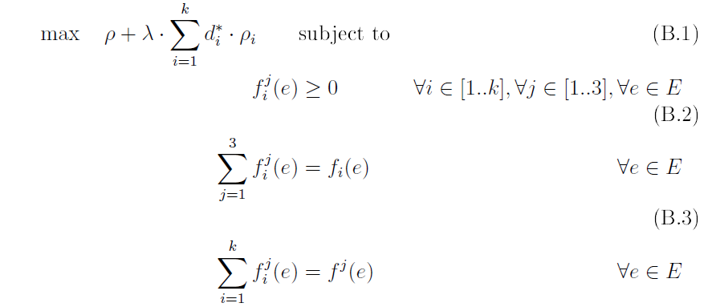
Routing & Scheduling
Formalize linear program:
Flow along edge e, in channel f for stream i
19

Slide 20
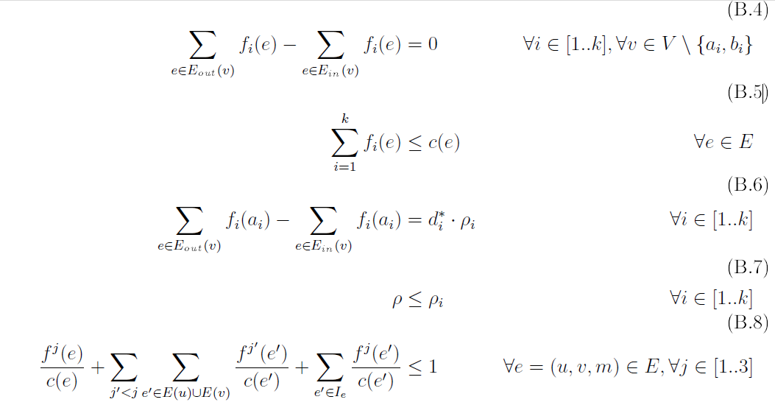
Linear Program (cont.)
Flow conservation
Capacity constraint
20

Slide 21
Conflict constraint
flow/capacity: used time slice
Only single channel used for transmission
No transmission done on interfering edges simultaneously
21

Slide 22
Linear Program (cont.)
Supply ratio for stream i, fraction of supplied demand
Solve LP for maximum ρ
Demand for stream i
22

Slide 23
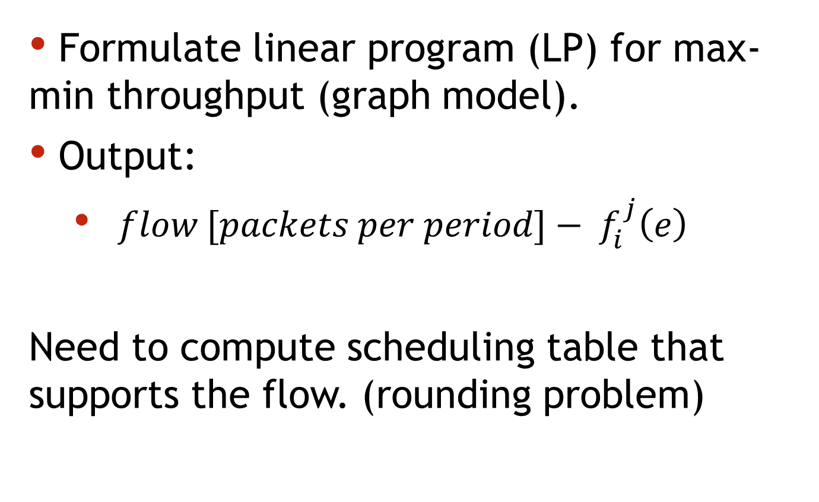
Routing & Scheduling algorithm
Formulate linear program (LP) for max-min throughput (graph model).
Output:
$flow [packets per period]− f_{i}^{j}\left(e\right)$
Need to compute scheduling table that supports the flow. (rounding problem)
23

Slide 24
Greedy scheduler
Greedy coloring of paths
Scan the links and frequency channels
Assign slots to each link and frequency channel
Example problem: (Period time: 1 sec.)
Slot 4: A -> B
Slot 3: B -> C
Slot 2: C -> D
Slot 1: D -> E
A
B
C
D
E
24

Slide 25
Greedy scheduler
Example problem: (Period time: 1 sec.)
Slot 4: A -> B
Slot 3: B -> C
Slot 2: C -> D
Slot 1: D -> E
0.75sec
A
B
C
D
E
25

Slide 26
Greedy scheduler
Example problem: (Period time: 1 sec.)
Slot 4: A -> B
Slot 3: B -> C
Slot 2: C -> D
Slot 1: D -> E
1.5sec
A
B
C
D
E
26

Slide 27
Greedy scheduler
Example problem: (Period time: 1 sec.)
Slot 4: A -> B
Slot 3: B -> C
Slot 2: C -> D
Slot 1: D -> E
2.25sec
A
B
C
D
E
27

Slide 28
Greedy scheduler
Example problem: (Period time: 1 sec.)
Slot 4: A -> B
Slot 3: B -> C
Slot 2: C -> D
Slot 1: D -> E
Large latency
3sec
A
B
C
D
E
28

Slide 29
Better schedule
Example test case: (Period time: 1 sec.)
Slot 1: A -> B
Slot 2: B -> C
Slot 3: C -> D
Slot 4: D -> E
0sec
A
B
C
D
E
29

Slide 30
Better schedule
Example test case: (Period time: 1 sec.)
Slot 1: A -> B
Slot 2: B -> C
Slot 3: C -> D
Slot 4: D -> E
0.25sec
A
B
C
D
E
30

Slide 31
Better schedule
Example test case: (Period time: 1 sec.)
Slot 1: A -> B
Slot 2: B -> C
Slot 3: C -> D
Slot 4: D -> E
0.5sec
A
B
C
D
E
31

Slide 32
Better schedule
Example test case: (Period time: 1 sec.)
Slot 1: A -> B
Slot 2: B -> C
Slot 3: C -> D
Slot 4: D -> E
0.75sec
A
B
C
D
E
32

Slide 33
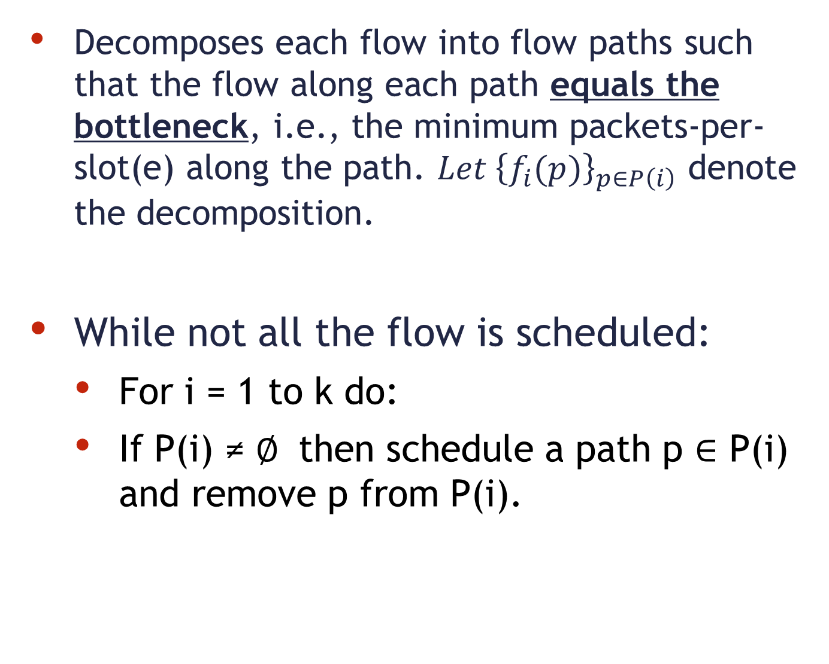
Path-peeling scheduler
Decomposes each flow into flow paths such that the flow along each path equals the bottleneck, i.e., the minimum packets-per-slot(e) along the path. ${Let \left\{f_{i}(p)\right\}}_{p∈P\left(i\right)}$ denote the decomposition.
While not all the flow is scheduled:
For i = 1 to k do:
If P(i) ≠ $∅$ then schedule a path p $∈$ P(i) and remove p from P(i).
33

Slide 34
Routing & Scheduling
Approximately computed in graph model.
Does the result work in the physical (SINR) model ?
34

Slide 35
Simulator
OMNET++/MiXiM – event driven network simulator
Extensible (C++)
Built-In wireless protocols (802.11b-Mac / Phy )
Wireless signal model (noise , interference , fading)
Mobility
Fast - Models packets (not symbols)
35

Slide 36
System stability
Successful delivery is a random variable.
white noise in channel
802.11 random quiet periods
Fluctuations in number of packets sent in each slot incur instable queue lengths
Flow control algorithm
Goal: stabilize queue size.
36

Slide 37
Flow Control algorithm
At the end of each schedule period each node locally performs (per stream):
Counts #packets transmitted along outgoing & incoming edges.
Sends updated requests for incoming link rates.
Drops the oldest packets from queue so that all pending packets are delivered within the next period.
37

Slide 38
Flow Control algorithm example
End of schedule period
Values indicate data transmitted across edges during last period (per stream)
0.3Mb
0.5Mb
1Mb
0.7Mb
0.4Mb
1Mb
0.8Mb
38

Slide 39
Flow Control algorithm example
End of schedule period
Values indicate data transmitted across edges during last period (per stream)
Update step #1:
0.9Mb min(0.5+0.4,1)
0.3Mb
0.5Mb
1Mb
0.7Mb
0.4Mb
1Mb
0.8Mb
39

Slide 40
Flow Control algorithm example
End of schedule period
Values indicate data transmitted across edges during last period (per stream)
Update step #2:
0.3Mb
0.9Mb
0.5Mb
1Mb
0.7Mb
0.4Mb
1Mb
0.9Mb
0.8Mb
40

Slide 41
Flow Control algorithm example
End of schedule period
Values indicate data transmitted across edges during last period (per stream)
Update step #3:
3/10*0.9Mb
0.3Mb
0.9Mb
0.5Mb
7/10*0.9Mb
1Mb
0.7Mb
0.4Mb
1Mb
0.9Mb
0.8Mb
41

Slide 42
Example Input scenario –
Nodes spaced equally on grid with random requests
1
8
15
22
29
36
43
1Km
2
9
16
23
30
37
44
3
10
17
24
31
38
45
4
11
18
25
32
39
46
Example
Transmission
Range
5
12
19
26
33
40
47
6
13
20
27
34
41
48
7
14
21
28
35
42
49
0
1Km

Slide 43
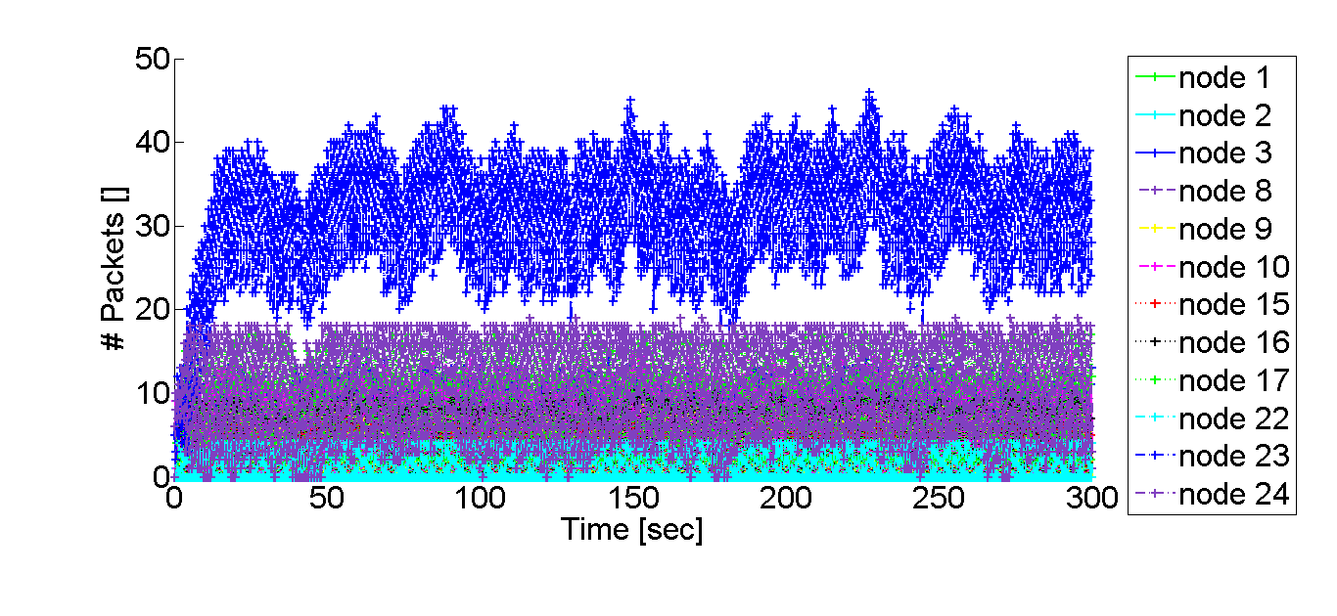
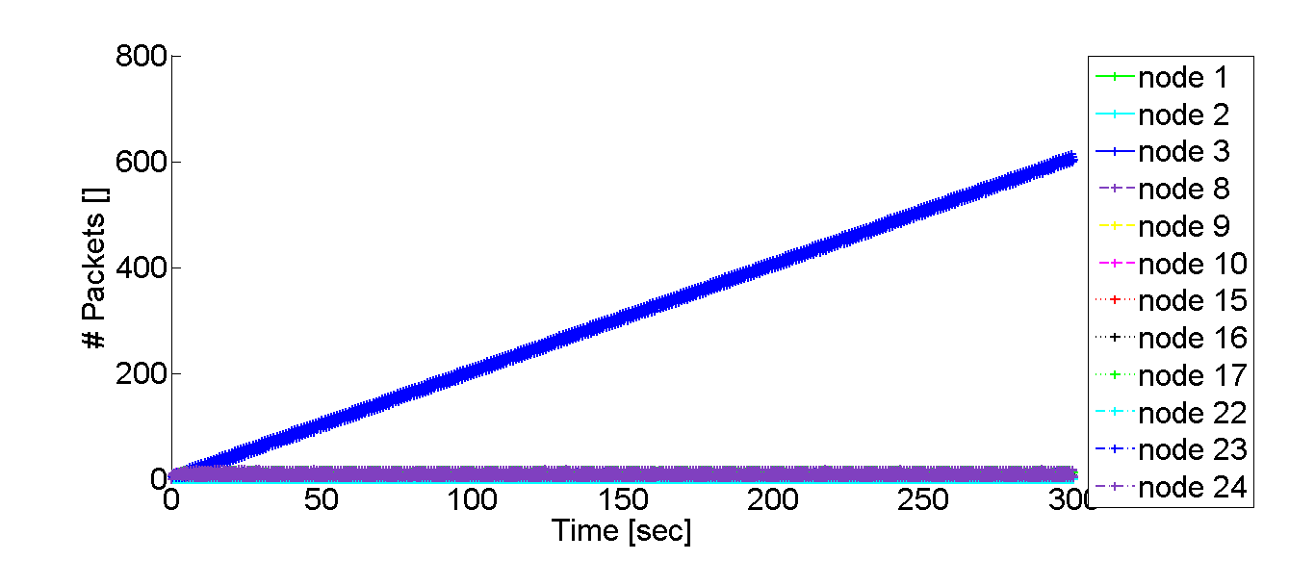
Queue size (one stream/different nodes)
With
flow control
Without
flow control
43

Slide 44
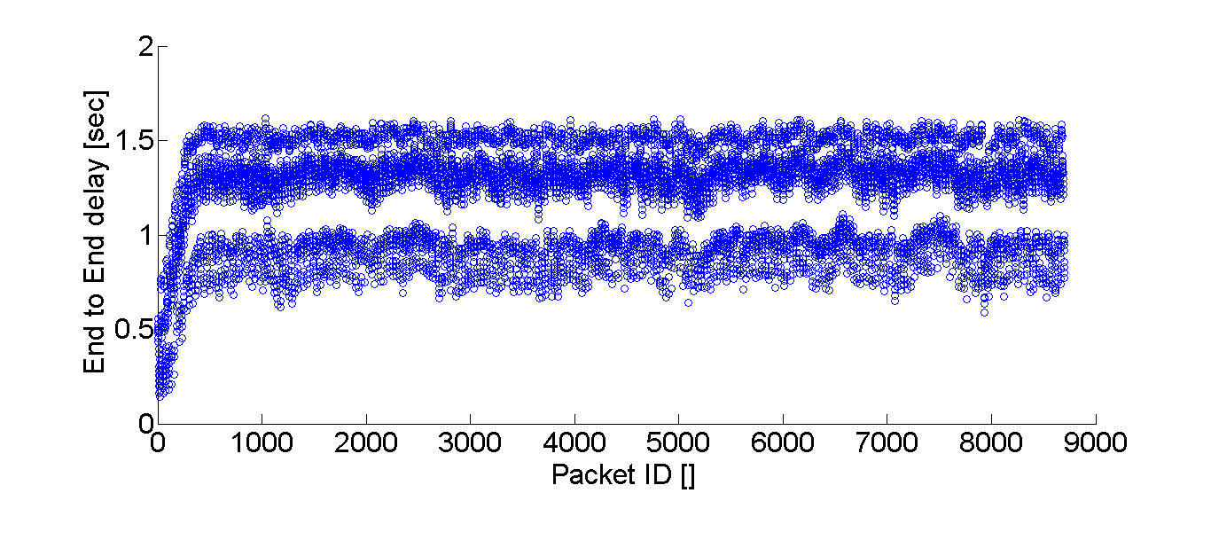
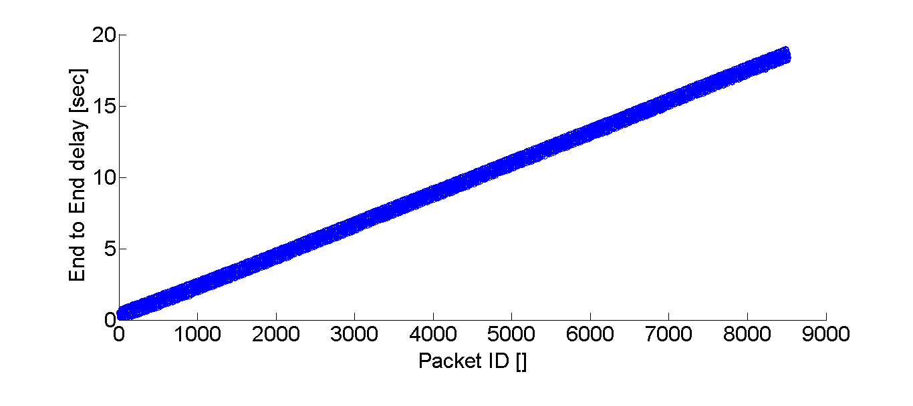
End-to-end delay (one stream)
With
flow
control
Without
flow
control
44

Slide 45
Flow-control rate changes over time
45

Slide 46
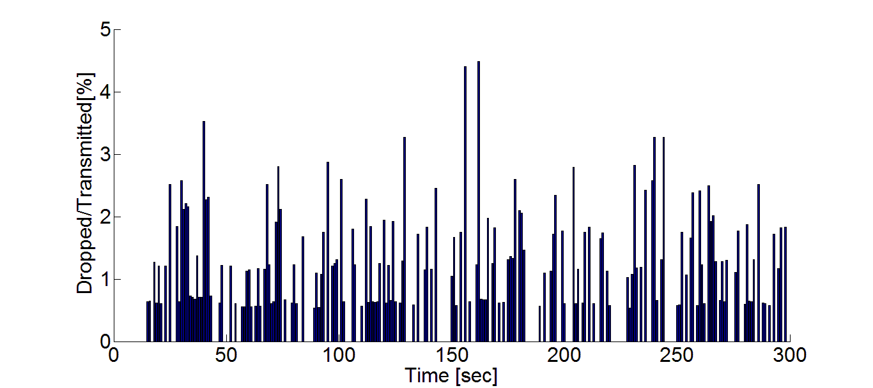
Drop rate (worst stream)

Slide 47
End-to-End delay (per scheduler)
47

Slide 48
Summary
Routing & scheduling approximation algorithm
Feasible in physical model (by simulation)
Local flow control algorithm
Support real-time video streaming requirements
48

Slide 49
Questions ?
49

Slide 50
Backup slides
50

Slide 51
Video playback example
51

Slide 52
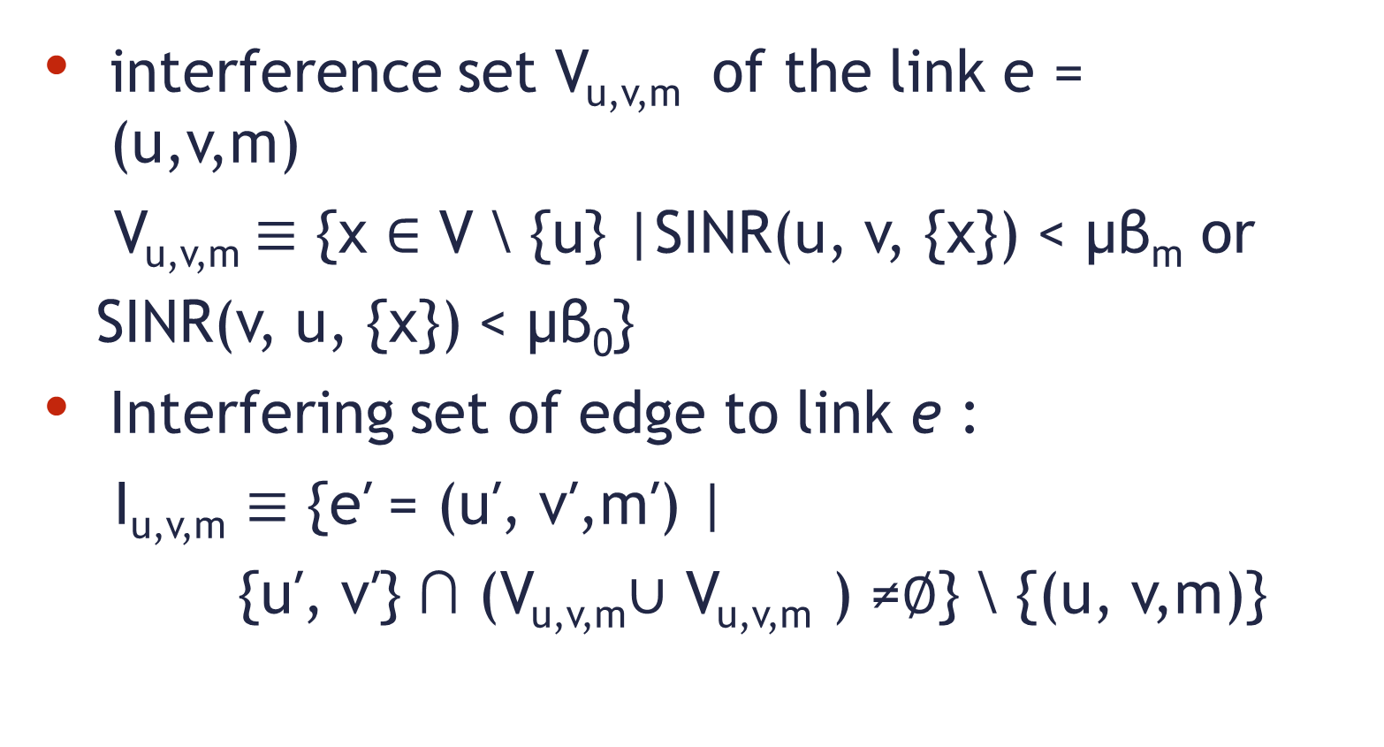
WiFi adjusted interference model
interference set V_{u,v,m} of the link e = (u,v,m)
V_{u,v,m}$≡$ {x ∈ V \ {u} |SINR(u, v, {x}) < μβ_{m} or
SINR(v, u, {x}) < μβ₀}
Interfering set of edge to link e :
I_{u,v,m} $≡$ {e′ = (u′, v′,m′) |
{u′, v′} ∩ (V_{u,v,m}∪ V_{u,v,m} ) ≠∅} \ {(u, v,m)}
52

Slide 53
Hidden node problem
A and B can communicate with N
A can’t “hear” B
B can’t hear A
A and B May
attempt to
transmit un the
same time and interfere
with each other!
N
B
A
53

Slide 54
Routing
NP Hard problem in general
Formalize constraints:
Flow in equals flow out
Radio is not used simultaneously for transmit and receive and not used in more than one channel
Flow is smaller or equal edge capacity
No conflict between transmitting nodes - by interfering edges induces by graph interference model (adjusted for WiFi- both ends transmit and multiple MCS)
54

Slide 55
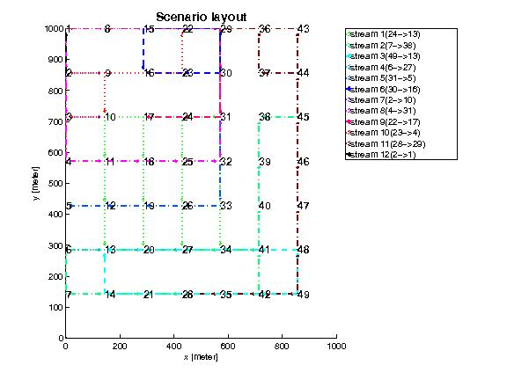
Routing result

Slide 56
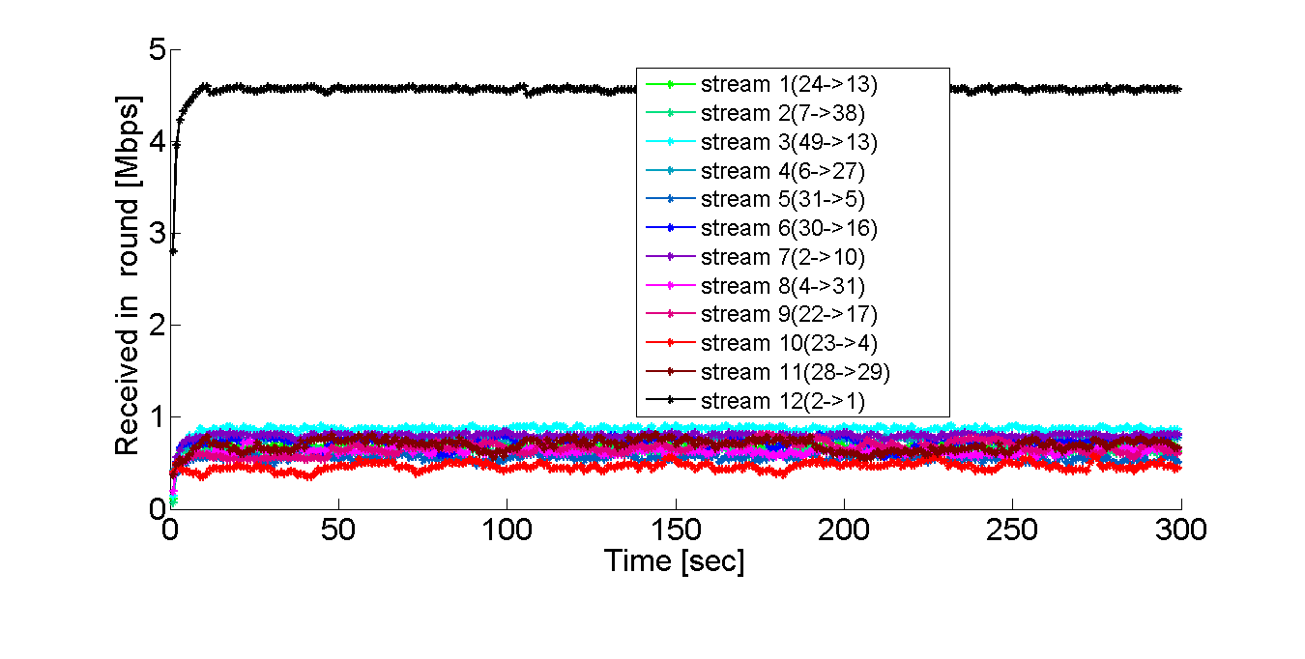
Throughput per stream
With flow control
Without flow control
May even increase ratio
56

Slide 57
End-to-end delay histogram (one stream)
With flow control
Without flow control

Slide 58
Routing & Scheduling
Formalize linear program:
2’nd target constant
Demand for stream i
Supply ratio for stream i, fraction of supplied demand
min _{i} Ρ_{i}
Flow along edge e, in channel f for stream i
58

Slide 59
Linear Program (cont.)
Capacity constraint
Flow conservation
Conflict constraint
59

Slide 60
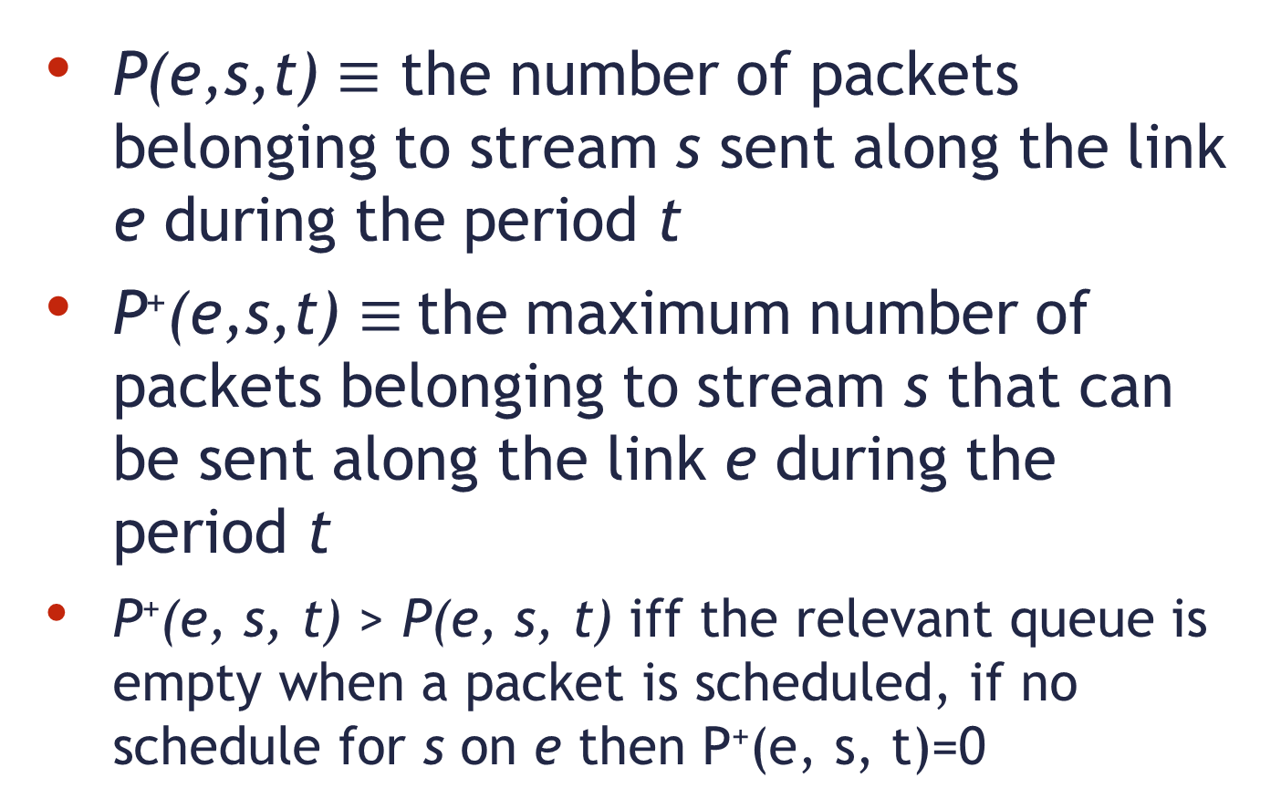
Flow Control algorithm - definitions
P(e,s,t) $≡$ the number of packets belonging to stream s sent along the link e during the period t
P⁺(e,s,t) $≡$the maximum number of packets belonging to stream s that can be sent along the link e during the period t
P⁺(e, s, t) > P(e, s, t) iff the relevant queue is empty when a packet is scheduled, if no schedule for s on e then P⁺(e, s, t)=0
60

Slide 61
Flow Control algorithm prelim.
Algorithm is executed locally for all nodes
Each node has a queue per stream
R(e, s) specifies the number of packets from stream s that the node is willing to receive along the link e in the next period t + 1
Initialize: for all e ∈ E_{in}(v)
R(e, s) ← [scheduler computed rate]
61

Slide 62
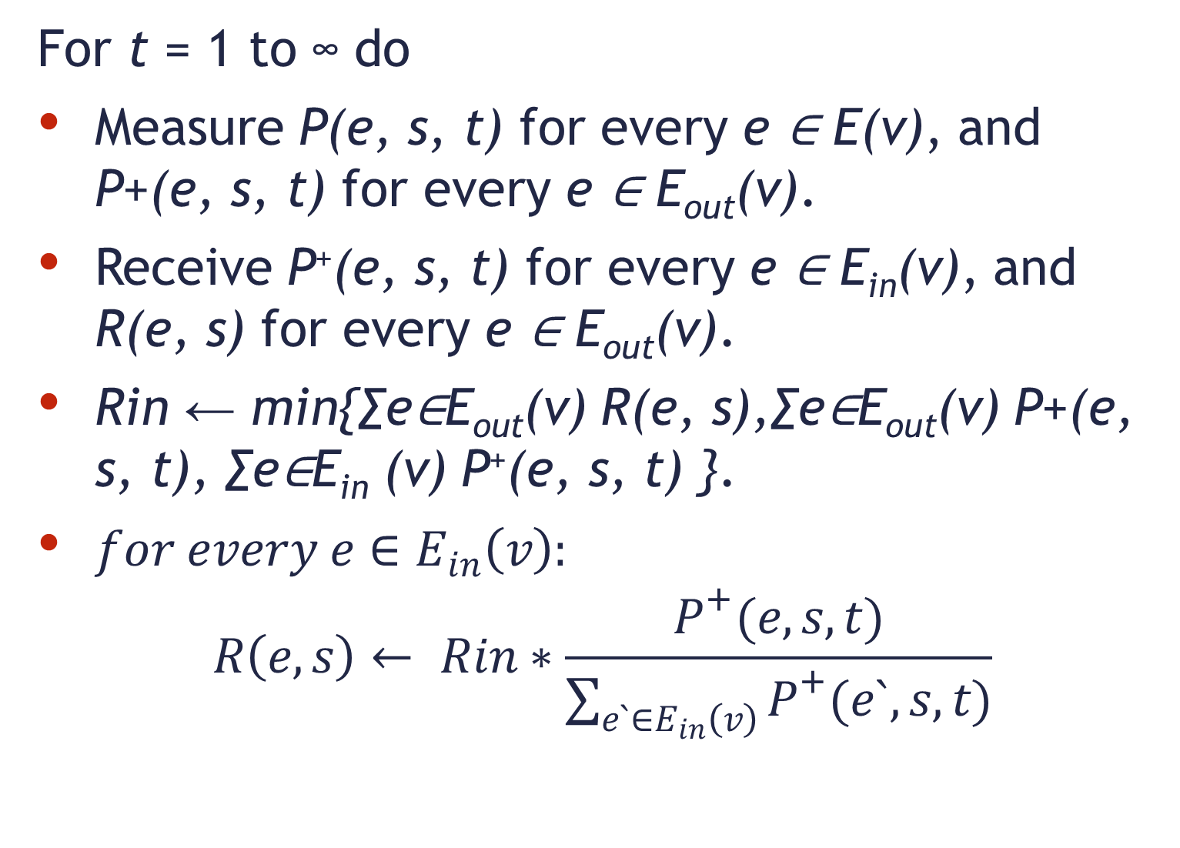
Flow Control algorithm
For t = 1 to ∞ do
Measure P(e, s, t) for every e ∈ E(v), and P+(e, s, t) for every e ∈ E_{out}(v).
Receive P⁺(e, s, t) for every e ∈ E_{in}(v), and R(e, s) for every e ∈ E_{out}(v).
Rin ← min{∑e∈E_{out}(v) R(e, s),∑e∈E_{out}(v) P+(e, s, t), ∑e∈E_{in} (v) P⁺(e, s, t) }.
$for every e∈E_{in}\left(v\right):$
$$R\left(e, s\right)← Rin∗\frac{P^{+}(e,s,t)}{\sum_{e`∈E_{in}\left(v\right)}{P^{+}(e`,s,t)}}$$
62

Slide 63
Flow Control algorithm
In addition at the end of each such round we drop the oldest packets from Q(v, s), if needed, so that |Q(v, s)| ≤ R_{in}
Intuitively the algorithms controls the rates and queues using minor changes according to what the wireless channels and queues can sustain.
63

Slide 64
Packet-Error-Rate / Signal-to-Noise Ratio
.

Slide 65
Raw Rate vs. Actual Rate
Payload size 1KB *

Slide 66
Previous work
LP(graph) + greedy coloring – constant approximation
PTAS – impractical due to rounding problem
Routing in SINR – logarithmic approximation with uniform power
simulations in graph model

Slide 67
Key Contributions
Adjusted graph model
SINR simulations
Path peeling scheduler
Flow control
Analysis for Video

