Slide 1
Video Compression - MPEG
Roger Cheng
Spring 2007

Slide 2
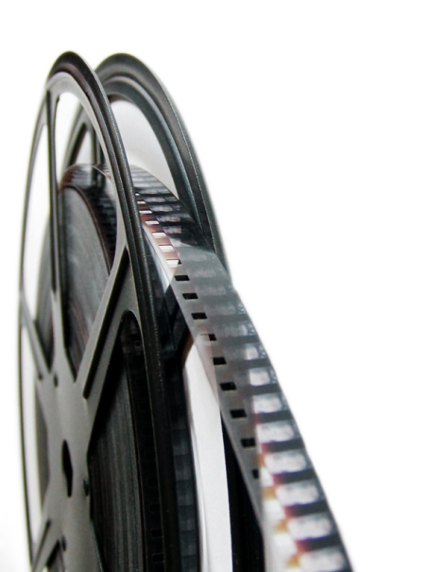
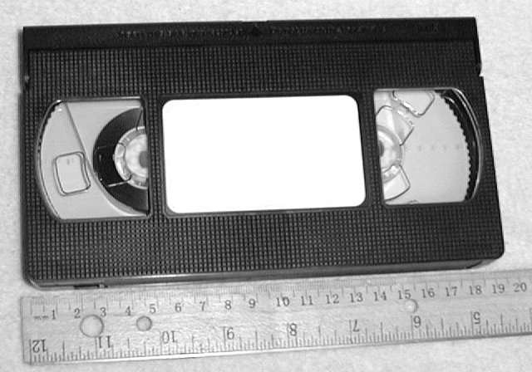
Evolution of video mediums
Film
  Invented in late 18th century, still widely used today
VHS
  Released in 1976, rapidly disappearing

Slide 3
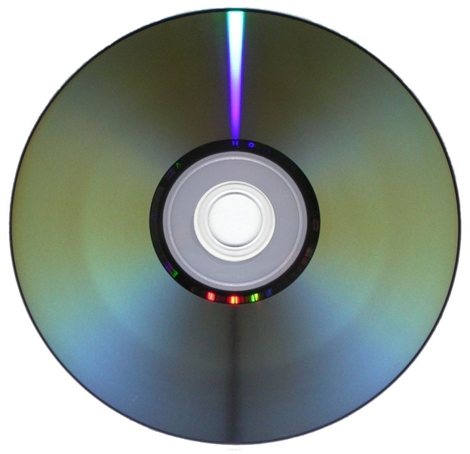
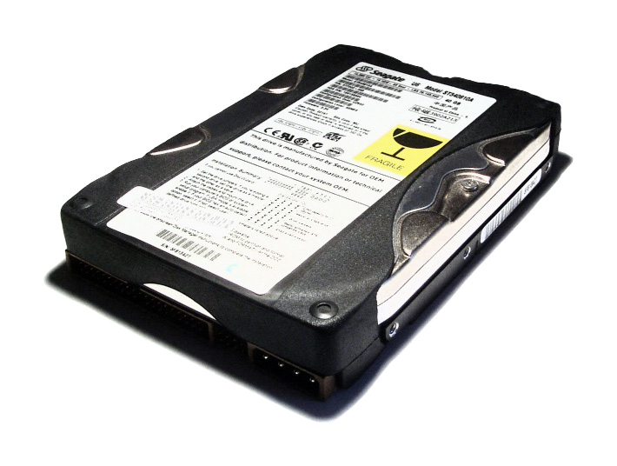
Evolution of video mediums
DVD
  Released in 1996, dominant for over a decade
Hard Disk
  Around for many years, only recently widely used for storing video (helped by explosion of Internet)

Slide 4
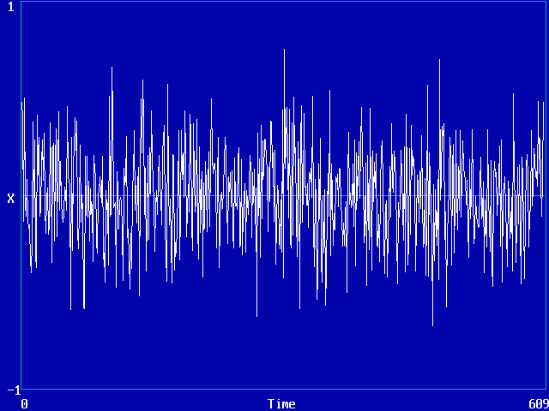

Transition from analog mediums to digital mediums
The “N word”
  Analog signals are prone to corruption by noise
Economics
  Optical media is cheaper to produce than magnetic media
Creates need to convert analog video to digital format

Slide 5
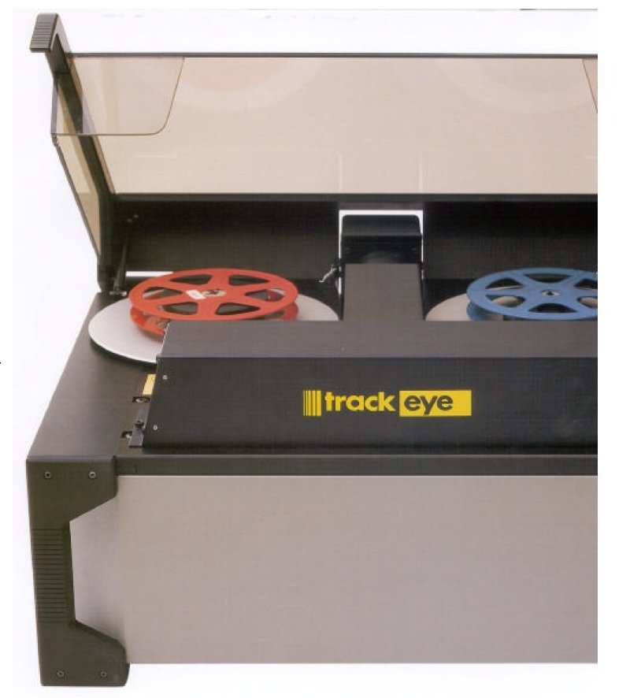
Video digitization
New digital video cameras have on-board hardware to capture directly to digital format
Old film can be scanned with special machines to produce digital stream

Slide 6
Video Encoding/Compression
Once video is in digital format, it makes sense to compress it
Similarly to image compression, we want to store video data as efficiently as possible
Again, we want to both maximize quality and minimize storage space and processing resources
This time, we can exploit correlation in both space and time domains

Slide 7
TMI! (Too Much Information)
Unlike image encoding, video encoding is rarely done in lossless form
No storage medium has enough capacity to store a practical sized lossless video file
  Lossless DVD video - 221 Mbps
  Compressed DVD video - 4 Mbps
  50:1 compression ratio!

Slide 8
Definitions
Bitrate
  Information stored/transmitted per unit time
  Usually measured in Mbps (Megabits per second)
  Ranges from < 1 Mbps to > 40 Mbps
Resolution
  Number of pixels per frame
  Ranges from 160x120 to 1920x1080
FPS (frames per second)
  Usually 24, 25, 30, or 60
  Don’t need more because of limitations of the human eye

Slide 9
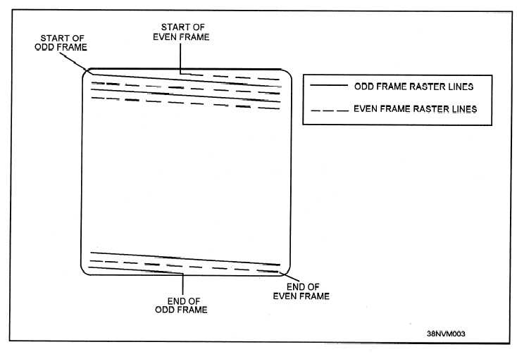
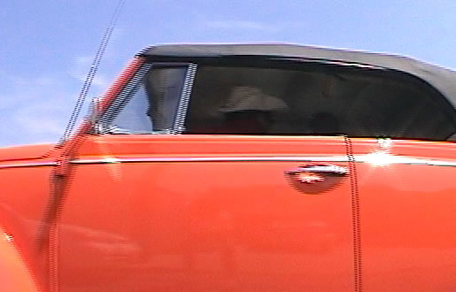
Scan types
Interlaced scan
  Odd and even lines displayed on alternate frames
  Initially used to save bandwidth on TV transmission
  When displaying interlaced video on a progressive scan display, can see “comb effect”

Slide 10
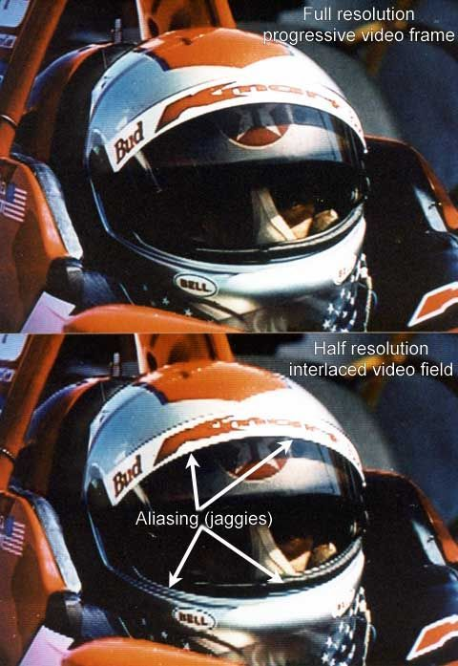
Scan types
Progressive scan
  Display all lines on each frame
  New “fixed-resolution” displays (such as LCD, Plasma) all use progressive scan
  Deinterlacing is not a trivial task

Slide 11
MPEG (Moving Pictures
Expert Group)
Committee of experts that develops video encoding standards
Until recently, was the only game in town (still the most popular, by far)
Suitable for wide range of videos
  Low resolution to high resolution
  Slow movement to fast action
Can be implemented either in software or hardware

Slide 12
Evolution of MPEG
MPEG-1
  Initial audio/video compression standard
  Used by VCD’s
  MP3 = MPEG-1 audio layer 3
  Target of 1.5 Mb/s bitrate at 352x240 resolution
  Only supports progressive pictures

Slide 13
Evolution of MPEG
MPEG-2
  Current de facto standard, widely used in DVD and Digital TV
  Ubiquity in hardware implies that it will be here for a long time
    Transition to HDTV has taken over 10 years and is not finished yet
  Different profiles and levels allow for quality control

Slide 14
Evolution of MPEG
MPEG-3
  Originally developed for HDTV, but abandoned when MPEG-2 was determined to be sufficient
MPEG-4
  Includes support for AV “objects”, 3D content, low bitrate encoding, and DRM
  In practice, provides equal quality to MPEG-2 at a lower bitrate, but often fails to deliver outright better quality
  MPEG-4 Part 10 is H.264, which is used in HD-DVD and Blu-Ray

Slide 15
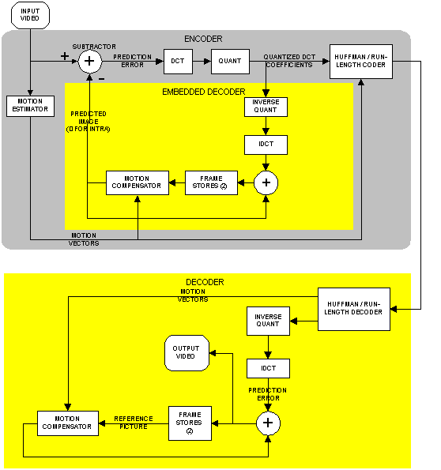
MPEG Block Diagram

Slide 16
MPEG technical specification
Part 1 - Systems - describes synchronization and multiplexing of video and audio.
Part 2 - Video - compression codec for interlaced and non-interlaced video signals.
Part 3 - Audio - compression codec for perceptual coding of audio signals. A multichannel-enabled extension of MPEG-1 audio.
Part 4 - Describes procedures for testing compliance.
Part 5 - Describes systems for Software simulation.
Part 6 - Describes extensions for DSM-CC (Digital Storage Media Command and Control.)
Part 7 - Advanced Audio Coding (AAC)
Part 8 - Deleted
Part 9 - Extension for real time interfaces.
Part 10 - Conformance extensions for DSM-CC.

Slide 17
MPEG video spatial domain processing
Spatial domain handled very similarly to JPEG
  Convert RGB values to YUV colorspace
  Split frame into 8x8 blocks
  2-D DCT on each block
  Quantization of DCT coefficients
  Run length and entropy coding

Slide 18

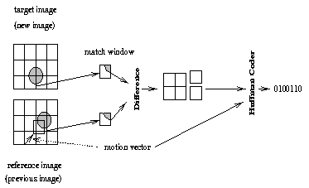
MPEG video time domain processing
Totally new ballgame (this concept doesn’t exist in JPEG)
General idea – Use motion vectors to specify how a 16x16 macroblock translates between reference frames and current frame, then code difference between reference and actual block

Slide 19
Types of frames
I frame (intra-coded)
  Coded without reference to other frames
P frame (predictive-coded)
  Coded with reference to a previous reference frame (either I or P)
  Size is usually about 1/3rd of an I frame
B frame (bi-directional predictive-coded)
  Coded with reference to both previous and future reference frames (either I or P)
  Size is usually about 1/6th of an I frame

Slide 20
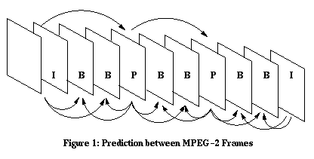
GOP (Group of Pictures)
GOP is a set of consecutive frames that can be decoded without any other reference frames
Usually 12 or 15 frames
Transmitted sequence is not the same as displayed sequence
Random access to middle of stream – Start with I frame

Slide 21
Things about prediction
Only use motion vector if a “close” match can be found
  Evaluate “closeness” with MSE or other metric
  Can’t search all possible blocks, so need a smart algorithm
  If no suitable match found, just code the macroblock as an I-block
  If a scene change is detected, start fresh
Don’t want too many P or B frames in a row
  Predictive error will keep propagating until next I frame
  Delay in decoding

Slide 22
Bitrate allocation
CBR – Constant BitRate
  Streaming media uses this
  Easier to implement
VBR – Variable BitRate
  DVD’s use this
  Usually requires 2-pass coding
  Allocate more bits for complex scenes
  This is worth it, because you assume that you encode once, decode many times

Slide 23
MPEG audio
MPEG-1 – 3 layers of increasing quality, layer 3 being the most common (MP3)
  16 bits
  Samping rate - 32, 44.1, or 48 kHz
  Bitrate – 32 to 320 kbps
  De facto - 44.1 kHz sample rate, 192 kbps bitrate
MPEG-2 – Supports > 2 channels, lower sampling frequencies, low bitrate improvement
AAC (Advanced Audio Coding)
  More sample frequencies (8 kHz to 96 kHz)
  Higher coding efficiency and simpler filterbank
  96 kbps AAC sounds better than 128 kbps MP3
Usually CBR, but can do VBR

Slide 24
MPEG Container Format
Container format is a file format that can contain data compressed by standard codecs
2 types for MPEG
  Program Stream (PS) – Designed for reasonably reliable media, such as disks
  Transport Stream (TS) – Designed for lossy links, such as networks or broadcast antennas

Slide 25
AV Synchronization
Want audio and video streams to be played back in sync with each other
Video stream contains “presentation timestamps”
MPEG-2 clock runs at 90 kHz
  Good for both 25 and 30 fps
PCR (Program Clock Reference) timestamps are sent with data by sender
Receiver uses PLL (Phase Lock Loop) to synchronize clocks

Slide 26


Real time video encoding
Motion estimation will be worse, so need higher bitrate to compensate
Very hard to do in software, need dedicated hardware or hardware assistance
Tivo, ReplayTV do this

Slide 27
Streaming media
Common types include Flash, RealVideo, Quicktime
Usually have low bandwidth available, need to optimize as such
Want dedicated network protocols for this purpose
  TCP will wait indefinitely for retransmission, so is often not suitable

Slide 28
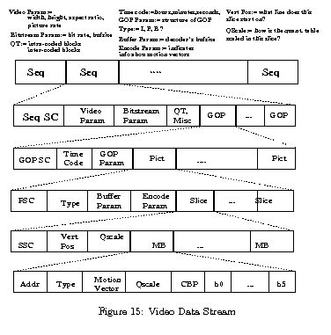
MPEG data stream

Slide 29

HDTV MPEG video demo

Slide 30
Analysis
Pros
  Overall sharp picture
  Audio and video stay in sync with each other
    What if we were transmitting this over a network?
Cons
  Picture flashes, blurs when there is too much movement on screen
    Higher bitrate often does not solve this problem

Slide 31
Conclusion
Video compression is important
Video compression is not easy
Video compression has come a long way
Not as mature as image compression => There is definitely room for improvement
  New paradigms in computing will dictate future research directions

