Slide 1
Real Time Video Streaming in Multi hop Ad-Hoc Wireless networks
Yaniv Fais
Under supervision of Prof. Guy Even
Joint work with Prof. Guy Even, Moti Medina,
Moni Shachar and Alexander Zadorojniy

Slide 2
Agenda
Problem Definition
Real-Time Video
WiFi introduction
Routing & Scheduling
Interference models
Simulator
Flow Control
Experimental results
Video transmission
2

Slide 3
Problem Definition
Ad-Hoc Wireless Network model
Nodes in the plane with single radio
Multiple radio channels
Interference is an important issue
Nodes know location and time (using GPS)
3

Slide 4
Problem Definition II
Input: Nodes + real-time video transmission requests:
Source , Destination , Bandwidth
(Source and destinations are not neighbors)
Goal: serve requests (max-min throughput)
4

Slide 5
Real-Time Video characteristics
High-bandwidth
~1Mbps after encoding
Require: low end-to-end delay
Few seconds at most
Require: small packet-loss
< 5%
Adjustable bit rate because encoder can be controlled (variable quality and compression ratio)
5

Slide 6
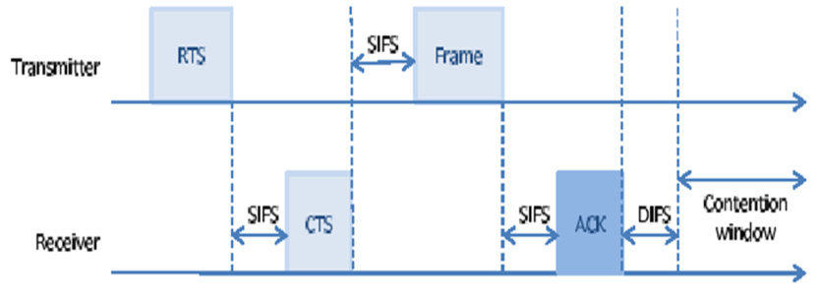
IEEE 802.11g (WiFi)
Carrier sense multiple access with collision detection (CSMA/CD)
Transmitter sends Request To Send (RTS)
6

Slide 7
IEEE 802.11g (WiFi)
Receiver sends “Clear To Send” (CTS)
All other nodes remain “quiet” throughout packet transmission
7

Slide 8
IEEE 802.11g (WiFi)
Transmitter sends frame with payload data (large frame – several KB)
8

Slide 9
IEEE 802.11g (WiFi)
Receiver sends “Acknowledge” (ACK) packet once complete
9

Slide 10
IEEE 802.11g (WiFi)
Distributed protocol that avoids collisions
But: (In multi-hop setting)
Large overhead (for each packet)
Unpredictable: no quality of service guarantee (throughput, end-to-end delay)
Unfair (starvation)
Unstable (unbounded queues)
10

Slide 11
Research goals
Full system solution for specific video streaming problem:
Inputs gathering
Scheduling & Routing computation
Flow control
Simulation
Results analysis
11

Slide 12
Solution sketch – Time division
Divide time unit into slots and in each time slot schedule a non-interfering set of links
Example:
Slot 1: Node 1 send to node 22 in channel 2, rate 48Mbps in stream 3
Slot 1: Node 10 send to node 2 in channel 2, rate 6Mbps in stream 5
Slot 2: ….
Compute schedule table from node locations in a central node and broadcast to all nodes
Nodes follow schedule periodically
12

Slide 13
Wireless interference model
Protocol (Graph) model
* Reception radius – upper bound on distance of transmitter
Interference radius – reception is successful only if no other transmitter within interference radius
But in reality signal goes beyond this range!
Actual
Interference
Interference
radius
Reception
radius
13

Slide 14
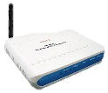
Graph model - problems
Optimistic
Ignores the additive effect of multiple interferences
Pessimistic
Excludes concurrent communication of two neighboring links
14

Slide 15
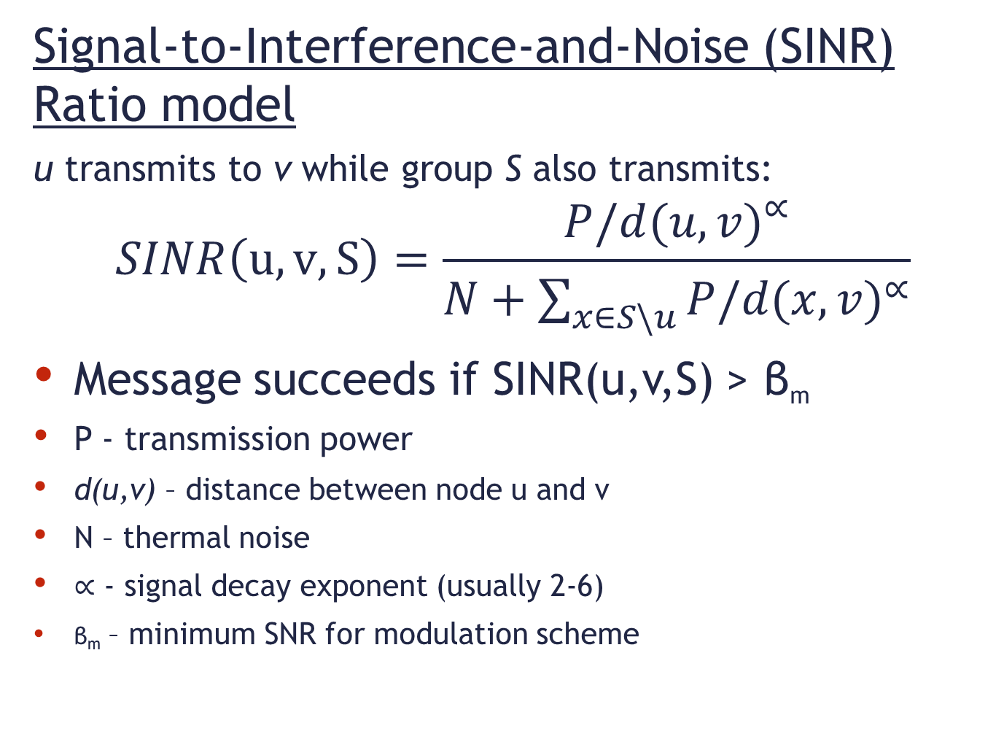
Wireless interference model
Signal-to-Interference-and-Noise (SINR) Ratio model
u transmits to v while group S also transmits:
$$SINR\left(u, v, S\right)=\frac{{P/d(u,v)}^{∝}}{N+\sum_{x∈S\backslash u}{{P/d(x,v)}^{∝}}}$$
Message succeeds if SINR(u,v,S) > β_{m}
P - transmission power
d(u,v) – distance between node u and v
N – thermal noise
$∝$ - signal decay exponent (usually 2-6)
β_{m} – minimum SNR for modulation scheme
15

Slide 16
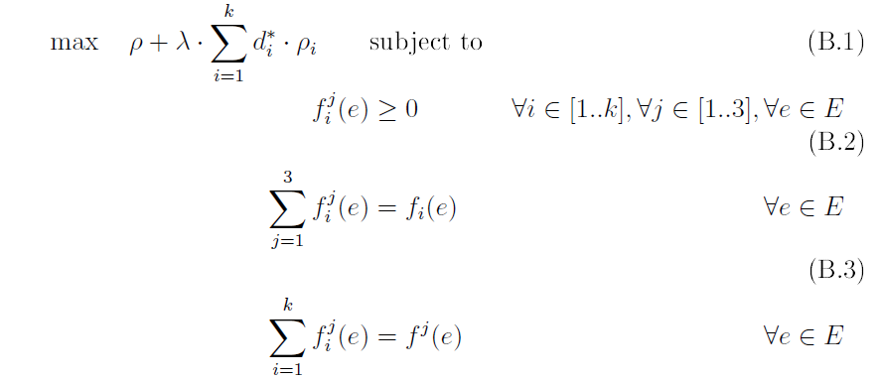
Routing & Scheduling
Formalize linear program:
2’nd target constant
Demand for stream i
Supply ratio for stream i, fraction of supplied demand
min _{i} Ρ_{i}
Flow along edge e, in channel f for stream i
16

Slide 17
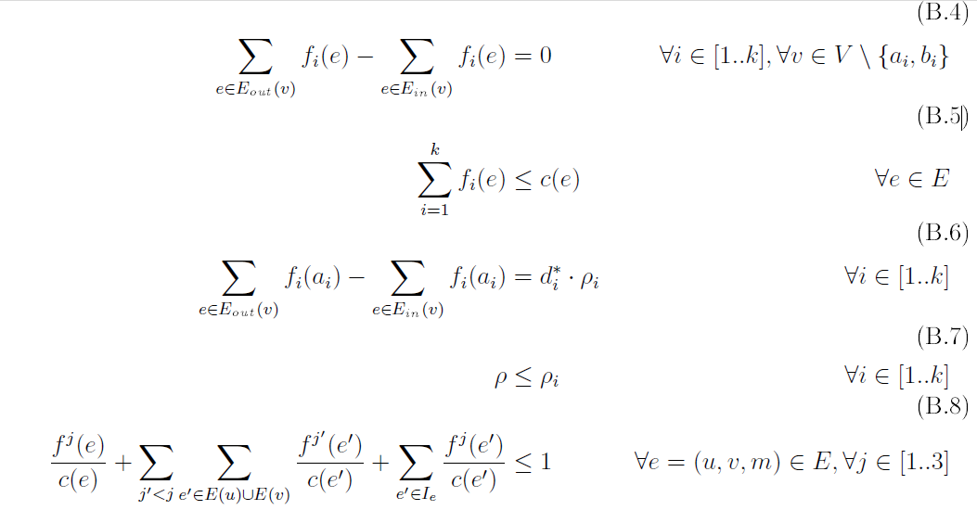
Linear Program (cont.)
Capacity constraint
Flow conservation
Conflict constraint
17

Slide 18
Conflict constraint
flow/capacity -> used time slice
Summarize all used time slices over neighboring edges such that they are feasible
18

Slide 19
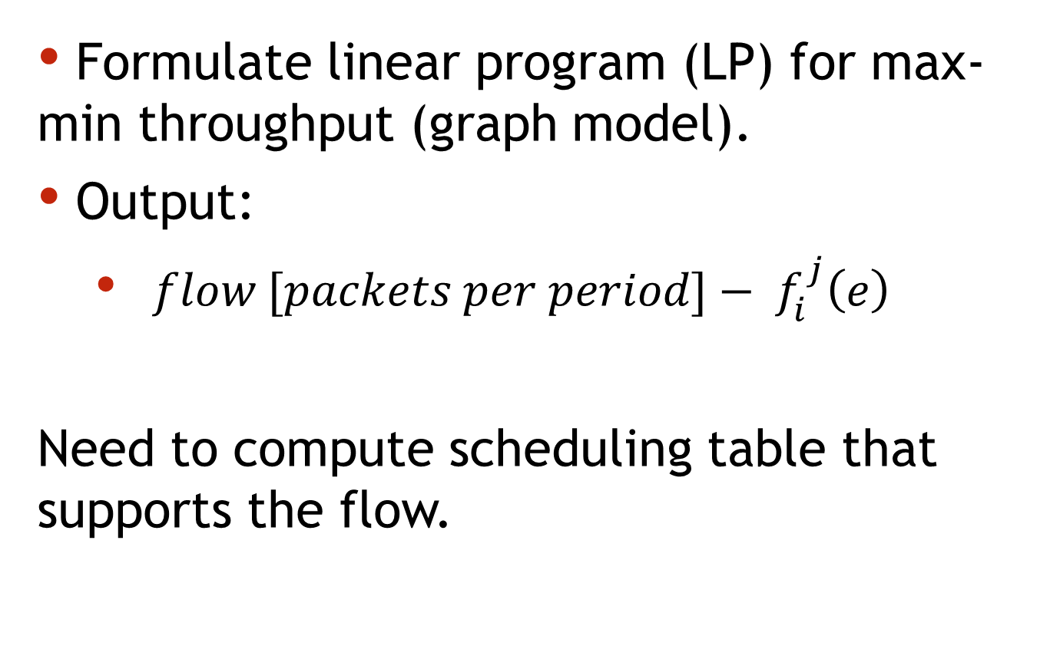
Routing & Scheduling algorithm
Formulate linear program (LP) for max-min throughput (graph model).
Output:
$flow [packets per period]− f_{i}^{j}\left(e\right)$
Need to compute scheduling table that supports the flow.
19

Slide 20
Greedy schedule
Multi commodity flow
Greedy coloring of routes
Increases end-to-end delay
Each hop one table duration
20

Slide 21
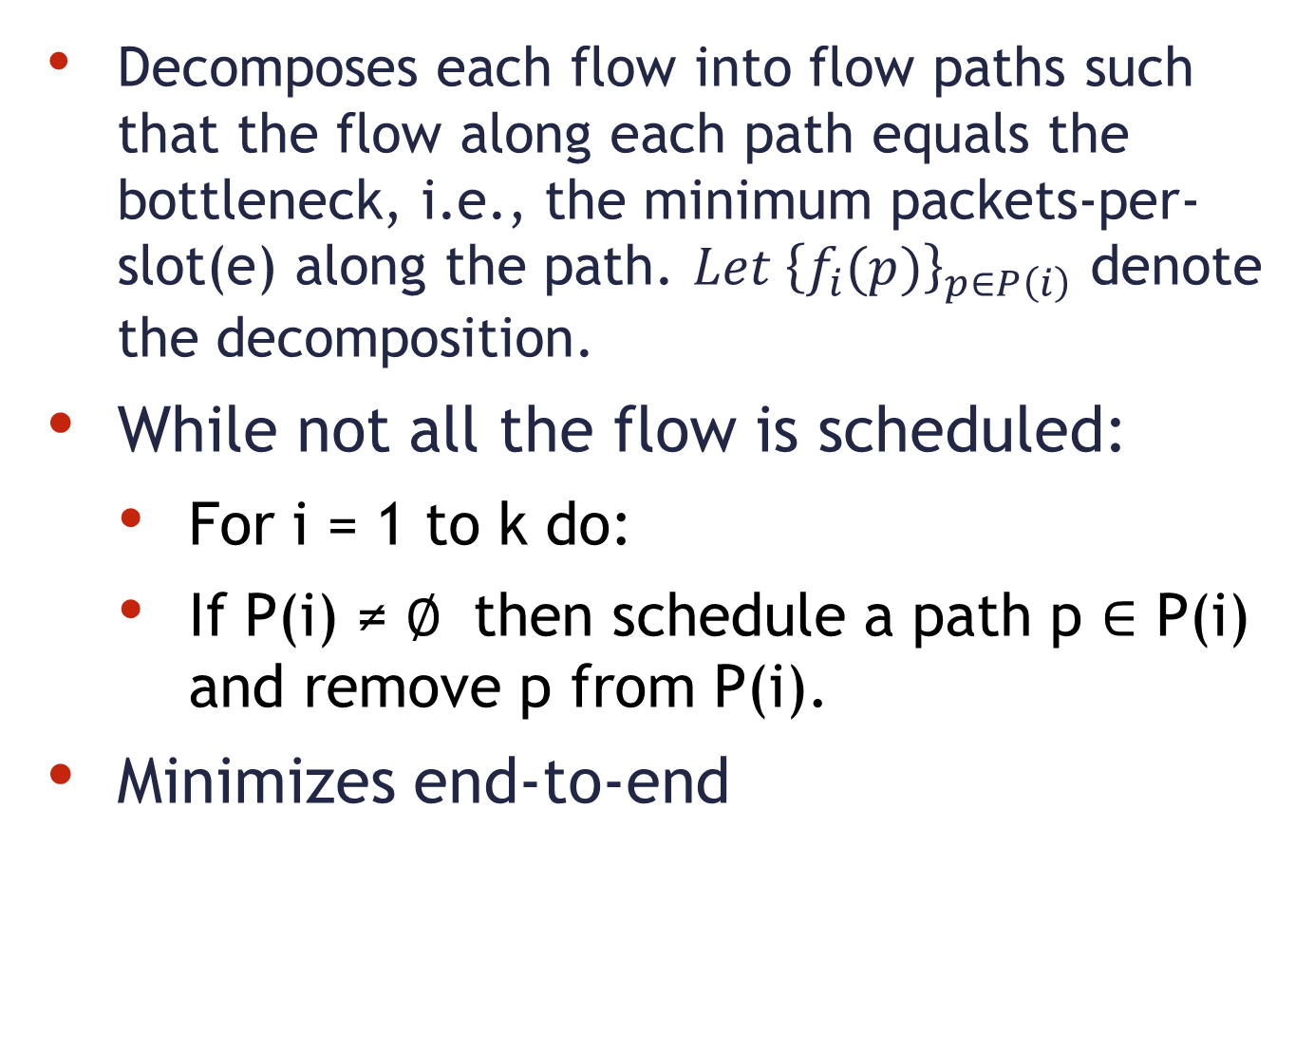
Path-peeling scheduler
Decomposes each flow into flow paths such that the flow along each path equals the bottleneck, i.e., the minimum packets-per-slot(e) along the path. ${Let \left\{f_{i}(p)\right\}}_{p∈P\left(i\right)}$ denote the decomposition.
While not all the flow is scheduled:
For i = 1 to k do:
If P(i) ≠ $∅$ then schedule a path p $∈$ P(i) and remove p from P(i).
Minimizes end-to-end
21

Slide 22
Routing & Scheduling
Computed in graph model and achieves a constant approximation ratio.
Does the result work in the physical (SINR) model ?
22

Slide 23
Simulator
OMNET++/MiXiM – event driven network simulator
Extensible (C++)
Built-In wireless protocols (802.11b-Mac / Phy )
Wireless signal model (noise , interference , fading)
Mobility
Fast - Models packets (not symbols)
23

Slide 24
Flow Control
Successful delivery is a random variable.
Real channel suffers from white noise - different than channel with fixed flow-capacity
802.11 random quiet periods
Fluctuations in number of packets sent in each slot incur instable queue lengths
Goal: stabilize queue size.
24

Slide 25
Flow Control algorithm
At the end of each schedule period each node (per stream):
Counts #packets transmitted along outgoing & incoming edges.
Sends updated requests for incoming link rates.
Drops the oldest packets from queue so that all pending packets are delivered within the next period.
25

Slide 26
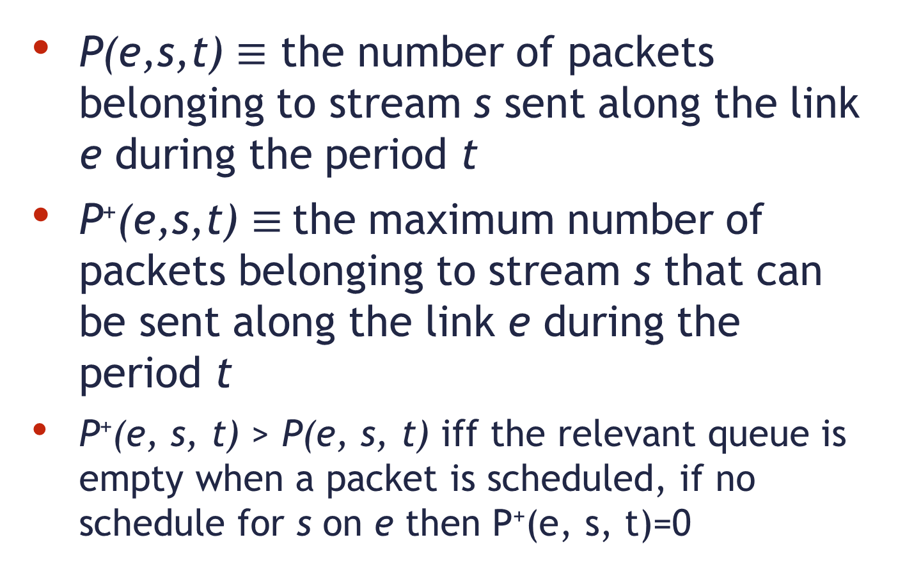
Flow Control algorithm - definitions
P(e,s,t) $≡$ the number of packets belonging to stream s sent along the link e during the period t
P⁺(e,s,t) $≡$the maximum number of packets belonging to stream s that can be sent along the link e during the period t
P⁺(e, s, t) > P(e, s, t) iff the relevant queue is empty when a packet is scheduled, if no schedule for s on e then P⁺(e, s, t)=0
26

Slide 27
Flow Control algorithm prelim.
Algorithm is executed locally for all nodes
Each node has a queue per stream
R(e, s) specifies the number of packets from stream s that the node is willing to receive along the link e in the next period t + 1
Initialize: for all e ∈ E_{in}(v)
R(e, s) ← [scheduler computed rate]
27

Slide 28
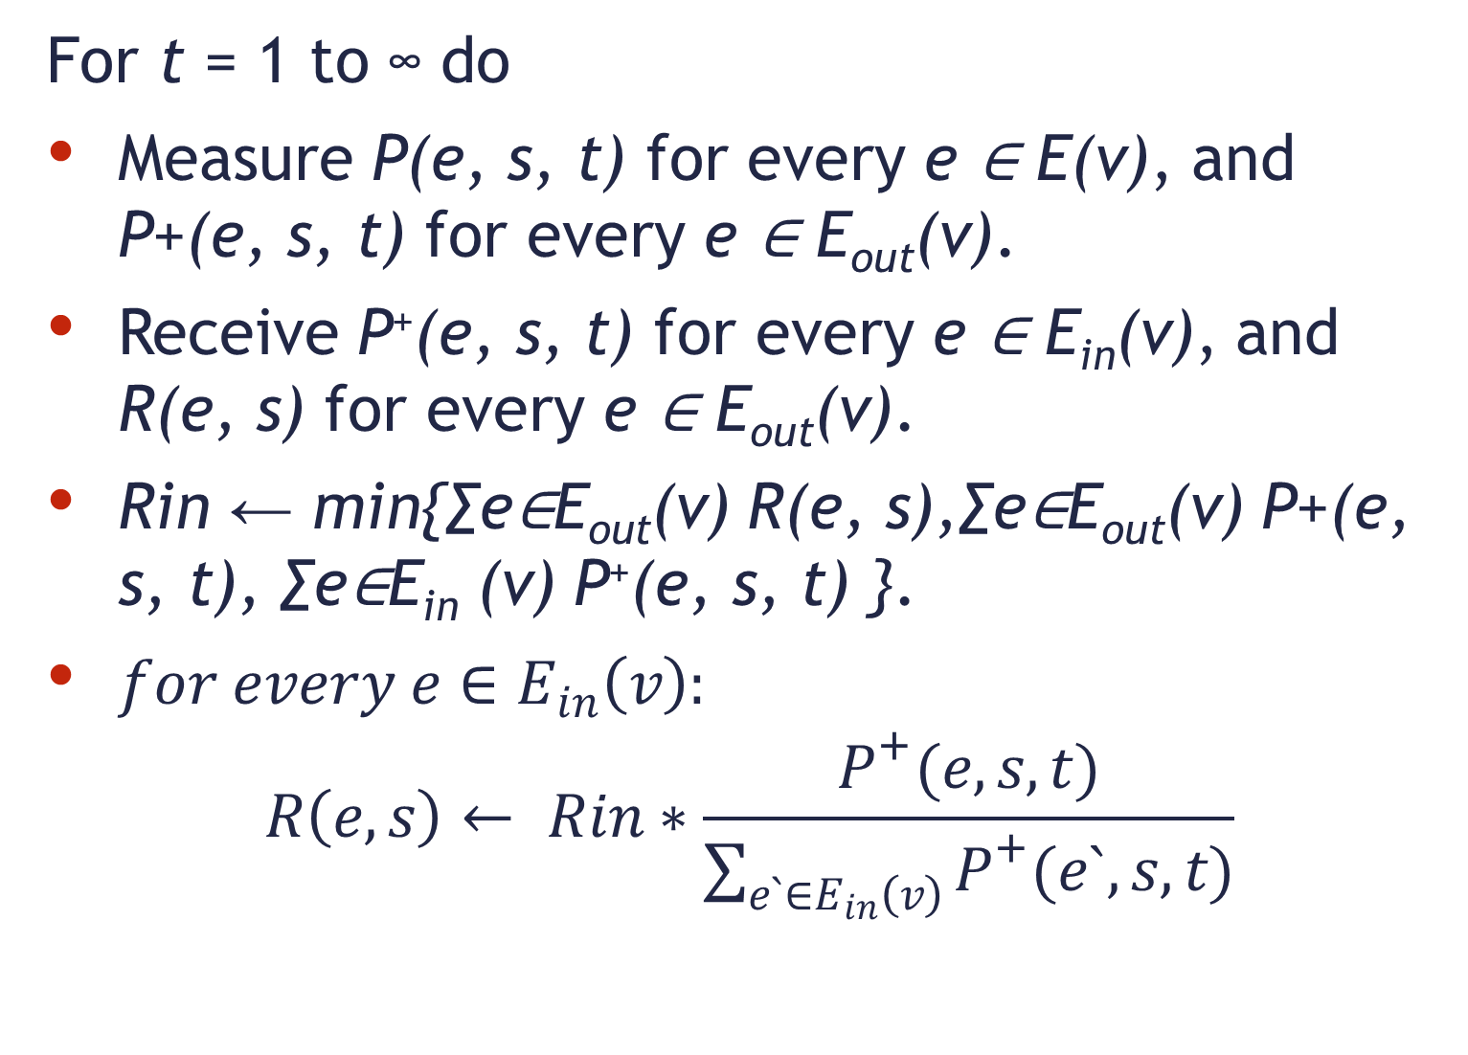
Flow Control algorithm
For t = 1 to ∞ do
Measure P(e, s, t) for every e ∈ E(v), and P+(e, s, t) for every e ∈ E_{out}(v).
Receive P⁺(e, s, t) for every e ∈ E_{in}(v), and R(e, s) for every e ∈ E_{out}(v).
Rin ← min{∑e∈E_{out}(v) R(e, s),∑e∈E_{out}(v) P+(e, s, t), ∑e∈E_{in} (v) P⁺(e, s, t) }.
$for every e∈E_{in}\left(v\right):$
$$R\left(e, s\right)← Rin∗\frac{P^{+}(e,s,t)}{\sum_{e`∈E_{in}\left(v\right)}{P^{+}(e`,s,t)}}$$
28

Slide 29
Flow Control algorithm
In addition at the end of each such round we drop the oldest packets from Q(v, s), if needed, so that |Q(v, s)| ≤ R_{in}
Intuitively the algorithms controls the rates and queues using minor changes according to what the wireless channels and queues can sustain.
29

Slide 30
Example Input scenario –
Nodes spaced equally on grid with random requests
1
8
15
22
29
36
43
1Km
2
9
16
23
30
37
44
3
10
17
24
31
38
45
500m
4
11
18
25
32
39
46
Example
Transmission
Range
5
12
19
26
33
40
47
6
13
20
27
34
41
48
7
14
21
28
35
42
49
0
500m
1Km

Slide 31
End-to-End delay (per scheduler)
31

Slide 32
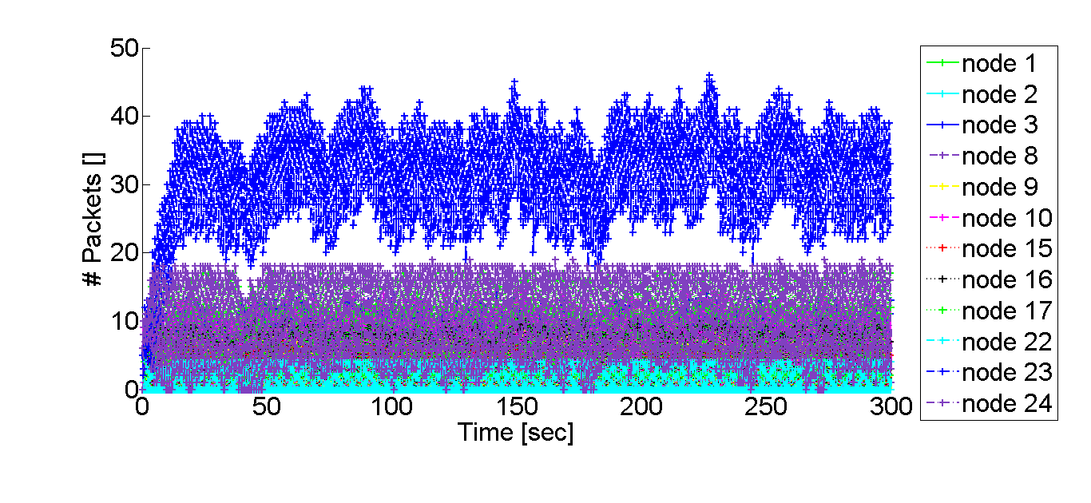
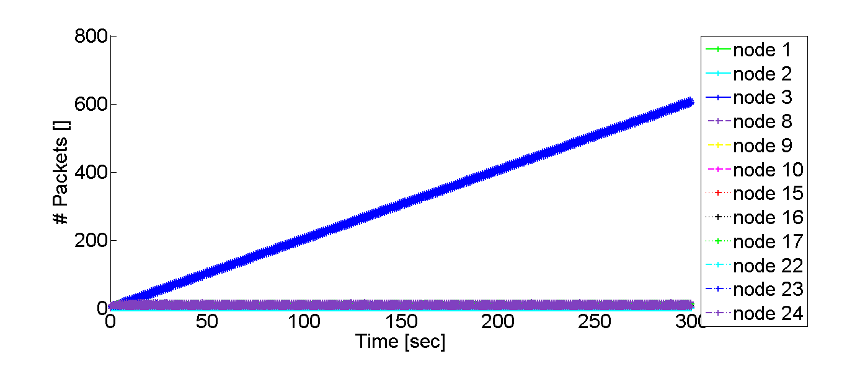
Queue size (one stream/different nodes)
With
flow control
Without
flow control
32

Slide 33
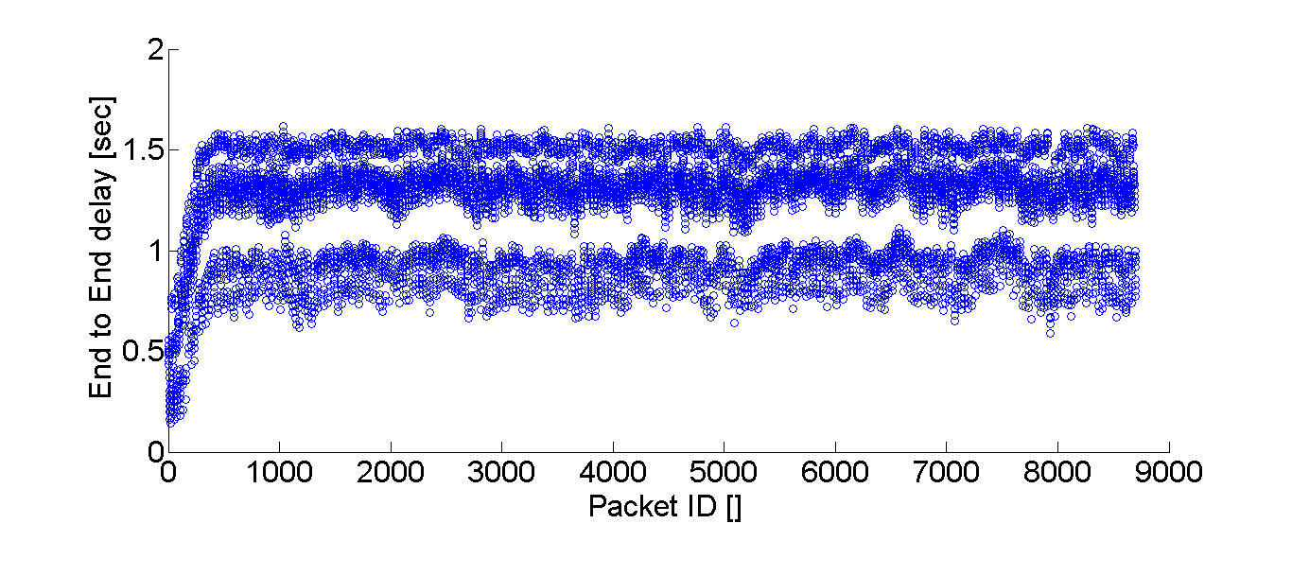
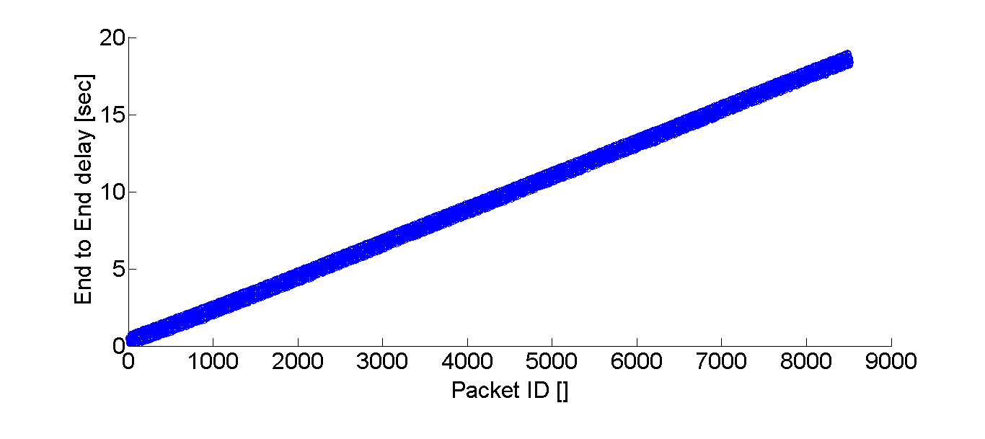
End-to-end delay (one stream)
With
flow
control
Without
flow
control
33

Slide 34
Flow-control rate changes over time
34

Slide 35
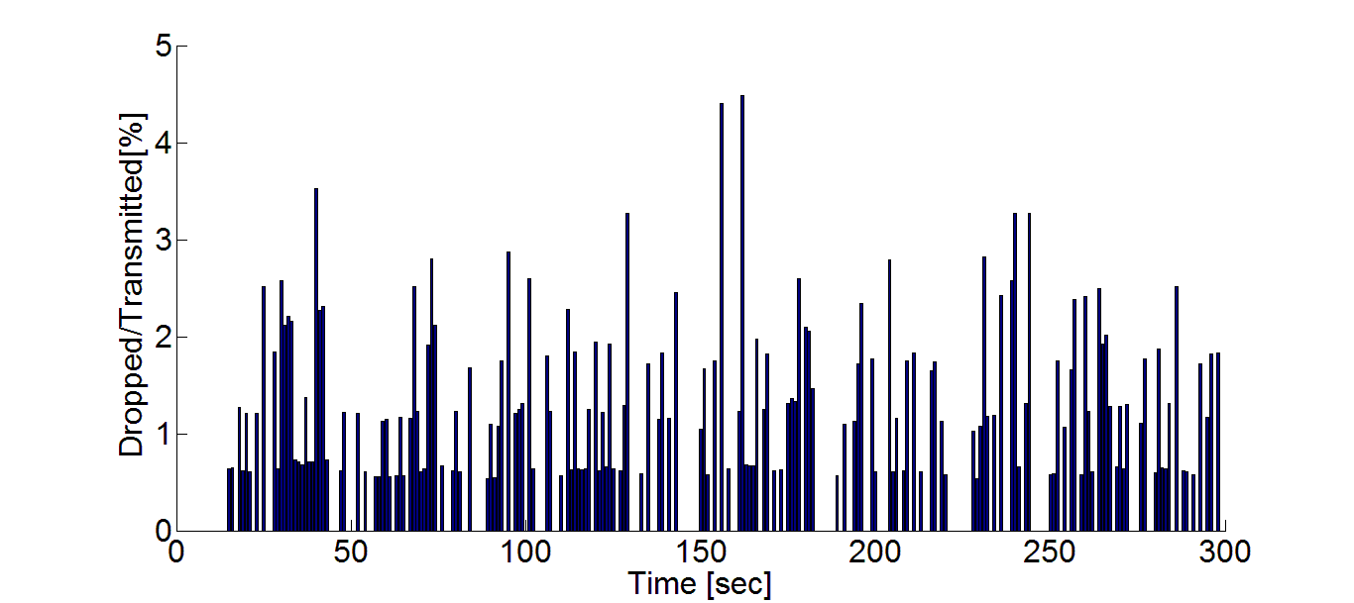
Drop rate (worse stream)

Slide 36
Summary
Routing & scheduling approximation algorithm
Feasible in physical model (by simulation)
Local flow control algorithm
Support real-time video streaming requirements
36

Slide 37
Questions ?
37

Slide 38
Backup slides
38

Slide 39
Video playback example
39

Slide 40
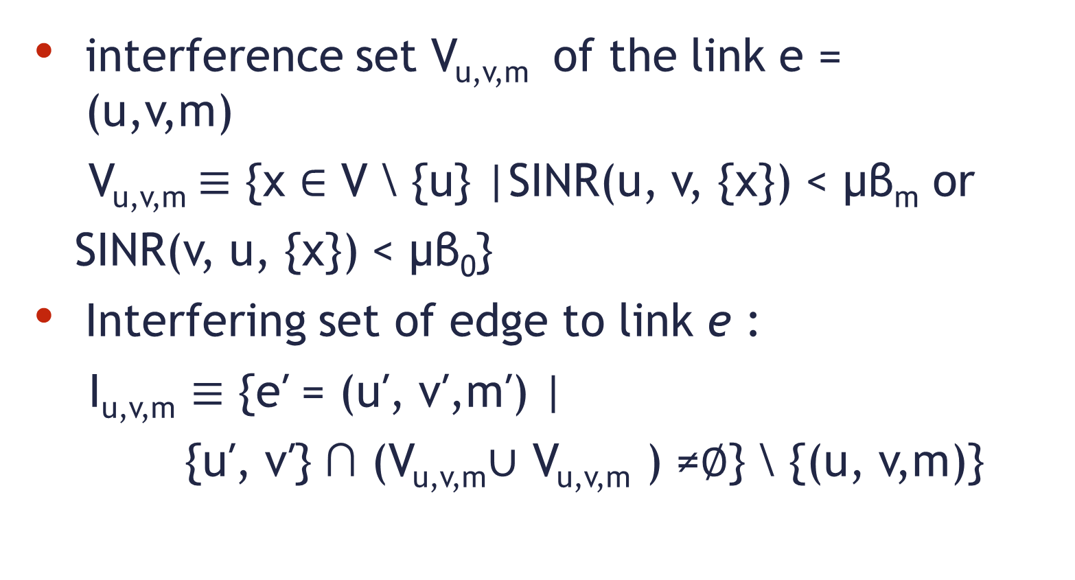
WiFi adjusted interference model
interference set V_{u,v,m} of the link e = (u,v,m)
V_{u,v,m}$≡$ {x ∈ V \ {u} |SINR(u, v, {x}) < μβ_{m} or
SINR(v, u, {x}) < μβ₀}
Interfering set of edge to link e :
I_{u,v,m} $≡$ {e′ = (u′, v′,m′) |
{u′, v′} ∩ (V_{u,v,m}∪ V_{u,v,m} ) ≠∅} \ {(u, v,m)}
40

Slide 41
Hidden node problem
A and B can communicate with N
A can’t “hear” B
B can’t hear A
A and B May
attempt to
transmit un the
same time and interfere
with each other!
N
B
A
41

Slide 42
Routing
NP Hard problem in general
Formalize constraints:
Flow in equals flow out
Radio is not used simultaneously for transmit and receive and not used in more than one channel
Flow is smaller or equal edge capacity
No conflict between transmitting nodes - by interfering edges induces by graph interference model (adjusted for WiFi- both ends transmit and multiple MCS)
42

Slide 43
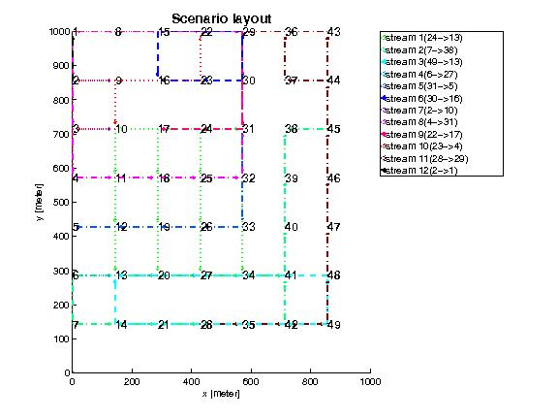
Routing result

Slide 44
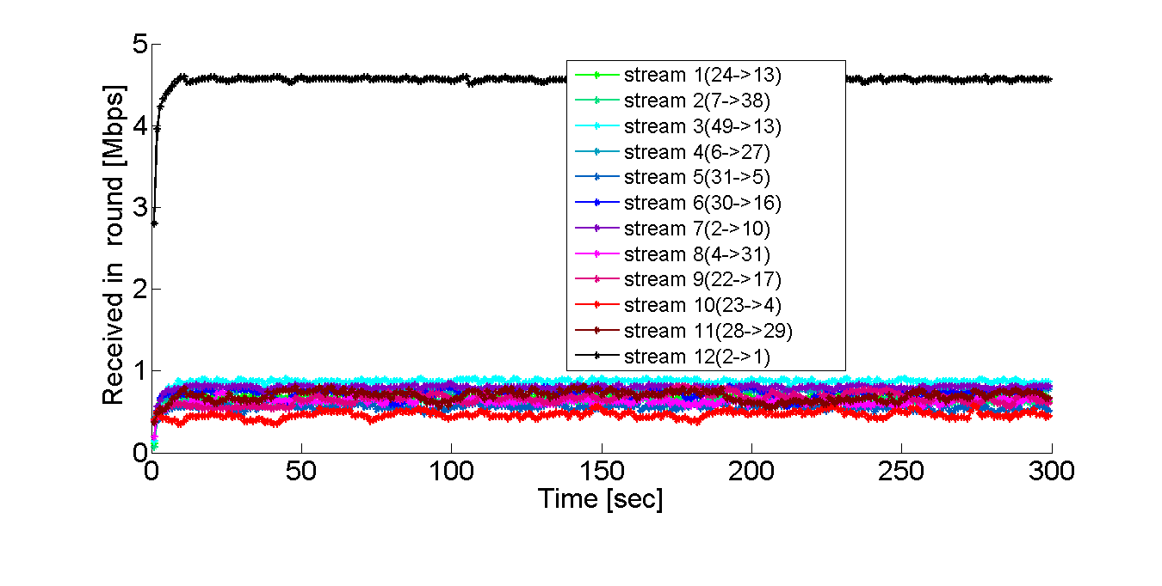
Throughput per stream
With flow control
Without flow control
May even increase ratio
44

Slide 45
End-to-end delay histogram (one stream)
With flow control
Without flow control

Slide 46
Packet-Error-Rate / Signal-to-Noise Ratio
.

Slide 47
Raw Rate vs. Actual Rate
Payload size 1KB *

