Slide 1


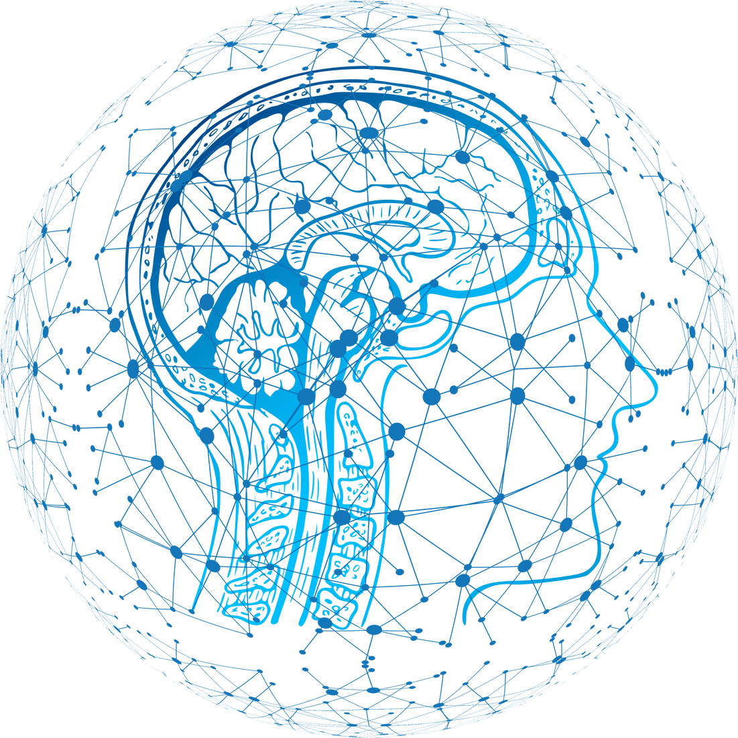
Noisier2Noise
Learning to Denoise from Unpaired Noisy Data
Samy Nehmad
Yaniv Hajaj
01

Slide 2
Introduction to Image Denoising
Introduction
Image denoising is a critical task in various fields, including medical imaging, satellite imagery, and photography. It involves removing noise from an image to reveal the true content, which is often obscured by random variations in brightness or color.
Challenges with Traditional Methods
Innovation with Noisier2Noise
Traditional denoising techniques require large datasets of paired noisy and clean images. However, obtaining clean images is often impractical, especially in real-world scenarios like space photography and medical imaging.
Noisier2Noise addresses these challenges by using only a single noisy image and a statistical noise model, eliminating the need for clean images. This method allows for effective denoising even when clean data is unavailable.
02

Slide 3
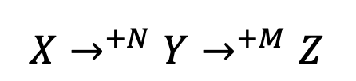
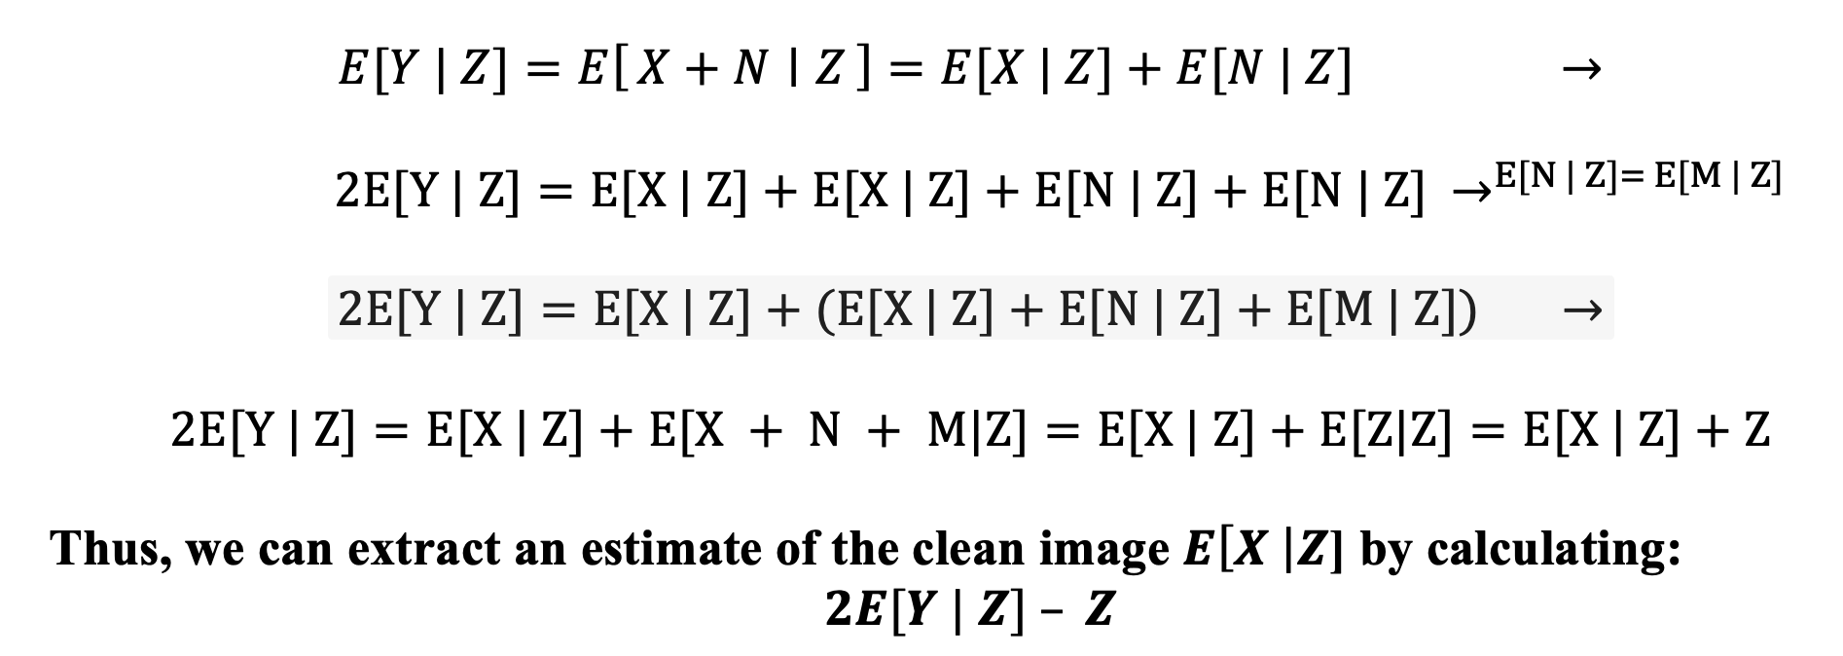
The Noisier2Noise Method
Problem Statement
Methodology
01
02
02
The Noisier2Noise method was developed to overcome the limitations of previous denoising techniques by requiring only a single noisy image and a statistical model of the noise. It is particularly useful in situations where multiple noisy images or clean images are impractical to obtain.
Noisier2Noise adds synthetic noise to an already noisy image and trains a neural network to predict the original noisy image. The network learns to distinguish between the original and synthetic noise, allowing it to reconstruct a cleaner image.
03

Slide 4
Improvements on the Method
Overlap Image Technique
We introduced an overlapping technique during testing to refine the denoising process. This technique involves generating multiple predictions of the denoised image and then aggregating these predictions using mean or median operations to produce a final result.
01
Unaugmented Noise Input
Feeding the network less noisy images during inference to improve visual quality, though this resulted in smoother but less detailed images.
At the end this approach was abandoned since it did not improved the output.
04

Slide 5
Experiments and Results
We experimented with different overlap techniques to refine the denoising process:
Trimmed Mean
Mean
Median
01
02
03
We introduced a trimmed mean technique where the lowest and highest percentages of predictions are discarded before calculating the mean. This approach helps in reducing the impact of outliers and enhances the overall denoising quality.
The mean aggregation method was tested as a baseline for combining multiple predictions during overlap.
The median technique, which takes the middle value of the predictions, was also evaluated. This method provided a good balance between preserving details and reducing noise.
Unaugmented Noise Input
We also tested the impact of using unaugmented noise input during inference, where the "noisier" input was set equal to the "noisy" image (noisier = noisy). This approach aimed to reduce the effect of synthetic noise added during training, providing the network with an input closer to what it was trained on.
05

Slide 6
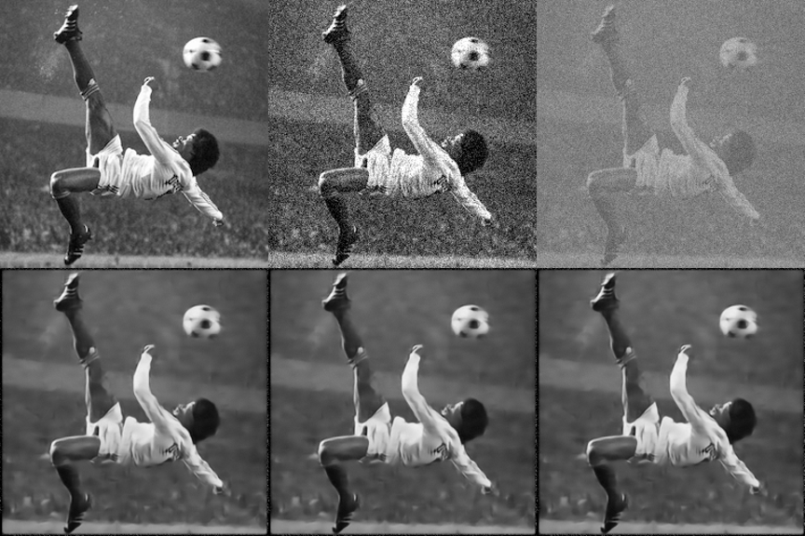
Visual Results
Comparative visual results demonstrated that Noisier2Noise, especially with the overlap technique, provided superior denoising, with clearer and more detailed images.
06

Slide 7
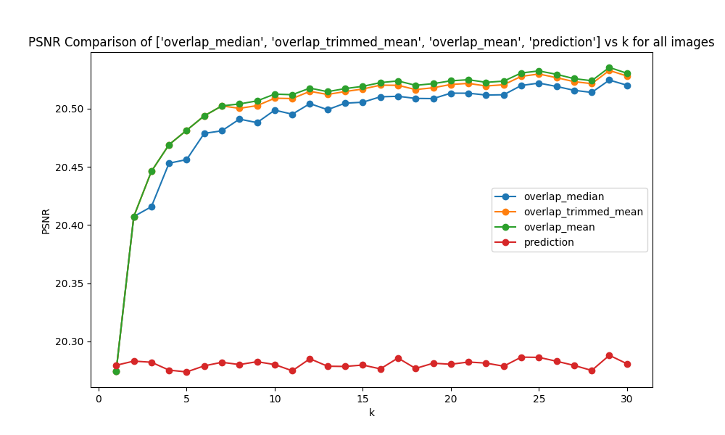
Graphs: PSNR
Performance Metrics
The performance of Noisier2Noise was evaluated using Peak Signal-to-Noise Ratio (PSNR) and Structural Similarity Index (SSIM), which are standard metrics for assessing image quality.
07

Slide 8
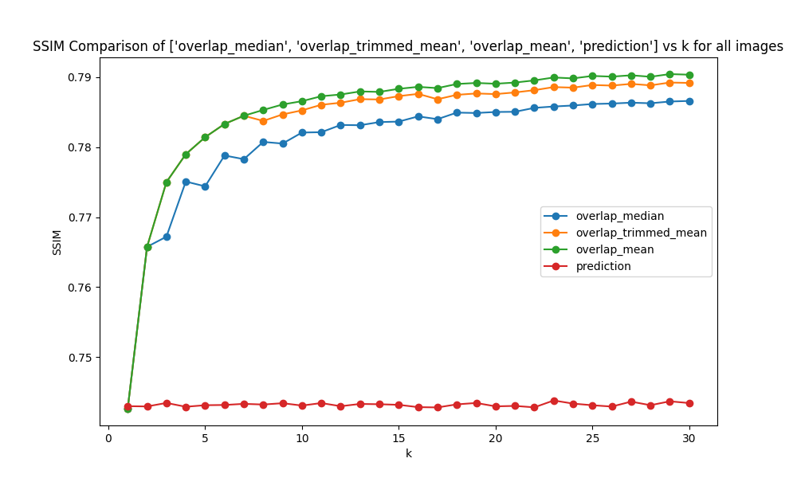
Graphs: SSIM
Performance Metrics
The performance of Noisier2Noise was evaluated using Peak Signal-to-Noise Ratio (PSNR) and Structural Similarity Index (SSIM), which are standard metrics for assessing image quality.
08

Slide 9
Conclusions
Summary of Findings
Limitations
01
02
Noisier2Noise successfully denoises images using only a single noisy realization and a statistical noise model. It eliminates the need for clean training data, making it applicable to a wide range of real-world scenarios.
The method's effectiveness depends heavily on the accuracy of the noise model used during training. Additionally, the computational complexity of the overlapping technique may limit its scalability.
Future Work
Final Thoughts
03
02
To improve Noisier2Noise, future research could explore adaptive noise modeling, more efficient processing techniques, and enhanced generalization to diverse noise types.
Noisier2Noise represents a significant advancement in image denoising, particularly in situations where clean data is unavailable. While there are challenges to address, such as noise model dependency and computational efficiency, the method shows great promise for practical applications.
09

