Slide 1


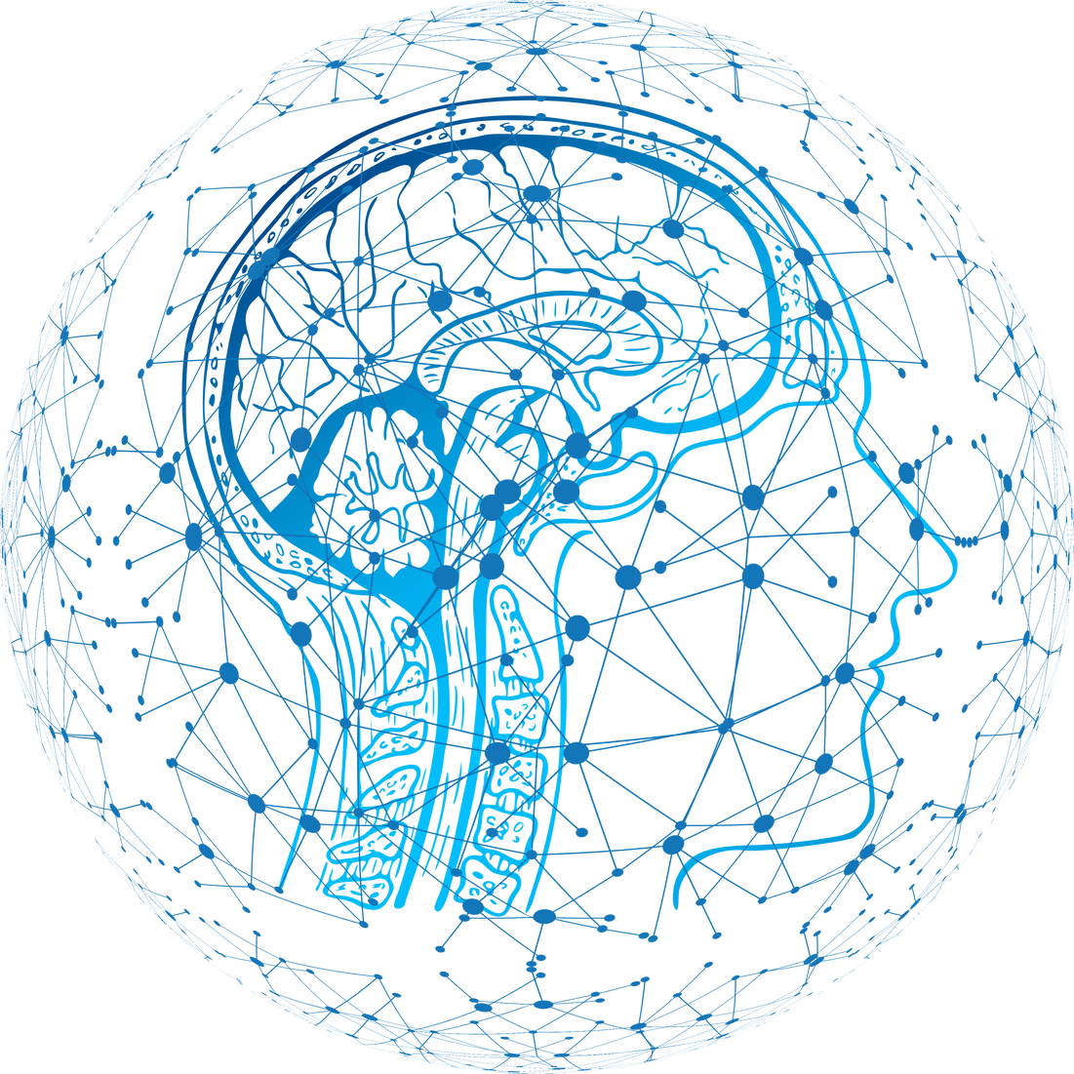
Noisier2Noise
Learning to Denoise from Unpaired Noisy Data
Samy Nehmad
Yaniv Hajaj
01

Slide 2
Introduction to Image Denoising
Introduction
Image denoising is an important process used in various fields such as healthcare, space exploration, and photography. Its main goal is to clarify images by removing 'noise’ (random variations in brightness or color that distort the true content).
Challenges with Traditional Methods
Innovation with Noise2Noise
Innovation with Noisier2Noise
Traditional denoising techniques require large datasets of paired noisy and clean images. However, obtaining clean images is often impractical, especially in real-world scenarios like space photography and medical imaging.
Noise2Noise improved image denoising by using two noisy versions of the same image instead of clean data. This method effectively trains denoising networks without clean images, but it requires two noisy captures, which isn’t always possible.
Noisier2Noise addresses these challenges by using only a single noisy image and a statistical noise model, eliminating the need for clean images. This method allows for effective denoising even when clean data is unavailable.
02

Slide 3
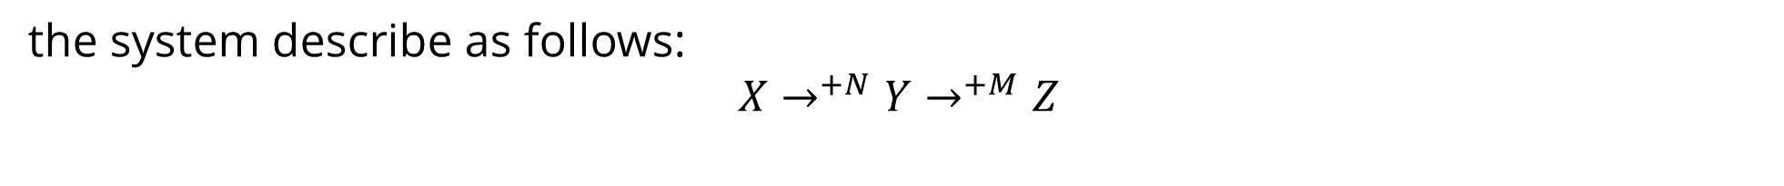
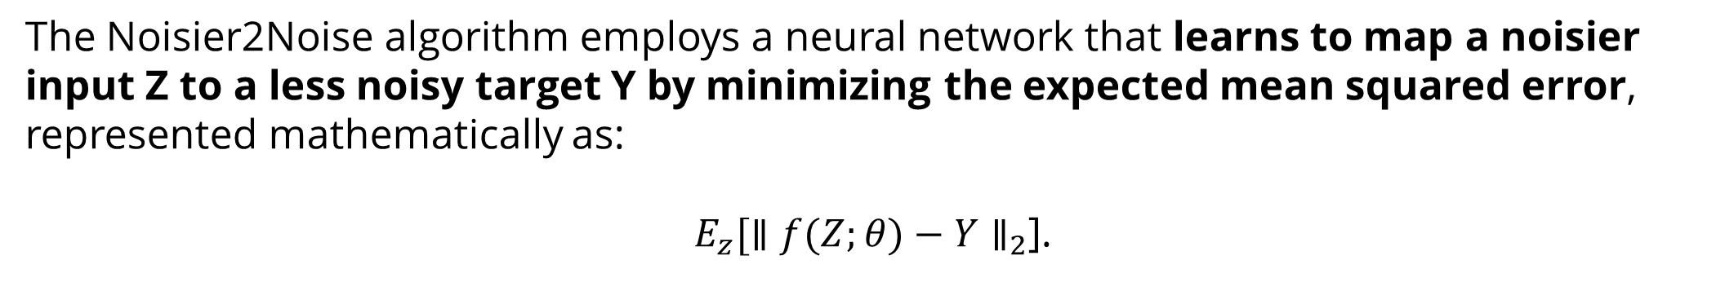
The Noisier2Noise Method
Problem Statement
Methodology
01
02
The Noisier2Noise method was developed to overcome the limitations of previous denoising techniques by requiring only a single noisy image and a statistical model of the noise. It is particularly useful in situations where multiple noisy images or clean images are impractical to obtain.
Noisier2Noise adds synthetic noise to an already noisy image and trains a neural network to predict the original noisy image. The network learns to distinguish between the original and synthetic noise, allowing it to reconstruct a cleaner image.
02
the system describe as follows:
$$X→^{+N}Y→^{+M}Z$$
The Noisier2Noise algorithm employs a neural network that learns to map a noisier input Z to a less noisy target Y by minimizing the expected mean squared error, represented mathematically as:
${E_{z}[∥f(Z;θ)−Y∥}_{2}$].
Given that the network never sees 𝑁 or 𝑀 in isolation, the ideal approach of simply subtracting 𝑀 from 𝑍 isn't feasible.
03

Slide 4
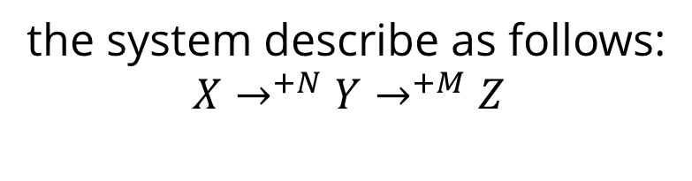
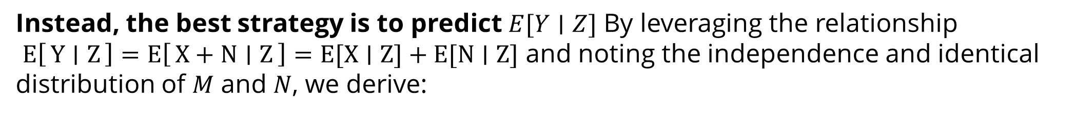
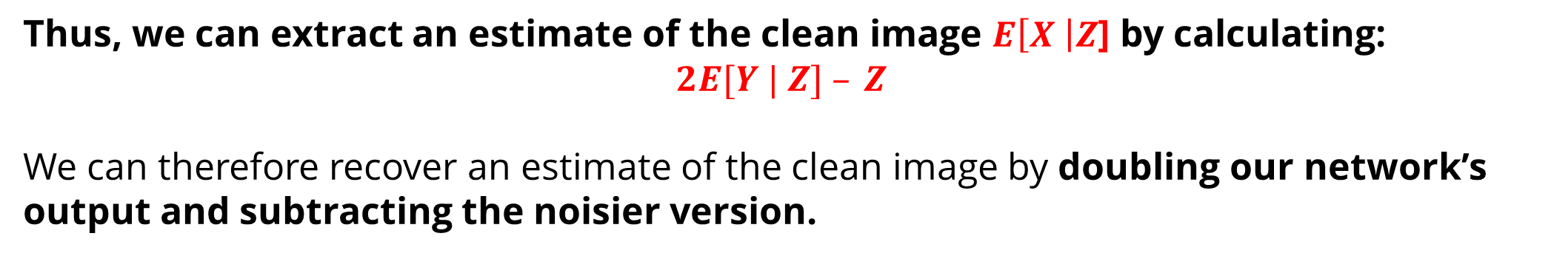
the system describe as follows:
$$X→^{+N}Y→^{+M}Z$$
The Noisier2Noise Method
Given that the network never sees 𝑁 or 𝑀 in isolation, the ideal approach of simply subtracting 𝑀 from 𝑍 isn't feasible.
Instead, the best strategy is to predict $E[Y∣Z]$ By leveraging the relationship $E\left[Y ∣ Z\right]=E\left[X+N ∣ Z\right]=E[X∣Z]+E[N∣Z]$ and noting the independence and identical distribution of 𝑀 and 𝑁, we derive:
$$E[Y | Z]=E\left[X+N ∣ Z\right]=E[X | Z]+E[N | Z] →^{M,N ∼ A iid }$$
$$2E[Y | Z]=E[X | Z]+E[X | Z]+E[N | Z]+E[N | Z]{ →}^{E[N | Z]= E[M | Z] }$$
$$2E[Y | Z]=E[X | Z]+(E[X | Z]+E[N | Z]+E[M | Z]) →$$
$$2E[Y | Z]=E[X | Z]+E[X + N + M|Z]=E[X | Z]+E[Z|Z]=E[X | Z]+Z$$
Thus, we can extract an estimate of the clean image $E\left[X \right|Z$] by calculating:
$$2E[Y | Z] – Z$$
We can therefore recover an estimate of the clean image by doubling our network’s output and subtracting the noisier version.
03

Slide 5
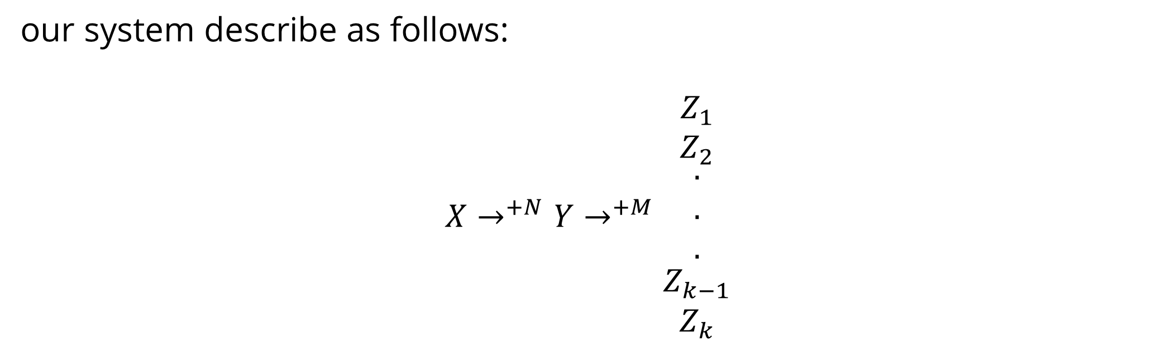
Improvements on the Method
Overlap Image Technique
We introduced an overlapping technique during testing to improve the denoising process. This technique involves generating multiple predictions of the denoised image and then aggregating these predictions using mean or median operations to produce a final result.
01
our system describe as follows:
$$X→^{+N}Y→^{+M}\begin{matrix}Z_{1} \\ \begin{matrix}Z_{2} \\ \begin{matrix}. \\ . \\ .\end{matrix} \\ Z_{k−1}\end{matrix} \\ Z_{k}\end{matrix}$$
04

Slide 6
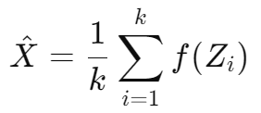


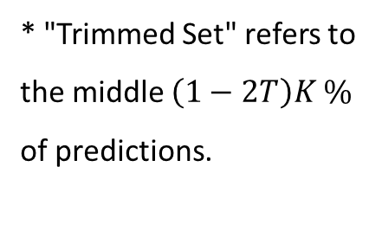
Our experiments and Results
We experimented with different overlap techniques to refine the denoising process:
Mean
Median
Trimmed Mean
01
02
03
The mean aggregation method was tested as a baseline for combining multiple predictions during overlap.
The median technique, which takes the middle value of the predictions, was also evaluated. This method provided a good balance between preserving details and reducing noise.
The trimmed mean technique aims to enhance denoising quality by discarding the highest and lowest predictions before averaging, minimizing the impact of extreme values.
* "Trimmed Set" refers to the middle $\left(1−2T\right)K \%$ of predictions.
05

Slide 7
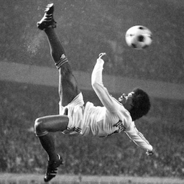

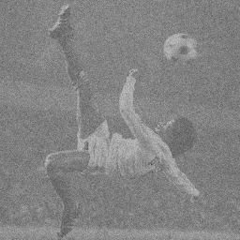


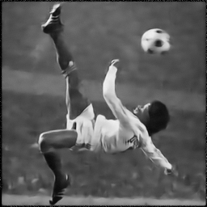






Our experiments and Results
We experimented with different overlap techniques to refine the denoising process (Gaussian):
$$X$$
$$Y$$
$$Z$$
$$→^{+N}$$
$$→^{+M}$$
01
02
03
prediction k=1
Mean k=30
Median k=30
Trimmed Mean k=30
05

Slide 8
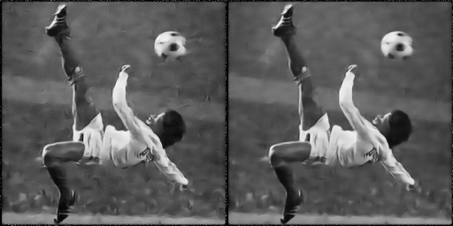

Visual Results
Comparative visual results demonstrated that Noisier2Noise, especially with the overlap technique, provided superior denoising, with clearer and more detailed images.
prediction k=1
Mean k=30
prediction k=1 75X75 pixels
Mean k=30 75X75 pixels
06

Slide 9

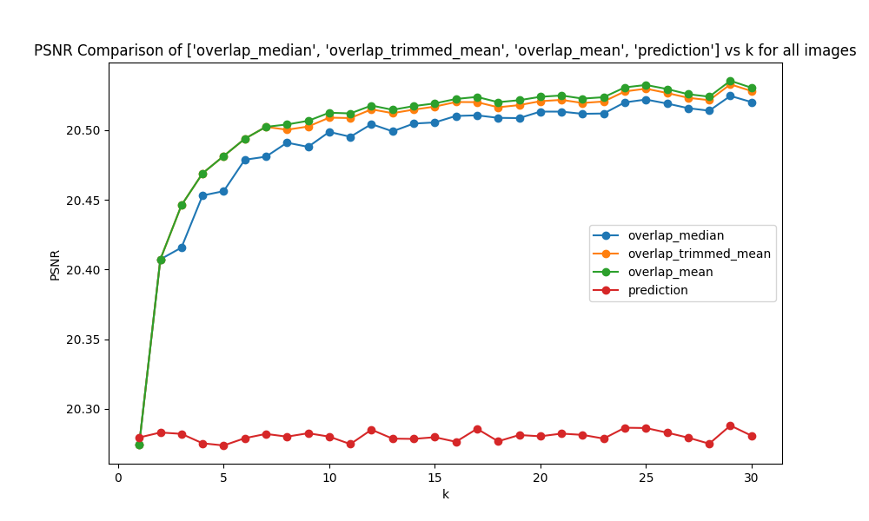
Graphs: PSNR
Performance Metrics
PSNR ( Peak signal-to-noise ratio ) A higher PSNR value suggests a lower level of error and noise, indicating better image quality. High PSNR values are generally associated with images that preserve fine details closely resembling the original.
* MAX is the maximum possible pixel value of the image (255 for 8-bit grayscale image).
* MSE is the mean squared error between the original and the processed image.
07

Slide 10
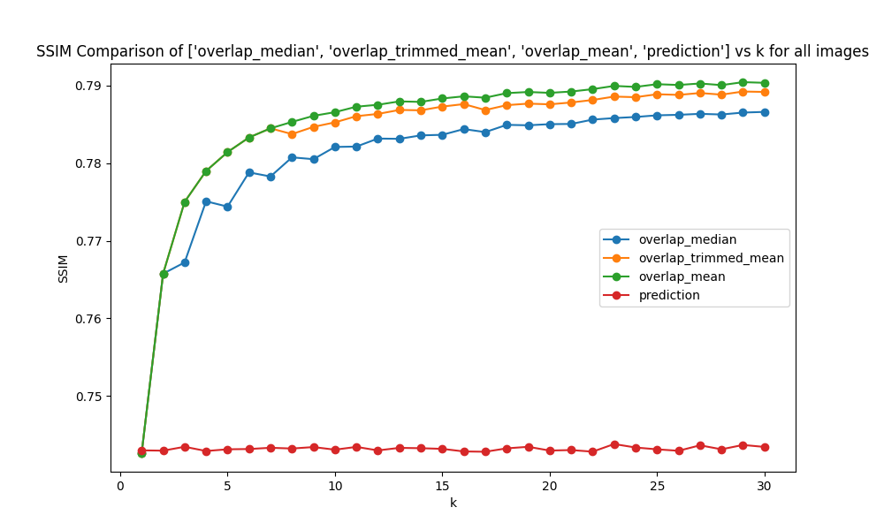
Graphs: SSIM
Performance Metrics
SSIM ( structural similarity index measure ) measures the visual impact of an image's characteristics: brightness, contrast, and structure. It compares local patterns of pixel intensities that have been adjusted for brightness and contrast. SSIM values range between -1 and 1, where 1 indicates perfect similarity. A high SSIM value suggests that the structure, brightness, and contrast of the image are well-preserved compared to the original. This metric strongly correlates with visual and perceptual quality as experienced by human observers.
08

Slide 11
Conclusions
Summary of Findings
Limitations
01
02
Noisier2Noise successfully denoises images using only a single noisy realization and a statistical noise model. It eliminates the need for clean training data, making it suitable to a wide range of real-world scenarios.
The method's effectiveness depends heavily on the accuracy of the noise model used during training. Additionally, the computational complexity of the overlapping technique may limit its ability to handle larger-scale datasets.
Future Work
Final Thoughts
03
04
To improve Noisier2Noise, future research could explore adaptive noise modeling, more efficient processing techniques, and improved handling of different noise types.
Noisier2Noise represents a significant advancement in image denoising, particularly in situations where clean data is unavailable. While there are challenges to address, such as noise model dependency and computational efficiency, the method shows great promise for practical applications.
09

