Slide 1
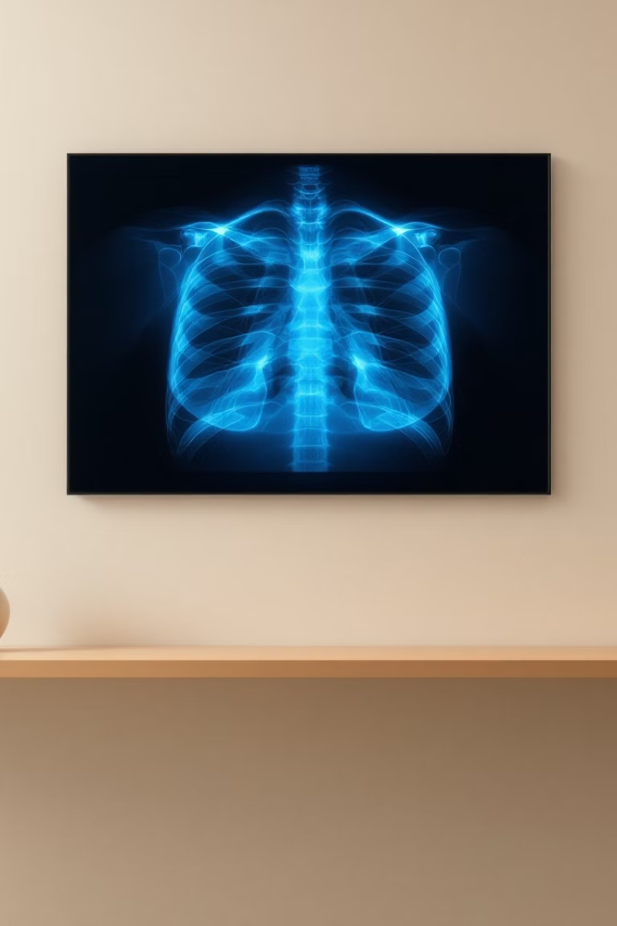
AutoImpress: Medical Report Summarization with LLMs
Automating impression generation from radiology reports using fine-tuned medical language models
Team members:
Yaniv Grosberg , ID- 315638221
Netanel Ohev Shalom, ID-208686832
Aviel Shmuel, ID- 206647968
GitHub Repository: https://github.com/Yanivgg/AutoImpress

Slide 2
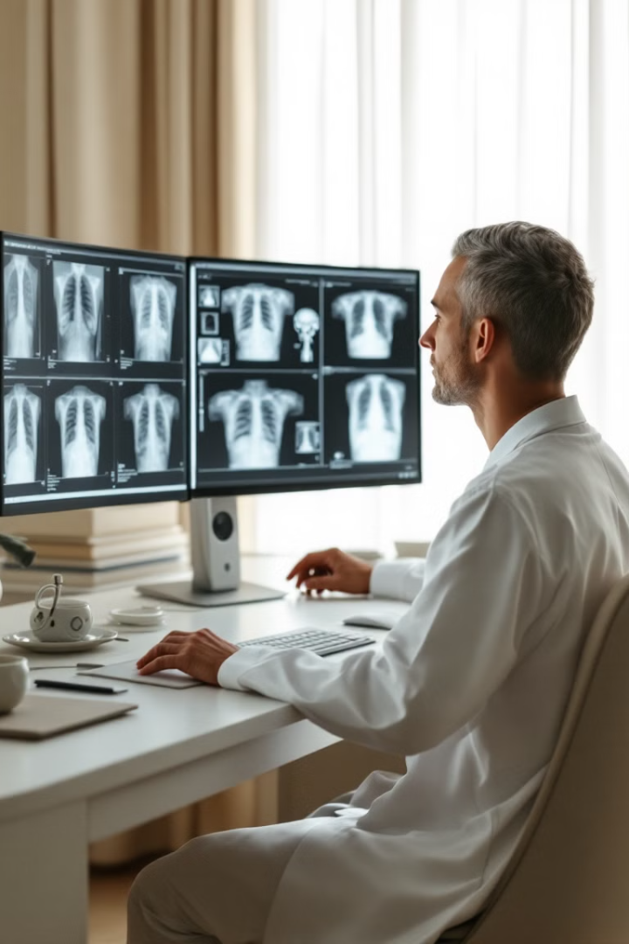




Project Overview
Problem
Radiologists write structured descriptions + final "Impression"
Challenge
Requires medical reasoning and domain expertise
Solution
Automate with fine-tuned medical LLMs
Benefits
Reduce workload, support junior clinicians

Slide 3
Data & Task Overview
NLP Task
Input
Dataset
Text-to-text generation
Findings
IU-XRay Dataset
Abstractive summarization
Indication
3,851 chest X-ray reports
Comparison
Open-access
MeSH terms
Goal
Automatically generate the impression section of a radiology report based on the findings,
indication, comparison, and other structured fields.

Slide 4
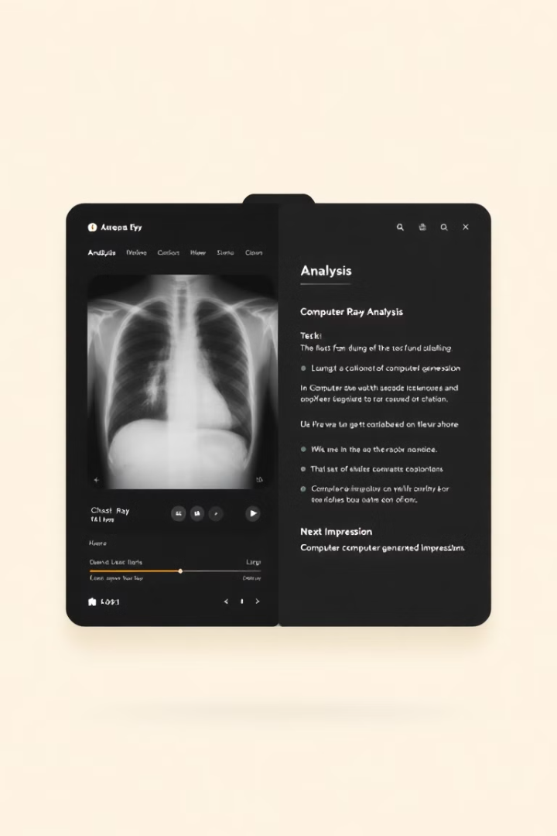
Real Examples
Example #1
Example #2
Input: "Lungs clear. No effusion."
Input: "Right lower lobe opacity with air bronchogram."
Indication: "Chest pain"
Output: "Findings consistent with right lower lobe pneumonia."
Output: "No acute cardiopulmonary abnormality."
Key Patterns
Condenses detailed findings
Adds clinical interpretation
Uses domain-specific phrasing

Slide 5
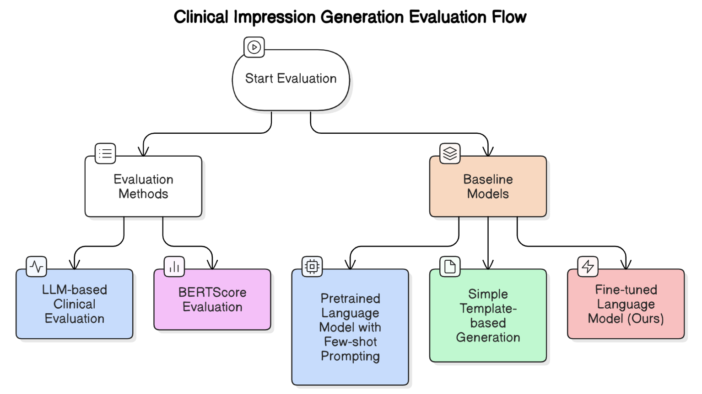
Evaluation Plan
LLM-based Clinical Evaluation A language model will assess whether the generated impression is clinically equivalent to the original.
BERTScore Measures semantic similarity between the generated and reference impressions using contextual embeddings.
Baseline Models
Pretrained Language Model with Few-shot Prompting A general-purpose LLM (e.g., T5) used without fine-tuning, guided by a small number of in-context examples.
Simple Template-based Generation Impression generated using predefined rules or patterns based on common radiology phrasing.
Fine-tuned Language Model (Ours) A domain-adapted LLM trained to generate impressions from structured inputs.

