Slide 1

ExplainMed: Medical Text Simplification Using NLP
Bridging the gap between complex medical terminology and patient comprehension through advanced natural language processing.
Team members:
Yaniv Grosberg , ID- 315638221
Netanel Ohev Shalom, ID- 208686832
Aviel Shmuel, ID- 206647968
GitHub Repository: https://github.com/Yanivgg/ExplainMed

Slide 2

Problem & Data Overview
The Challenge
Data Sources
Expected Output
Medical documents and articles contain complex terminology that patients and non-experts readers struggle to understand.
Annotated corpora: CLEF eHealth, PubMed abstracts, Kaggle NER datasets
JSON/EXCEL format with extracted term, classification type, and simplified explanation.
Medical ontologies: UMLS, SNOMED, Medline for grounding explanations.
Our NLP solution extracts medical terms, classifies them, and generates simple explanations.
LLM-generated synthetic explanations

Slide 3
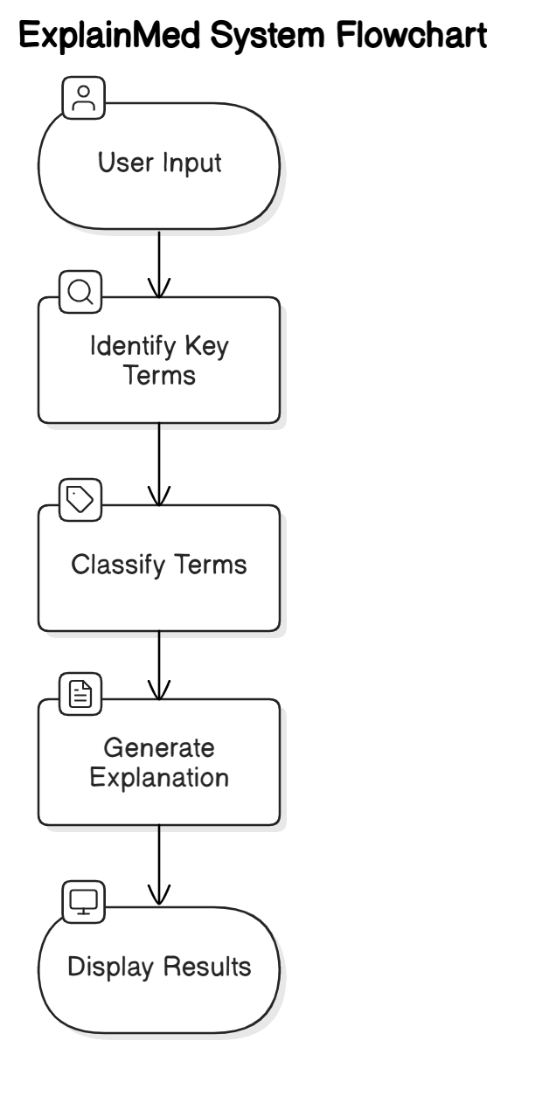
System Example
1.Input (Medical sentence):
"The patient presented elevated troponin levels indicating myocardial damage."
Output (JSON format):
{
"term": "Troponin",
"type": "Biomarker",
"explanation": "A protein found in the heart muscle, often used to detect heart attacks."
}
2.Input (Medical sentence):
"The doctor prescribed metformin to manage the patient's type 2 diabetes."
Output (JSON format):
{
"term": "Metformin",
"type": "Drug",
"explanation": "An oral medication used to lower blood sugar levels in people with type 2 diabetes."
}

Slide 4

Evaluation
Metrics
• NER: Precision, Recall, F1 for term extraction.
• Explanation: ROUGE score, human clarity assessment.
Baseline
spaCy NER + dictionary-based explanation lookup.
Novelty
• Combines structured entity extraction with layman explanation.
• JSON format output suitable for apps or patient portals.
• Focus on making scientific/clinical documents accessible to non-experts.

