Slide 1
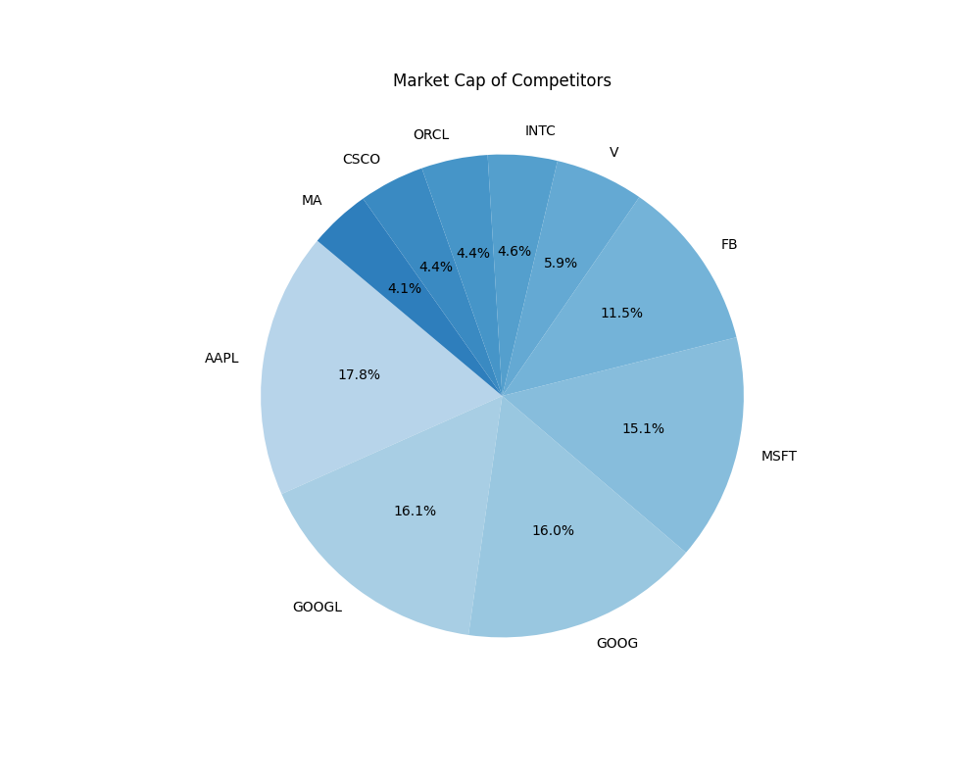
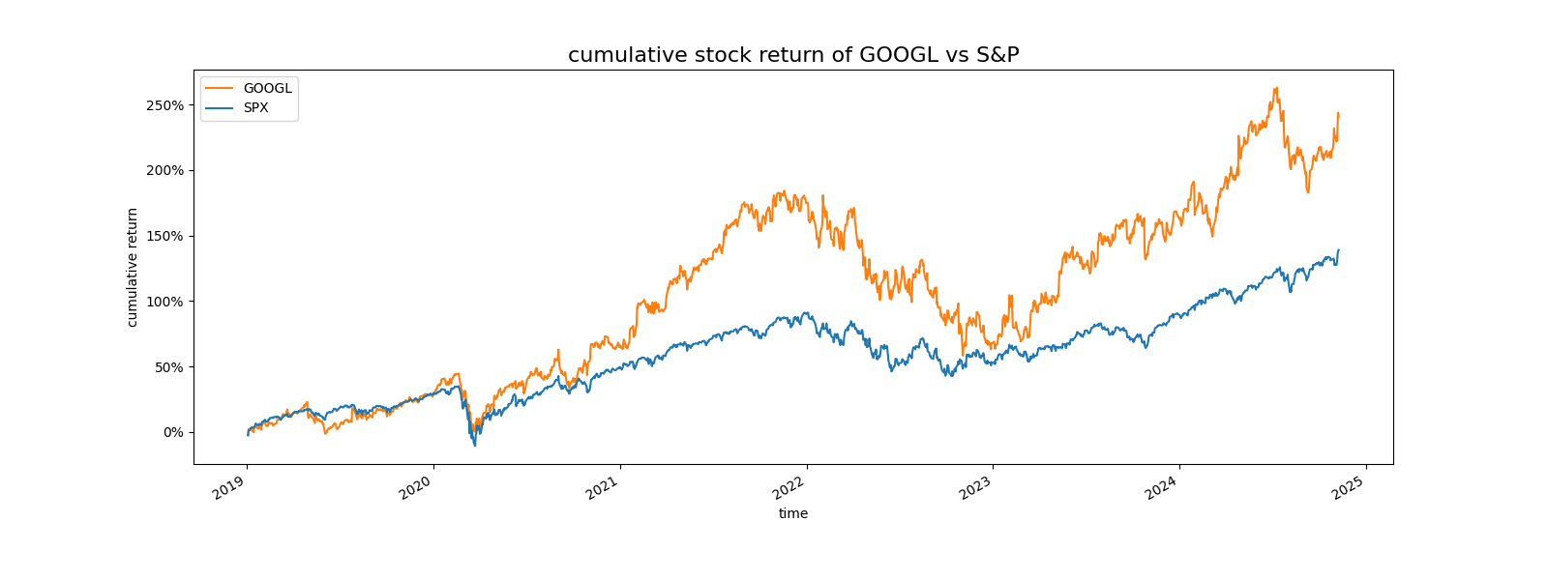
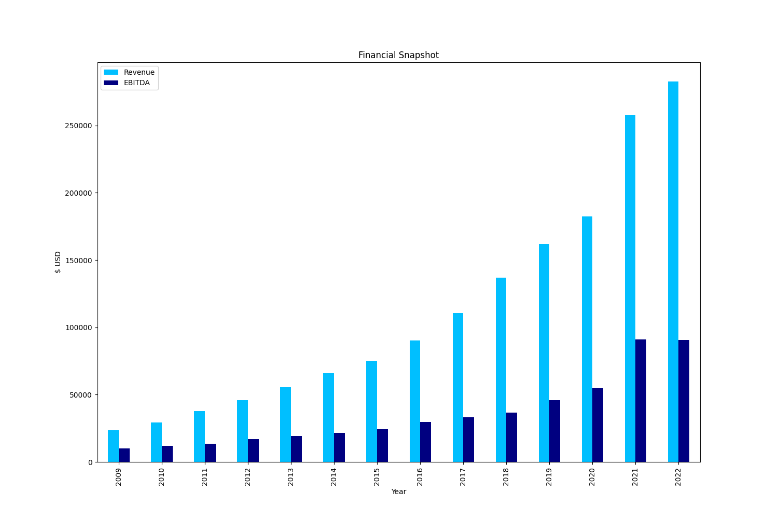
Financials
Symbol | Market Cap | Price/Earnings | Earnings/Share | Price/Sales
AAPL | $809.51BB | 16.86 | 9.2 | 3.46
GOOGL | $733.82BB | 31.48 | 22.27 | 6.8
GOOG | $728.54BB | 40.29 | 22.27 | 6.77
MSFT | $689.98BB | 25.76 | 2.97 | 7.11
FB | $523.42BB | 27.9 | 5.39 | 13.24
V | $270.04BB | 32.72 | 2.8 | 14.43
INTC | $211.54BB | 12.32 | 1.98 | 3.35
ORCL | $202.3BB | 18.81 | 2.2 | 5.26
CSCO | $199.43BB | 17.87 | 1.91 | 5.48
MA | $187.1BB | 34.99 | 3.65 | 15.02

