Slide 1
Overview
- **Foundation**: Google was founded on September 4, 1998, by Larry Page and Sergey Brin at Stanford University.
- **Key Products**: Google Search, YouTube, Google Assistant, Google Cloud, Android, Google Chrome, Gmail, Google Maps, Google Photos, Google Play.
- **Monetization Model**: Primarily through digital advertising (Google Search, YouTube Ads, Google Network), Google Cloud services, Google Play revenue, and hardware sales.
- **Target Customers**: Individual users, businesses, advertisers, and content creators.
- **Ownership**: Owned by Alphabet Inc., with Sundar Pichai as CEO of both Alphabet Inc. and Google.
- **Marquee Customers**: Includes Procter & Gamble, Home Depot, and National Geographic.
- **Mission**: To organize the world's information and make it universally accessible and useful.

Slide 2
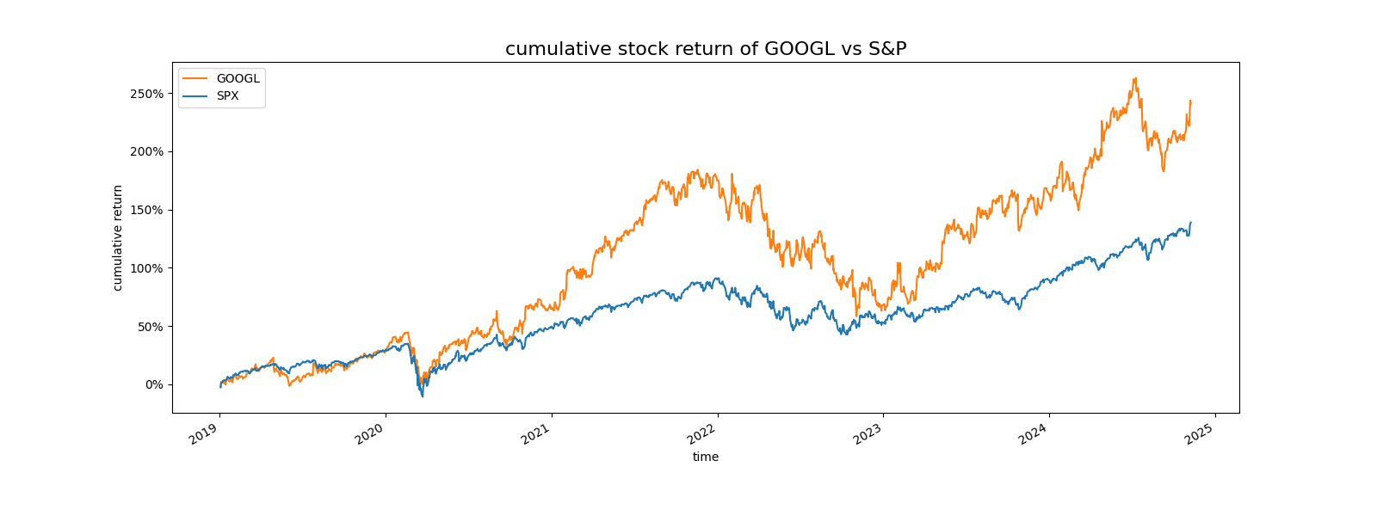
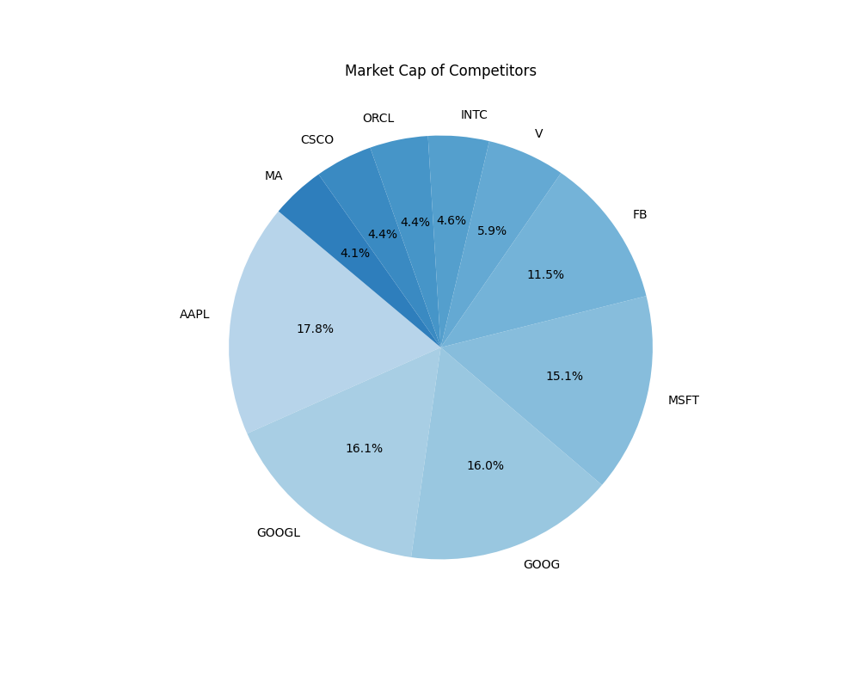
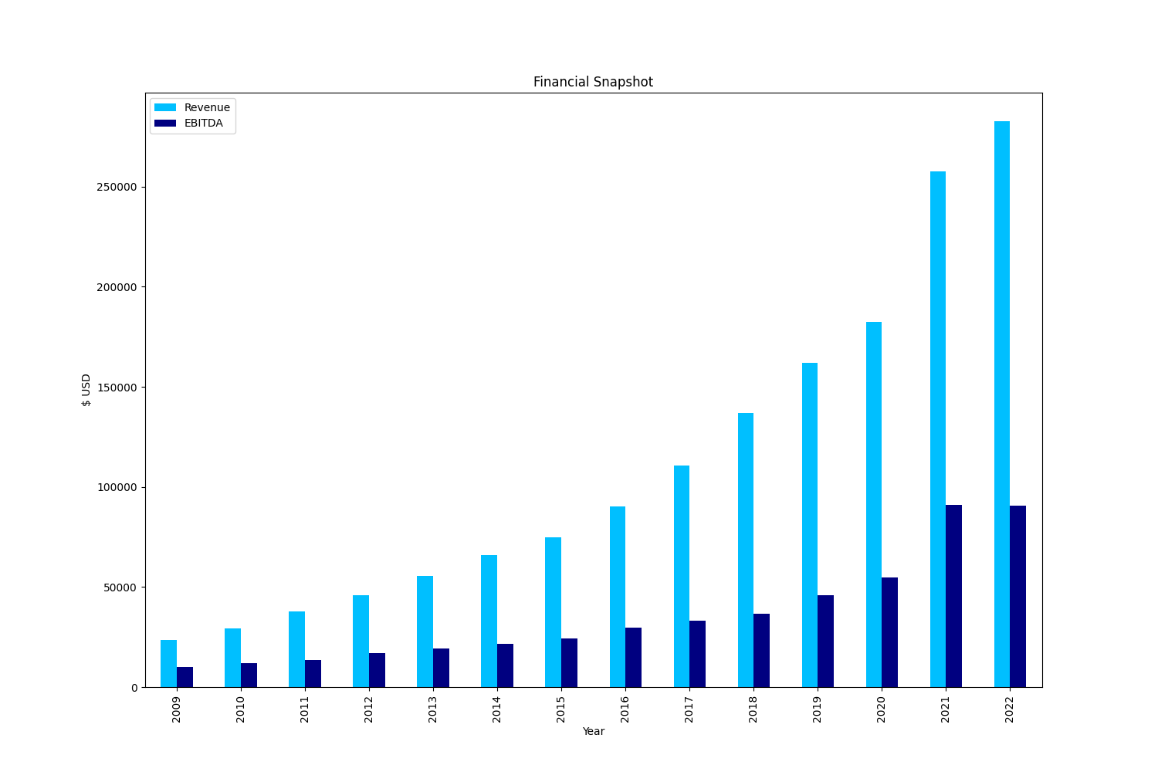
Financials
Symbol | Market Cap | Price/Earnings | Earnings/Share | Price/Sales
AAPL | $809.51BB | 16.86 | 9.2 | 3.46
GOOGL | $733.82BB | 31.48 | 22.27 | 6.8
GOOG | $728.54BB | 40.29 | 22.27 | 6.77
MSFT | $689.98BB | 25.76 | 2.97 | 7.11
FB | $523.42BB | 27.9 | 5.39 | 13.24
V | $270.04BB | 32.72 | 2.8 | 14.43
INTC | $211.54BB | 12.32 | 1.98 | 3.35
ORCL | $202.3BB | 18.81 | 2.2 | 5.26
CSCO | $199.43BB | 17.87 | 1.91 | 5.48
MA | $187.1BB | 34.99 | 3.65 | 15.02

Slide 3
Geographic Mix
- **Global Presence:** Alphabet Inc. has key physical locations in North America, Europe, Asia-Pacific, Latin America, and Africa.
- **North America:** Headquarters in Mountain View, CA, with offices in New York, Austin, Chicago, Boulder, Kirkland, Toronto, Waterloo, and Montreal.
- **Europe:** Offices in London, Dublin, Berlin, Hamburg, Paris, and Amsterdam.
- **Asia-Pacific:** Offices in Bangalore, Hyderabad, Singapore, Tokyo, Shanghai, Sydney, and Melbourne.
- **Latin America & Africa:** Offices in São Paulo, Nairobi, and Johannesburg.
- **Revenue Visualization:** Charts depicting revenue distribution among Google Services, Google Cloud, and Other Bets.
- **Recent Developments:** New cloud partnerships and expanded YouTube subscription services to enhance AI, machine learning, and premium content offerings.

Slide 4
Management
- **Sundar Pichai**: CEO and Director, oversees operations, strategy, innovation, and growth.
- **Ruth M. Porat**: President, Chief Investment Officer, and CFO, manages financial planning, risk management, and investments.
- **Amie Thuener O'Toole**: VP, Corporate Controller, and Principal Accounting Officer, handles corporate accounting and financial reporting.
- **John L. Hennessy**: Chair of the Board, leads board meetings and governance duties.
- **Larry Page & Sergey Brin**: Co-Founders and Directors, provide technical expertise and visionary leadership.
- **Frances H. Arnold, R. Martin Chávez, L. John Doerr, Roger W. Ferguson Jr., K. Ram Shriram, Robin L. Washington**: Directors with diverse expertise in science, finance, technology, economics, venture capital, and corporate governance.
- **Leadership Stability**: No pending changes in leadership, indicating confidence and consistency in current direction.

Slide 5
Recent News
- **Big Tech CEOs' Reactions**: CEOs, including Google's, commented on recent election results.
- **Google's Innovations**: Significant advancements in Google Search, YouTube, and Google Maps.
- **Legal Issues**: Ongoing antitrust investigations in Europe and the UK.
- **Stock Price Growth**: From $27.73 in Jan 2014 to $180.36 in Nov 2024, showing substantial growth.
- **Profitability**: Strong financial performance with notable increases in revenue, operating income, and net income from 2022 to 2023.
- **Market Trends**: Shift towards digital platforms driving revenue growth, though at a moderating rate.
- **Business Segmentation**: Diversified into Google Services, Google Cloud, and Other Bets, each contributing to overall performance.

Slide 6
M&A Profile
- **Completed Acquisitions:**
- Fitbit Inc. for $2.1 billion (January 2021)
- Mandiant Inc. for $5.4 billion (September 2022)
- **Recent Announcements:**
- No significant new acquisition announcements in 2023
- **Terminated Deals:**
- Fitbit acquisition faced regulatory scrutiny but was completed
- **Divestitures:**
- No clear indications of major divisions for sale
- **Acquisition Goals:**
- Focus on cloud computing, AI, cybersecurity, and wearables
- **Financial Performance:**
- 2023 Revenue: $282.8 billion, Net Income: $76.0 billion
- 2024 Projected Revenue: $304.5 billion, Net Income: $82.3 billion
- **Strategic Focus:**
- Enhancing technological capabilities in key sectors

Slide 7
Miscellanea
- **Search Engines and Online Advertising**: Google faces competition from Bing (6.7% market share), Yahoo (declining share), and Baidu (70% in China).
- **Cloud Computing Services**: Competitors include AWS (33% market share, $80.1B revenue), Microsoft Azure (22% market share, $55B revenue), and IBM Cloud ($25B revenue).
- **Video Streaming**: Key competitors are Netflix (246M subscribers, $40B revenue) and Amazon Prime Video (part of 200M Prime memberships, significant revenue impact).
- **Global Ad Spending Market**: Digital advertising market size is $679B, with Google holding a 29% share.
- **Cloud Computing Market**: Public cloud services market size is $591B, with Google Cloud holding an 8.5% share.
- **Search Engine Market**: Global search spending market size is $144B, with Google commanding 92% of the market.
- **News Highlight**: Nvidia surpasses $3.6 trillion market value, showcasing its competitive strength in the tech sector.

