Slide 1



A Decidable Logic for Tree Data-Structures with Measurements
Xiaokang Qiu and Yanjun Wang
Purdue University
January 24, 2019

Slide 2



Reasoning about trees
Program Verification
Compiler Optimization
Web Browsers
key
prt
sz
ht
key
prt
sz
ht
key
prt
sz
ht
key
prt
sz
ht
key
prt
sz
ht
key
prt
sz
ht
key
prt
sz
ht
key
prt
sz
ht
key
prt
sz
ht
key
prt
sz
ht
key
prt
sz
ht
key
prt
sz
ht
Notes:
Logical reasoning about tree data structures is needed in many scenarios. For example, it can be used to verify the correctness of tree-manipulating programs. Reasoning about operations over abstract syntax tree is also very helpful during compiler optimization. Also, tree traversals are pretty common in document rendering and webpage layout engines.

Slide 3
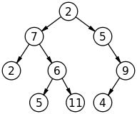
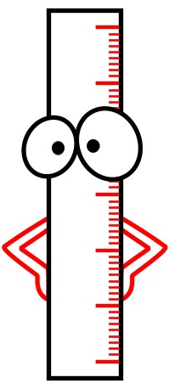

Measurements for Trees
Height
Size
Black Height for Red-Black Trees
etc.
Optimization
Notes:
In this paper, we focus on reasoning about an important property of trees, namely, measurements of trees, such as height, size or black-height for red-black trees etc. Reasoning about measurements of trees are very desirable. For example, one may try to make sure that a compile-time optimizer always reduce s the size of the program in terms of the number of AST nodes. Or a tree balancing routine does not increase the height of the tree.
A compile-time optimizer always reduces the size of the program
A tree balancing routine does not increase the height of the tree

Slide 4

Challenges
Aggregate functions determined by the whole tree
Tangled with data properties (e.g., sortedness)
and shape properties (e.g., balancedness)
“An AVL tree is a self-balancing binary search tree…In an AVL tree, the heights of the two child subtrees of any node differ by at most one…”
Strand [POPL’11, SAS’11] decidable but cannot describe this
Dryad [POPL’12, PLDI’13, PLDI’14, OOPSLA’17] can but undecidable
Notes:
The main challenge of reasoning about measurements is that measurements are aggregate functions which are determined by the whole tree. Thinking about the size of a tree, it can not be determined unless we go through every node in the tree counting the numbers. What makes things more challenging is that measurements are always tangled with data properties, like sortedness and shape properties, such as balancedness. For example, AVL tree is a balanced binary search tree. Keys stored in AVL tree is sorted and the height difference is at most 1 between every two subtrees that share same parent. Since reasoning about AVL tree often involves properties of data, shape and measurement, it’s hard to handle AVL tree in a decidable fashion.
Aggregate functions : counting numbers of the whole tree
For example, AVL tree is a binary search tree that is balanced. It requires that keys in the tree are sorted. And for each node, the absolute height between two subtrees is at most 1.
AVL tree has never been handled by a decidable logic.

Slide 5
Our Work: Dryad_{dec}
A decidable logic that can solve a wide variety of problems requiring flexible combination of measure-related, data-related and shape-related properties for trees
Dryad
+ Syntactic restrictions
= Decidable Dryad_{dec}
(Refined templates for recursive definitions)
(Based on small model property)
Dryad
Dryad_{dec}
Program verification
Traversal fusion
Program synthesis
Notes:
In this paper, we present a program logic dryaddec that can solve a wide variety of problems requiring flexible combination of measure, data and shape-related properties for trees. Dryaddec is a fragment of our previous work dryad logic which is too expressive to be decidable. Based on Dryad, We carefully added several syntactic restrictions so that the satisfiability of Dryaddec is decidable. Dryaddec allows user-defined recursive functions and predicates. And it is capable of describing a variety of combined properties, including AVL trees and red-black trees and their verification conditions. We built a decision procedure for Dryaddec and solved more than 200 benchmarks that are from different applications including program verification, traversal fusion and program synthesis.
Dryad: previous work no need to mention popl
Too expressive to be decidable
The fragment we develop is decidable
Summwy for exiperiments
Build decision procedure
Solve 100+ bench

Slide 6
Dryad + Syntactic restrictions = Decidable Dryad_{dec}
Notes:
I will firstly introduce the syntax of Dryad.

Slide 7
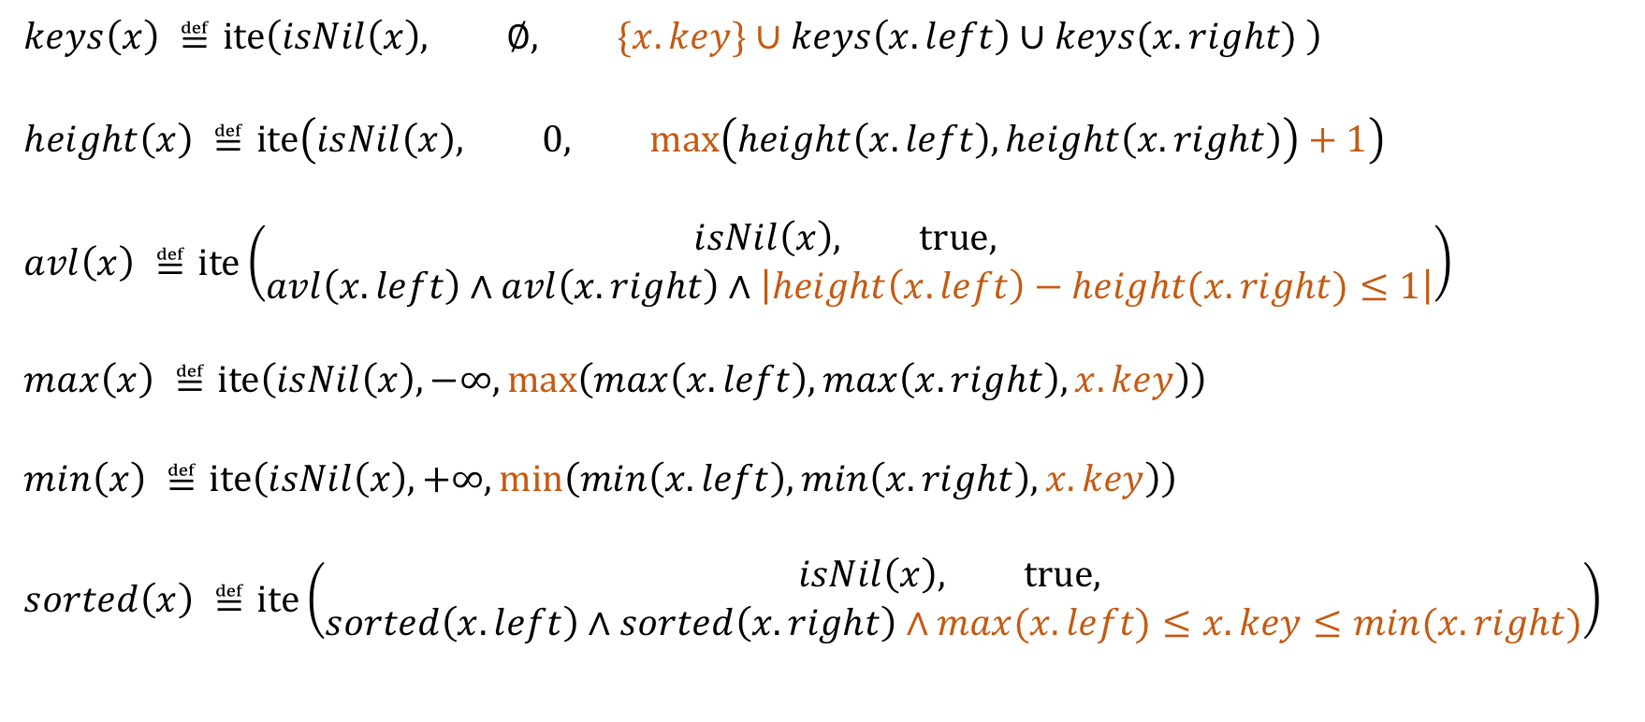
Dryad is expressive
Dryad
  $$keys\left(x\right) ≝\text{ite}\left(isNil\left(x\right), ∅, \{x.key\}∪keys\left(x.left\right)∪keys(x.right) \right)$$
  $$height\left(x\right) ≝\text{ite}\left(isNil\left(x\right), 0, \max\left(height\left(x.left\right),height\left(x.right\right)\right)+1\right)$$
  $$avl\left(x\right) ≝\text{ite}\left(\begin{aligned}isNil\left(x\right), \text{true}, \\ avl\left(x.left\right)∧avl\left(x.right\right)∧\left|height\left(x.left\right)−height(x.right)≤1\right|\end{aligned}\right)$$
  $$max\left(x\right) ≝\text{ite}\left(isNil\left(x\right), −∞,\max\left(max\left(x.left\right),max\left(x.right\right),x.key\right)\right)$$
  $$min\left(x\right) ≝\text{ite}\left(isNil\left(x\right), +∞,\min\left(min\left(x.left\right),min\left(x.right\right),x.key\right)\right)$$
  $$sorted\left(x\right) ≝\text{ite}\left(\begin{aligned}isNil\left(x\right), \text{true}, \\ sorted\left(x.left\right)∧sorted\left(x.right\right)∧max(x.left)≤x.key≤min(x.right)\end{aligned}\right)$$
Notes:
Starting from some exmaples.
Dryad is pretty expressive and expressive enough to define avl and rbt…. For example, the integer set function keys that express the set of keys stored in the tree x can be defined as a base case empty set when the tree is empty and the recursive case which is the union of the local key and keys stored in subtrees. Height of tree can also be defined with the base case being 0 and the recursive case being the maximum height of subtrees plus 1. All the other pred/func are defined also in the recursive style. As you can see, Dryad is very powerful. But unfortunately, dryad is too expressive to be decidable. To obtain decidability without sacrificing the expressivity of Dryad too much, we carefully restrict the logic to a decidable subset, namely Dryaddec. All the functions and predicates I showed here are also in dryaddec and its satisfiability is decidable.
As you can imagine the other pred/func are defined also in the recursive style. Pred can be recursively defined using defined functions. For example, avl height
Why we want to use Dryad, because Dryad is very powerful.

Slide 8
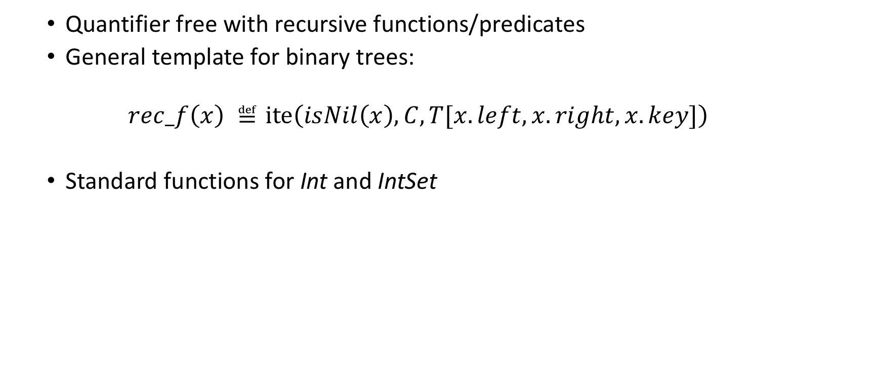
Dryad
  Quantifier free with recursive functions/predicates
  General template for binary trees:
  $$rec_f\left(x\right) ≝\text{ite}\left(isNil\left(x\right), C, T[x.left, x.right, x.key]\right)$$
  Standard functions for Int and IntSet
Base case
Recursive case
Notes:
Dryad is a quantifier free logic with user-defined recursive functions and predicates. Here is a general template for binary trees. Functions and predicates are recursively defined over a base case and a recursive case. If the tree is empty, then the base case which is a constant with respect to the function type, otherwise the function or predicate is evaluated to the recursive case. Standard integer functions such as linear integer arithmetic operations and set functions such as union, intersection and membership are also allowed.
The syntax of Dryaddec is mostly inherited from Dryad.
Function/pred recurisively defined over base case and recursive case.
If tree is empty, base case: constant, with respect to the type
Standard: int linear arithmetic set: union/intersection membership…

Slide 9
Dryad is expressive
Dryad
Dryad_{dec}
Notes:
Dryad is pretty expressive and expressive enough to define avl and rbt…. For example, the integer set function keys that express the set of keys stored in the tree x can be defined as a base case empty set when the tree is empty and the recursive case which is the union of the local key and keys stored in subtrees. Height of tree can also be defined with the base case being 0 and the recursive case being the maximum height of subtrees plus 1. All the other pred/func are defined also in the recursive style. As you can see, Dryad is very powerful. But unfortunately, dryad is too expressive to be decidable. To obtain decidability without sacrificing the expressivity of Dryad too much, we carefully restrict the logic to a decidable subset, namely Dryaddec. All the functions and predicates I showed here are also in dryaddec and its satisfiability is decidable.
As you can imagine the other pred/func are defined also in the recursive style. Pred can be recursively defined using defined functions. For example, avl height
Why we want to use Dryad, because Dryad is very powerful.

Slide 10
Dryad + Syntactic restrictions = Decidable Dryad_{dec}
Notes:
Before introducing the details of Dryaddec’s syntactic restrictions, I wanna talk about our main idea of decidability proof first.

Slide 11
Deciding Satisfiability
Small Model Property
root
root
root
l’
l
l
r
r
l’
r’
r
r
r
l
r
l
l
l
r
l
r
l
Large satisfying tree
Satisfying tailored tree
Notes:
The main idea of our decidability proof is small model property. We tried to restrict Dryad’s syntax in some way so that the fragment of Dryad satisfies the small model property. Given a formula in a logic that satisfy the small model property. If there exist a large model for the formula, in other words, there is a large enough tree satisfying the formula. We can always pick a subset of nodes in the large tree to construct a tailored tree. And the smaller tree also satisfy the formula. It is to say, small model property guarantees that if there is a satisfying model, then a satisfying model can be found within a bound. If we can not find a satisfying tree within that bound, then there is no tree in any size can satisfy the formula.
I will introduce/go through the decidability proof in details shortly…
Logic satisfying small model property
If there is a large satisfying tree. We can always pick a subset of nodes to construct a smaller tree. And the smaller tree also satisfy the formula. If there is a large model, then there is a small model.
Small model property guarantees that if there is a satisfying tree, then there is a satisfying tree up to a bound. If we can not find a satisfying tree within that bound, then there is no tree in any size can satisfy the formula.
Explicityly go through all trees within height bound
Since the bound is fixed, the formula size is fixed with respect to the bound. We can reduce Dryad_{dec} to linear arithmetic formula

Slide 12

Decision procedure
Find a height/size bound $B$ and reduce Dryad_{dec} to linear arithmetic formula
root
l’
n₁
n₂
l’
r’
$$\max\left(T\right)=>max⁡(n1, n2,n3,n4)$$
n₃
n₄
Satisfying tailored tree
Notes:
The decision procedure is quite straight forward. Firstly, we compute the height or size bound according to the formula and then explicitly go through and check every possible tree within the bound. Since the bound is fixed, the formula size is also fixed. We can reduce Dryad_{dec} to linear arithmetic formula. For example, the function max that compute the maximum key in the tree can be reduced to the arithmetic max of all the keys and has nothing to do with the tree data structure.
Explicityly go through all trees within height bound
Since the bound is fixed, the formula size is fixed with respect to the bound. We can reduce Dryad_{dec} to linear arithmetic formula
Nothing to do with the tree data structure

Slide 13
Dryad + Syntactic restrictions = Decidable Dryad_{dec}
Notes:
Remember that the idea is to restrict the logic to satisfy small model property. I will then show you how we restrict the logic.
Then I will show how we restrict the logic to satisfy the small model property.

Slide 14
Dryad_{dec}: a decidable subset of Dryad
Refines the general template to seven templates
Increasing Int Function
General Predicate
Max-based Function
Decreasing Int Function
$$rec_f\left(x\right) ≝\text{ite}\left(isNil\left(x\right), C, T[x.left, x.right, x.key]\right)$$
Sum-based Function
Measure-Related Predicate
Increasing IntSet Function
Non-Measure Functions
Measure Functions
Predicates
Notes:
To obtain small model property, we carefully restrict the syntax of Dryad and refine the general template of Dryad to 7 templates in Dryaddec. Measurements are first class citizen in our logic. So we divide integer functions into two categories, non-measure functions and measure functions. The predicates are also divided into general predicates and measure-related predicates. I will explain each of them shortly. First, let us look into non-measure functions.
Dryad_dec is a subset of Dryad. We refine the general template to 7 templates.
Measurements are first class citizen in our logic. So we divide int functions into two category. Nmf mf
I will explain each of them shortly.
Gp mp.

Slide 15


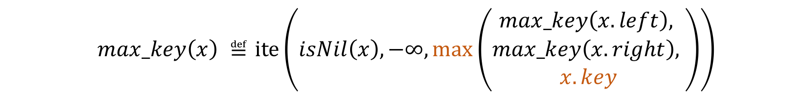





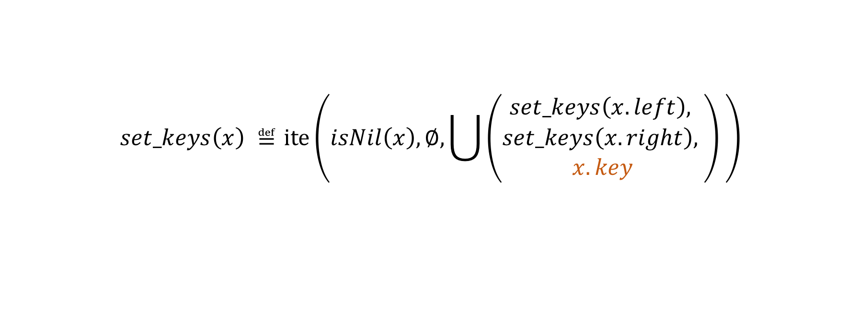





Non-Measure Functions
Three classes of non-measure functions (min, max, keys, etc.):
  Increasing Int functions:
  Decreasing Int functions:
  Increasing IntSet functions:
$$max_key\left(x\right) ≝\text{ite}\left(isNil\left(x\right), −∞,\max\left(\begin{aligned}max_key\left(x.left\right), \\ max_key\left(x.right\right), \\ x.key\end{aligned}\right)\right)$$
$max_T$
Local Int term
$max_T$
$$max_T$$
$t\left[x\right]$
$$min_key\left(x\right) ≝\text{ite}\left(isNil\left(x\right), ∞,\min\left(\begin{aligned}min_key\left(x.left\right), \\ min_key\left(x.right\right), \\ x.key\end{aligned}\right)\right)$$
$min_T$
$min_T$
$min_T$
$t\left[x\right]$
$$set_keys\left(x\right) ≝\text{ite}\left(isNil\left(x\right), ∅, \bigcup{\left(\begin{aligned}set_keys\left(x.left\right), \\ set_keys\left(x.right\right), \\ x.key\end{aligned}\right)} \right)$$
$set_T$
$set_T$
$set_T$
$T\left[x\right]$
Notes:
Basically, non-measure functions can be used to compute the max, min or set of terms in the tree. For example, using the template of non-measure function, we can define a max_key function which collect all the local field key in the tree and compute the max of them. Similarly, the min of local key and the set of keys in the tree can also be computed. These three examples represent three classes of non-measure functions allowed in the logic, increasing int function, decreasing int function and increasing intset function. The local int term in non-measure functions do not need to necessarily be key. You can use arbitrary local int term and compute max, min, or set of them.
We can define a max_key function which collect all the local field key in the tree and compute the max of them. The local int term do not need to neccearyly be key.
You can use arbitrary local int term to compute max of them. Using this template.
Decreasing .. Intuitively compute the min of local int term
Intset compute the union of local intset terms

Slide 16
Why increasing/decreasing?
Notes:
Why are those functions named as increasing/decreasing?

Slide 17
  Lemma 1: monotonically increasing/decreasing
$$min\left( \right) ≤ min\left( \right)$$
Notes:
Thinking about the nature definition of min, if there is a tree and we we pick an arbitrary subset of nodes in the tree to form a smaller one. Obviously, the min of keys stored in the smaller tree will be greater than or equal to the minimum key in the original tree. In other words, the value of function min is monotonically increasing when we tailor the tree to a smaller size. That is where the increasing/decreasing in the names of non-measure functions come from.
Thinking about the nature definition of min, if there is a large tree and we tailor the tree to a smaller tree. Obviously, the min of … …. That where the increasing/decreasing in the names of non-measure function come from.
Imagine that we have a large satisfying tree, if we pick a arbitrary subset of nodes in the tree. The value of non-measure function of tailored tree is monotonically increasing/decreasing. For example the min of large tree is always <= the min of tailored tree. That where the increasing/decreasing in the names of non-measure function come from.

Slide 18
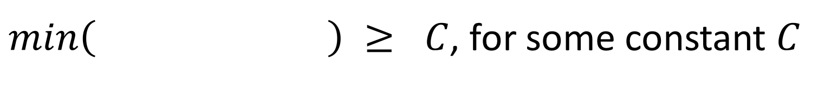

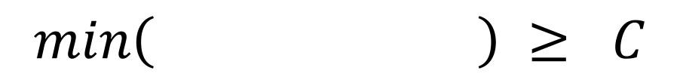
  An Argument for Small Model Property
$min\left( \right) ≥ C$, for some constant $C$
$$≤$$
😊
$$min\left( \right) ≥ C$$
Notes:
With this observation, we can deduce the following argument. Suppose that there is a term in the formula which is min of a tree is greater than or equal to C for some constant C. Even if we tailor the tree, since the min of tailored tree is greater than the min of original tree. The term can still be valid if it’s valid for the original tree.

Slide 19
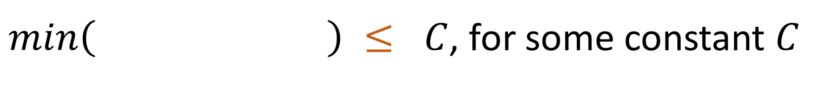
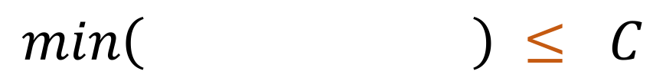
  An Argument for Small Model Property
$min\left( \right) ≤ C$, for some constant $C$
$$≤$$
🤔
$$min\left( \right) ≤ C$$
Notes:
However, things are different when the term becomes that min of a tree is less than or equal to a constant C. Since the the function min is monotonically increasing after tailoring the tree. Even if the term is valid before tailoring, it’s not necessarily valid anymore.

Slide 20

  Lemma 2: a witness node is sufficient to preserve the value
Witness for $min$
$$min\left( \right) = min\left( \right)$$
Notes:
We then observe that a witness node is sufficient to preserve the value of non-measure function. The witness node, in this case, is the node that stored the minimum key in the tree. If the witness node is preserved when tailoring the tree, the value of min will not be affected by tailoring.
Only one witness node for a non-measure function

Slide 21
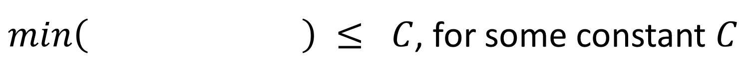

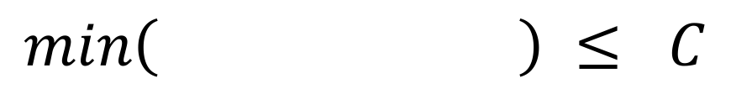
  An Argument for Small Model Property
$min\left( \right) ≤ C$, for some constant $C$
$$=$$
$$min\left( \right) ≤ C$$
😊
Notes:
Therefore, if we preserve the witness node, the value of min is also preserved after tailoring, so that the term can still be valid.

Slide 22
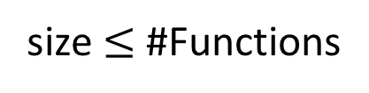

Bound for Non-Measure Functions
Witness for $max$
Witness for $min$
$$non_measure_f\left( \right) = non_measure_f\left( \right)$$
size $≤$ #Functions
Notes:
As long as every witness node is preserved in tailored tree, the values of non-measure functions in tailored tree are equal to the ones in original tree. In other words, the validity of formula related to non-measure functions is unchanged after tailoring. Each non-measure function only has a single witness node. The bound related to non-measure functions in formula can be easily computed as the number of non-measure functions in the formula.

Slide 23
Dryad_{dec}: a decidable subset of Dryad
Refines the general template to seven templates
Increasing Int Function
General Predicate
Max-based Function
Decreasing Int Function
Sum-based Function
Measure-Related Predicate
Increasing IntSet Function
Non-Measure Functions
Measure Functions
Predicates
Notes:
After knowing non-measure functions, let us look into the other category of functions, the measure function

Slide 24
















Measure Functions
Local constraints
Measure functions are first-class citizens
  Max-based (height) functions:
  Sum-based (size) functions:
$$height\left(x\right) ≝\text{ite}\left(isNil\left(x\right), 0,\max\left( height\left(x.left\right), height\left(x.right\right)\right)+ \text{1} \right)$$
$$black_height$$
$$black_height$$
$$black_height$$
$$Max_based$$
$$\text{ite}\left(x.isBlack, 1, 0\right)$$
$Max_based$
$$Max_based$$
$\text{ite}\left(υ[x], 1, 0\right)$
$$size\left(x\right) ≝\text{ite}\left(isNil\left(x\right), 0,\operatorname{sum}\left( size\left(x.left\right), size\left(x.right\right)\right)+ \text{1 }\right)$$
$$leaf_size$$
$\text{ite}\left(υ[x], 1, 0\right)$
$$Sum_based$$
$$leaf_size$$
$$\text{ite}\left(x.isLeaf, 1, 0\right)$$
$$Sum_based$$
$$Sum_based$$
$$leaf_size$$
Notes:
As I said, measurements are special in our logic. There are two types of measure functions, max-based functions and sum-based functions. Intuitively, the measure functions compute the height or size of a tree. The height or size properties that measure functions compute do not need to be regular height or size. One can define black-height for red black tree counting nodes which are black, or define the leaf-size of tree counting the number of leaves. User can set arbitrary local constraint to compute other height or size.
Intuitively compute the height/size
Not necessarily be regular height/size
Define black-height for red black tree count node which is black
Or Define the leaf-size of tree counting the number of leaves.
You can set some local constraint to compute other height/size.
Measurements are special in our logic
Intuitively, the measure functions compute height and size of trees.
First height
not necessarily be regular height
black height count the node which is black
This is the most important restriction in our logic. I will explain why we need this restriction shortly.

Slide 25
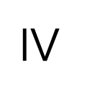
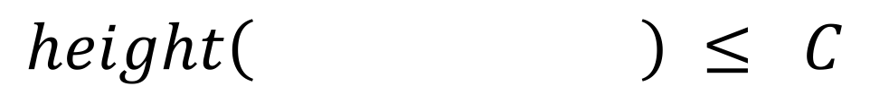
  An Argument for Small Model Property
$height\left( \right) ≤ C$, for some constant $C$
$$≥$$
😊
$$height\left( \right) ≤ C$$
Notes:
With measure functions, let’s think about the same situation we encounter with non-measure functions. Suppose in the formula, there is a valid term that height of a tree is less than C, for some constant C. If we tailor the tree, height of the tailored tree is obviously less than or equal to the original tree height. The term is still true after tailoring.

Slide 26
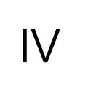
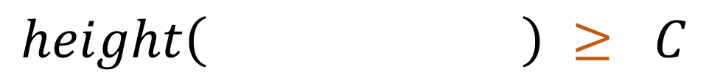
  An Argument for Small Model Property
$height\left( \right) ≥ C$, for some constant $C$
$$≥$$
🤔
$$height\left( \right) ≥ C$$
Notes:
However, if there is a term stating that height of tree is greater than some constant C. If the tree is tailored, the term may no longer be valid anymore.

Slide 27
There is NO witness node for measure functions.
(because they are aggregate functions.)
Notes:
Remember that, for non-measure functions, we use a witness node to preserve the value of a non-measure function after tailoring. However, things are different with measure functions like height. There is no way that we can play the same trick to find a witness node for measure function to preserve their value.

Slide 28
Idea: Preserve the difference
y
$$height\left( \right)−height\left( \right)=K$$
x
-
-
$$height\left( \right)−height\left( \right)=K$$
=
1
=
1
Notes:
So we come up with an idea that why don’t we preserve the difference of measure functions? If the term related to measure functions are in difference form. We can tailor both two trees and reduce their heights by one simultaneously, so that the height difference between these two trees is unchanged by tailoring. In this way, properties related to measure functions in the formula can stay the same after tailoring.

Slide 29
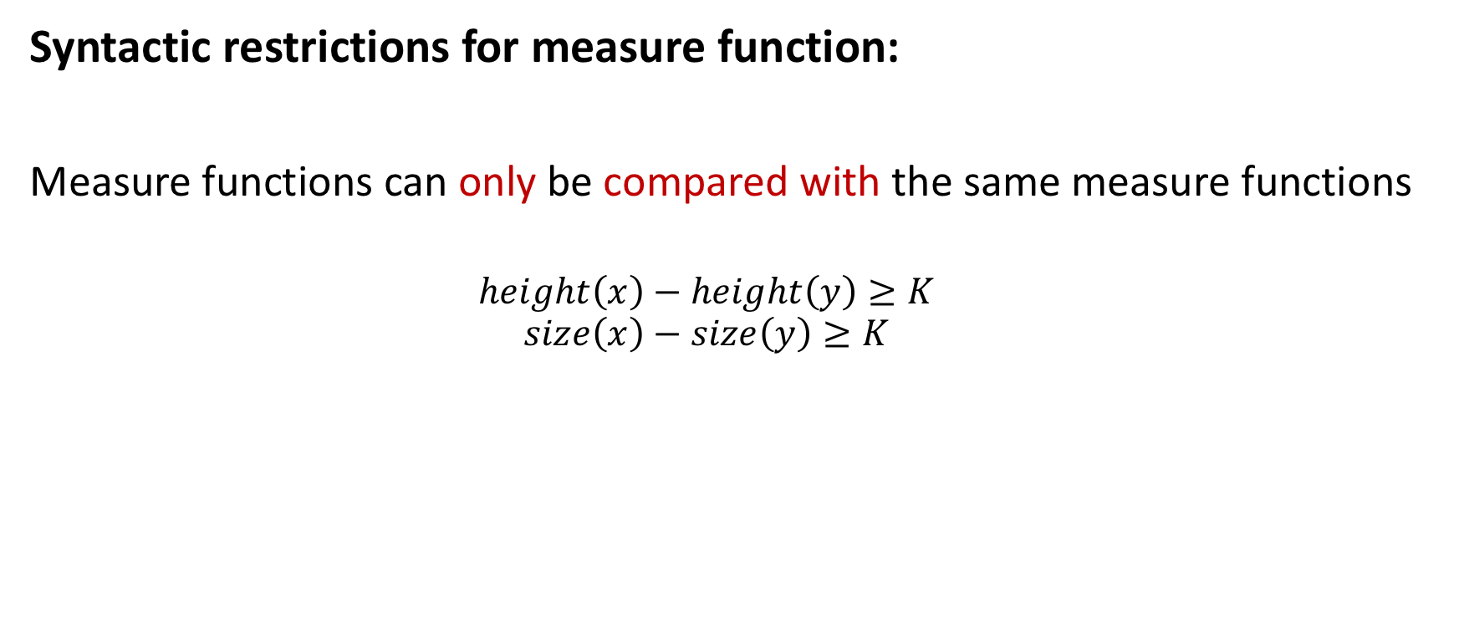
Syntactic restrictions for measure function:
Measure functions can only be compared with the same measure functions
  $$height\left(x\right)−height\left(y\right)≥K$$
  $$size\left(x\right)−size\left(y\right)≥K$$
Notes:
Therefore, an important syntactic restriction is added for measure functions. measure functions can only be compared with the same measure functions. In other words, when appearing in the formula, measure functions can only occur in the difference form with the same type of measure function. This is the most important restriction in the logic.

Slide 30
Dryad_{dec}: a decidable subset of Dryad
Refines the general template to seven templates
Increasing Int Function
General Predicate
Max-based Function
Decreasing Int Function
Sum-based Function
Measure-Related Predicate
Increasing IntSet Function
Non-Measure Functions
Measure Functions
Predicates
Notes:
After introducing the functions, I will then talk about the predicates.

Slide 31
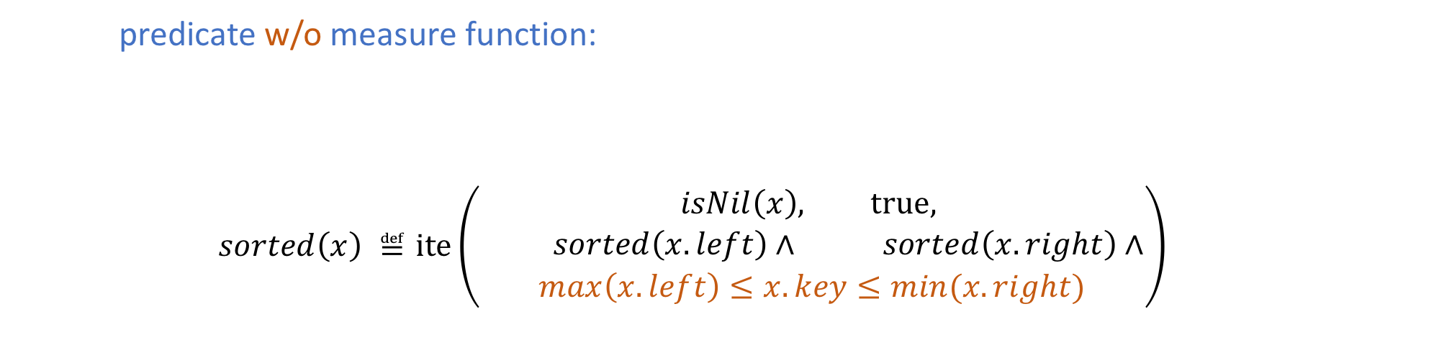



General Predicate
May involve many general predicates and non-measure functions
  predicate w/o measure function:
  $$sorted\left(x\right) ≝\text{ite}\left(\begin{aligned}isNil\left(x\right), \text{true}, \\ \begin{aligned} sorted\left(x.left\right)∧ sorted\left(x.right\right)∧ \\ \max\left(x.left\right)≤x.key≤min(x.right)\end{aligned}\end{aligned}\right)$$
$$general_p$$
$$general_p$$
$$general_p$$
$$φ[x.f, x.left, x.right]$$
max occurs only on the LHS
min occurs only on the RHS
Notes:
The first type of predicates are general predicates. General predicates are predicates defined without using measure functions. For instance, sorted can be expressed by a general predicate. When the tree x is empty, sorted of x is trivially true, otherwise, sorted of x is true if both subtrees of x are sorted and the local key is greater than the max key in the left and less than the min key in the right. One thing to notice is that, to maintain monotonicity, decreasing int function max can only occur on the left hand side and increasing int function min can only occur on the right hand side. In general predicate, user can set up arbitrary constraints involving many other general predicates and non-measure functions to define other general predicate.

Slide 32
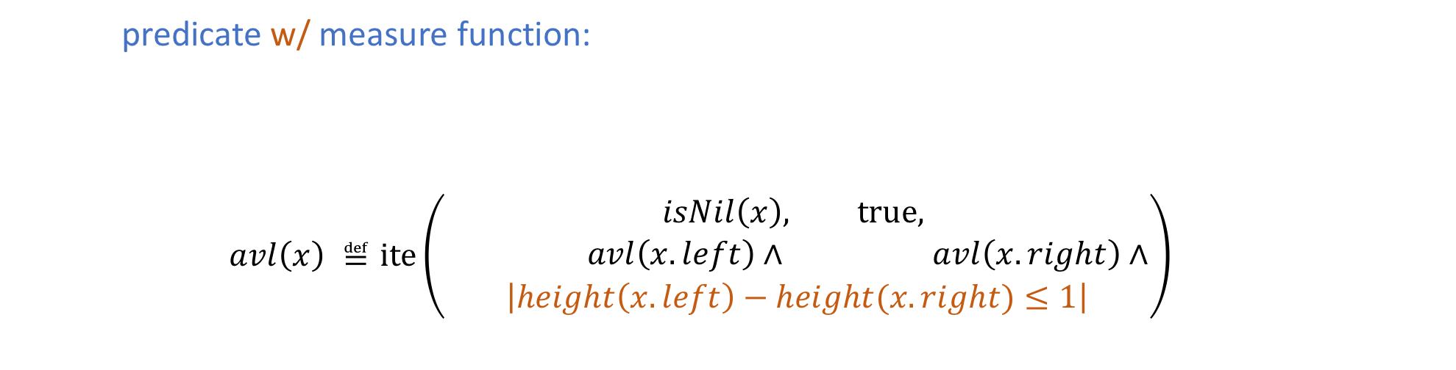




Measure-related Predicate
  predicate w/ measure function:
  $$avl\left(x\right) ≝\text{ite}\left(\begin{aligned}isNil\left(x\right), \text{true}, \\ \begin{aligned} avl\left(x.left\right)∧ avl\left(x.right\right)∧ \\ \left|height\left(x.left\right)−height(x.right)≤1\right|\end{aligned}\end{aligned}\right)$$
May involve one Max-based measure function and many non-measure functions
$measure_p$
$measure_p$
$measure_p$
$$φ[x.f, x.left, x.right]$$
Notes:
The other type of predicates are measure-related predicates. As the name has shown, measure-related predicates are predicates with measure function involved. Foe example, the balancedness of avl tree can be defined in this template. The definition of avl tree relates to a measure function height and the height appears in the form of difference. User can involve a Max-based measure function and many non-measure functions
The local constraint in measure-related predicate may involve a Max-based measure function and many non-measure functions. AVL balacedness can be defined by a measure-related predicate. Avl relates to a measure function height in its definition and the height appears in difference form.
The formula in measure-related predicate can involve…
We can define predicate like avl. It’s a measure-related predicate because it involve type 1 function height in the definition. And the height appears in difference. That’s why this definition of avl is allowed

Slide 33
Dryad_{dec}: a decidable subset of Dryad
Refines the general template to seven templates
Increasing Int Function
General Predicate
Max-based Function
Decreasing Int Function
Sum-based Function
Measure-Related Predicate
Increasing IntSet Function
Non-Measure Functions
Measure Functions
Predicates
Notes:
After introducing the syntax, I will then show you that with measure functions involved, our logic satisfies the small model property.

Slide 34



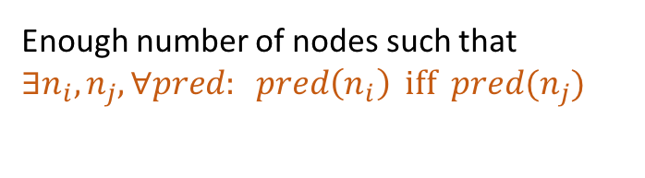
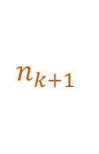


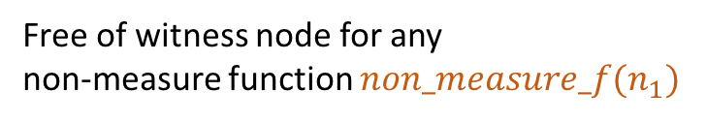
Sketch of proof
$$T$$
Enough number of nodes such that $∃n_{i},n_{j},∀pred: pred\left(n_{i}\right) \text{iff} pred(n_{j})$
$$n_{1}$$
Free of witness node for any
non-measure function $non_measure_f(n_{1})$
$$n_{k}$$
$$n_{k+1}$$
Replace $n_{k}$ with $n_{k+1}$!
$$n_{T}$$
A long-enough path
Notes:
The idea of proof for max-based function is that… Suppose there is a large enough tree, then we can have a long-enough path in the tree such that there exist a pair of nodes. These two nodes agree on every predicate appears in the formula. And there is no witness node for non-measure functions in the shaded area. So we can replace the larger tree with the small one and none of the properties get lost, other than that the height of tree is reduce by one.
Shaded area do not contain any witness node.
Suppose we have a large enough tree, so that we can have a long-enough path in the tree such that there exist a pair of nodes.
This two nodes agree on every predicate appears in the formula. And there are no witness nodes for non-measure fuctions.
So we can replace the larger tree with the small tree and nothing get losed

Slide 35
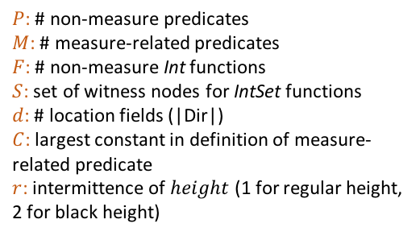
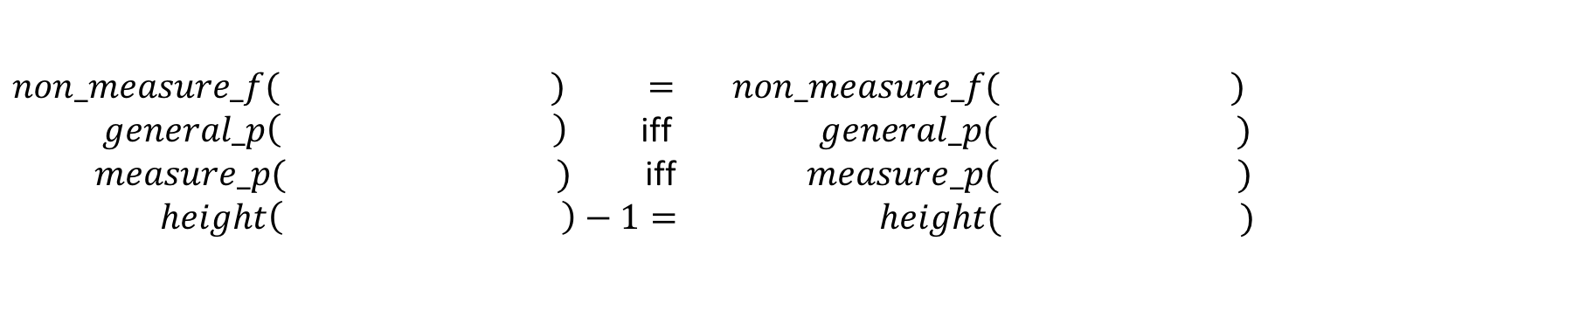
Bound for Max-based measure functions
Lemma 4: For any Max-based measure function $height$, given a tree with height greater than height bound $\left(P+M+F+\left|S\right|+1\right)∙\left((d−1)Cr+1\right)$
witness nodes
$P$: # non-measure predicates
$M$: # measure-related predicates
$F$: # non-measure Int functions
$S$: set of witness nodes for IntSet functions
$d$: # location fields (|Dir|)
$C$: largest constant in definition of measure-related predicate
$r$: intermittence of $height$ (1 for regular height, 2 for black height)
One can tailor to such that
$$non_measure_f( ) = non_measure_f( )$$
$general_p\left( \right)$ iff $general_p( )$
$measure_p( )$ iff $measure_p( )$
$height\left( \right)−1= height( )$
Notes:
Therefore, with max-based measure function, our logic still satisfy the small model property. Given a formula, if we can find a tree with height greater than the height bound. The bound is computed using some parameters in the formula. If we have such a large enough satisfying tree, we can always tailor the tree with all the witness nodes preserved. And all properties, such as non-measure functions, general predicate, measure-related predicate got preserved. The height of tree was reduced by one. Since we only allow height difference appear in logic, it still satisfy small model property.
You can imagine that there is no way to tailor the tree but always preserve the height.

Slide 36
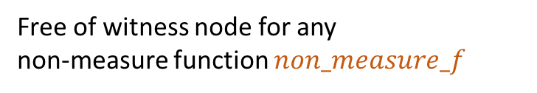
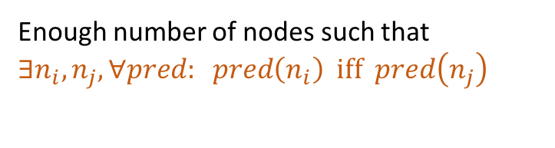
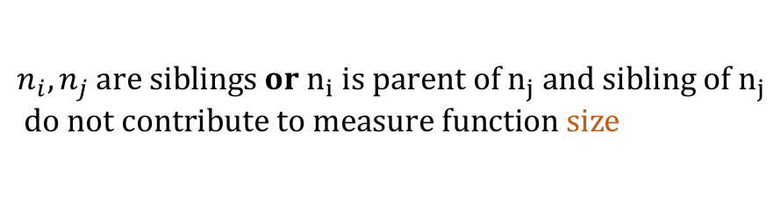
Sketch of the Proof
$$T$$
Enough number of nodes such that
$$∃n_{i},n_{j},∀pred: pred\left(n_{i}\right) \text{iff} pred\left(n_{j}\right)$$
$$n_{i},n_{j} are siblings or n_{i} is parent of n_{j} and sibling of n_{j}$$
$$do not contribute to measure function size$$
Free of witness node for any
non-measure function $non_measure_f$
$$n_{k}$$
$$n_{k+1}$$
Replace $n_{k}$ with $n_{k+1}$!
Notes:
Suppose we have a large enough tree, so that we can have a long-enough path in the tree such that there exist a pair of nodes.
This two nodes agree on every predicate appears in the formula. And there are no witness nodes for non-measure fuctions.
So we can replace the larger tree with the small tree and nothing get losed

Slide 37
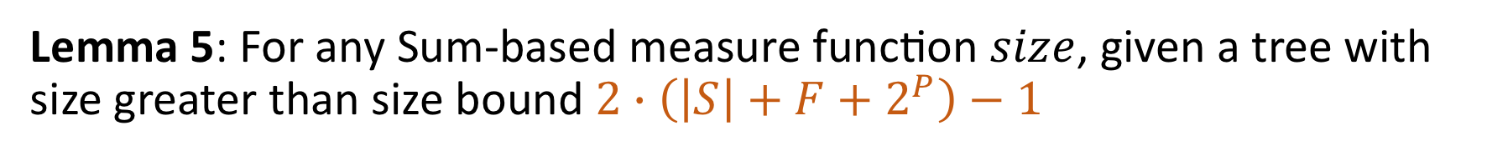
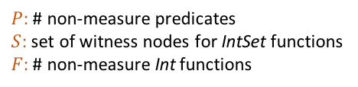
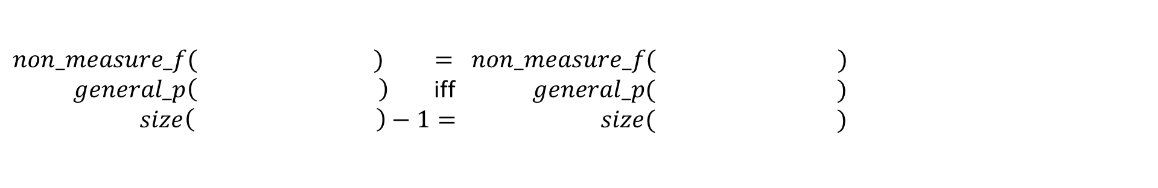
Bound for Sum-based measure functions
Lemma 5: For any Sum-based measure function $size$, given a tree with size greater than size bound $2∙\left(\left|S\right|+F+2^{P}\right)−1$
$P$: # non-measure predicates
$S$: set of witness nodes for IntSet functions
$F$: # non-measure Int functions
One can tailor to such that
$$non_measure_f( ) = non_measure_f( )$$
$general_p\left( \right)$ iff $general_p( )$
$$size\left( \right)−1= size( )$$
Notes:
We have the same result for sum-based function too, though the size bound and proof is different.
With sum-based function, we also prove that the logic still satisfy small model property.

Slide 38
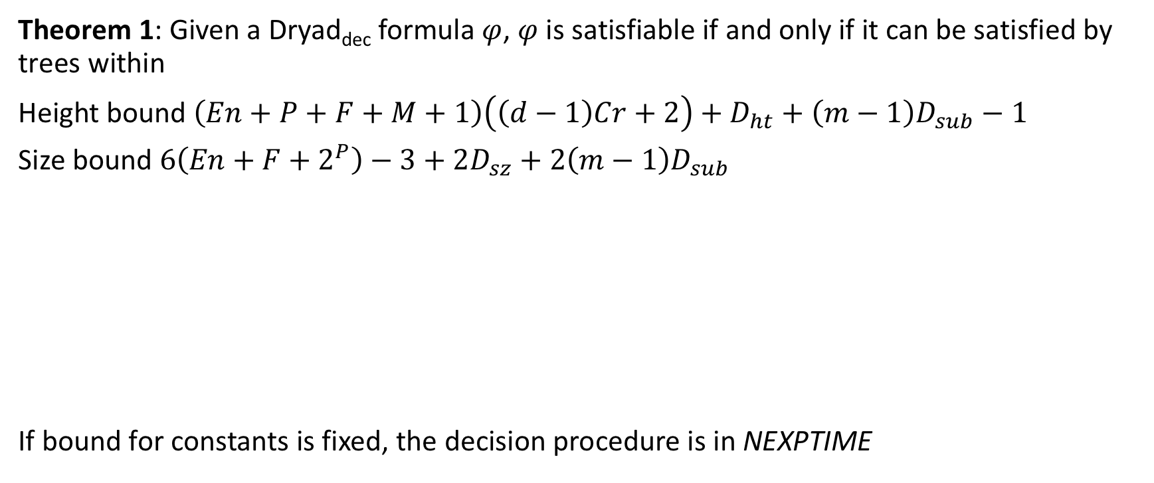
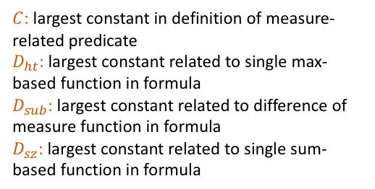
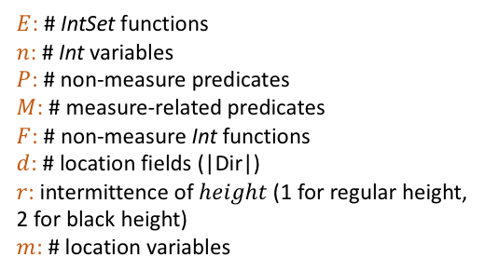
Decidability of Dryad_{dec}
Theorem 1: Given a Dryad_{dec} formula $φ$, $φ$ is satisfiable if and only if it can be satisfied by trees within
Height bound $\left(En+P+F+M+1\right)\left(\left(d−1\right)Cr+2\right)+D_{ht}+\left(m−1\right)D_{sub}−1$
Size bound $6\left(En+F+2^{P}\right)−3+2D_{sz}+2\left(m−1\right)D_{sub}$
If bound for constants is fixed, the decision procedure is in NEXPTIME
$E$: # IntSet functions
$n$: # Int variables
$P$: # non-measure predicates
$M$: # measure-related predicates
$F$: # non-measure Int functions
$d$: # location fields (|Dir|)
$r$: intermittence of $height$ (1 for regular height, 2 for black height)
$m$: # location variables
$C$: largest constant in definition of measure-related predicate
$D_{ht}$: largest constant related to single max-based function in formula
$D_{sub}$: largest constant related to difference of measure function in formula
$D_{sz}$: largest constant related to single sum-based function in formula
Notes:
Therefore, given a dryaddec formula phi, the formula phi is satisfiable if and only if it can be satisfied by trees with a computable height or size bound. And the decision procedure is quite straightforward. It’s in non-deterministic exponential time, if the bound for constants is fixed.

Slide 39

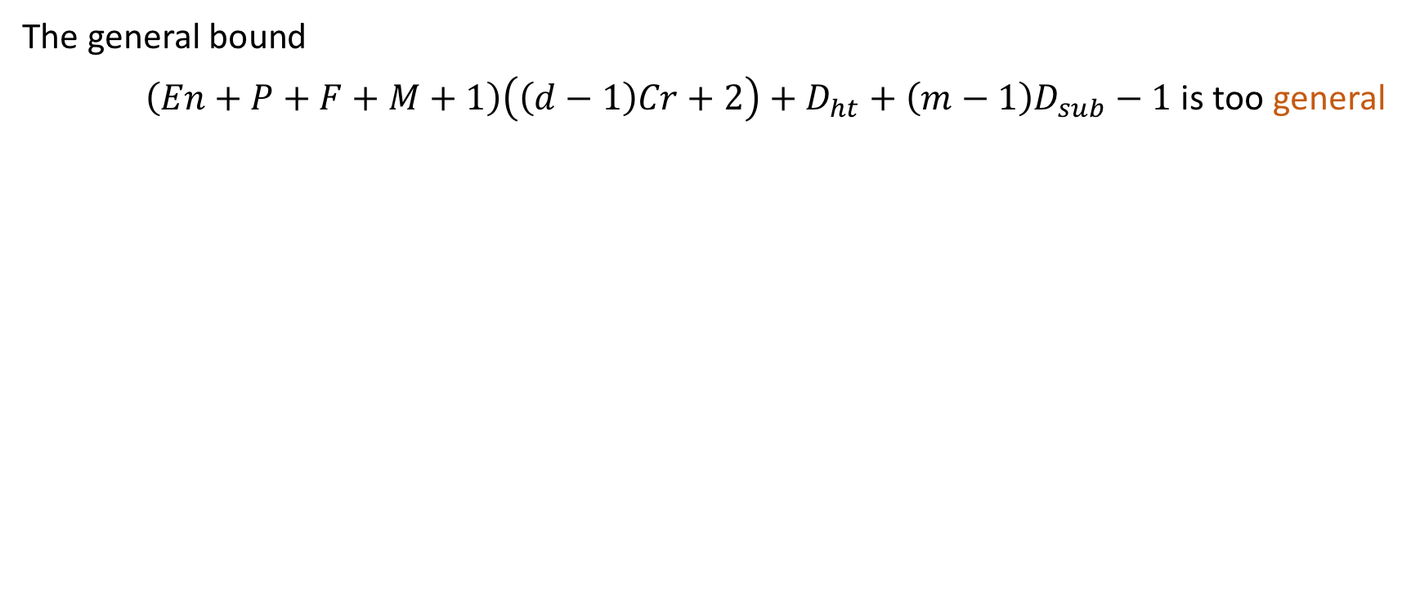



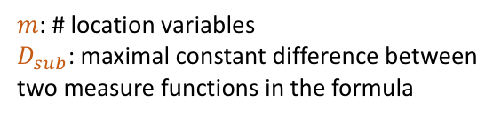


Bound refinement
$m$: # location variables
$D_{sub}$: maximal constant difference between two measure functions in the formula
The general bound
$\left(En+P+F+M+1\right)\left(\left(d−1\right)Cr+2\right)+D_{ht}+\left(m−1\right)D_{sub}−1$ is too general
Refinement based on AVL, RBT mutation
Worst case
Not common
Refinement based on BST mutation
$$\left(maxChain−1\right)D_{sub}$$
Refinement based on Treap mutation
_
_
_
_
_
…
…
…
$$n+4$$
$$3m−2$$
$$maxChain$$
$$n+3$$
$$m$$
…
Notes:
However, the general bound I showed in the previous slide is too general and loose, affecting the scalability of the decision procedure. We also implemented the decision procedure with a set of bound refinements. For example, m is the number of location variables in the formula. It only contributes to the bound with the term (m − 1)Dsub. The bound is only precise when all location variables in the formula construct a chain in which every two trees are in the difference form. This situation is the worst case and not common in reality. Actually finding out the longest chain in the formula is sufficient for the bound. So we can refine the bound by analyzing how the location variables occur in the formula. We also implement some bound refinements based on the definition of height …etc.
by analyzing how location variables occur in the formula, we can optimize the height bound
For example, we optimized the bound by converting Dryad_{dec} formula to DNF form, and then computed the height/size bound for each disjunct separately, since the formula is satisfiable if and only if one of the disjuncts is satisfiable.
Optimizations are basically based on the formula or based on the definition of predicates or functions.
Convert Dryad_{dec} formula to DNF
Optimize the bound based on constraints or on definition
2nd related to formula
Worst case not common in reality
too loose
Give an example
4th rbt avl related to predicate definition

Slide 40
Experimental Result
Notes:
To show the expressivity of Dryaddec and the efficiency of the decision procedure, we applied Dryaddec to three different scenarios.

Slide 41
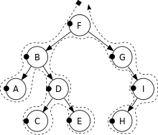

Applications
Dryad_{dec}
Program verification
Traversal fusion
Program synthesis
Notes:
Using Dryadded, we first encoded nature proof verification conditions for functional correctness of recursive tree-manipulating programs. Also we used Dryaddec to check the fusibility of recursive tree traversals. We applied Dryaddec to synthesize conditional linear integer arithmetic functions as well.

Slide 42
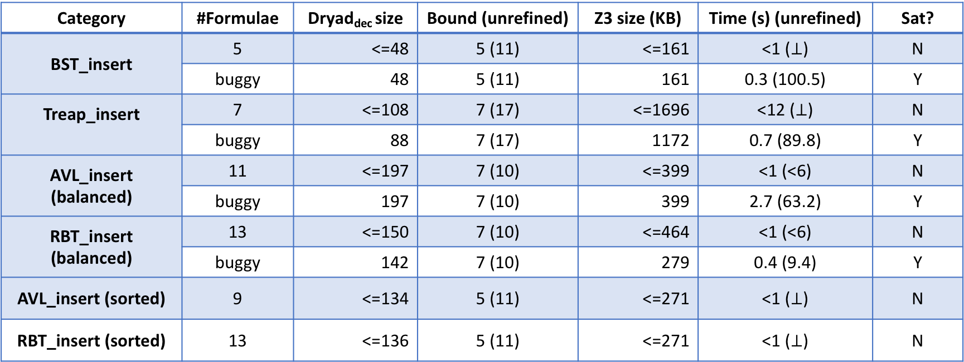
Program verification
Category | #Formulae | Dryad_{dec} size | Bound (unrefined) | Z3 size (KB) | Time (s) (unrefined) | Sat?
BST_insert | 5 | <=48 | 5 (11) | <=161 | <1 ($⊥$) | N
 | buggy | 48 | 5 (11) | 161 | 0.3 (100.5) | Y
Treap_insert | 7 | <=108 | 7 (17) | <=1696 | <12 ($⊥$) | N
 | buggy | 88 | 7 (17) | 1172 | 0.7 (89.8) | Y
AVL_insert (balanced) | 11 | <=197 | 7 (10) | <=399 | <1 (<6) | N
 | buggy | 197 | 7 (10) | 399 | 2.7 (63.2) | Y
RBT_insert (balanced) | 13 | <=150 | 7 (10) | <=464 | <1 (<6) | N
 | buggy | 142 | 7 (10) | 279 | 0.4 (9.4) | Y
AVL_insert (sorted) | 9 | <=134 | 5 (11) | <=271 | <1 ($⊥$) | N
RBT_insert (sorted) | 13 | <=136 | 5 (11) | <=271 | <1 ($⊥$) | N
Notes:
For program verification, we verified full functional correctness of several tree-manipulating programs, including binary search tree insert, treap insert, AVL insert and red black tree insert. We can see that all the verification conditions can be solved in reasonable time. In order to do sanity check, we also manually crafted some buggy programs, the decision procedure also can solve the benchmarks and come up with a correct counterexample.

Slide 43
Traversal fusion
A(n)
if (n == nil) return
A(n.l);
A(n.r);
S_{A};
B(n)
if (n == nil) return
S_{B};
B(n.l);
B(n.r);
Category | #Formulae | Dryad_{dec} size | Bound | Z3 size (KB) | Time (s) | Sat?
Fusion (post_pre) | 2 | 4 | 5 | 84 | <1 | N
 | 2 | 4 | 5 | 84 | <1 | Y
 | 20 | 4 | 6 | <=216 | <1 | Y
Fusion (mult_rec) | 4 | 4 | 7 | 604 | <3 | N
 | 20 | 4 | 9 | <=3304 | <7 | Y
🤔
Fused(n)
if (n == nil) return
Fused(n.l);
Fused(n.r);
S_{A};
S_{B};
Checking the fusibility of mutually recursive traversals can not be handled by any state-of-art checkers.
Notes:
The second set of benchmarks is for checking the fusibility of recursive tree traversals. Traversal fusion is to fuse two traversals into a single traversal, so that the tree only need to be traversed once, instead of being traversed several times. One of the crucial parts for this fusion process is to check if the fused traversal has identical behavior with the original two traversals. We used Dryaddec to check all possible fusions of two pairs of traversals: a pair of mutually recursive traversals and another pair of a post-order traversal execute before a pre-order traversal. Noted that checking the fusibility of mutually recursive traversals can not be handled by any state-of-art checkers. All the benchmarks can be solved in negligible time. And the result is also the same with what we expected.

Slide 44
Program synthesis
Category | Formulae Name | (solved in #iteration) | Dryad_{dec} size | Time (s)
Multiple functions | fg_fivefuncs, fg_sixfuncs, fg_sevenfuncs, fg_eightfuncs, fg_ninefuncs, fg_tenfunc1, fg_tenfunc2 | 3 | <279 | <1
Polynomial | fg_polynomial1, fg_polynomial2, fg_polynomial3 | 3 | <60 | <1
 | fg_polynomial4 | 4
Other CLIA | fg_max2 | 7 | <2227 | <1
 | fg_VC22_a | 17
INV | ex11-new | 18 | <936 | <1
 | ex11 | 17
 | vsend | 4
 | ex14_simp, ex14_vars, treax1, trex1_vars | 3
 | formula22, formula25, formula27 | 1
SyGuS synthesizer
Candidate
Dryad_{dec}
Decision Procedure
Synthesizer
Verifier
CEGIS
Counterexample
Notes:
The last set of benchmarks is for synthesizing conditional linear integer arithmetic functions. We implemented a toy Syntax Guided Synthesis SyGuS synthesizer and the Dryaddec decision procedure is served as the synthesis engine inside the CEGIS framework of the synthesizer. The SyGuS synthesizer is tested on several benchmarks from the annual SyGuS competition. Although the synthesizer is not well-engineered, the queries for synthesis are solved in reasonable time.
Served as the synthesis engine
Very dumb cegis implementation

Slide 45
Conclusion
Dryad
+ Syntactic restrictions
= Decidable Dryad_{dec}
(Refined templates for recursive definitions)
(Based on small model property)
Dryad
Dryad_{dec}
Program verification
Traversal fusion
Program synthesis
Thank you!
Notes:
In conclusion, we present a decidable logic Dryaddec for tree data structures with measurements. It’s the first decidable logic that can solve a wide variety of problems requiring flexible combination of measure-related, data-related and shape-related properties for trees. By adding syntactic restrictions to Dryad logic, dryaddec satisfies small model property so that it’s decidable. We proved its expressivity with three different applications, namely program verification, traversal fusion and program synthesis.
Warpup
decidable logic
We built a decision procedure and applied dryad_dec to
Program verification
Program synthesis
Applications
Test generation
Tree fusion
The limitation we can not handle loop, that’s why we want to have binary…
Why do we want to do
Explore other potential applications
We are look into examples like ….
Tree fusion Project lead by Prof. Milind Kurkni. Check if two traversals are fusable.
We are looking forward to encode compiler test generation problem in Dryad_dec

