Slide 1
Challenge 1: Temperature Sensing EC 544 – Fall 2015
Group 4: Lama, Dung, Hitesh, Yisi, Weilun

Slide 2
Solution Architecture
Central Station
Sensor 1
Sensor 2
Sensor 3
Sensor 4
Sensor Components
Thermistor Circuit (voltage divider)
XBee Router
Arduino Board
XBee Coordinator
Computer
Central Station Components

Slide 3
Data Flow
Sensor Side
Sketch calculates Temp
XBee Router sends data to Central St.
Sleep for 5 min (Power Saving)
Arduino reads analog voltage
Central Station Side
XBee Coordinator receives temp from all sensors
JS script calculates avg temp
Output avg temp to web interface

Slide 4
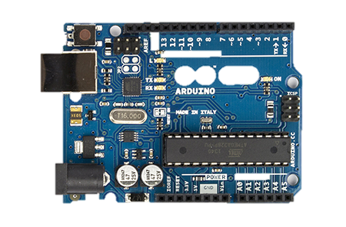
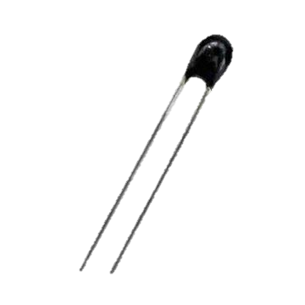
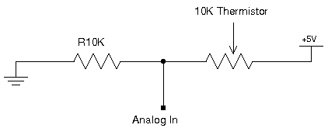
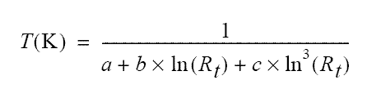
Calibration
Variable Resistance
Thermistor
Reads only Voltage
That is why we used a Voltage Divider circuit.
Steps to Calculate
Temperature
Back calculate the Resistance Rt from the Voltage V₀ using
Rt = R*( 1023.0 / Vo - 1.0 )
Once we have the resistance Rt we can easily get the temperature with the Steinhart Equation:

Slide 5
Design Decisions
Data Processing:
Sensors: Calculate Temperatures
Central Station: Stores latest values for each sensors and calculates average
Sampling Interval:
Every 5 min.
Sensor Positioning:
Within the XBee range
Power Consumption:
Set Arduino to sleep mode in between intervals

Slide 6
Challenges & Future Improvements
Challenges:
Learning how to use and integrating different platforms
Calibration: getting accurate readings and calculating the SH coefficients
Future Improvements:
Averaging Algorithm:
- Improve to handle sensor malfunctions/outliers
- Improve to give weight to each sample depending on sensor location
Data Storage:
- Store data so that it can be later retrieved and visually represented

