Slide 1
Challenge 4: Steering the Car EC 544 – Fall 2015
Group 4: Dung, Hitesh, Lama, Yisi, Weilun

Slide 2

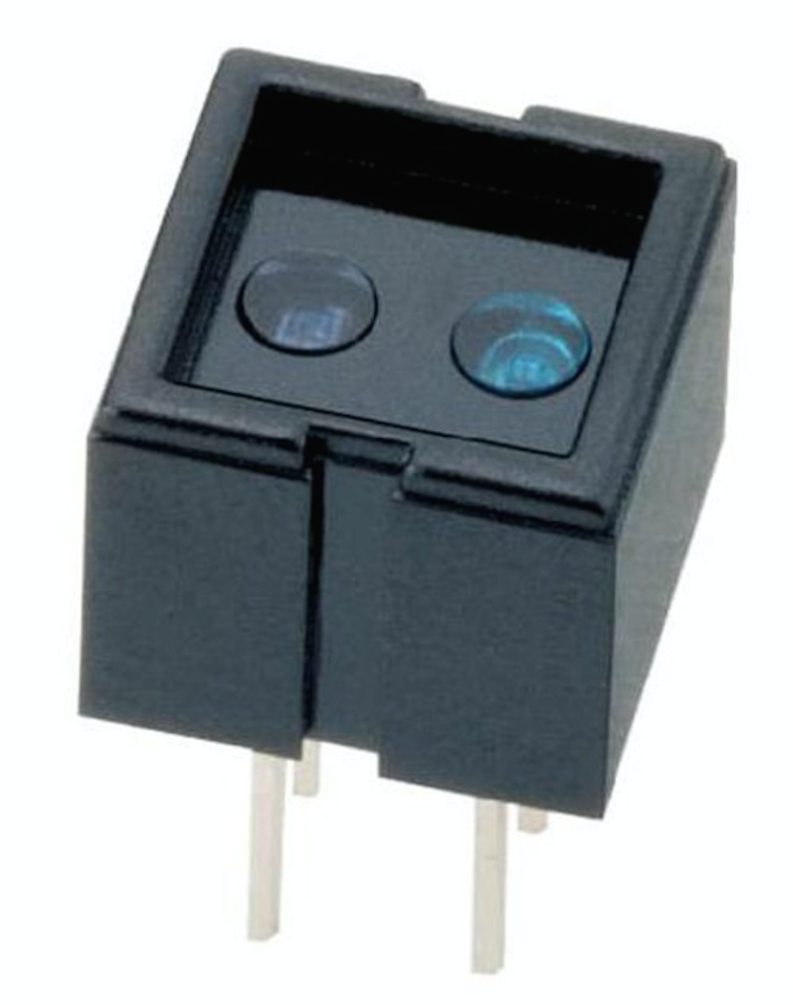
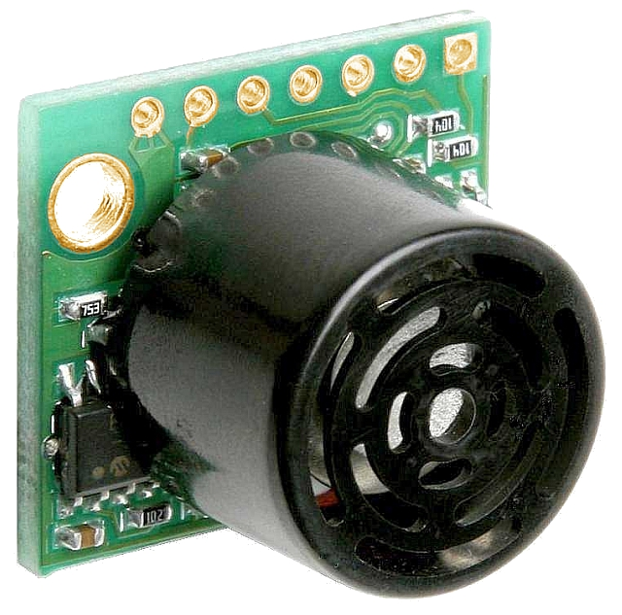
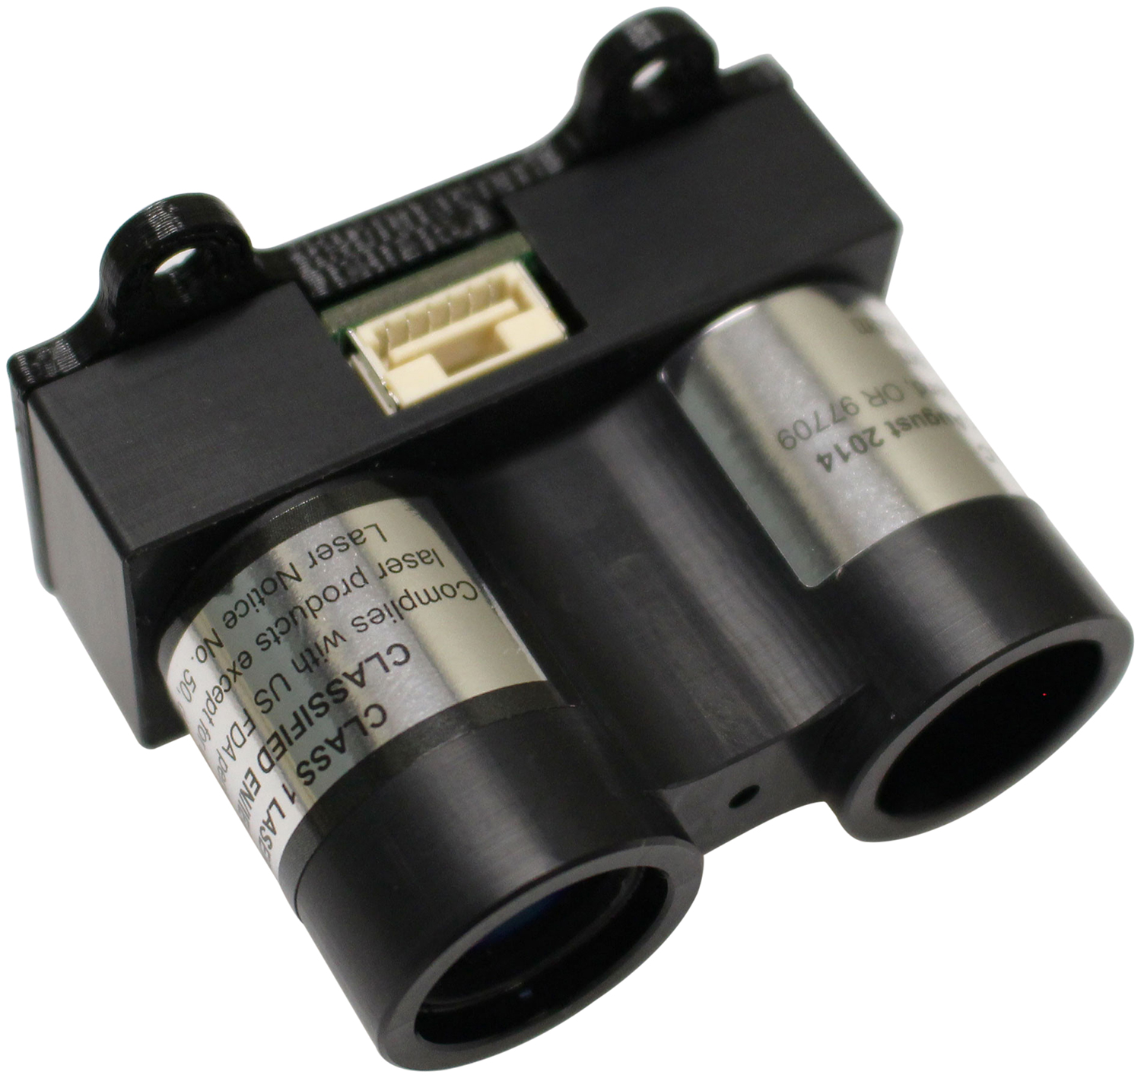
Solution Architecture
Speed Sensor
xBee
xBee
Arduino
Arduino
UltraSonic
LIDARLite

Slide 3
Design Decisions
Sensor:
1 LIDAR sensor on the side:
Accurate response (not much of noise)
Rapid response
2 Ultrasonic sensor in the front:
Scalable
Effective in detecting corners and small obstacles
1 IR speed sensor on inner side of wheel:
Sensitive to colors, can be used to calculate angular velocity
Helpful in remote control

Slide 4
Design Decisions
Control Algorithms:
Side
PID algorithm
Adapt the output to adjust the wheel direction
Front
Receive value from the two sensors and stop if either of them senses obstacle ahead
Speed
Rotary encoder, sense the color wheel inside of the wheel
Remote: xBee
Sending start/stop commands
Monitoring the speed via xBee

Slide 5
Challenges & Future Improvements
Challenges:
Choosing the proper sensors to use and interfacing them together on Arduino
Dealing with limitations of each sensor, calibrating the out puts
Learning to use PID libraries an testing on combination of PID coefficients
Future Improvements:
Make the crawler adaptive to different environment:
Make turns,etc.
Better remote control:
Change speed, make turns, etc.

Slide 6
Thank You!

