Slide 1
Challenge7&8: Autonomous Driving and Remote Monitoring and Control EC 544 – Fall 2015
Group 4: Dung, Hitesh, Lama, Yisi, Weilun

Slide 2
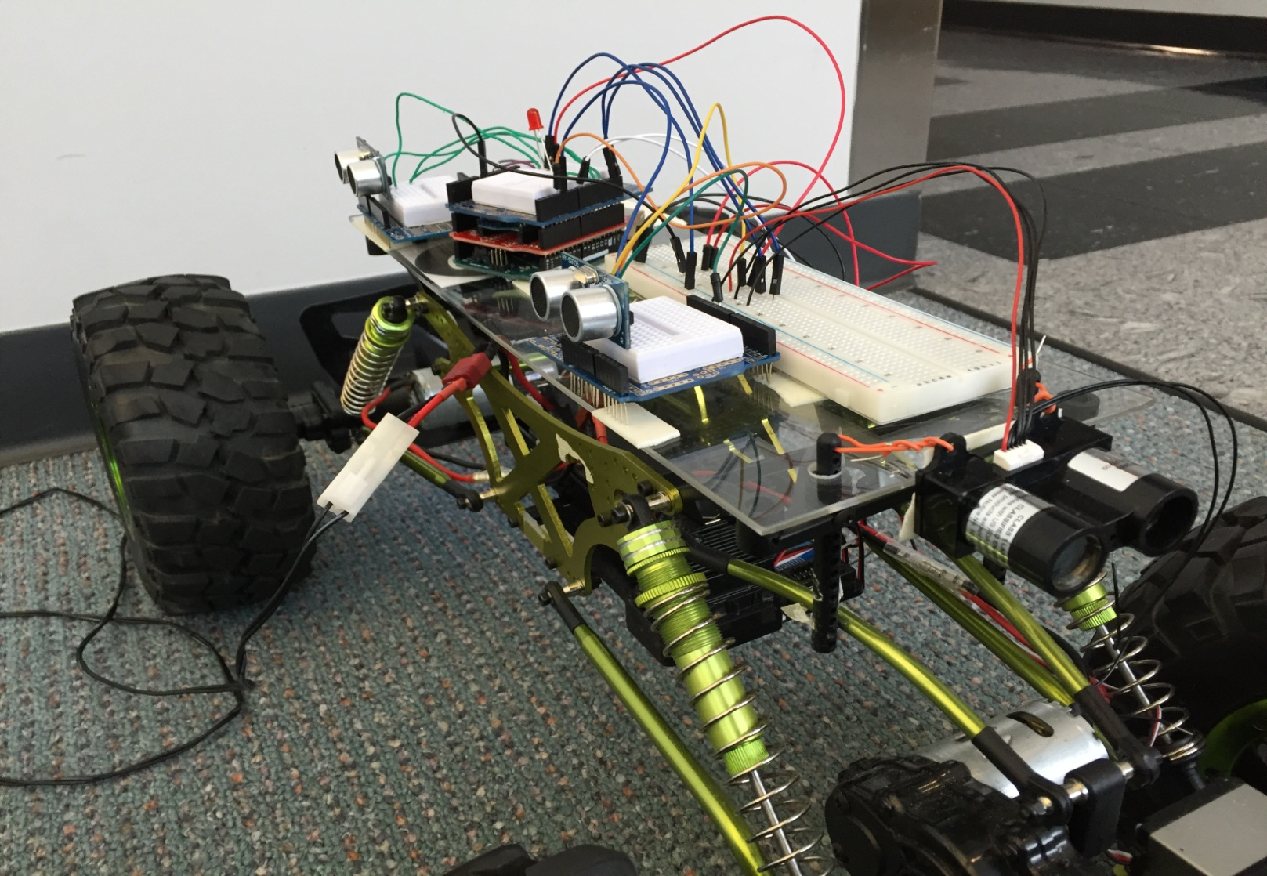
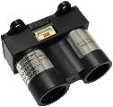
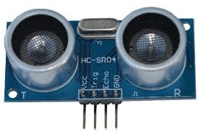
Solution Architecture: Autonomous Driving
Front
LIDARLite
Sensor
xBee
Arduino
Bread Board
Ultrasonic
Sensor

Slide 3
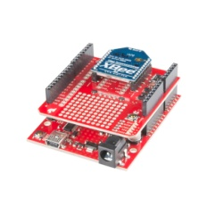
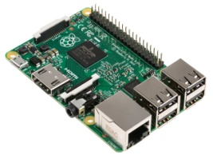
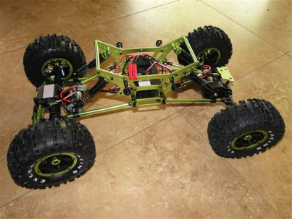
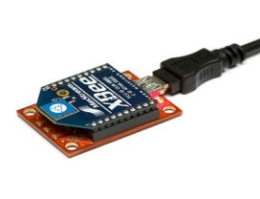
Solution Architecture: Localization
Beacons sends RSSI value to the coordinator
Beacon 2
Beacon 3
Coordinator
Beacon 1
Beacon 4

Slide 4
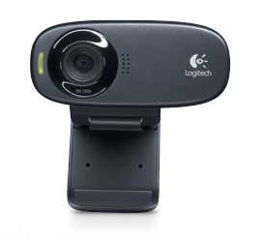
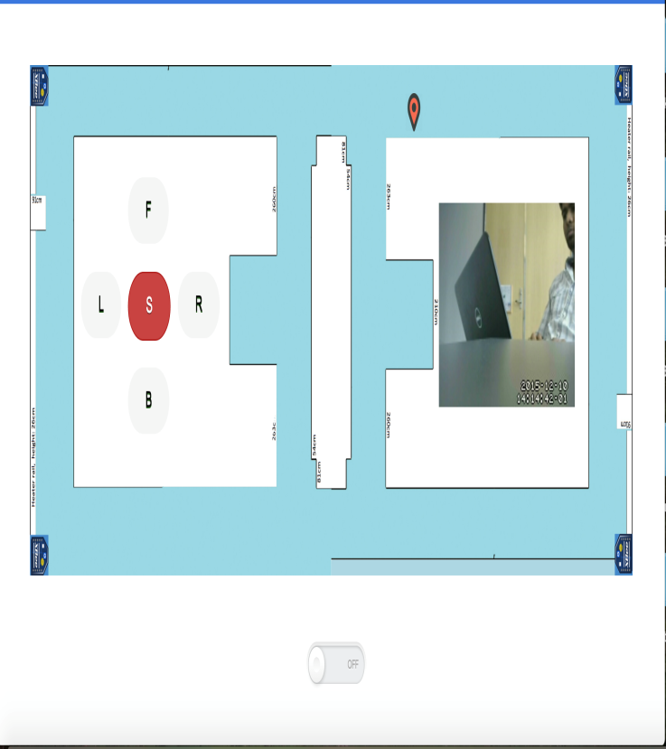

Solution Architecture: Video Streaming
Raspberry pi runs a script

Slide 5
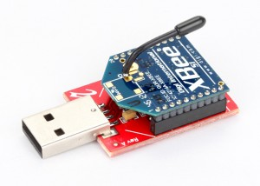

Solution Architecture: Remote Control

Slide 6
Design Decisions
Autonomous Control
Using Sensor Information for autonomous Control
LIDAR in front of the Car and 2 ultrasonic sensors on right side
Sensor Input decides the turning phase and the PID phase
Remote Access
Connecting to BU Wifi andAssigning a dynamic DNS name to PI (no-ip client)
Intializing the script at start up
XBee Configuration
2 Xbees on the Pi, API mode for localization and AT for remote control
This is done in order to present a reliable, real-time solution to the problem.
Localization
Dividing the course into appropriate sized partitions and collecting 3 sample per each
Using knn lode js to access the data set.

Slide 7
Challenges & Future Improvements
Challenges:
Defining a configuration/algorithm for autonomous control
Preparing a data set of RSSI values at various locations in the map
Dependencies of the Sensors varying with changing physical condition
Issues with software installation on the Pi
Future Improvements:
Integrate more reliable data in designing the turning condition
Using more reliable sensors
Use beacons for localization and autonomous control that have better precision.

Slide 8
Thank You!

