Slide 1
Challenge 5: Find the Arduino EC 544 – Fall 2015
Group 4: Dung, Hitesh, Lama, Yisi, Weilun

Slide 2
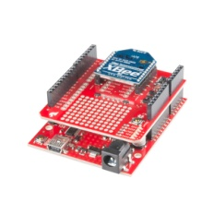
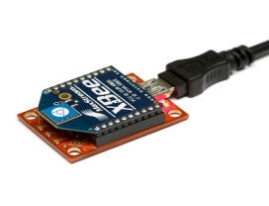
Solution Architecture
Beacon 2
RSSI
Beacon 3
Trackable Device
(Coordinator)
Beacon 1
Beacon 4

Slide 3

Solution Architecture
Webpage
Returns location coordinates
Displays coordinates on the map
Reads RSSI
from 4 Beacons
RSSI_Server
(NodeJS)
Coordinator
Feed current RSSI reading
kNN predicts current location

Slide 4
Design Decisions
Use of kNN vs. Trilateration:
- Distance is not a function of signal strength → kNN is a better solution for XBee like beacons
Data Collection:
- Deciding on a location
- Creating a map of the space and Dividing the room in partitions/coordinates.
- Collecting the data for each partition.
kNN Implementation:
- Used a NodeJS kNN library to train the dataset and predict location.
- Can be run on the Raspberry Pi

Slide 5
Challenges & Future Improvements
Challenges:
Inconsistent outcome when using trilateration method
Collecting RSSI data for all partitions on the map.
Handling inconsistent RSSI values from the XBees.
Malfunctioning of Beacon 1.
Powering a portable Rapsberry Pi
Future Improvements:
Achieve more accurate localization by:
- Collecting more kNN training data.
- Using more beacons and replacing the malfunctioning XBee.

Slide 6
Thank You!

