Slide 1
Challenge 7: Autonomous Driving EC 544 – Fall 2015
Group 4: Dung, Hitesh, Lama, Yisi, Weilun

Slide 2
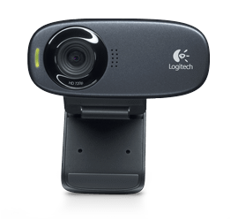
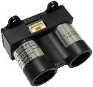

Solution Architecture
webcam
xBee
xBee
Arduino
Raspberry pi
LIDARLite
Sensor
Ultrasonic
Sensor
Turning only
PID an turning

Slide 3
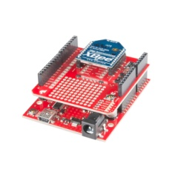
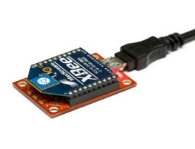
Solution Architecture
Beacon 2
RSSI
Beacon 3
Coordinator on the crawler
Beacon 1
Beacon 4

Slide 4
Design Decisions
Autonomous Driving
Running in PID mode when driving in the hallway
Entering turning mode when sensing wall ahead
Choosing the full course instead of half to avoid the gap at the elevator
Indoor Localization
Four beacons at the four corners
Put the coordinator on the pi and attach on the crawler
Connect the pi to BU wifi and install no ip client on the pi to have ddns
Dividing the whole course into 16 sections
Collect several readings at each section and use NodeJS kNN library to train the dataset and predict location

Slide 5
Challenges & Future Improvements
Challenges:
Design the turning condition of crawler
Setup the raspberry pi with wifi and ddns
Experience unexpected behavior of crawler
Power the Rapsberry Pi
Future Improvements:
Improve remote control
Achieve more accurate localization by collecting more kNN training data

Slide 6
Thank You!

