Slide 1
Challenge 3:Remote Access to a Wireless Sensor Network EC 544 – Fall 2015
Group 4: Dung, Hitesh, Lama, Yisi, Weilun

Slide 2
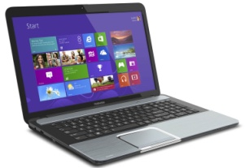

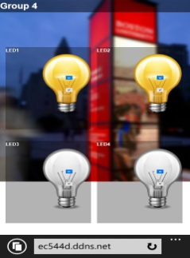
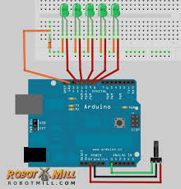
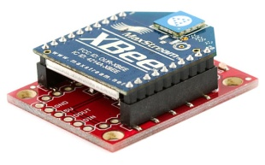
Solution Architecture
EC544d.ddns.net:8080
Router
Port Forward to
CLIENT
ServerAdress:3000
SERVER (Pi)
Arduino with LEDs
Control Code
(node js)
Receives Data
Sends data
Html page

Slide 3
Solution Architecture
EC544_4_ Router
CLIENT
ServerAdress:3000
SERVER (Pi)
Arduino with LEDs
Control Code
(node js)
Receives Data
Sends data
Html page

Slide 4
Design Decisions
Remote Access Method:
DDNS:
We get a domain name which is always accessible
Easy to configure
Data Flow:
Bidirectional communication:
Retrieve the current status of LEDs (arduino→server→webpage )
Switch the LEDs on/off (webpage→server→arduino)
Using socket I/O to communicate between webpage and control server

Slide 5
Challenges & Future Improvements
Challenges:
Learning how to use a Raspberry PI
Designing the solution architecture
Implementing remote access and configuring DDNS
Future Improvements:
Adding Security Layer:
- Adding an login page
Making it more smart phone friendly:
- Mobile App

Slide 6
Thank You!

