Slide 1
Challenge 6: Infectious Swarm! EC 544 – Fall 2015
Group 4: Dung, Hitesh, Lama, Yisi, Weilun

Slide 2
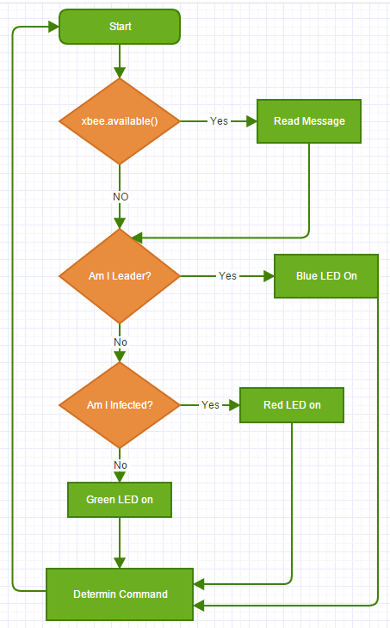
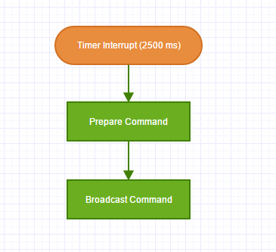
Software Architecture
id (1, 2, 3, 4…)
leader (true/false)
infected (true/false)
command (C / I / N)
immunity_interval (ms)
alive_time[]

Slide 3
Design Decisions
Leader Election
Assign every device an ID
Leader is the device with lowest ID
To be a candidate for leader, the device has to be online for at least the last 15 seconds, otherwise it is not considered to be on the network anymore
Use of XBee’s API vs AT mode
Implemented the same algorithm using both modes
AT mode showed better performance (less latency) and cleaner message
Use of Timer Interrupts
Used a timer to trigger the sending of messages
Fewer messages sent → less congested network → better response time
Command Message (each character is a single message, a device may send multiple messages at each interrupt)

Slide 4
Challenges & Future Improvements
Challenges
Learning about leader election algorithms
Learning how to implement bi-directional communication in API mode
Having to implement the algorithm in both API and AT modes
Resolving unexpected behavior when integrating all components (Example: use of sprintf and timer and Xbee's API/AT mode)
Future Improvements
Faster leader election when leader goes offline
Faster prorogation of “clear” message when clearing an infection

Slide 5
Thank You!

