Slide 1
Challenge 5: Find the Arduino EC 544 – Fall 2015
Group 4: Dung, Hitesh, Lama, Yisi, Weilun

Slide 2
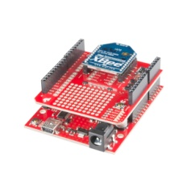
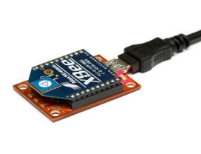
Solution Architecture
Beacon 2
RSSI
Beacon 3
Trackable Device
(Coordinator)
Beacon 1
Beacon 4

Slide 3

Solution Architecture
Webpage
Returns location coordinates
Displays coordinates on the map
Reads RSSI
from 4 Beacons
RSSI_Server
(NodeJS)
Coordinator
Feed current RSSI reading
kNN predicts current location

Slide 4
Design Decisions
Use of kNN vs. Trilateration:
- Distance is not a function of signal strength → kNN is a better solution for XBee like beacons
Data Collection:
- Deciding on a location
- Creating a map of the space and Dividing the room in partitions/coordinates.
- Collecting the data for each partition.
kNN Implementation:
- Used a NodeJS kNN library to train the dataset and predict location.
- Can be run on the Raspberry PI

Slide 5
Challenges & Future Improvements
Challenges:
Inconsistent outcome when using trilateration method
Collecting RSSI data for all partitions on the map.
Handling inconsistent RSSI values from the XBees.
Interference affecting signal strength returned by the beacons.
Malfunctioning of Beacon 1.
Future Improvements:
Achieve more accurate localization by:
- Collecting more kNN training data.
- Using more beacons and replacing the malfunctioning XBee.

Slide 6
Thank You!

