Slide 1
Challenge 6: Infectious Swarm! EC 544 – Fall 2015
Group 4: Dung, Hitesh, Lama, Yisi, Weilun

Slide 2
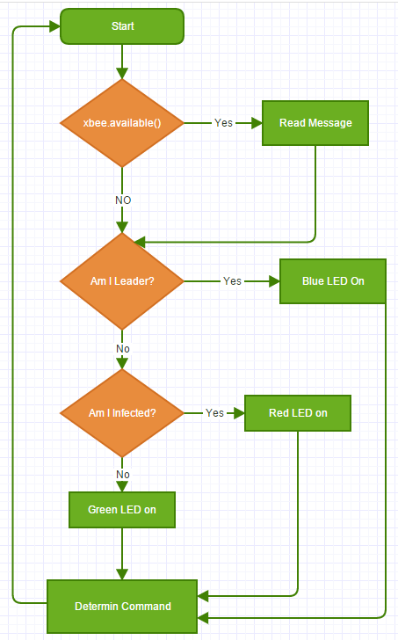
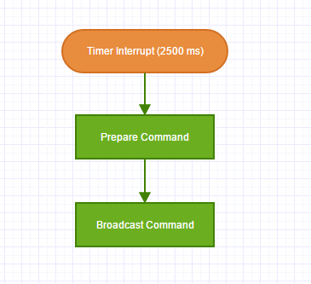
Software Architecture
id (1, 2, 3, 4…)
leader (true/false)
infected (true/false)
command (C / I / N)
immunity_interval (ms)
alive_time[]

Slide 3
Design Decisions
Leader Election
Assign every device an ID
Leader is the device with lowest ID
If leader goes offline for more than 15 seconds, assign a new leader
Use of XBee’s API vs AT mode
Implemented the same algorithm using both modes
AT mode showed better performance (less latency)
Use of Timer Interrupts
Used a timer to trigger the sending of messages
Fewer messages sent → less congested network → better response time

Slide 4
Challenges & Future Improvements
Challenges
Learning about leader election algorithms
Learning how implement bi-directional communication in API mode
Having to implement the algorithm in both API and AT modes
Resolving unexpected behavior when integrating all components (Example: use of sprintf and timer)
Future Improvements
Faster leader election when leader goes offline
Faster prorogation of “clear” message when clearing an infection

Slide 5
Thank You!

