Slide 1
Challenge 3: Remote Access to a Wireless Sensor Network EC 544 – Fall 2015
Group 4: Dung, Hitesh, Lama, Yisi, Weilun

Slide 2
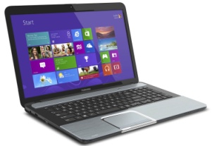

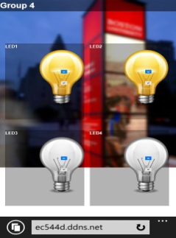
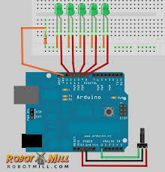
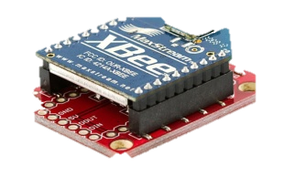
Solution Architecture – External Access
EC544d.ddns.net:
8080
Router
Port Forward to
Client
Server’s Static Address
:3000
SERVER (Pi)
Lighting Device
Control Code
Receives Data
Sends data
Web Page

Slide 3
Design Decisions
Data Flow:
Bidirectional communication:
On Arduino start up, send the current status of LEDs (arduino→server→webpage )
Switch the LEDs on/off (webpage→server→arduino)
Using socket I/O to communicate between webpage and control server
Remote Access Method:
DDNS:
Solves the lack of a static IP
Provides a domain name that is easily accessible
Easy to configure

Slide 4
Challenges & Future Improvements
Challenges:
Setting up the Raspberry Pi
Combining different components and designing the overall solution architecture
Working around latency issues with remote access
Future Improvements:
Adding a Security Layer:
- asking for login credentials
Making it more smart phone friendly:
- Mobile App

Slide 5
Thank You!

