Slide 1
Challenge 2: Collecting, Saving, & Visualizing Data EC 544 – Fall 2015
Group 4: Dung, Hitesh, Lama, Yisi, Weilun

Slide 2
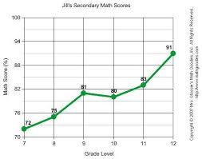

Solution Architecture
CLIENT
CSV Files
Requests
real-time data
Request
Historical data
Stores data continuously
Sends historical data
Sends real-time data
Retrieves historical data
SERVER

Slide 3
Design Decisions
Charting Library:
ZingChart:
Variety of chart types
Flexibility in data handling
Supports Real-time data (refresh attribute)
Data storage:
CSV files:
Easier to stream large datasets
Takes much less storage space
(Real Time Sampling Rate):
Refresh chart every 200 ms using latest data values

Slide 4
Challenges & Future Improvements
Challenges:
Choosing a charting library
Learning to integrate HTML, JavaScript, CSS, ZingChart, etc.
Learning to use the ZingChart API
Future Improvements:
Exploring more ZingChart features:
- Make the charts more interactive
- Achieve better styling
Better data handling strategy:
- Scalability

Slide 5
Thank You!

