Slide 1

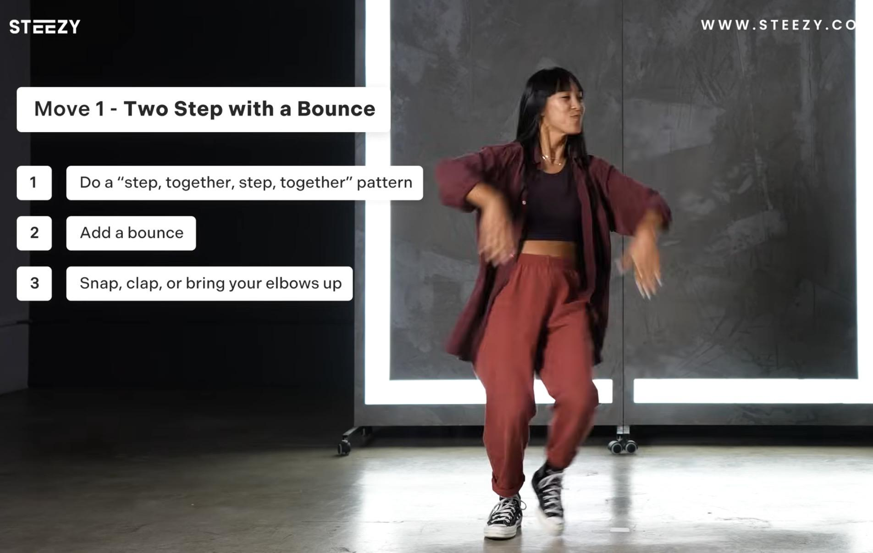
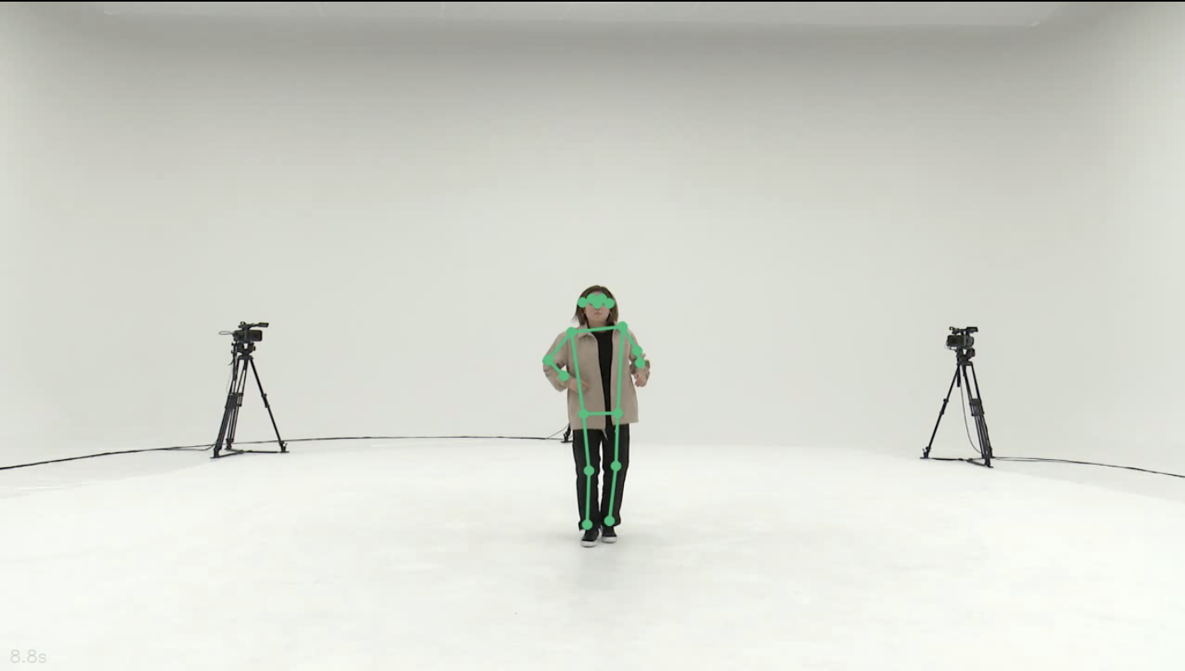
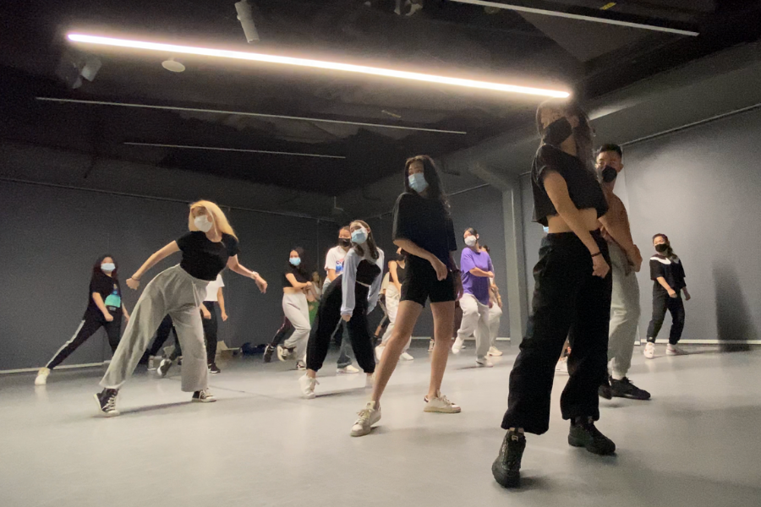
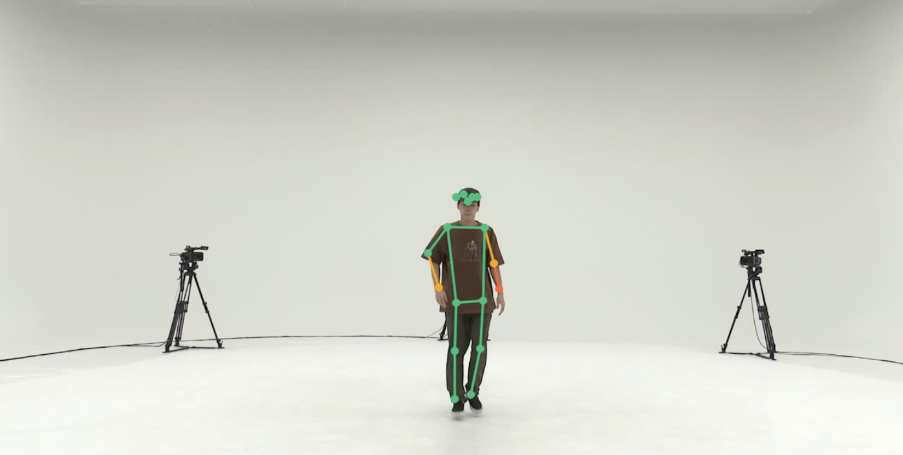
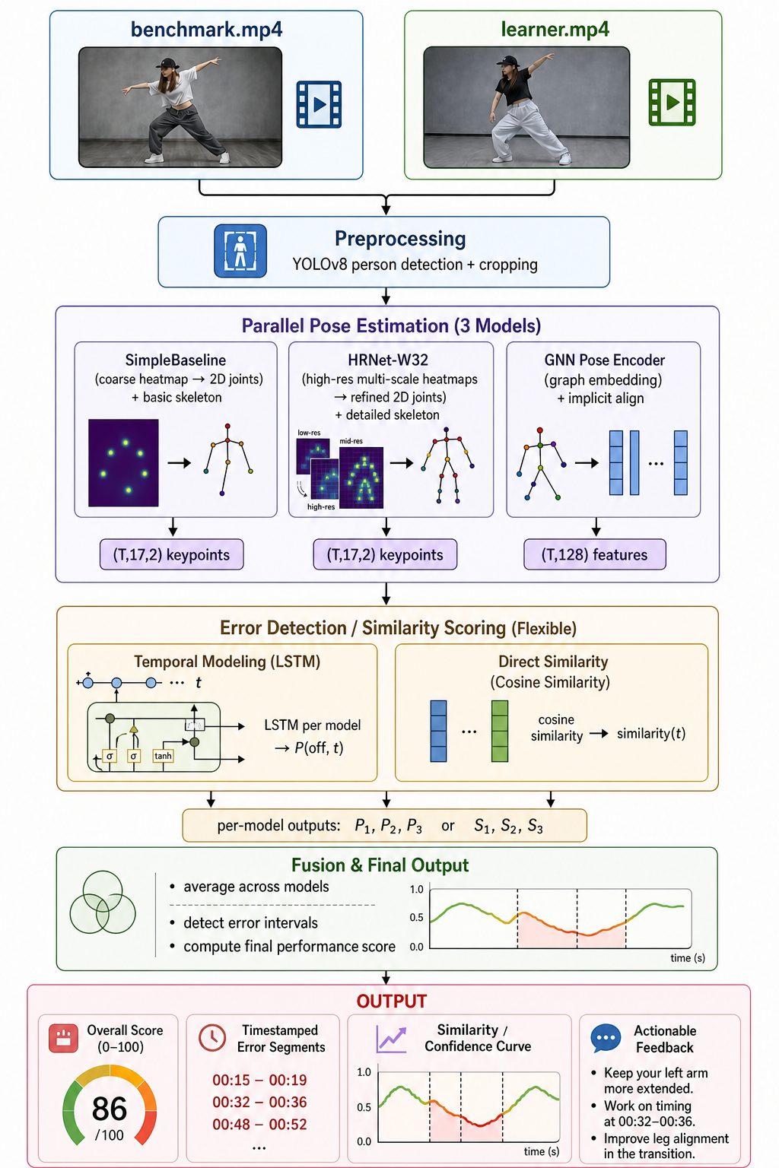
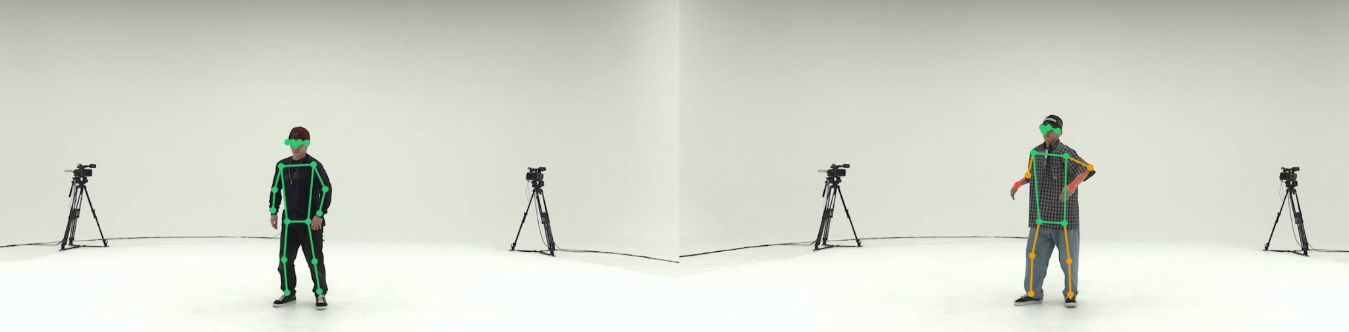
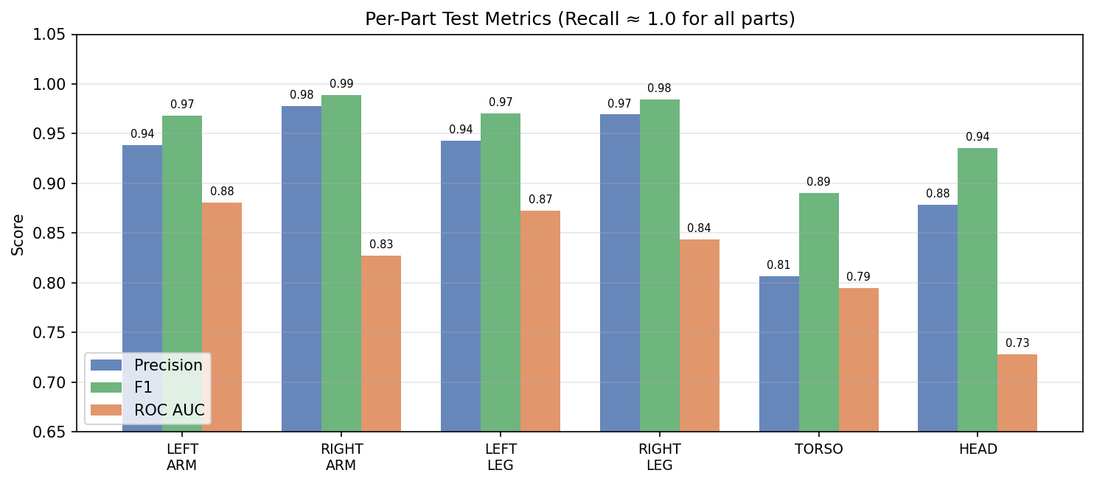
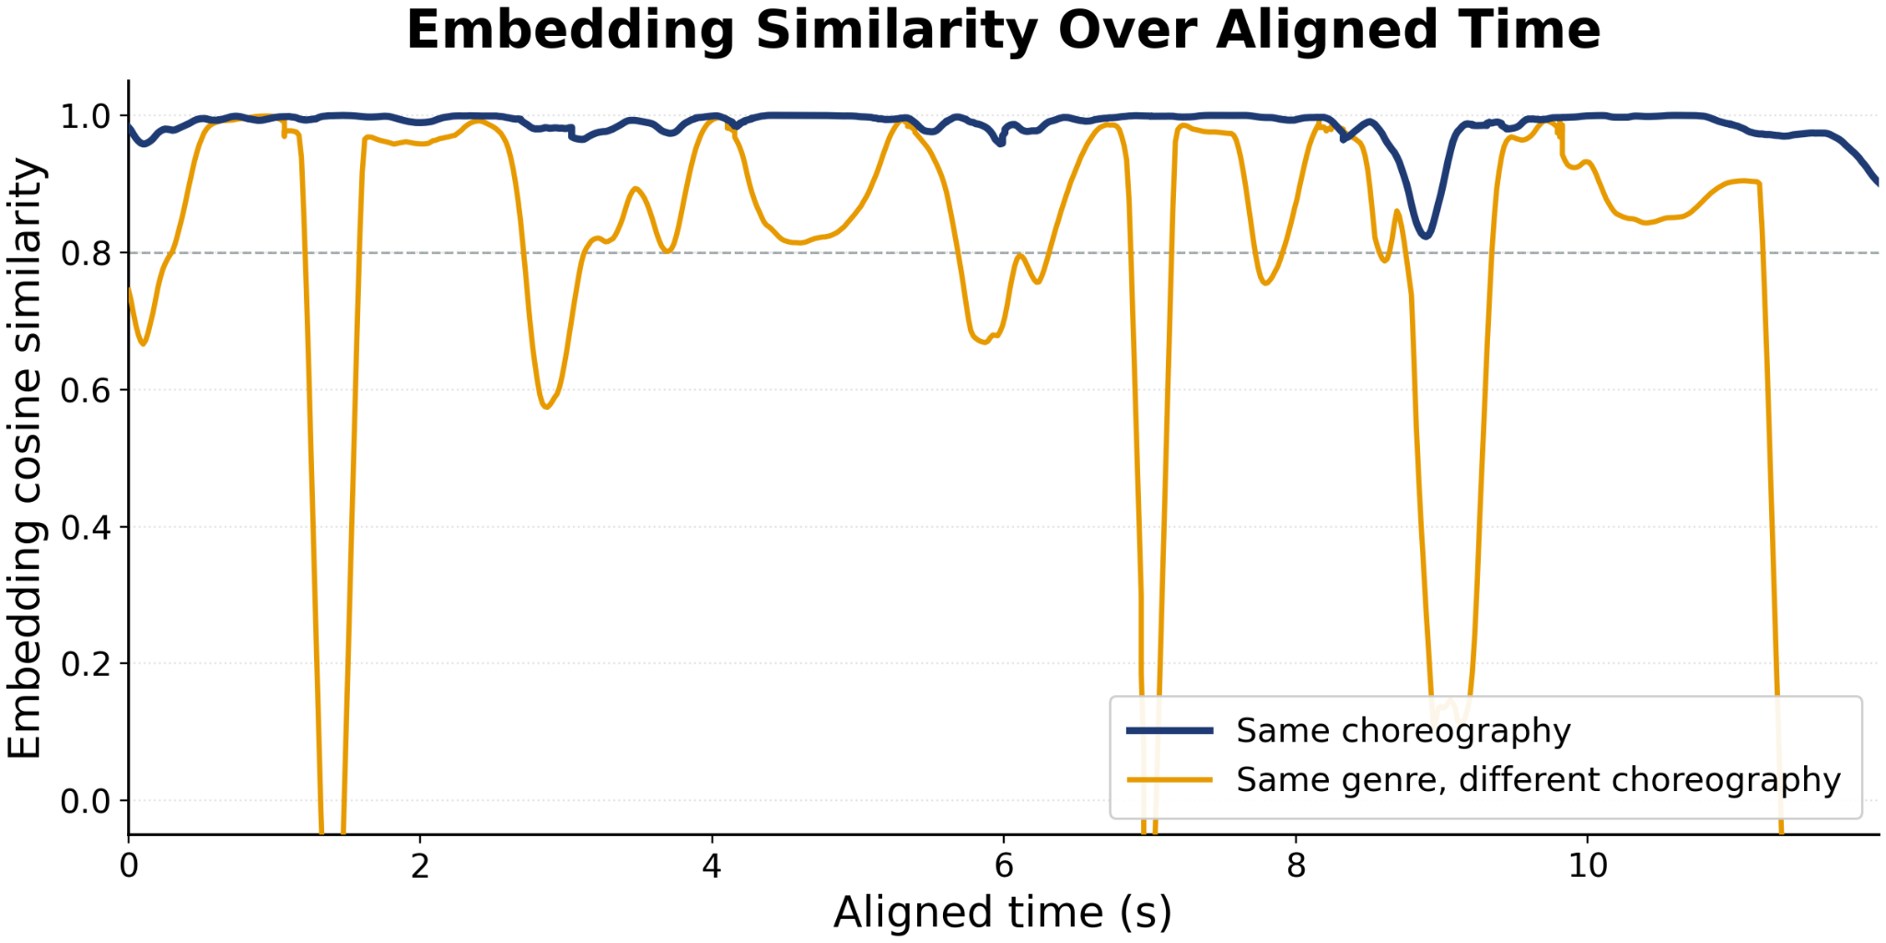
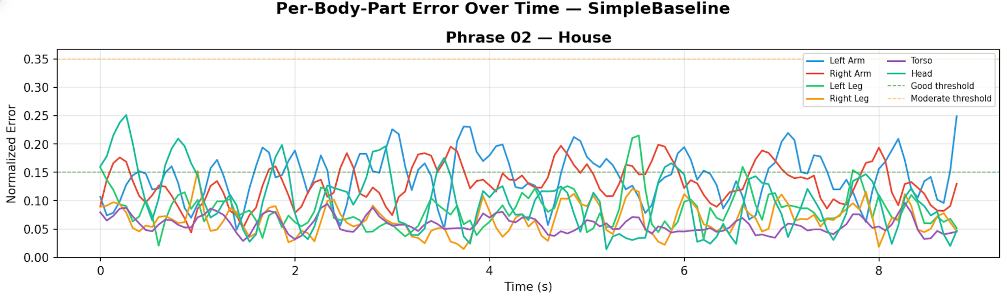
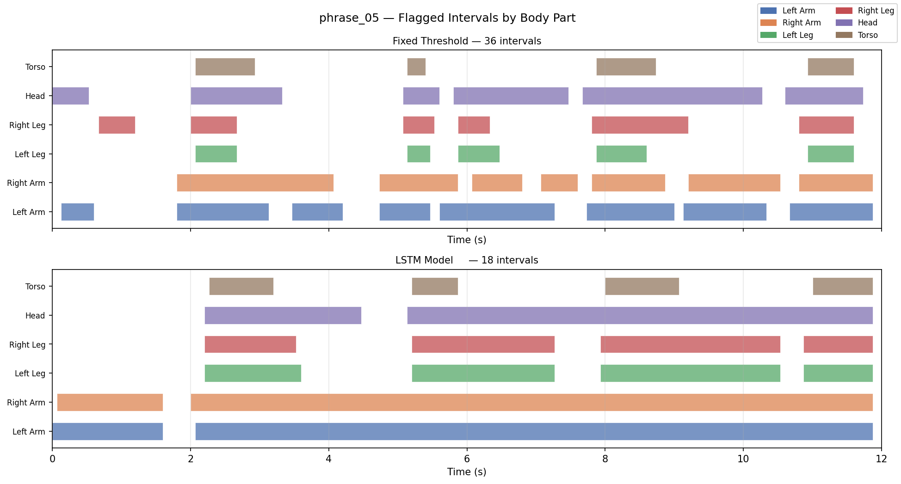
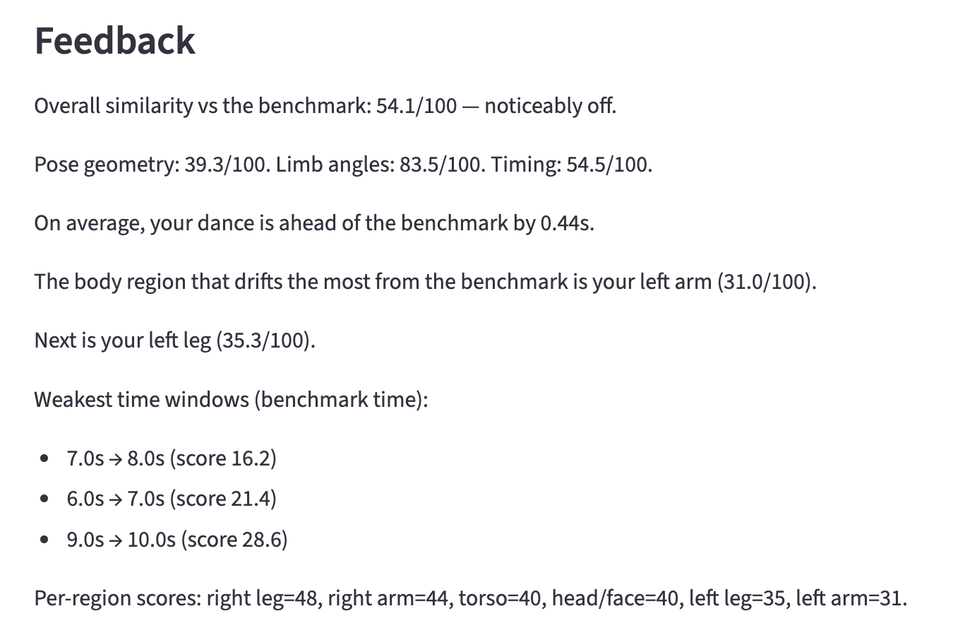
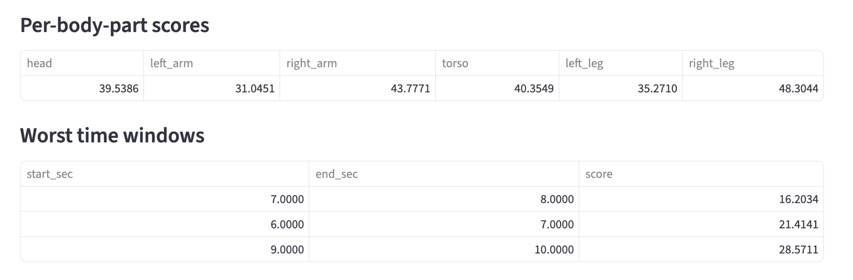
CSCI 1430
Dance Alignment Analysis for Group Choreography Learning
Huitian Ding Qien Lin Mohan Wang Yanmi Yu
Motivation
Define the problem
Goal
Dance learners on YouTube & TikTok have no way to know what they're doing wrong
Existing tools only give a single score, not which body part, not when
We use pose estimation to give specific, timely movement feedback
Compare a learner’s dance video to a reference video.
Align motions even if timing is different.
Identify which body parts deviate most.
Give clear feedback on where and when mistakes happen.
Build a benchmark-based dance alignment pipeline that compares a learner’s dance video against a reference choreography video.
Extract pose and motion representations from both videos using multiple model branches, including SimpleBaseline, HRNet-W32, and a GNN-based pose encoder.
Handle timing differences between the learner and reference by aligning motion sequences over time rather than comparing frames one-to-one.
Detect movement errors and similarity patterns using both temporal modeling with LSTM and direct embedding-based cosine similarity.
Fuse outputs from multiple models into an interpretable final performance score, timestamped error segments, similarity curves, and actionable body-part feedback.
Reference performer
Learner
Approach
Pipeline
1. Simple Baseline Pose Estimation: We implemented SimpleBaseLine (Xiao et al., ECCV 2018) from scratch. The model uses a ResNet-like backbone to extract image features and 3 deconvolutional layers to produce 17 joint heatmaps, with joint coordinates are extracted via argmax. A YOLOv8 person detector crops each dancer before inference. Trained on COCO keypoints 2017 using MSE loss on Gaussian heatmaps.
2. GNN Embedding-Based Alignment:
We encode each normalized 17-joint pose frame as a skeleton graph, where joints are nodes and body connections are edges. A graph neural network maps each frame into a 128-dimensional movement embedding. Instead of comparing only raw keypoint positions, we perform Dynamic Time Warping(DTW) in this learned embedding space to align motion patterns across time. We then compute cosine similarity between aligned embeddings and plot the similarity curve to show when the learner is semantically aligned with or diverges from the reference choreography.
3a. HRNet Pose Estimation: We use an HRNet-W32 top-down model to predict 17 joint heatmaps from cropped dancer frames. It preserves high-resolution features through multi-scale fusion and uses a 1×1 pose head. We train from scratch on AIST++ keypoints with visibility-masked MSE loss.
3b. Fine-tuned HRNet: We also fine-tune an ImageNet-initialized HRNet-W32 backbone with a randomly initialized pose head. A smaller backbone LR and larger head LR adapt visual features to dance pose estimation.
4.LSTM Temporal Error Detector: A unidirectional LSTM takes a per-frame 24-dimensional difference feature vector (6 body parts × 4 error metric) and outputs P(off) per frame per body part. Any contiguous window where P(off) > 0.5 for ≥ 0.5 s is surfaced as a timestamped deviation interval. This replaces the old fixed geometric threshold with a learned temporal model that suppresses transient noise and merges fragmented alerts into coherent feedback.
Results
References
[1] Bazarevsky, Valentin, et al. BlazePose: On-device Real-time Body Pose Tracking. 2020. arXiv, arXiv:2006.10204.
[2] Kim, Jong-Wook, et al. “Human Pose Estimation Using MediaPipe Pose and Optimization Method Based on a Humanoid Model.” Applied Sciences, vol. 13, no. 4, 2023, p. 2700.
[3] Xiao et al., "Simple Baselines for Human Pose Estimation and Tracking," ECCV 2018.
[4] "Private K-Pop Dance Class Singapore," Middle Class, middleclass.sg/trending/private-k-pop-dance-class-singapore/.
[5] “3 Easy Beginner Dance Moves” by steezystutio, Youtub. Accessed 4 May 2026.

